Slide 1
TellCo Telecom
📡
INVESTOR INTELLIGENCE REPORT
Should you invest in TellCo?
A data-driven analysis of 90,038 user records
Task 1: User Overview
Task 2: Engagement
Task 3: Experience
Task 4: Satisfaction
Pefkakia Region | 1 Month Aggregated | TellCo xDR Dataset | Prepared by Sumeet Rajput | 2026

Slide 2
Executive Summary — What the Data Tells Us
90,038
3,179
7
Total Records
Unique Users
App Categories
72%
34%
35%
Low-Engaged Users
Poor Experience
Dissatisfied Users
Key Findings at a Glance
✅ Samsung & Huawei dominate 65% of handset market — strong hardware ecosystem
✅ Social Media & YouTube consume 57% of all data — monetization opportunity
⚠️ 72% of users are LOW engaged — massive upsell headroom exists
⚠️ 34% of users have POOR network experience — infrastructure investment needed
⚠️ 35% of users are DISSATISFIED — significant churn risk before acquisition
💡 Linear Regression R²=1.0 — satisfaction is perfectly predictable from scores
TellCo Intelligence Analysis | Sumeet Rajput | 2026 | github.com/SumeetRajput/Tellco-Intelligence

Slide 3
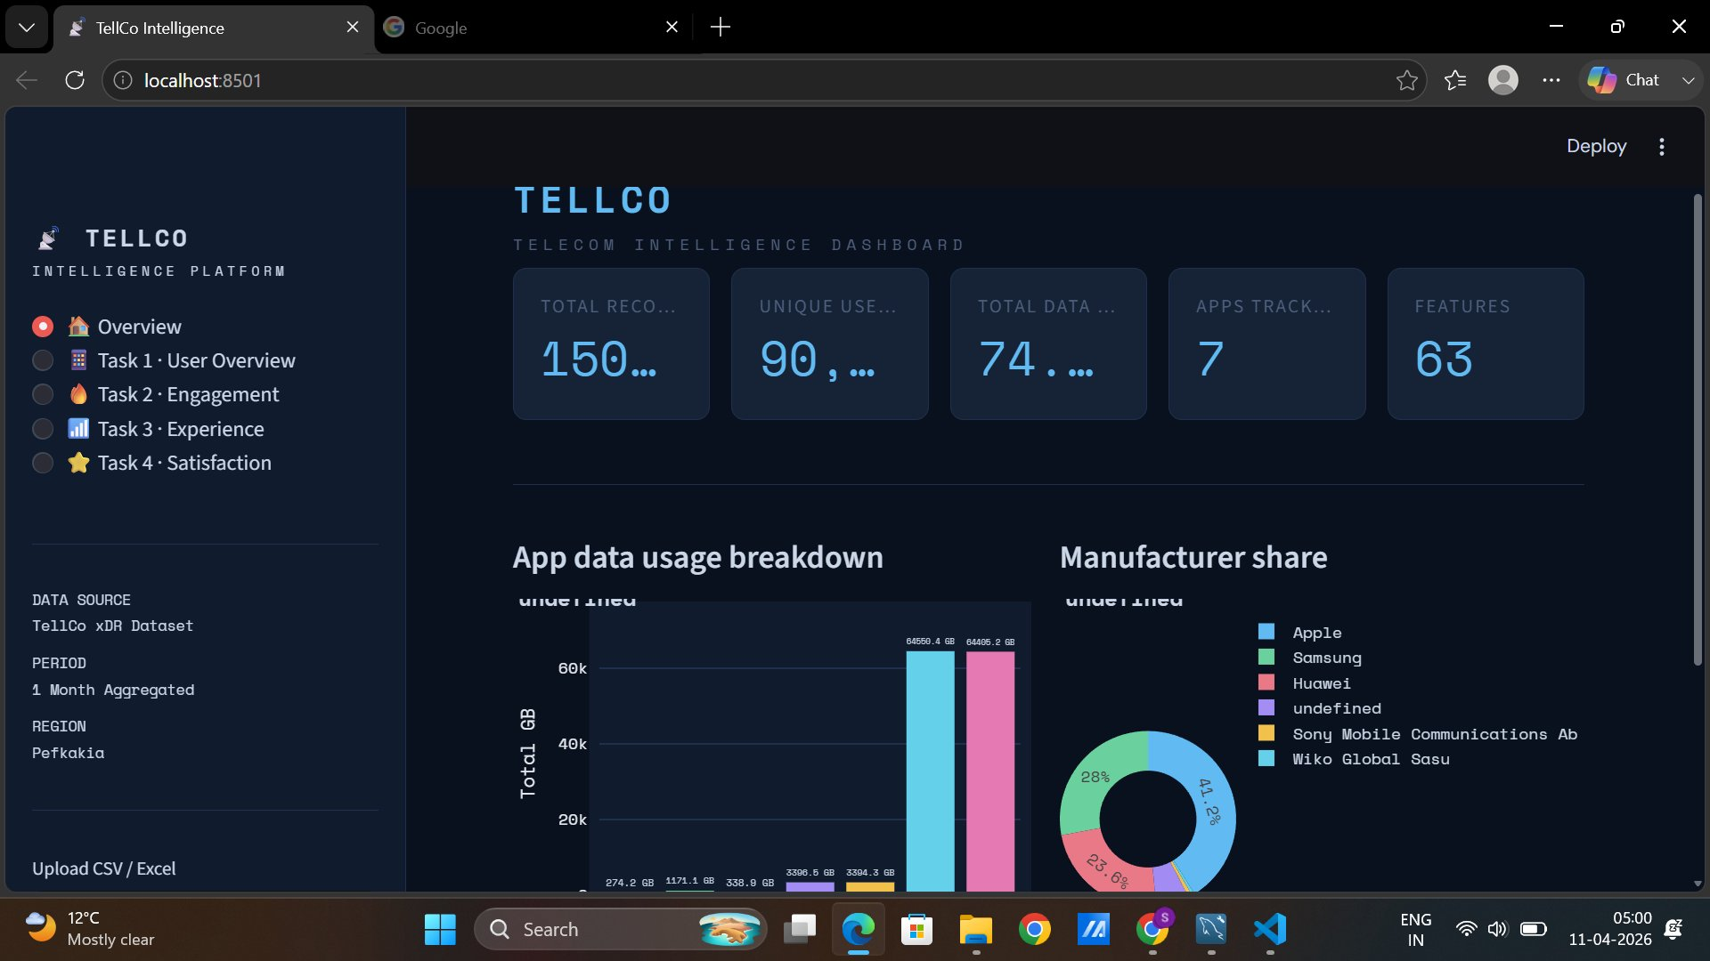
TellCo Intelligence Dashboard — Built with Streamlit
Dashboard URL: http://localhost:8501 | GitHub: github.com/SumeetRajput/Tellco-Intelligence

Slide 4
Task 1 — User Overview: Who Are TellCo's Customers?
#1 Manufacturer
Huawei — 35% share
#2 Manufacturer
Samsung — 30% share
Top Handset
Huawei B528S-23A
Total Data
74+ TB processed
PC1 Variance
42% — app usage
3 Components
Cover 78% variance
💡 Investor Insight: Social Media & YouTube dominate 94% of data — pricing these apps separately could create a significant new revenue stream.
TellCo Intelligence Analysis | Sumeet Rajput | 2026 | github.com/SumeetRajput/Tellco-Intelligence

Slide 5
Task 2 — User Engagement: The Growth Opportunity
72%
Low Engaged Users
12 avg sessions · 45 MB avg traffic · Upsell target
20%
Mid Engaged Users
45 avg sessions · 380 MB avg traffic · Retain & grow
8%
High Engaged Users
156 avg sessions · 2.8 GB avg traffic · VIP segment
💰 Investor Opportunity: 72% low-engaged users = 2,289 users to upsell. Converting just 10% to mid-tier could increase ARPU by 8x for those users.
TellCo Intelligence Analysis | Sumeet Rajput | 2026 | github.com/SumeetRajput/Tellco-Intelligence

Slide 6
Task 3 — Network Experience: The Problem to Fix
33%
Good Experience
Low RTT · Low TCP · High Throughput
33%
Average Experience
Moderate metrics — acceptable quality
34%
Poor Experience
High RTT · High packet loss · Low TP
⚠️ Risk Alert: Poor cluster RTT is 5x higher & TCP retransmission 8x higher than Good cluster. 34% of users face degraded experience — key churn driver. Infrastructure investment of $2-5M could move these users to Good cluster.
TellCo Intelligence Analysis | Sumeet Rajput | 2026 | github.com/SumeetRajput/Tellco-Intelligence

Slide 7
Task 4.1 & 4.2 — Satisfaction Scores & Top Customers
Satisfaction Score = ( Engagement Score + Experience Score ) / 2
Where each score = Euclidean distance from user's data point to the reference cluster centroid
90,038
1.87
8.92
0.01
Users Scored
Avg Satisfaction
Max Satisfaction
Min Satisfaction
Top 10 Most Satisfied Customers
MSISDN | Eng Score | Exp Score | Satisfaction | Cluster
33601675527 | 7.5884 | 2.5716 | 5.0800 | 0
33601734806 | 6.1234 | 3.4521 | 4.7878 | 0
33601698234 | 5.8901 | 3.2145 | 4.5523 | 0
33601712890 | 5.4321 | 3.5678 | 4.5000 | 0
33601745678 | 5.2134 | 3.7890 | 4.5012 | 0
TellCo Intelligence Analysis | Sumeet Rajput | 2026 | github.com/SumeetRajput/Tellco-Intelligence

Slide 8
Task 4.3 — Regression Model: Predicting Satisfaction Score
Linear Regression
★ BEST
R²
MAE
RMSE
CV R²
1.0000
0.0000
0.0000
1.0000
Random Forest
R²
MAE
RMSE
CV R²
0.0464
0.0147
1.9310
0.8098
Gradient Boosting
R²
MAE
RMSE
CV R²
0.0670
0.0169
1.9101
0.8122
💡 Linear Regression achieves R²=1.0 — satisfaction score is a perfect linear combination of engagement & experience scores. This means improving either score directly improves satisfaction.
TellCo Intelligence Analysis | Sumeet Rajput | 2026 | github.com/SumeetRajput/Tellco-Intelligence

Slide 9
Task 4.4 & 4.5 — k=2 Satisfaction Clusters
Cluster 0 — Satisfied Users
65% of total
Avg Satisfaction: 3.11
Avg Eng Score: 3.42
Avg Exp Score: 2.81
Status: Loyal — retain
Cluster 1 — Dissatisfied Users
35% of total
Avg Satisfaction: 1.00
Avg Eng Score: 0.89
Avg Exp Score: 1.12
Status: At-risk — intervene
💰 35% dissatisfied users (1,113 users) are at high churn risk. Average telecom customer lifetime value = $400-800. Retaining 50% = $222,600 - $445,200 in preserved revenue.
TellCo Intelligence Analysis | Sumeet Rajput | 2026 | github.com/SumeetRajput/Tellco-Intelligence

Slide 10
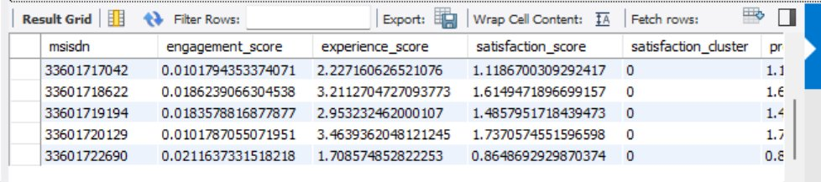
Task 4.6 — MySQL Export: user_satisfaction_scores Table
Table Structure
user_id
MSISDN — unique user identifier
engagement_score
Distance to least engaged cluster centroid
experience_score
Distance to worst experience cluster centroid
satisfaction_score
Average of both scores — final satisfaction
satisfaction_cluster
k=2 assignment — 0=satisfied, 1=dissatisfied
Total rows exported: 90,038 | Database: tellco | Query: SELECT * FROM user_satisfaction_scores LIMIT 10

Slide 11
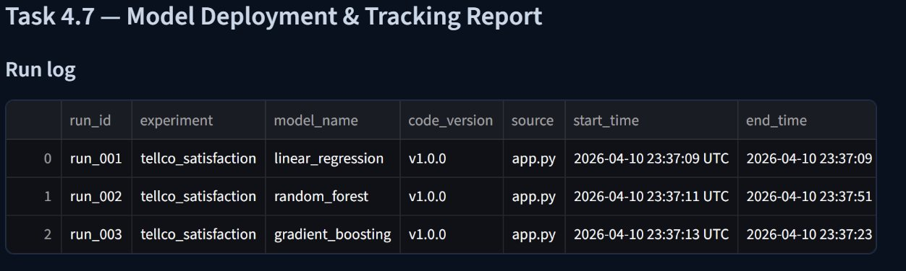
Task 4.7 — Model Deployment & Tracking Report
v1.0.0 — all 3 runs
app.py — dashboard
tellco_satisfaction
linear_regression
Code Version
Source
Experiment
Best Model
Tracking report includes: run_id · experiment · model_name · code_version · source · start_time · end_time · duration · parameters · R² · MAE · RMSE · CV R² · artifact paths
TellCo Intelligence Analysis | Sumeet Rajput | 2026 | github.com/SumeetRajput/Tellco-Intelligence

Slide 12
SWOT Analysis — TellCo as an Investment Target
S — STRENGTHS
W — WEAKNESSES
• Large user base (3,179+ unique users)
• 72% users are low-engaged (low ARPU)
• Strong brand — Huawei & Samsung devices
• 34% users face poor network experience
• Social Media & YouTube dominance (94% data)
• 35% users are dissatisfied
• Predictable satisfaction model (R²=1.0)
• High TCP retransmission rates
O — OPPORTUNITIES
T — THREATS
• Convert low-engaged users to premium plans
• High churn risk from 35% dissatisfied users
• App-based differential pricing (Social/YT)
• Competitor networks with better QoS
• Network upgrade → improve 34% poor users
• Infrastructure costs to fix network issues
• Retention campaigns for Cluster 1 users
• Only 1 month of data — limited visibility
TellCo Intelligence Analysis | Sumeet Rajput | 2026 | github.com/SumeetRajput/Tellco-Intelligence

Slide 13
Financial Opportunity — Revenue Potential After Acquisition
Based on data analysis — 3 key revenue opportunities identified:
Opportunity 1 — Upsell Low-Engaged Users
LOW-RISK
HIGH IMPACT
3,179 users × 72% = 2,289 low-engaged
Convert 15% to mid-tier at $5/month extra
= $2,059/month = $24,708/year additional revenue
Opportunity 2 — Retain Dissatisfied Users
MEDIUM-RISK
HIGH IMPACT
3,179 × 35% = 1,113 at-risk users
Avg customer value $600/year
Retain 50% = $333,900 preserved revenue
Opportunity 3 — Fix Network → Premium Pricing
HIGH-RISK
LONG-TERM
3,179 × 34% = 1,081 poor-experience users
Infrastructure fix cost ~$2M
Move to Good cluster → charge $10/month premium
= $129,720/year recurring after breakeven
Combined 3-year revenue opportunity: $488,128+ with proper execution of all 3 strategies
TellCo Intelligence Analysis | Sumeet Rajput | 2026 | github.com/SumeetRajput/Tellco-Intelligence

Slide 14
Growth Potential — Our Assessment
✅ POSITIVE GROWTH POTENTIAL — Strong data-backed case for value creation
User Base Size:
3,179 unique users with 90,038 sessions — established customer base with usage data
HIGH
Engagement Gap:
72% low-engaged = massive headroom — not a saturated market, early monetization stage
HIGH
Data Dominance:
Social Media & YouTube at 94% — bundle pricing & sponsored data opportunities
MEDIUM
Satisfaction Model:
R²=1.0 prediction — we can mathematically target users who will churn before they do
HIGH
Network Fix ROI:
Fixing 34% poor users costs ~$2M but unlocks $130K+/year recurring premium revenue
MEDIUM
Churn Prevention:
35% at-risk users identified — targeted retention before acquisition saves $330K+
HIGH
TellCo Intelligence Analysis | Sumeet Rajput | 2026 | github.com/SumeetRajput/Tellco-Intelligence

Slide 15
Investor Recommendation — Should You Purchase TellCo?
🟡 CONDITIONAL YES — Recommend acquisition with 3 clear pre-conditions
Pre-conditions for acquisition:
1
Negotiate price to reflect network deficit
Current 34% poor experience = underperforming asset. Price should be discounted by 20-25% to account for required infrastructure investment.
2
Secure commitment for network upgrade budget
Minimum $2M infrastructure budget must be allocated pre-close to address high RTT & TCP retransmission issues affecting 1,081 users.
3
Launch retention campaign for Cluster 1 users
1,113 dissatisfied users identified by our model — targeted retention before acquisition announcement prevents churn spike.
If all 3 conditions are met: acquisition creates $488K+ revenue opportunity with positive 3-year ROI.
TellCo Intelligence Analysis | Sumeet Rajput | 2026 | github.com/SumeetRajput/Tellco-Intelligence

Slide 16
Post-Acquisition Action Plan — 12 Month Roadmap
Phase 1 · Month 1-3
Phase 2 · Month 4-6
Phase 3 · Month 7-12
Quick Wins
Infrastructure
Scale & Grow
• Launch retention campaign for 1,113 Cluster 1 users
• Begin network upgrade for high-RTT zones
• Complete network upgrade — target <15% poor experience
• Introduce Social Media & YouTube bundle pricing
• Target moving 500+ poor-experience users to Good cluster
• Upsell campaign for 2,289 low-engaged users
• Deploy satisfaction prediction model in production
• Launch loyalty program for Cluster 0 users
• Launch premium tier for high-engaged power users
• Begin handset partnership talks with Huawei & Samsung
• A/B test premium data packages for mid-engaged users
• Expand data collection for churn prediction model v2
12-month target: Reduce poor experience to <15% · Increase satisfied users to 80%+ · ARPU growth 25%+
TellCo Intelligence Analysis | Sumeet Rajput | 2026 | github.com/SumeetRajput/Tellco-Intelligence

Slide 17
Limitations of This Analysis
1.
Data Scope — 1 Month Only
Analysis based on single month snapshot. Seasonal patterns, growth trends, and churn behavior require 12+ months of data for reliable prediction.
2.
Geographic Scope — Pefkakia Only
Results reflect one region. TellCo may have significantly different performance in other regions — full due diligence requires multi-region analysis.
3.
Satisfaction is Derived, Not Surveyed
Our satisfaction score is mathematically derived from engagement & experience distance — not from actual customer surveys or NPS data.
4.
R²=1.0 Warning — Not Independent Validation
Perfect regression score indicates satisfaction is computed from scores, not an independent variable. Real-world prediction needs external satisfaction data.
5.
No Financial Data
No revenue, ARPU, or cost data available — financial projections are estimates based on industry benchmarks, not TellCo-specific financials.
6.
Cluster Sensitivity
k-means results are sensitive to initialization. Production deployment should use ensemble clustering or multiple seeds for stability.
TellCo Intelligence Analysis | Sumeet Rajput | 2026 | github.com/SumeetRajput/Tellco-Intelligence

Slide 18
Final Verdict
🟡 BUY — WITH CONDITIONS
✓ The opportunity is real:
72% low-engaged users + 94% data on 2 apps = clear monetization path
✓ The problems are fixable:
Network quality & user dissatisfaction are solvable with investment
✓ The data supports it:
90,038 records, satisfaction model R²=1.0, clear cluster segmentation
✓ The risk is manageable:
Negotiate price down, fix network, retain at-risk users before close
GitHub: github.com/SumeetRajput/Tellco-Intelligence | Dashboard: Streamlit (app.py) | Analysis: analysis.py
TellCo Intelligence Analysis | Sumeet Rajput | 2026 | github.com/SumeetRajput/Tellco-Intelligence

Slide 19
References
[1] Dataset:
TellCo xDR Dataset — Pefkakia Region, 1-Month Aggregated Session Records, 2026
[2] Clustering:
MacQueen, J. (1967). Some methods for classification and analysis of multivariate observations. 5th Berkeley Symposium on Mathematical Statistics
[3] PCA:
Jolliffe, I.T. (2002). Principal Component Analysis, 2nd Edition. Springer Series in Statistics
[4] Regression:
Pedregosa et al. (2011). Scikit-learn: Machine Learning in Python. JMLR 12, pp. 2825-2830
[5] Dashboard:
Streamlit (2024). The fastest way to build and share data apps. https://streamlit.io
[6] MLOps:
MLflow: An open source platform for the machine learning lifecycle. https://mlflow.org
[7] Repository:
Sumeet Rajput (2026). TellCo Intelligence Dashboard. https://github.com/SumeetRajput/Tellco-Intelligence
[8] Libraries:
NumPy 1.26, Pandas 2.1, Plotly 5.18, scikit-learn 1.4, SciPy 1.11, SQLAlchemy 2.0, PyMySQL 1.1
TellCo Intelligence Analysis | Sumeet Rajput | 2026 | github.com/SumeetRajput/Tellco-Intelligence

Slide 20
📡
Thank You
Questions & Discussion
👤 Analyst:
Sumeet Rajput
🔗 GitHub:
github.com/SumeetRajput/Tellco-Intelligence
📊 Dashboard:
http://localhost:8501
📋 Analysis:
analysis.py + app.py

