Slide 1
Job Market Analysis
& Recommendation System
An end-to-end study of 244,827 freelance job postings
Upwork marketplace · February–March 2024
Sumeet Rajput
Notes:
This project analyses 244,827 Upwork job postings across eight analytical tasks. The headline point I want to make today is that the most valuable work was not the modelling - it was discovering that the raw data contained a collection artifact that would have invalidated half the analysis.

Slide 2
SCOPE
Eight tasks, one pipeline
The brief defines eight separate analytical tasks. They are not eight projects — they are one dataset viewed eight ways, so the system is built as a single cleaned pipeline that every task draws from.
1
Keyword–pay correlation
2
Emerging job categories
3
Demand forecasting
4
Rates across countries
5
Recommendation engine
6
Market dynamics dashboard
7
Remote work landscape
8
Future projections
Delivered as: analysis pipeline · recommendation API · Streamlit dashboard · SQL layer · Docker deployment · 17-page report
Notes:
Most submissions treat these as eight disconnected notebooks. Building one cleaned dataset that all eight draw from means every result rests on the same auditable set of data-quality decisions.

Slide 3
THE FINDING THAT SHAPED EVERYTHING
The raw data contained a
false growth curve
283 rows spread across the 48 days before 13 February — roughly 6 per day. Then 244,545 rows across the next 41 days — roughly 5,960 per day.
~100,000%
4 of 8
apparent February growth — entirely an artifact of when the scraper started
tasks are time-series and would have been invalidated by these 283 rows
Notes:
This is the single most consequential thing I found. If you plot raw daily volume you appear to discover explosive market growth in February. It is not real - it is the date the scraper was switched on. Tasks 2, 3, 6 and 8 are all time-series tasks, so all four would have been wrong.

Slide 4
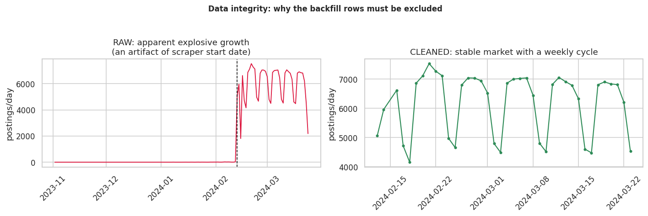
EVIDENCE
Raw versus cleaned
Left: raw daily volume implies explosive growth. Right: after excluding pre-collection backfill, a stable market with a clear weekly cycle.
Every time-series result in this project filters on a `ts_reliable` flag that excludes these rows, the 15 February collection outage, and the truncated final day.
Notes:
Same data, two treatments. The left panel is what you get if you trust the file. The right panel is what is actually there: a stable market with a strong weekly cycle.

Slide 5
METHODOLOGY
Flag, don't delete
Different tasks need different exclusions. A forecasting model must drop the collection outage; a pay histogram is unaffected by it. One deletion policy cannot serve both — so the pipeline imposes none.
1
38,514
4,279
row deleted
pay values kept null
flagged, not removed
out of 244,828 — a null title
15.7% — never imputed
excluded only where relevant
Why imputation would have been wrong
38,514 postings disclose no rate at all. Filling those with a mean would invent a sixth of the pay data and pull every statistic toward the centre — narrowing exactly the distributions that Tasks 1 and 4 exist to measure. Missing pay is treated as an informative category: the client chose to negotiate rather than advertise.
Notes:
Rows carry boolean quality flags rather than being deleted, so each analysis declares its own requirements and every decision stays auditable.

Slide 6
FEATURE ENGINEERING
The dataset has no category column
All 22 categories are derived from job title text using a two-tier keyword taxonomy. Because they are manufactured, their accuracy must be measured — not assumed.
Tier 1 — specific phrases
63.9%
Multi-word matches, ordered so commercial context beats technical: 'Shopify Developer' resolves to E-commerce.
92.5% precision
Tier 2 — generic tokens
26.3%
Catches bare words like 'Website' that phrase rules cannot match. Without it, 38% of the corpus is uncategorised.
86.7% precision
Unmatched
9.9%
Left as 'Other', never guessed. Every row records which tier classified it.
labelled honestly
Overall taxonomy precision: 89.6%, measured by re-checking a 240-title sample against independent anchor terms.
Notes:
When someone asks how accurate my categories are, I do not say 'it is keyword-based'. I say 63.9% tier-1, 26.3% tier-2, 9.9% unmatched, 89.6% measured precision, and here is the validation table.

Slide 7
TASK 1
What keywords are worth
Hourly rates and fixed budgets are incompatible units — converting between them needs project duration, which the dataset lacks. The analysis runs as two tracks that are never averaged.
HOURLY TRACK
FIXED-PRICE TRACK
attorney
$105/hr
+367%
ticket
$1,000
+900%
lawyer
$90/hr
+300%
blockchain
$775
+675%
cryptocurrency
$55/hr
+144%
ghostwriter
$750
+650%
assistant
$8/hr
−62%
thumbnail
$20
−80%
philippines
$4/hr
−82%
quiz
$5
−95%
26× spread, all FDR-significant with large effect sizes
200× spread across 510 keywords tested
990 keywords tested · Mann-Whitney U · Cliff's delta effect sizes · Benjamini-Hochberg FDR correction. With n>100k, p-values alone are meaningless — effect size is the filter that matters.
Notes:
Important caveat: this is correlation, not causation. Adding 'senior' to a title does not raise the rate - it signals scope and client type that were already priced in. And 'philippines' is the client's sourcing preference, not a statement about worker capability.

Slide 8
TASK 3
Machine learning lost
A naive rule — predict the same weekday one week ago — beat every model I trained. This is reported rather than concealed.
Seasonal naive (lag-7)
1.60%
Why it lost
Random Forest
3.81%
93%
Ridge regression
5.67%
of the Random Forest's feature weight sits on the weekday indicator, its Fourier encoding and the 7-day lag. The model spent its capacity relearning the calendar — which the naive rule encodes for free.
Naive (lag-1)
15.50%
MAPE on a held-out temporal split — never a random split, which would train on the future to predict the past.
With 24 training days, the weekly cycle is essentially the entire signal. Recognising when a simple method suffices is an engineering judgement, not a failure.
Notes:
The temptation is to drop the baseline and present 3.81% as a success. Feature importance shows why that would mislead. I would rather report an honest negative than a flattering result I cannot defend.

Slide 9
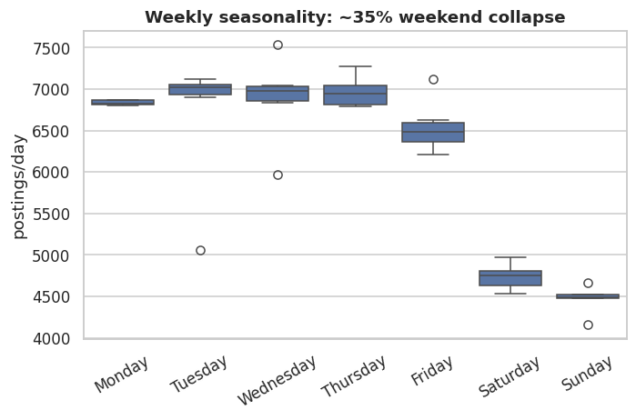
TASK 3
The signal that dominates everything
Weekdays average 6,779 postings; weekends 4,612 — a 32% collapse. This is the strongest pattern in the dataset, and any credible short-horizon forecast must reproduce it.
Notes:
Clients post on working days. Volume swings 32% on this cycle while the structure of demand barely moves - the hourly-versus-fixed split varies by under 2 percentage points.

Slide 10
TASK 5
A recommender that was measured
Most implementations build cosine similarity and stop, with no evidence the recommendations are any good. A recommender without an evaluation metric is an untested assertion.
0.636
0.080
7.9×
0.761
Precision@10
Random baseline
Lift
Mean reciprocal rank
category-relevant results
chance agreement
over random selection
first hit in top 1–2
How it works
How it ranks
TF-IDF over titles with unigrams and bigrams, plus a domain stopword list that strips hiring boilerplate — 'urgent', 'expert', 'needed'. Without it the engine matches postings on shared filler rather than on the work itself.
Content similarity 0.80, pay disclosure 0.12, recency 0.08. A posting that hides its rate is a materially worse lead, and a two-day-old posting is more actionable than a five-week-old one.
Notes:
Relevance is proxied by the derived category, which has its own error rate - so this measures topical coherence, not whether a human would want the job. The engine sees only titles: no description, no skills, no client rating.

Slide 11
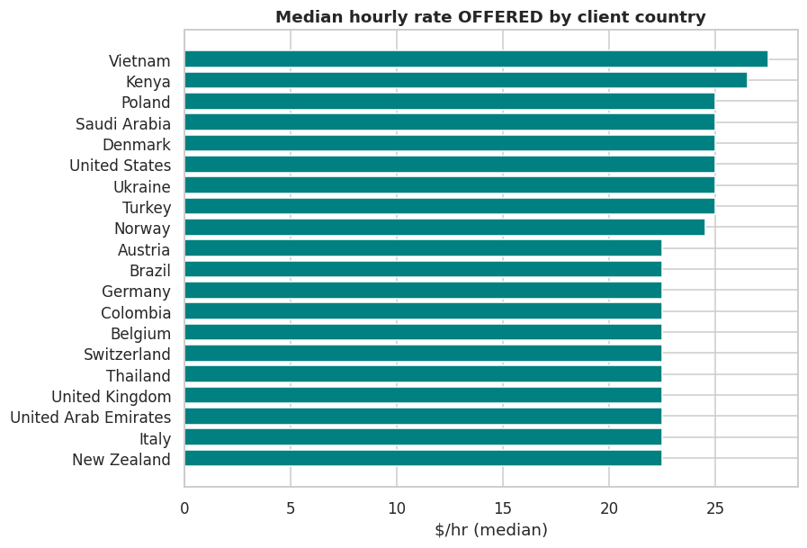
TASK 4
What clients pay, by country
A critical distinction
`country` is the CLIENT's location, not the freelancer's. This shows what clients PAY, not what workers in that country EARN.
46
2.8×
countries
rate spread
min. 200 postings
$27.50 to $10.00
41%
66%
US share
top-5 share
of all postings
HHI 0.192
Rates are not PPP-adjusted, so a higher nominal rate does not mean higher real value. Because the US is 41% of postings, any pooled global average is a disguised US average — medians are reported per country and never pooled.
Notes:
Interesting detail: rate ranking does not track national income. Several lower-income countries post higher medians than wealthy ones, which suggests self-selection in who uses international freelance platforms.

Slide 12
THREE RESULTS THAT LOOK LIKE FAILURES
…and are reported as found
ML lost to a naive rule
1
Random Forest and Ridge were both beaten by 'same as last week'. Dropping the baseline would have made 3.81% MAPE look like a success.
No category is emerging
2
Task 2 asks for emerging categories. Across 39 days, none shows significant growth and two show significant decline. Ranking insignificant slopes would misrepresent the evidence.
Task 7 was unanswerable as posed
3
Upwork is remote-only, so 'the shift to remote' has no comparison group. Reporting that remote work dominates would be a tautology dressed as a finding.
Adjusting an analysis until it produces a positive finding is the mechanism by which unreliable research gets made.
Notes:
This is the slide I most want to be asked about. A result that contradicts the expected narrative is still a result. All three are documented with their evidence in section 11 of the report.

Slide 13
DELIVERY
What was built
Analysis pipeline
Recommendation API
Python · pandas · scikit-learn · SciPy
FastAPI + Flask, same model class
1 file, 8 tasks, 50s
7 endpoints, auto Swagger
Dashboard
SQL layer
Streamlit, six pages
SQLite / PostgreSQL
search, filters, data quality
CTEs, window functions
Interactive charts
Deployment
Plotly, incl. world choropleth
Docker + Compose, non-root
8 standalone HTML
one command, 4 services
Verification
21 invariant self-tests · SQL layer cross-checked against pandas on 5 measures, all agreeing · taxonomy precision measured on a held-out sample
Notes:
Both Flask and FastAPI exist because the brief specifies Flask, while FastAPI gives auto-generated OpenAPI docs which are themselves a Task 5 deliverable. Both import the same recommender class - one model, evaluated once.

Slide 14
IN CLOSING
The most valuable finding
wasn't a model
It was noticing that 283 rows out of 244,828 would have manufactured a false growth narrative across half the project. Everything downstream depends on having caught it.
Where the data couldn't answer
the constraint is stated, not worked around
Where the model lost
the baseline is reported, not hidden
Where categories were invented
their precision is measured, not assumed
Thank you · Questions welcome
Notes:
Close on judgement rather than output volume. The three lines above are the ones I would want an examiner to remember.

