Slide 1
AI Customer Complaint &
Case Processing System
A GenAI batch workflow for structured extraction, customer email
generation, and internal case summarization
IIT Patna USDC — GenAI Development Program | Final Project (Project 1)

Slide 2
THE PROBLEM
Manual complaint handling doesn't scale
1
2
3
Slow
Inconsistent
Repetitive
Support staff read every complaint document by hand to pull out customer details and the issue.
Two agents summarize the same complaint differently, and formatting varies across channels.
Drafting a reply email and an internal case note is done manually for every single case.
Business scenario: an AI Customer Complaint & Case Processing System that reads complaint documents
from a folder and automates extraction, replies, and internal summaries.

Slide 3
THE APPROACH
Three focused AI steps, not one big prompt
STEP 1
STEP 2
STEP 3
Structured Extraction
Customer Email
Internal Case Summary
LLM reads the raw document and returns fixed fields (name, category, status...), validated with Pydantic.
→
Uses only the validated data to draft a short, professional reply — no re-reading the raw text.
→
Same validated data produces a management-facing overview, key issue, and next action.
Documents are processed in parallel across the batch; the 3 steps within one document run sequentially.

Slide 4
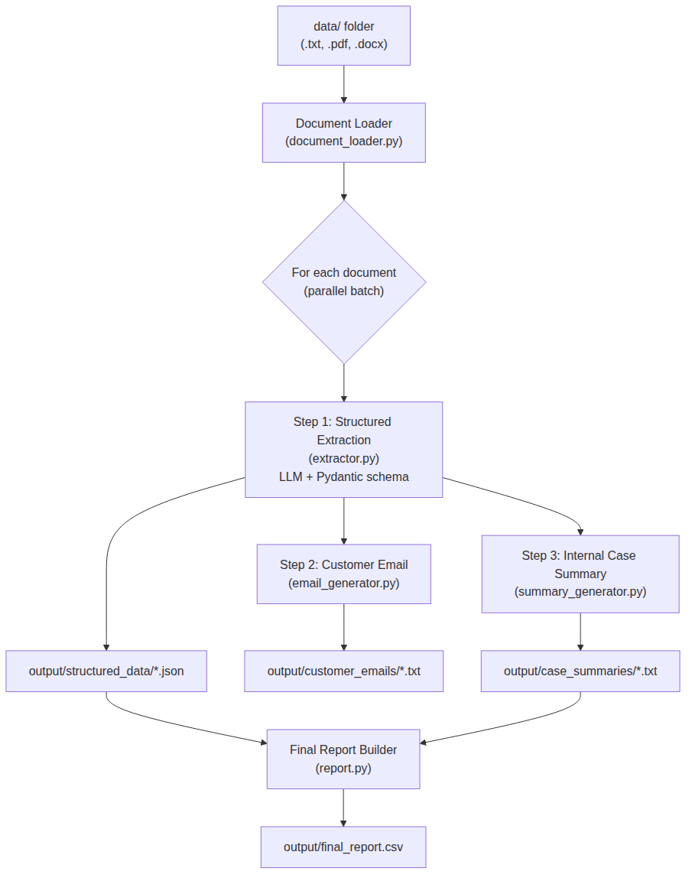
ARCHITECTURE
End-to-end data flow
Batch Flow
data/ folder holds .txt / .pdf / .docx complaint files
Document Loader extracts plain text from each format
Each document processed in its own thread (parallel)
Extraction → Email → Summary run in sequence per doc
Report Builder consolidates everything into one CSV

Slide 5
UNDER THE HOOD
Technology stack
Language
Python 3.10+
LLM
OpenAI Chat Completions API (gpt-4o-mini by default)
Structured Output
Pydantic v2 models (ComplaintCase, CaseSummary)
Document Parsing
pypdf (PDF), python-docx (DOCX), built-in I/O (TXT)
Parallel Execution
concurrent.futures.ThreadPoolExecutor
Reporting
pandas → final_report.csv
Config / Secrets
python-dotenv (.env file, never committed)
Logging
Python's built-in logging module

Slide 6
WHY IT'S BUILT THIS WAY
Key design decisions
Separate LLM calls per task
Each of the 3 steps has one clear job — easier to debug, test, and matches the workflow-orchestration requirement.
Pydantic validation, always
Raw LLM output is never saved directly; it must pass schema validation first.
Parallel batch, sequential steps
Documents run concurrently; the 3 steps inside one document stay in order since 2 & 3 depend on 1.
Mock LLM mode
MOCK_LLM=true tests the entire pipeline — files, errors, CSV — with zero API cost.
Fail-soft batch processing
One bad document is logged and skipped; it never stops the rest of the batch.

Slide 7
RESULTS
Sample output — final_report.csv
File
Customer
Category
Complaint?
Escalate?
Status
complaint_001.txt
Ananya Rao
Service Quality
Yes
Yes
Escalated
complaint_002.pdf
Sneha Kulkarni
Delivery
Yes
No
In Progress
complaint_003.txt
Vikram Mehta
Delivery/Refund
Yes
Yes
Escalated
complaint_004.docx
Rahul Deshmukh
Billing
Yes
Yes
In Progress
complaint_005.txt
Priya Nair
General
No
No
Resolved
Each row also produces: a structured JSON file, a drafted customer email, and an internal case summary.

Slide 8
BEING HONEST ABOUT SCOPE
Limitations
Known Limitations
Not Yet Handled
• Extraction quality depends on the LLM and how clearly the source document is written
• Simple fixed backoff on LLM failures, not an advanced rate-limit strategy
• No OCR — scanned, image-only PDFs are not supported
• Local batch tool — no web UI, database or authentication (out of scope for this assignment)
• English only, for both extraction and generated text

Slide 9
Demo & Questions
python main.py → output/final_report.csv + per-case JSON / email / summary files
GitHub: complaint-case-processor | README.md has full setup + design notes

