Slide 1
Securify Safeguarding Your Digital World

Slide 2
Introduction The cybersecurity landscape approach key features threat intelligence user education partnerships call to action

Slide 3
Introduction
More than 20 years later, unprecedented events like COVID-19 pandemic contested elections, and spiking sociopolitical unrest have led to an explosion in the number and severity of cybercrimes over the course of just a few years. We’re likely to see security threats become more sophisticated and therefore more expensive over time: experts predict that the global costs of cybercrime will reach $10.5 trillion by 2025, up 15% from $3 trillion in 2015.
In vison of these threats, with the increased need to gain awareness on the cybersecurity domain we have introduced the SECURIFY.

Slide 4
WHY securify
SECURIFY is the sole information and awareness site on the various trending day to day cryptographic threats.
Securify gives a vast knowledge about the threat and it also gives the information about the history of the threat and all the possible vulnerabilities, with all these features the available prevention is also given.

Slide 5
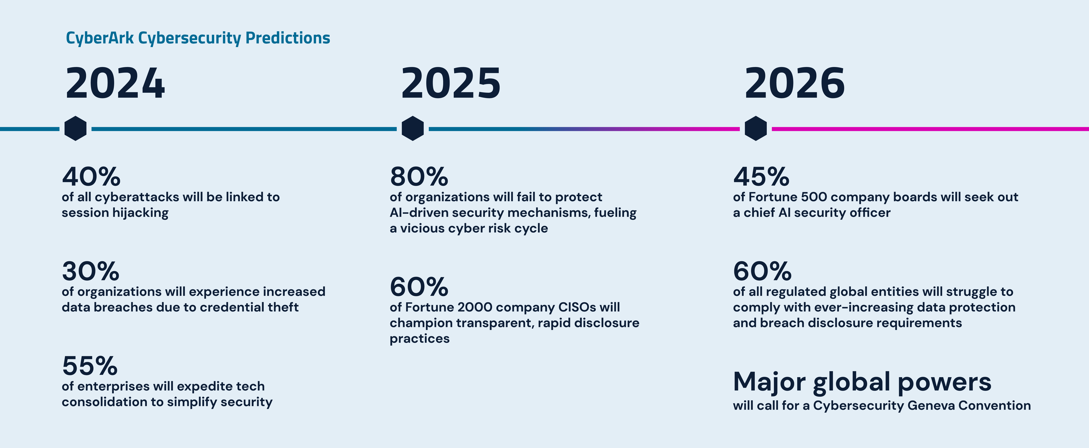
Stats

Slide 6
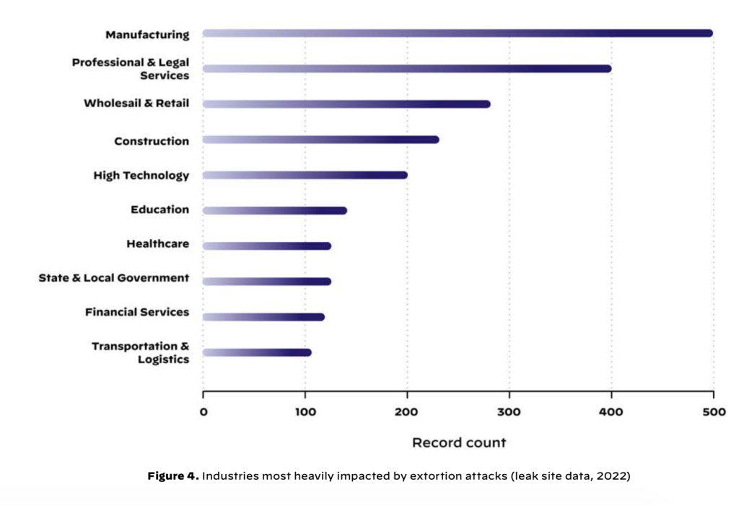

Slide 7
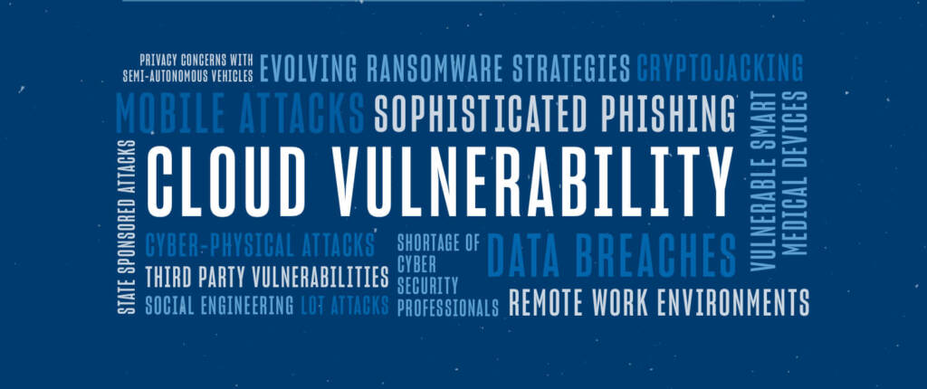
TOP CYBER THREATS IN 2024

Slide 8
HOW OUR WEBSITE WILL MAKE AN IMPACT IN SECURITY

Slide 9
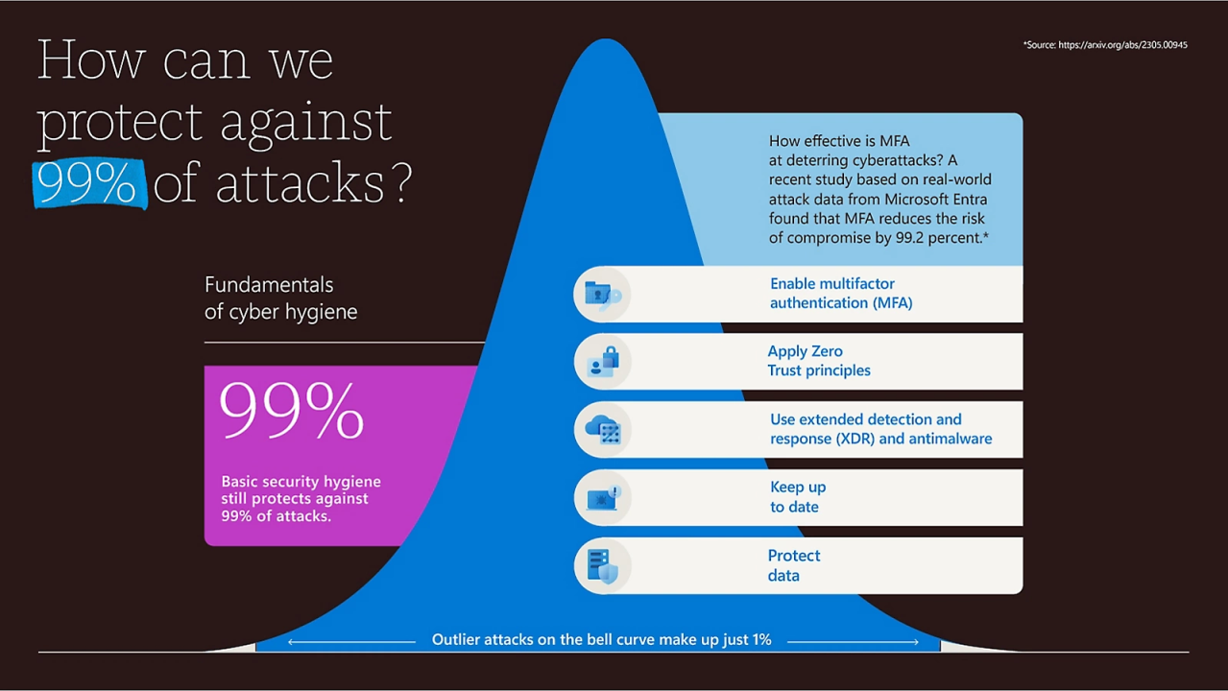

Slide 10
Cyber threat intelligence

Slide 11
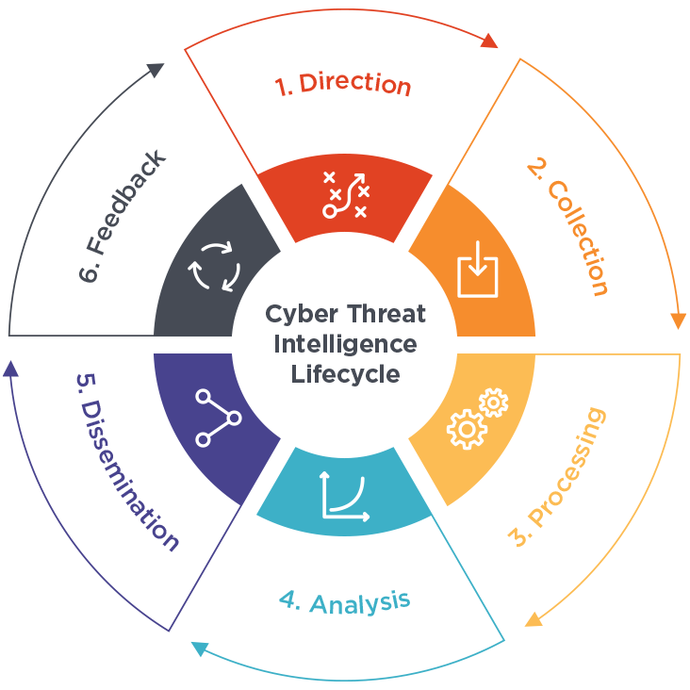

Slide 12
partnership with the government

Slide 13


Slide 14

Thank you
Team Members
Name | UID
Sumeet Sharma | 2110030252
Karam Sai Vardhan Reddy | 2110030190
Shaik Mohd Afeef Sayeed | 2110030252
U Sai Subrahmanyam | 2110030293

