Slide 1

Getting started with MongoDB

Slide 2
Agenda
Problems with RDBMS
What is MongoDB
Performance of SQL and MongoDB
Comparison between SQL and MongoDB
CRUD operation in MongoDB
Where clause commands
Linking (Joins)
Aggregation Pipeline

Slide 3
Why MongoDB why not MySQL?
Before we understand what MongoDB is we need to understand issues with traditional RDBMS.
ANY GUESS?

Slide 4

1. Scalability
Difficult to scale millions of millions of data.
Data stored in multiple tables (relationship) it is difficult to scale.

Slide 5

2. Flexibility
Fixed data structure therefore not easy to make modifications to data structure
You need to spend hours and hours on designing the database before development
In Agile projects database requires constant restructuring

Slide 6

3. Performance
Data is generally stored across multiple tables. Joins have huge performance impact as it requires lot of CPU and resources
Need to install and configure complex caching mechanism to make it faster

Slide 7
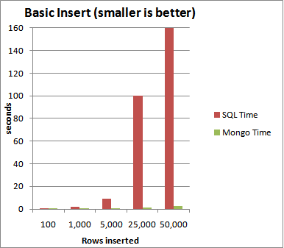
MongoDB vs SQL performance chart

Slide 8
What is MongoDB?
It is a NoSQL database called (Document database)
It stores data in flexible JSON-like document.
Easy to develop REST API in JSON
It is highly scalable and flexible database

Slide 9
How MongoDB looks when compared to RDBMS ?
[
{
“first_name” : “Joe”, “last_name” : “Satana”, “email” : “joe@abc.in”
},
{
“first_name” : “Bob”, “last_name” : “Michel”, “email” : “bob@abc.in”
}
]
first_name | last_name | email
Joe | Satana | joe@abc.in
Bob | Michel | bob@abc.in

Slide 10
Comparison between SQL and MongoDB
SQL Server | MongoDB
Database | Database
Table | Collection
Index | Index
Row | Document
Column | Field
Joining | Linking & Embedding

Slide 11
Where to use MongoDB?
Big Data
Content Management and Delivery
Mobile and Social Infrastructure
User Data Management
Data Hub

Slide 12
MongoDB commands
mongo | Enter the MongoDB client
show dbs | List all database. Should have at least on record to display the db in list.
db | Display active database name
db.stats() | Show the database name, number of collection and documents in the database, etc.
use db_name | To switch / create database
db.dropDatabase( ) | Drop database

Slide 13
Collections = Tables in MongoDB is called as collections
Name | Collection name
Options | capped - Overwrite oldest entries if collection size is reached. autoindexId - Automatically index the _id field size - Maximum size of the collection in bytes if capped = true max - Maximum number of documents allowed in collection
To create a collection
db.createCollection(name, options)
Eg :
db.createCollection(‘Employee s’)
Drop a collection
db.collection_name.drop()

Slide 14
Where conditions
Operation | Syntax | Example | RDBMS Equivalent
Equality | {<key>:<value>} | db.posts.find({"by":"tutorials point"}).pretty() | where by = 'tutorials point'
Less Than | {<key>:{$lt:<value>}} | db.posts.find({"likes":{$lt:50}}).pretty() | where likes < 50
Less Than Equals | {<key>:{$lte:<value>}} | db.posts.find({"likes":{$lte:50}}).pretty() | where likes <= 50
Greater Than | {<key>:{$gt:<value>}} | db.posts.find({"likes":{$gt:50}}).pretty() | where likes > 50
Greater Than Equals | {<key>:{$gte:<value>}} | db.posts.find({"likes":{$gte:50}}).pretty() | where likes >= 50
Like | {<key>:{'$regex':<value>}} | db.posts.find({“title”: {'$regex': ‘How’} }) | where title like ‘%How%’

Slide 15
Linking ( JOINS )
{
"name" : "John",
"mail" : "John@xyz.com", "phone" : {
‘ph1’ : "8080808080",
‘ph2’ : "9090909090",
‘landline’ : "010-45454545"
}
}

Slide 16
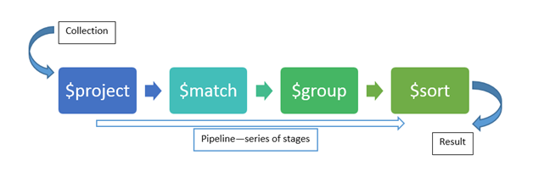
Aggregation Pipeline

Slide 17
Reference
https://docs.mongodb.com/manual/reference
Question?

Slide 18
Thank you

