Slide 1
Intro to Redux

Slide 2
Do I need Redux? 3 Principles
Flux vs Redux Redux Flow

Slide 3
Do I need Redux?

Slide 4
React + Redux
Vanilla JS
jQuery
React
Simple No setup
Complex Significant setup

Slide 5

When Do I Need Redux?
Complex data flows
Inter-component communication Non-heirarchical data
Many actions
Same data used in multiple places

Slide 6
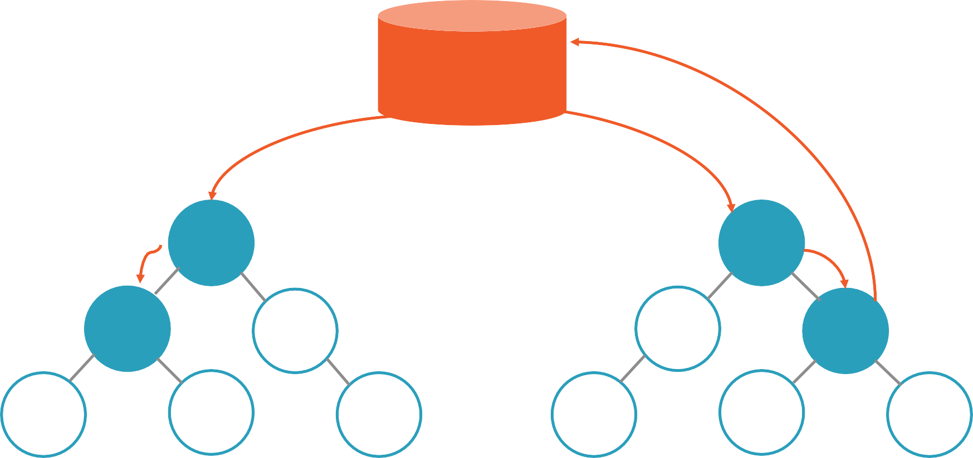
Store
Action: Create User

Slide 7



Redux: 3 Principles
One immutable store
Actions trigger changes
Reducers update state

Slide 8
Flux vs Redux

Slide 9
Data down. Actions up.

Slide 10



Flux and Redux: Similarities
Unidirectional Flow
Actions
Stores

Slide 11



Redux: New Concepts
Reducers
Containers
Immutability

Slide 12
Flux vs Redux
Flux
Redux
Action
Action
Dispatcher
Reducers
Store
Store
React
React

Slide 13
Flux
Redux
Stores contain state and change logic
Store and change logic are separate

Slide 14
Flux
Redux
Store and change logic are separate One store
Stores contain state and change logic
Multiple stores

Slide 15
Flux
Redux
Store and change logic are separate One store
Single store with hierarchical reducers
Stores contain state and change logic
Multiple stores Flat and disconnected stores

Slide 16
Flux
Redux
Store and change logic are separate One store
Single store with hierarchical reducers No dispatcher
Stores contain state and change logic
Multiple stores Flat and disconnected stores Singleton dispatcher

Slide 17
Flux
Redux
Store and change logic are separate One store
Single store with hierarchical reducers No dispatcher
Container components utilize connect
Stores contain state and change logic
Multiple stores Flat and disconnected stores Singleton dispatcher
React components subscribe to stores

Slide 18
Flux
Redux
Store and change logic are separate One store
Single store with hierarchical reducers No dispatcher
Container components utilize connect State is immutable
Stores contain state and change logic
Multiple stores Flat and disconnected stores Singleton dispatcher
React components subscribe to stores
State is mutated

Slide 19
Redux Flow

Slide 20
Redux Flow
function appReducer(state = defaultState, action) { switch(action.type) {
case RATE_COURSE:
//return new state
}
}
Action
{ type: RATE_COURSE, rating: 5 }
Store
Reducers
React
Notified via React-Redux

