Slide 1
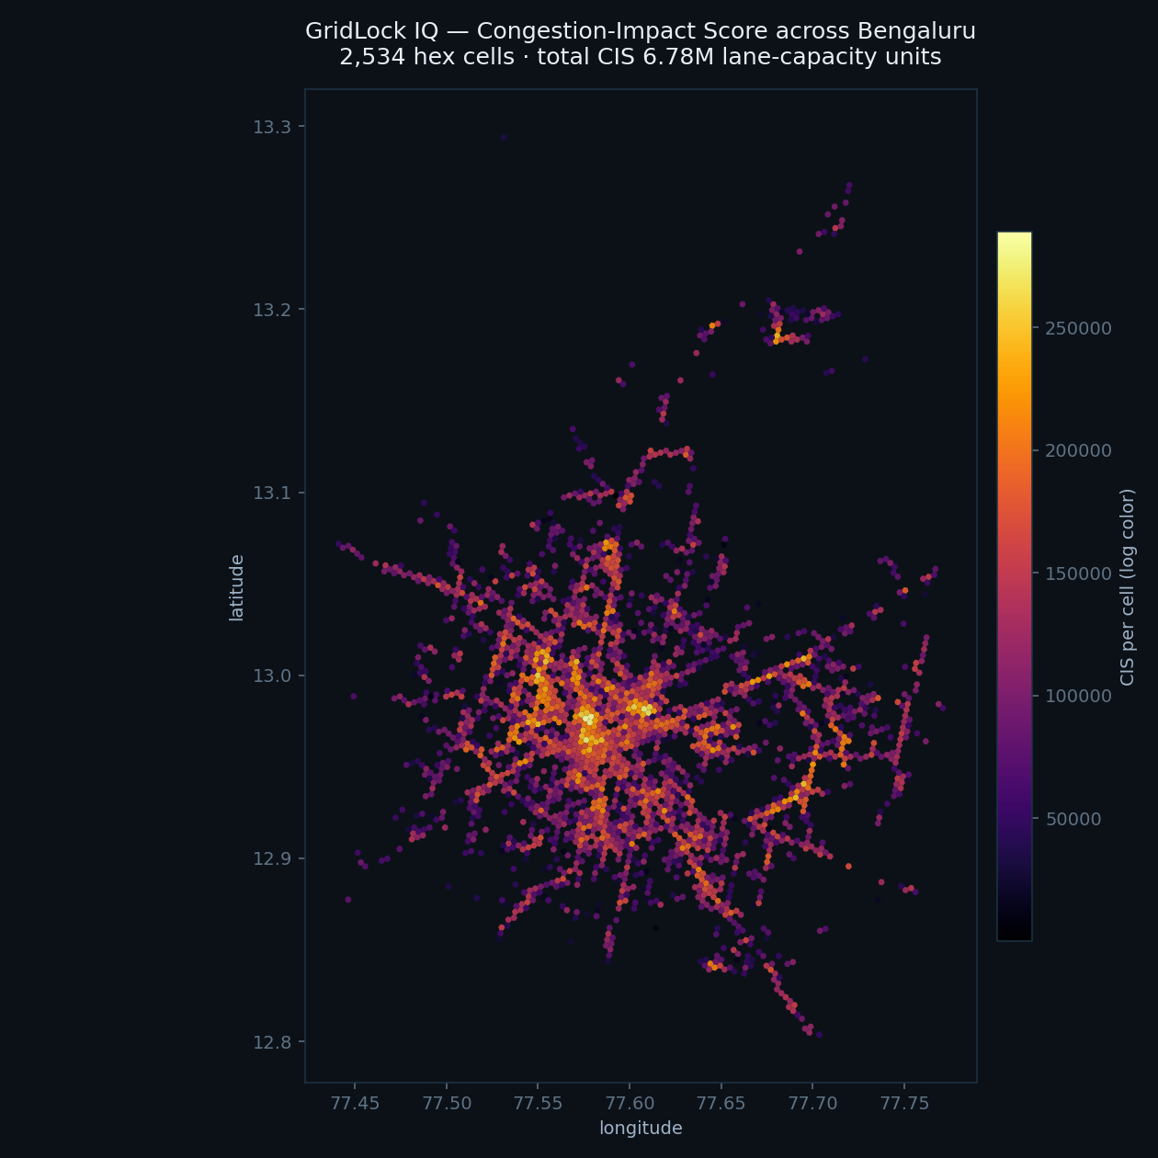
FLIPKART GRiD · ML TRACK
GridLock IQ
Parking-Induced Congestion Intelligence
“We don't count tickets — we measure the traffic they steal.”
40.9%
50%
84.9×
of all congestion impact sits in 64 hotspot cells
of impact relieved by just 24 optimally-placed patrol units
return on patrol payroll (planning estimate)
298,450 real Bengaluru enforcement tickets · Nov 2023 – Apr 2024

Slide 2
THE OPERATIONAL CHALLENGE
Enforcement is blind to congestion impact
1
Reactive & patrol-based
Officers chase reports; no system points them to the worst spots first.
THE DATA
298,450
2
No impact heatmap
parking-enforcement tickets
Tickets are counted, but their effect on traffic flow is never measured.
54 stations
across Bengaluru
3
Can't prioritize zones
50.4%
With limited marshals, nobody knows which 1% of streets to cover.
occur at a mapped junction
231,890
unique vehicles tracked

Slide 3
THE WINNING IDEA
We turn each violation into capacity lost
CIS = severity × vehicle footprint × (1 / lane_count) × junction × peak
Real OSM road fusion
100% of coords snapped to OpenStreetMap; 51% carry an explicit lane tag. Blocking 1 of 2 lanes ≫ 1 of 6.
A priority index, not a count
A bus double-parked in 1 of 2 lanes at a junction in rush hour scores ~30× a scooter on a footpath.
Robust to the weights
Under ±25% weight noise (300 draws) the top-20 hotspots stay 91% stable.

Slide 4
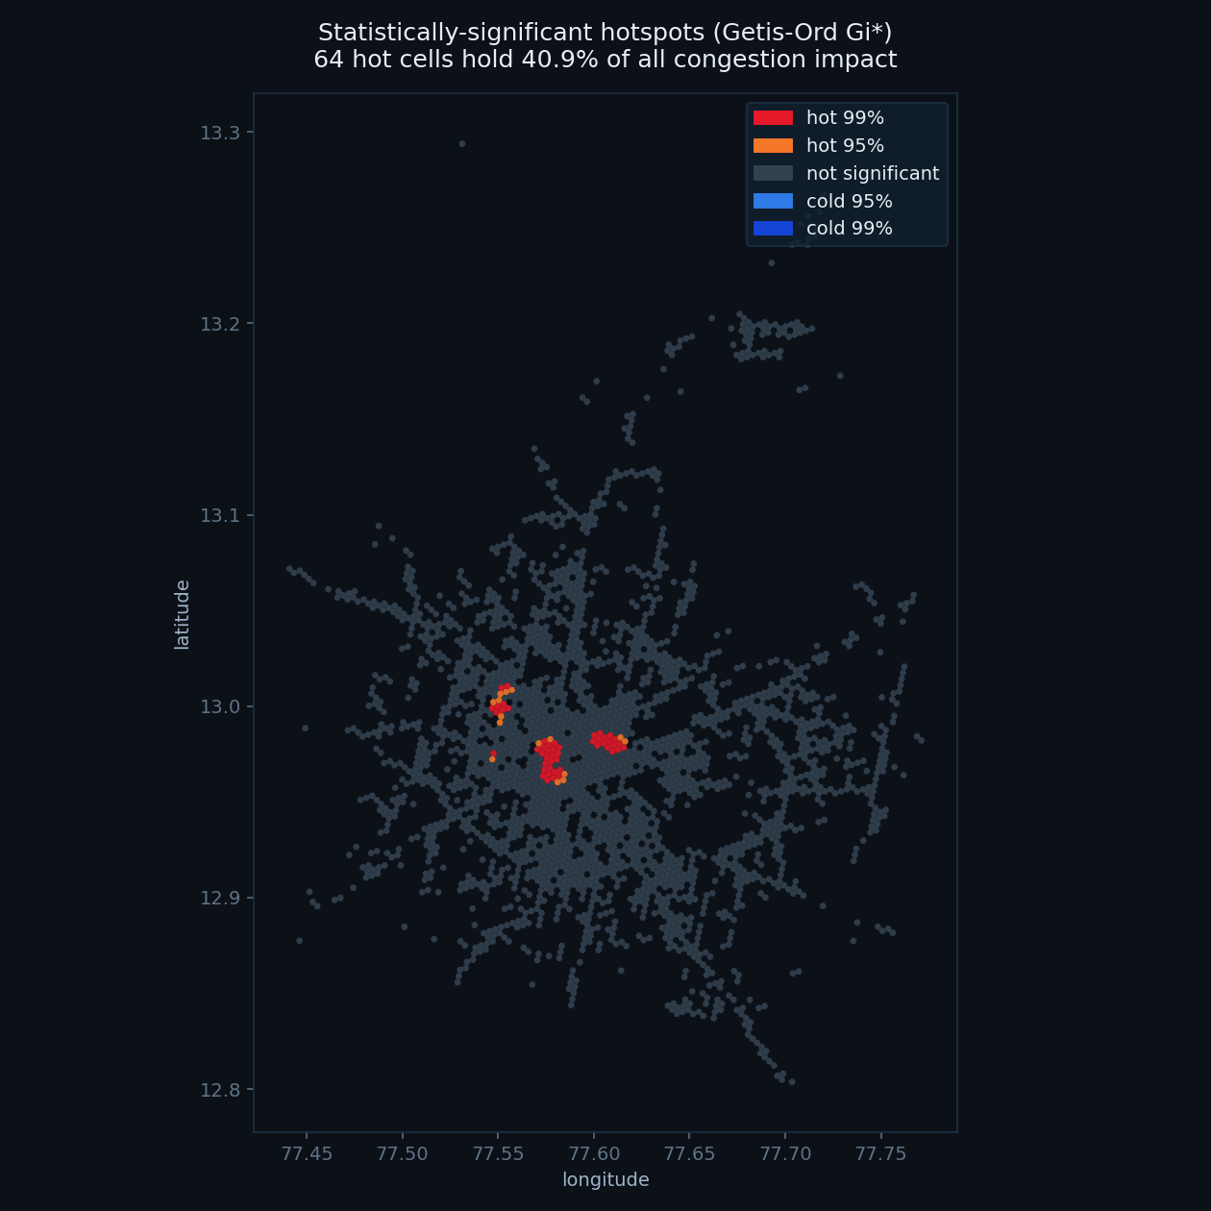
MEASURE
Where it hurts — statistically, not by eye
64
40.9%
cells survive Getis-Ord Gi* with Benjamini-Hochberg FDR
of all congestion impact concentrated there
Significant, not just busy. Gi* finds cells whose impact exceeds spatial chance; FDR controls 2,534 simultaneous tests, so every flagged cell is real (top cell z ≈ 27, p ≈ 10⁻¹⁶²).
🧪 Robustness. Ranking is 90% stable under ±25% weight perturbation (Spearman 0.998) — the conclusion does not depend on hand-set weights.

Slide 5
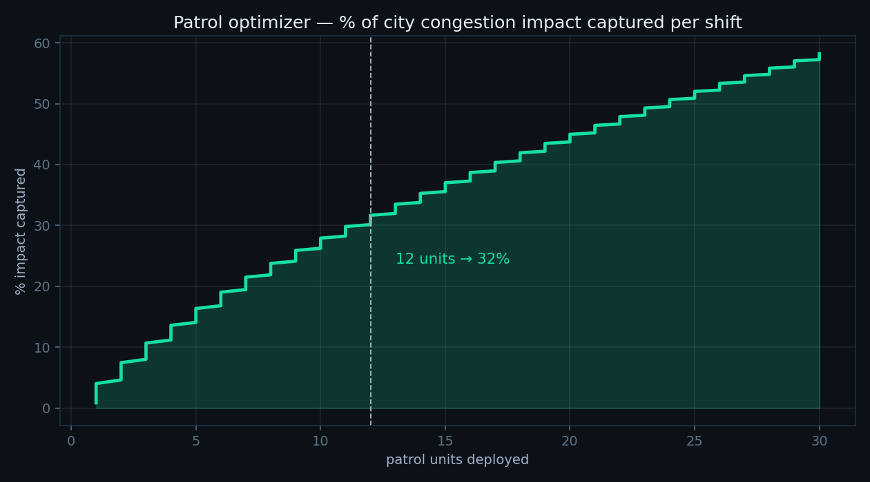
PREDICT & ACT
Forecast tomorrow's worst cells, then optimize patrols
FORECAST (temporal holdout, vs naive baseline)
15% lower MAE than persistence (56.66 vs 66.39); Precision@30 0.659 — matches persistence on ranking, wins on magnitude. A true forward forecast for any shift.
PATROL OPTIMIZER (greedy submodular, ≥63% of optimal)
31.7% of city impact from 12 units; 24 units relieve 50% — then the curve flattens. That is the city's exact funding answer, drag-the-slider live in the demo.

Slide 6
IT PAYS FOR ITSELF
Recover wasted effort — and price the problem
WASTED-ENFORCEMENT MODEL
ECONOMIC LAYER (transparent, tunable)
30.1%
₹211.5 cr/yr
of reviewed tickets are rejected — each a wasted officer-hour.
estimated parking-induced congestion cost (planning estimate).
ROC-AUC 0.707
≈ 14,734 officer-hours/yr saveable
40.9% of that cost sits in the hotspots
Optimized patrol → 84.9× ROI on its payroll
Used to prioritize human review, not auto-reject — human stays in the loop.
Targeted enforcement is high-leverage: small spend, large relief.

Slide 7
BEYOND ENFORCEMENT
Design the problem out — and close the loop
♻️ Chronic sites
🚗 Repeat offenders
📷 CV auto-detection (live)
919 micro-sites are ticketed almost daily yet never improve. We recommend the fix — ANPR cameras, bollards, loading bays — not more tickets.
711 vehicles have 10+ violations (worst: 55). A leaderboard for escalation and targeted action.
A YOLOv8 detector on junction CCTV / patrol dashcams flags illegal parking in real time and feeds the SAME CIS pipeline — zero human latency. Built and running.

Slide 8
FROM DATA TO DEPLOYMENT
Targeted enforcement, on a screen the city can fund
40.9%
24 units
₹211.5 cr
84.9×
impact in 64 hotspot cells
to relieve 50% of impact
priced congestion / yr
enforcement ROI
DEPLOYMENT PATH
1
Today: nightly batch → next-shift heatmap + patrol routes pushed to marshals
2
Next: live ticket feed → daily retraining of forecast & rejection models
3
Future: CV edge detection on CCTV → auto-tickets into the same CIS pipeline
GridLock IQ — built end-to-end on 298,450 real Bengaluru tickets.

