Slide 1
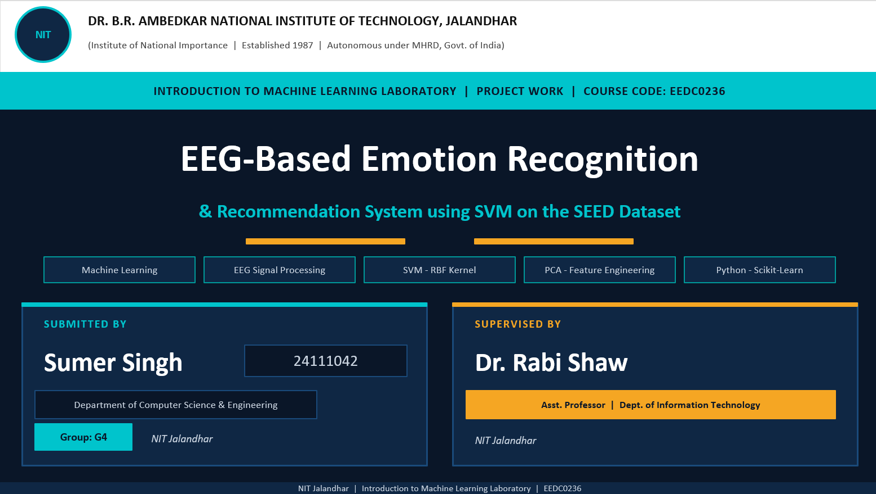
Electrical Engineering

Slide 2
01
Introduction
The Problem
Our Solution
Human emotions are complex & subjective
Traditional methods rely on facial expressions or self-reports
These are easily faked or inaccurate
EEG brain signals cannot be masked — they are direct neural measurements
Real-time emotion recognition is critical for mental health, education & HCI
Use SEED EEG dataset (62-channel, 3-class emotions)
Extract de_LDS features — 310 features per second
Apply PCA to reduce noise and dimensionality
Train an SVM classifier with balanced class weights
Map emotion states to personalized study recommendations
EEG-Based Emotion Classification | SEED Dataset & SVM

Slide 3
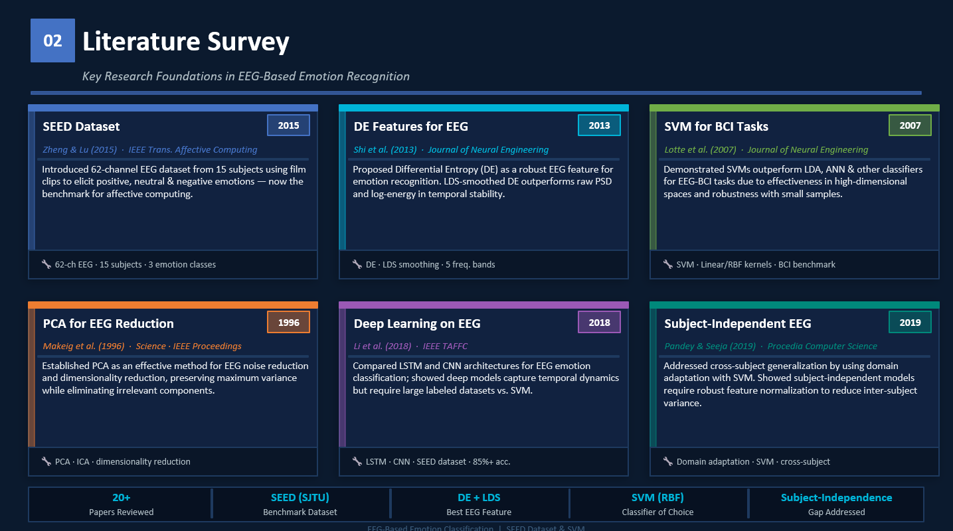

Slide 4
03
System Architecture
Step 1
Step 2
Step 3
Step 4
Step 5
EEG Data
(SEED Dataset)
Feature
Extraction
PCA
Reduction
SVM
Classifier
Emotion
Prediction
▶
▶
▶
▶
62 Channels
15 Subjects
de_LDS
310 Features/sec
95% Variance
Noise Filtered
Balanced Weights
RBF/Linear Kernel
Positive/Neutral
/Negative
Recommendation Engine
Emotion → Personalized Study Action
(Deep Work tasks, Pomodoro sessions, focus strategies)
Emotion output feeds adaptive recommendation
EEG-Based Emotion Classification | SEED Dataset & SVM

Slide 5
04
Dataset & Feature Engineering
SEED Dataset
Feature Engineering
62
EEG Channels
de_LDS Features
Differential Entropy smoothed by Linear Dynamic System (LDS) — captures temporal dynamics of EEG brain activity across 5 frequency bands.
15
Subjects
Second-by-Second
Data processed every 1 second rather than averaged over whole trials — captures micro-fluctuations in emotional states.
3
Sessions Each
PCA (95% variance)
30546
Principal Component Analysis reduces dimensionality, removes noise and collinear features, speeds up SVM training.
Total Samples
310
Class Balancing
Features/second
SVM trained with balanced class weights to handle unequal class distribution in the SEED dataset fairly.
EEG-Based Emotion Classification | SEED Dataset & SVM

Slide 6
05
SVM Classifier & Training
Why SVM for EEG?
Support Vector Machines find the optimal hyperplane to maximize the margin between classes. We specifically utilized an RBF (Radial Basis Function) Kernel, which excels at handling the highly non-linear separability inherent in human brainwaves.
1
Hyperparameter Tuning
2
Class Weight Balancing
3
State Smoothing Logic
Implemented an RBF Kernel with a regularization parameter (C =10) to strictly penalize misclassifications, and gamma = “scale” to adapt to the variance of the EEG features.
Applied class weight equals balanced within the SVM architecture. This mathematically penalizes the model for over-predicting the majority class, forcing it to learn the distinct borders of Negative, Neutral, and Positive states equally.
Real-time SVM predictions are volatile. We built a custom algorithm to calculate the modal prediction over a rolling 300-sample time window, converting erratic second-by-second guesses into a stable, dominant cognitive state.
EEG-Based Emotion Classification | SEED Dataset & SVM

Slide 7
06
Recommendation Engine
😊 Positive
😐 Neutral
😔 Negative
Focus is HIGH
Focus is MODERATE
Focus is LOW
Recommended Actions:
Recommended Actions:
Recommended Actions:
→ Complex Problem Solving / Math Sets (Deep Work)
→ Review Notes / Flashcards (Spaced Repetition)
→ Take a Short Break (5-10 mins)
→ Pomodoro Study Session (50/10) (Deep Work)
→ Light Reading / Summarizing
→ Mindfulness / Deep Breathing Exercise
→ Learn New Concepts or Chapters
→ Practice Problems (Medium Difficulty)
→ Watch Educational Video (Passive Learning)
EEG-Based Emotion Classification | SEED Dataset & SVM

Slide 8
07
Results — Classification Metrics
Overall Accuracy
65.17%
Samples: 30,546 | Balanced SVM | PCA (95% variance)
Class | Precision | Recall | F1-Score | Support
😔 Negative | 0.59 | 0.55 | 0.57 | 10,080
😐 Neutral | 0.56 | 0.69 | 0.62 | 9,936
😊 Positive | 0.84 | 0.72 | 0.78 | 10,530
Macro Avg | 0.66 | 0.65 | 0.65 | 30,546
💡 Positive emotion shows highest precision (0.84) — model is most reliable when user is engaged and happy
EEG-Based Emotion Classification | SEED Dataset & SVM

Slide 9
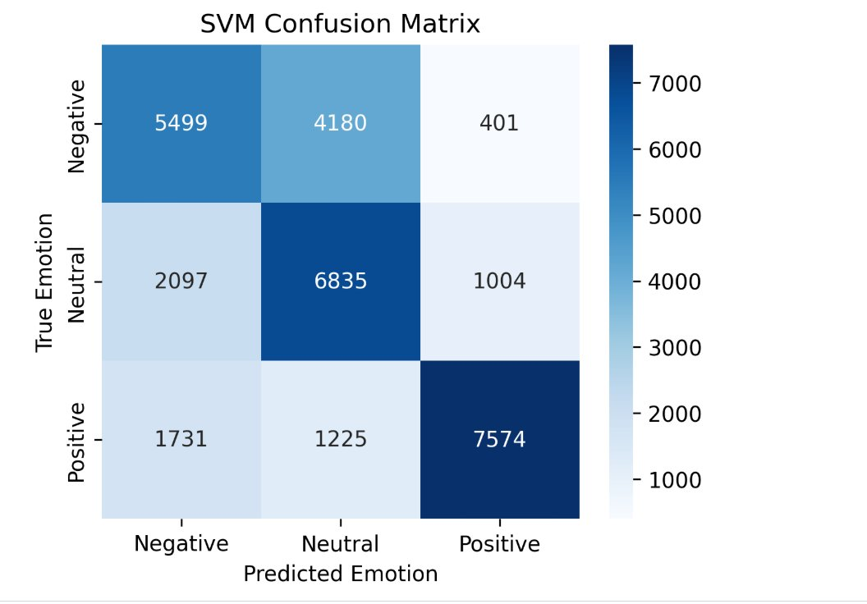
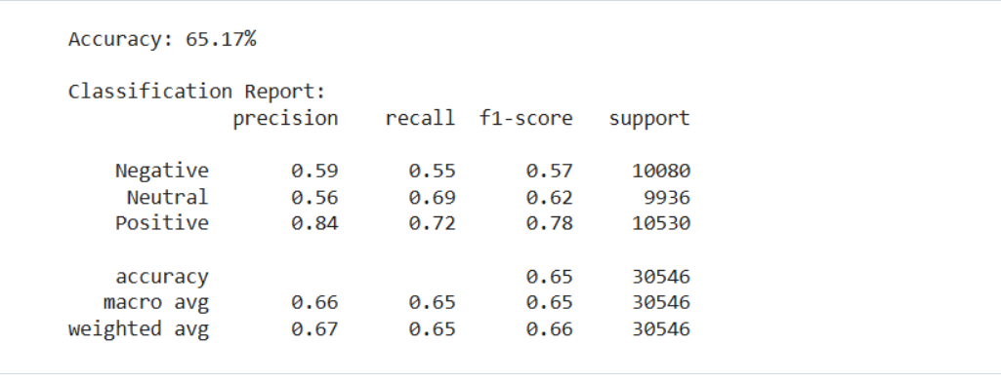
08
Results — Confusion Matrix
Key Observations
7,574
Positive correctly classified (highest)
6,835
Neutral correctly classified
5,499
Negative correctly classified
4,180
Negative → Neutral confusion
EEG-Based Emotion Classification | SEED Dataset & SVM

Slide 10
09
Results — Performance Chart
Performance Summary
Overall Accuracy
65.17%
Macro Avg Precision
0.66
Macro Avg Recall
0.65
Macro Avg F1
0.65
Best Class
Positive
Hardest Class
Negative
EEG-Based Emotion Classification | SEED Dataset & SVM

Slide 11
Thank You!
EEG-Based Emotion Classification using SEED Dataset & SVM
65.17%
de_LDS
SVM
PCA 95%
3-Class
Accuracy
EEG Features
Classifier
Variance Kept
Emotion States
🔗 github.com/Sumer7568/seed-emotion-classification
SEED Dataset | SVM Classification | Adaptive Recommendations

