Slide 1












TABLE OF CONTENT
Project Overview
Introduction Objectives Data Set Tools
Data Manipulation Process Insights
Recommended Analysis Recommendations

Slide 2

INTRODUCTION
This project showcases an in-depth analysis of data of a supermarket/ store. By leveraging big data, this analysis aims to optimize retail decision-making by examining sales, customer orders, and return data. It contains visual interactive graphs which helps to understand data profoundly. It also reveals key trends, which will help to boost product sales, streamlines inventory management and increases profitability.
Notes:
I will be presenting an in-depth analysis of a supermarket's sales performance and customer data. My objective is to provide insights that can optimize retail decision-making and drive profitability.
This project focuses on analyzing sales, customer orders, and return data from a supermarket. By leveraging big data, we aim to boost product sales, streamline inventory management, and enhance overall profitability through visual interactive graphs and key trends.

Slide 3


OBJECTIVES
The objectives of this analysis are to:
Evaluate product category performance and growth drivers
Analyze repeat versus new orders and customer retention rates
Determine average profit margins for sub-categories,
Track cumulative sales over time,
Assess sales trends with time.
Data preprocessing
Data Manipulation
Data Visualisation
Insights & Findings
Notes:
The main objectives of this analysis are to:
Evaluate product category performance and growth drivers
Analyze repeat versus new orders and customer retention rates
Determine average profit margins for sub-categories
Track cumulative sales over time
Assess sales trends over time

Slide 4
PROJECT OVERVIEW
Project
Store Performance and Sales Analysis
This project contains consumer data of supermarket or store chain mainly related to Sales, Orders and Returns. Also, we are provided various product categories and subcategories of customer sales. The aim is to analyse this data and recommend meaningful insights to help this store to increase its profits and sales.
Conducted By
Sumera Ashfaq
Data Source
Customer Retail Data
Notes:
This project analyzes consumer data from a supermarket, focusing on sales orders and returns across various product categories and subcategories. The aim is to derive meaningful insights to help the store increase profits and sales.

Slide 5


DATA SET
No. Of Tables
4
Orders, Returns, People & Dates
Customers
Products
Categories
Dataset Structure: Transaction data, regional performance, and return analysis.
Rows: Orders – 9994, Returns – 296, People - 4 Columns: Orders – 21, Returns – 2, People - 2
shippers
Notes:
We used customer retail data with four tables: Orders, Returns, People, and Dates. The dataset includes 9994 rows for Orders and 296 rows for Returns, with various columns providing detailed transaction and performance information.

Slide 6
TOOLS
MS Power BI
Data Visualization & Dynamic Dashboard
MS Power Point & MS Power BI
Presentation and Insights
MS Power Query
Data Cleaning and Preparation
Power Pivot, Power BI
Data modelling & Relationships
DAX, SQL
Calculated Columns & Measures
Notes:
The tools used for this analysis include:
MS Power BI for data visualization and dynamic dashboards
MS PowerPoint for presentation and insights
MS Power Query for data cleaning and preparation
Power Pivot and Power BI for data modeling and relationships
DAX and SQL for calculated columns and measures

Slide 7
DATA MANIPULATION PROCESS
Measures & Calculated Columns
Exclusions & Filters
Total Sales
Total Profit
Order Count
Returned Order Count
Sales by Category
Profit by Category
Order Count by Category
Return Impact
Repeat Order
New Order
Total Orders
Total Customer
Customers with Repeat Orders
Retention Rate
Profit Margin
Average Profit Margin per Sub-Category
Negative Sales Values
Duplicate Row
Category
Sub-Category
Region
Notes:
To analyze the data, I need to create the following columns. These columns will help visualize the data and draw conclusions.
Some of the filters that are used are also mentioned.

Slide 8
DATA MANIPULATION PROCESS
Measures & Calculated Columns
Exclusions & Filters
Cumulative Sales
Cumulative Profit
Sales by Quarter
Sales by Month
Sales by Quarter
Profit Percentage
Distinct Order Count
Repeat Orders
Dates
Notes:
The item in the blue represents calculated column that are used to give insights.
For calculating cumulative with time, new table Dates was created.

Slide 9


INSIGHTS

Slide 10

Key Metrics
The key matrices for this project include:
Sales Performance: Total sales, sales by product category, and sales trends over time.
Profitability: Average profit margins by product sub-category.
Customer Analysis: Repeat versus new orders, customer retention rates.
Cumulative Sales: Total sales accumulation by product sub-category over time.
Growth Analysis: Identification of categories driving growth and profitability.
These matrices provide essential insights into product performance, profitability, customer behavior, and overall business growth.
Notes:
Key metrics for this project include:
Sales Performance: Total sales and trends over time
Profitability: Average profit margins by sub-category
Customer Analysis: Repeat versus new orders and retention rates
Cumulative Sales: Total sales accumulation by sub-category
Growth Analysis: Categories driving growth and profitability

Slide 11

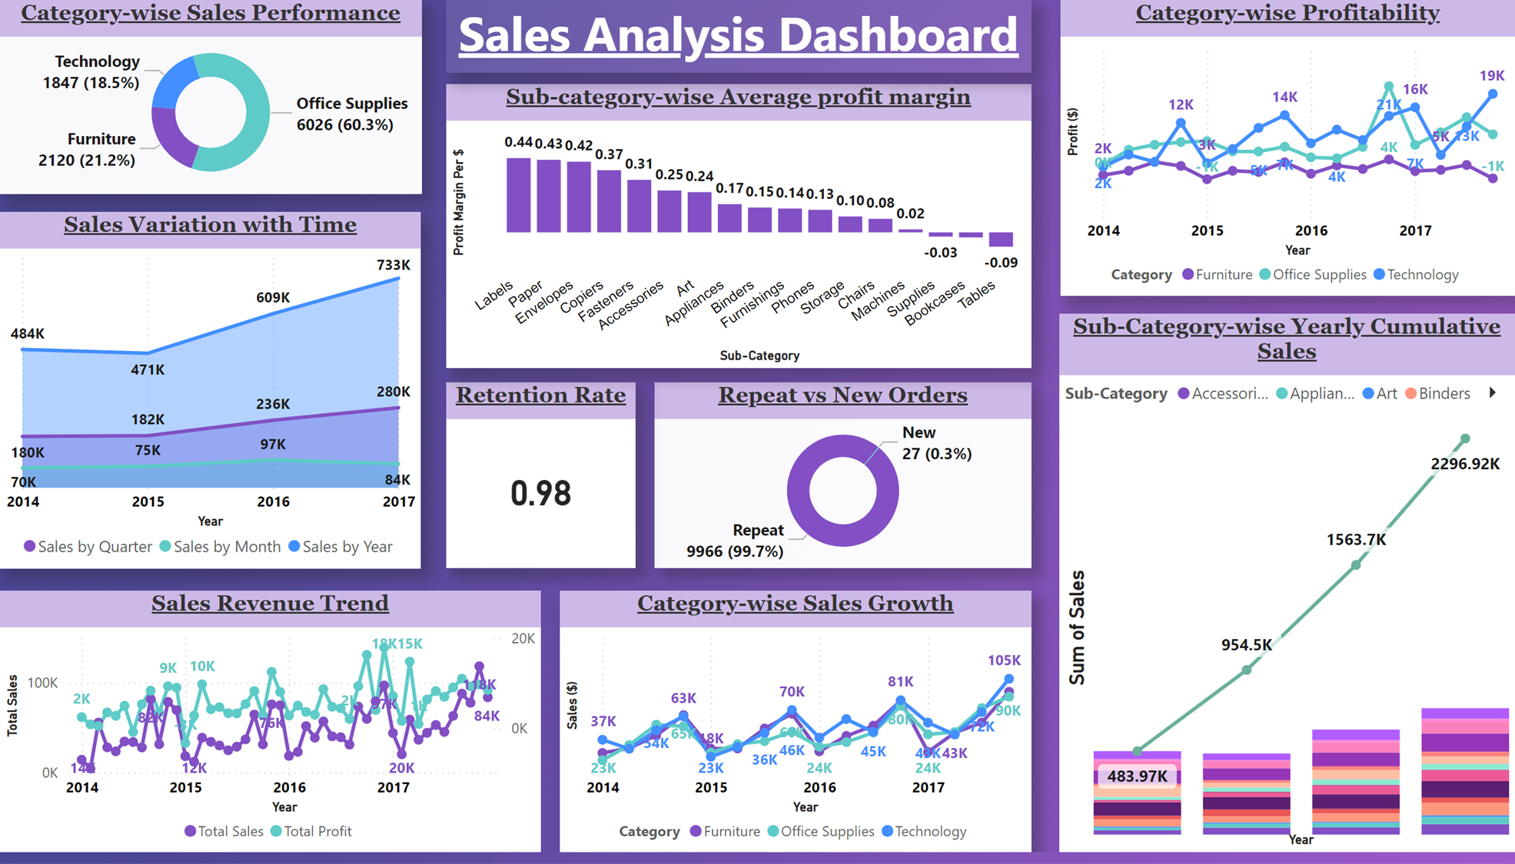
Notes:
This is the dashboard that was created using given data. Project questions that were given can be easily answered with this dashboard.

Slide 12

Recommended
Analysis
Notes:
In this section, I will outline my recommended approach for analyzing this data. I will detail my thought process for examining the raw data from the supermarket and explain how I structured the analysis.

Slide 13
Recommended Analysis
Total Sales
Sales Distribution
Category & Sub-category Performance
Customer Analysis
Return Impact
Seasonal Variation
Notes:
1 Given that revenue is the primary key parameter influencing other indices, I began my analysis with this metric.
2&3 Subsequently, I examined the performance of various categories and subcategories, which provided insights into sales, revenue, and profit from different perspectives.
4 Following these analyses, I shifted to the customer perspective, evaluating how consumers from different regions are performing and identifying which categories are purchased the most and least.
5 Additionally, I assessed the impact of returns on profitability.
6 Finally, I analyzed seasonal trends to inform inventory management and the effectiveness of offers and discounts.

Slide 14
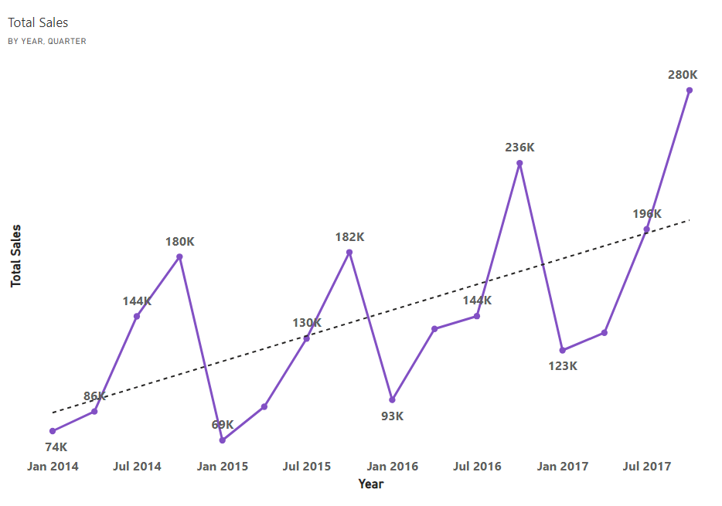
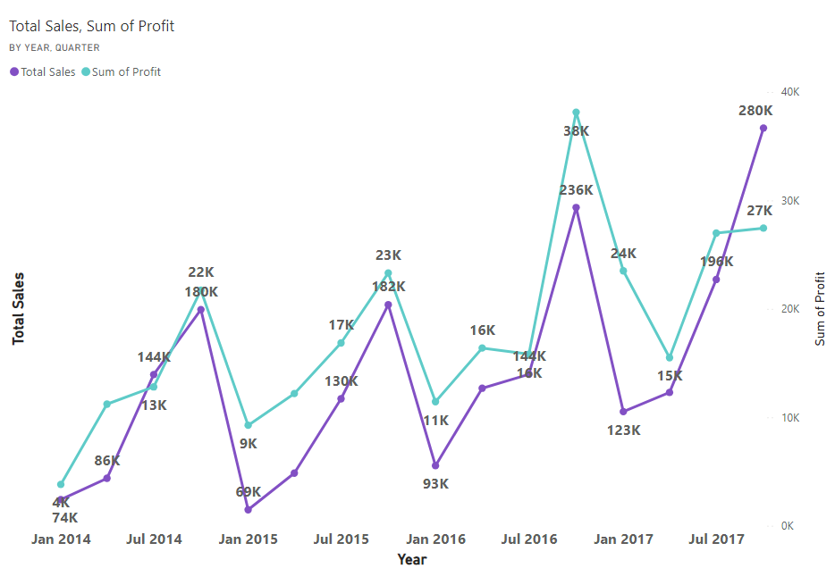
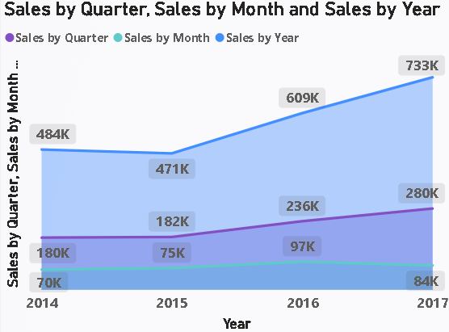
Recommended Analysis
Total Sales
Sales Distribution
Sub-category Distribution
Customer Analysis
Return Impact
Sales is increasing. This only signifies that store is progressing in long term on an average of 17.1 % per annum.
Years | Total Sales | % Increase
2014 | 484247 | NA
2015 | 470533 | -2.83%
2016 | 609206 | 28.64%
2017 | 732592 | 25.48%

Slide 15
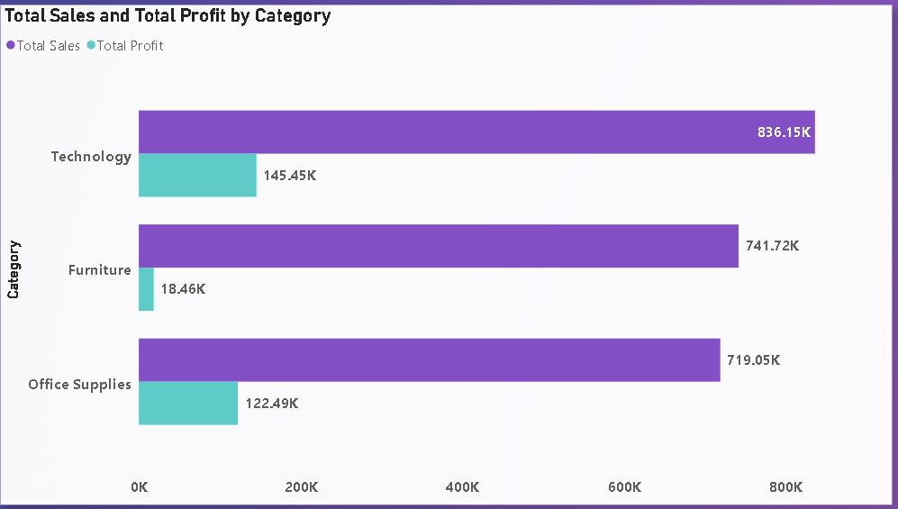
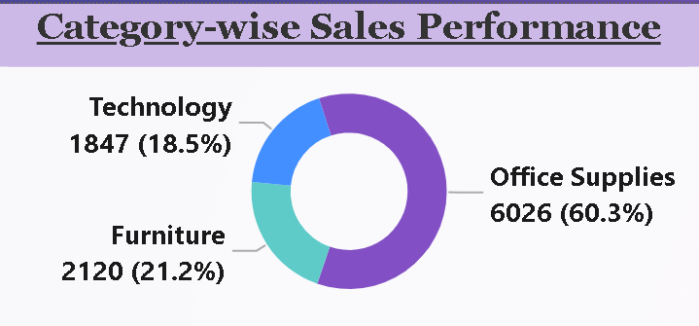
Recommended Analysis
Total Sales
Sales Distribution
Sub-category Distribution
Customer Analysis
Return Impact
Furniture category's low profit despite similar total sales. Investigation required.
Sales is increasing. This only signifies that store is progressing in long term on an average of 17.1 % per annum.
Notes:
There are few notable observations in this graph, particularly concerning furniture. Although furniture sales are comparable to technology sales, the total profit from furniture is only 12% of that from technology. Additionally, it is worth noting that office supplies have the highest number of sales orders, yet they generate the lowest profit.

Slide 16
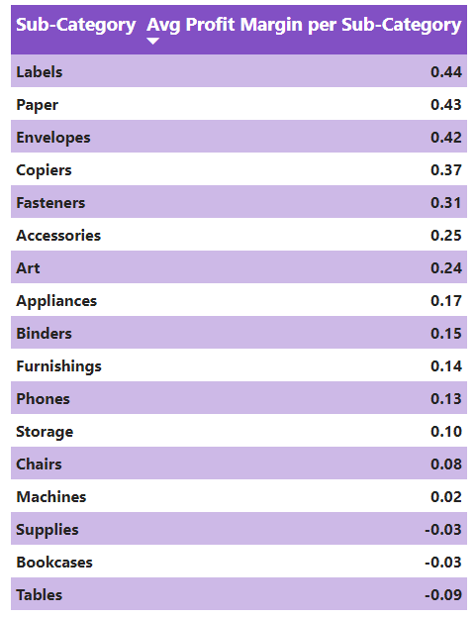
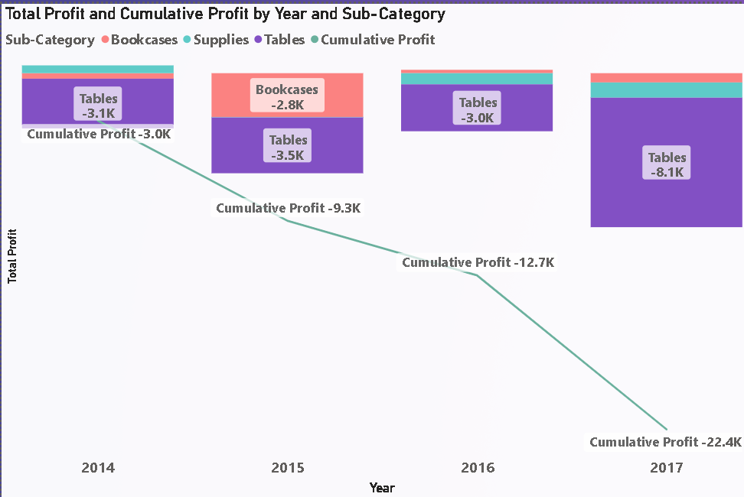

Recommended Analysis
Total Sales
Sales Distribution
Sub-category Distribution
Customer Analysis
Return Impact
Furniture category's low profit despite similar total sales. Investigation required.
Sales is increasing. This only signifies that store is progressing in long term on an average of 17.1 % per annum.
Subcategories namely supplies, bookcases & tables are clearly driving down overall profitability.
Average profit margin for each product sub-category
Notes:
When examining the subcategories, we observe that a few are driving profits down, resulting in losses. These items require further attention and analysis to identify the underlying issues.

Slide 17
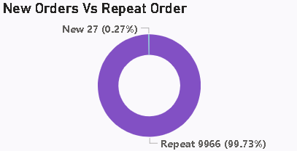
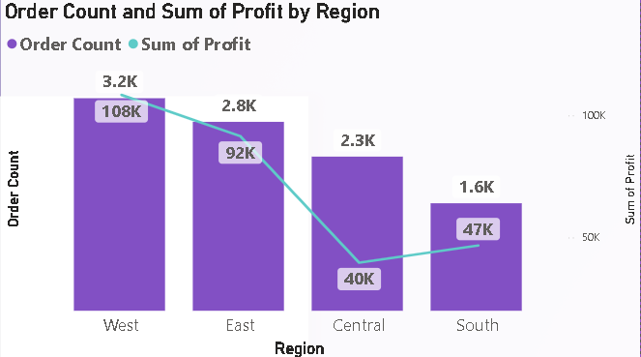
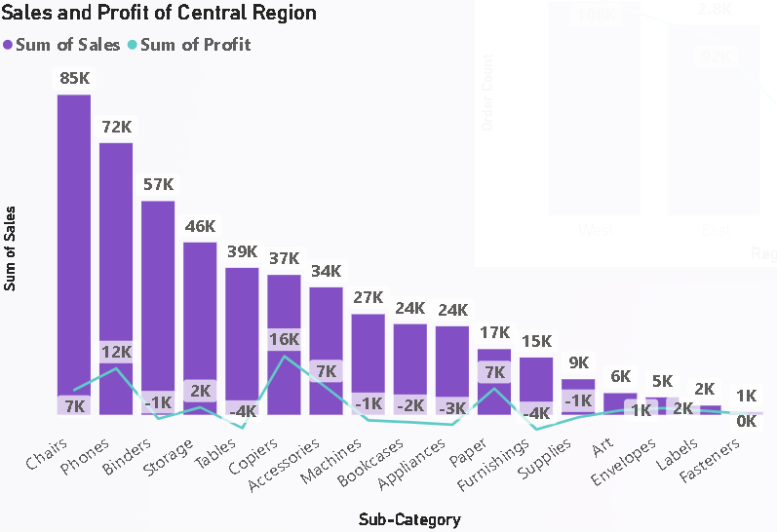
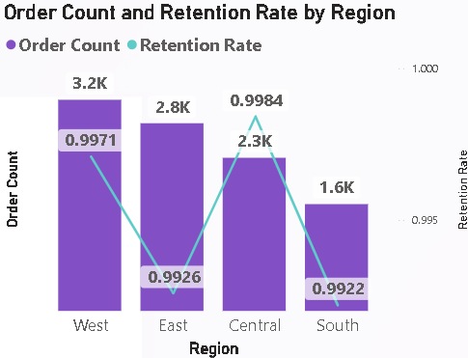
Recommended Analysis
Total Sales
Sales Distribution
Sub-category Distribution
Customer Analysis
Return Impact
Furniture category's low profit despite similar total sales. Investigation required.
Sales is increasing. This only signifies that store is progressing in long term on an average of 17.1 % per annum.
Subcategories namely supplies, bookcases & tables are clearly driving down overall profitability.
Overall customer retention is 98%, indicating excellent performance, but regional variations must be analyzed for deeper insights.
Retention rate 98%
Notes:
Here, we observe that retention is strong.
However, when examining profit by region, the Central region shows lower profit totals despite having higher retention rates and more sales than the Southern region.

Slide 18
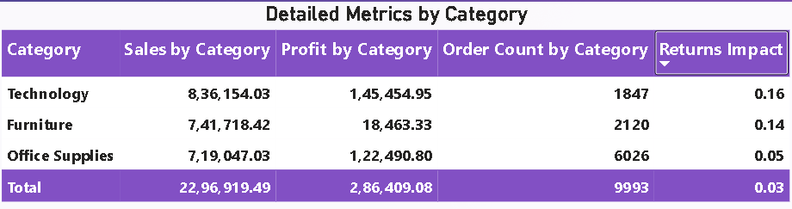
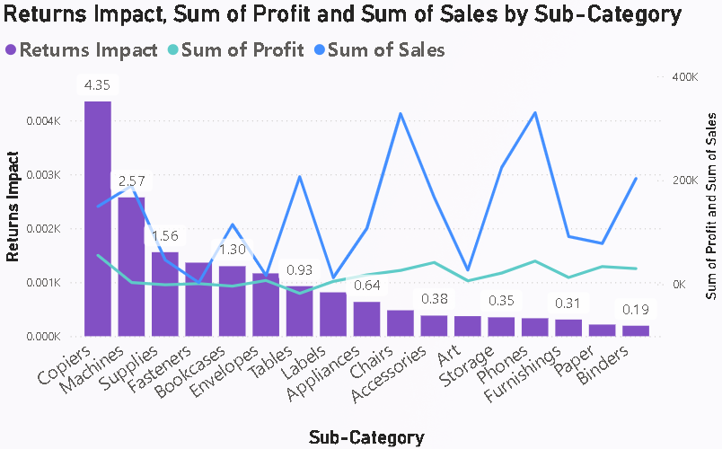
Recommended Analysis
Total Sales
Sales Distribution
Sub-category Distribution
Customer Analysis
Return Impact
Furniture category's low profit despite similar total sales. Investigation required.
Sales is increasing. This only signifies that store is progressing in long term on an average of 17.1 % per annum.
Subcategories namely supplies, bookcases & tables are clearly driving down overall profitability.
Overall customer retention is 98%, indicating excellent performance, but regional variations must be analyzed for deeper insights.
High return rates suggest issues with product quality, customer satisfaction, or mismatched expectations..
Notes:
A return impact metric above one indicates that returns are significantly hurting sales or profitability. This could signal issues like high return rates due to product quality or customer dissatisfaction, leading to revenue loss and additional costs for processing and restocking returned items.
In a supermarket dataset, if the return impact (a calculated metric) is greater than one, it generally means that the returned items have had a significant negative impact on the sales or profitability. Here's a detailed explanation:
Return Impact Explanation
Return Impact > 1:
Sales: Indicates that the value of returned goods is significant relative to total sales.
Profit: Suggests that the profitability is adversely affected due to high return rates.
Potential Implications
High Return Rates: The store might be experiencing high return rates, indicating issues with product quality, customer satisfaction, or mismatched expectations.
Loss in Revenue: Returns can lead to substantial losses in revenue as the store has to refund customers and possibly cannot resell the returned items.
Additional Costs: Handling returns often incurs additional costs such as processing, restocking, and potential markdowns if the returned products are resold at a lower price.

Slide 19
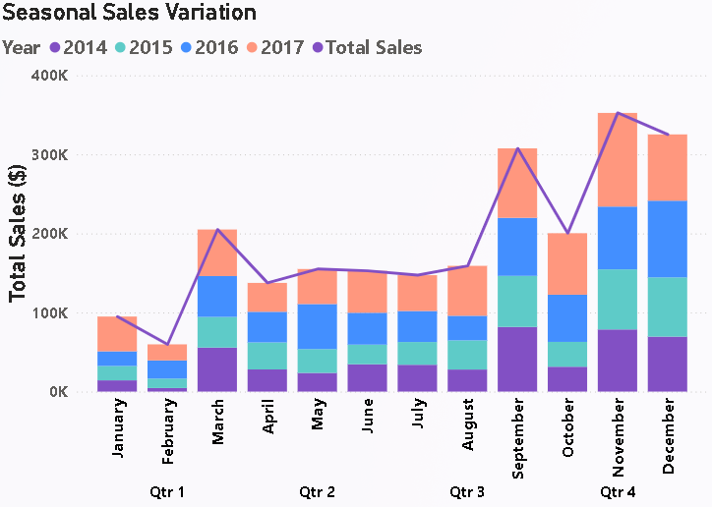
Recommended Analysis
Total Sales
Sales Distribution
Sub-category Distribution
Customer Analysis
Return Impact
Furniture category's low profit despite similar total sales. Investigation required.
Sales is increasing. This only signifies that store is progressing in long term on an average of 17.1 % per annum.
Subcategories namely supplies, bookcases & tables are clearly driving down overall profitability.
Overall customer retention is 98%, indicating excellent performance, but regional variations must be analyzed for deeper insights.
High return rates suggest issues with product quality, customer satisfaction, or mismatched expectations..
Seasonal Variation
Sales are typically low at the start of the year but higher in the last four months (winter season) compared to the annual average.
The graph shows that sales are typically lower at the start of the year, with a noticeable increase in the last four months (winter season). This trend is consistent across the years 2014 to 2017, indicating higher sales in Q4 compared to the annual average.

Slide 20
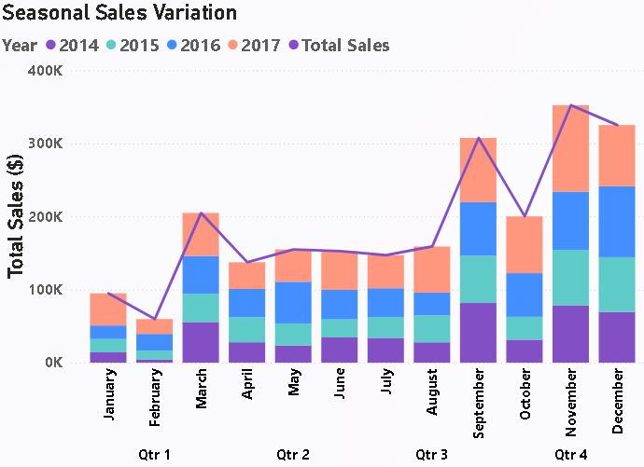
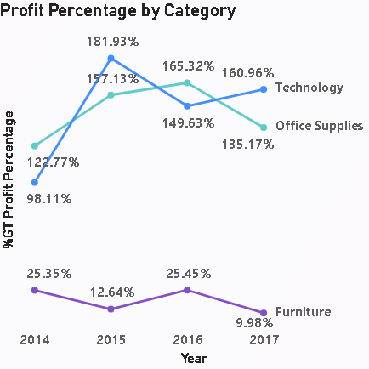
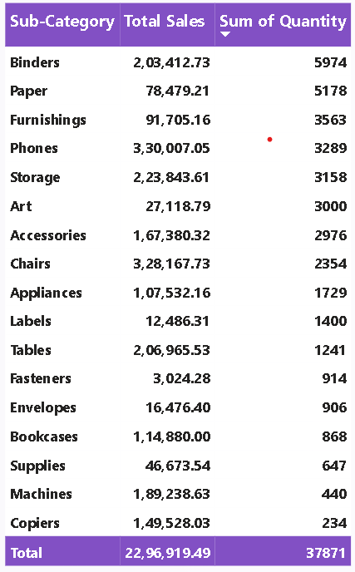
Are there any noticeable trends ?
Sales Patterns
Profitability
Sub-Category Performance
Return Impact
Notes:
The analysis revealed several noticeable trends:
Sales are typically lower at the start of the year and increase significantly in the last four months, indicating higher sales during the winter season.
Sales Patterns: Sales are higher during holidays and lower at the year's start.
Profitability: Higher margins are found in certain categories, but furniture shows low profit due to high return rates.
Sub-Category Performance: Consistent demand is seen for binding paper, furnishings, and phones.
Return Impact: High return rates affect profitability, especially in copiers, machines, and supplies.

Slide 21
Recommendations

Slide 22
Analysis Report
Seasonal Sales Patterns
Higher sales during holidays; lower at the year's start.
Strategy: Focus marketing and inventory on peak seasons.
Sub-Category Performance
Consistent demand for Binding, Paper, furnishing & phones.
Strategy: Stock these items consistently; promote non-essentials seasonally.
Customer Retention
High retention at 98%, showing strong loyalty.
Strategy: Maintain quality and service; improve regions with lower retention like southern region.
Regional Variations
Different sales patterns in various region. Central & Southern region requires attention.
Strategy: Tailor strategies to regional preferences.
Profitability
Higher margins in certain categories; high return rates & low profit in furniture.
Strategy: Reduce returns through quality control and better customer support.
Sales Growth
Steady growth with periodic spikes from promotions.
Strategy: Continue effective promotions; monitor market conditions. Roll out offers in offseason like Q1 period.
Product Returns
High return rates affecting profitability for copiers, machine & supplies.
Strategy: Improve product descriptions and quality to reduce returns.
Notes:
Based on our analysis, here are our key recommendations:
Focus marketing and inventory strategies on peak seasons to capitalize on higher sales periods.
Consistently stock high-demand items such as binding paper, furnishings, and phones, while promoting non-essential items seasonally.
Maintain quality and customer service to retain the high 98% retention rate, while improving regions with lower retention.
Tailor strategies to address regional sales patterns, particularly in the Central and Southern regions.
Reduce returns by improving product quality and customer support to mitigate their negative impact on profitability.

Slide 23

THANK YOU
Notes:
In conclusion, our analysis provides valuable insights into sales performance, profitability, and customer behavior, which can help the supermarket make informed decisions to enhance profitability and drive growth. Thank you for your attention, and I look forward to any questions you may have.

