Slide 1


An Ecosystem designed to help the global healthcare community.

Slide 2

Contents:
Problem Statement
Approach
Application Focus
Architecture Diagram
Object Model

Slide 3

Problem Statement
Global Health Network System is a Java swing application which integrates data coming from all areas of healthcare system to do analytics on data of the healthcare value chain from chemical compounds to all the way to patient’s treatment and recovery. Global Health Network System maintains statistical data of an active chemical compound effective in targeting a certain gene in a disease and provides a chemical compound to the test the effectiveness in targeting other diseases that share the same gene. We believe that adopting a common global data standard and upgrading healthcare system would benefit Global Health Network system in further improvements of patient care and better preparedness for a global pandemic.

Slide 4
Approach
To help Global Health System integrate data coming from different sources of healthcare system.
To provide a common platform for global biotechnology community to focus on the development and marketing of new drugs for the treatment of disease in healthcare patients anywhere in the world.
Drug enterprise keeps tracks of the gene and their targeting chemical compound. This way, a drug manufacturer can create a new drug in the future when a new disease is occurred by combination of existing genes to avoid any delays in manufacturing a new drug.

Slide 5
Application Focus
The application focuses to do analysis on data a network owns in all phases of healthcare value chain from chemical compounds to all the way to patient’s treatment and recovery.
Data management
Procurement – providing a method for inventory tracking
Information-sharing & collaboration i.e. sending the disease-related information from the hospital to the lab and lab to the drug company from there to chemical enterprise.
Provide a dashboard for the network admins to view sales of medicine, pre-dominant genes in all diseases and common diseases in a network.

Slide 6
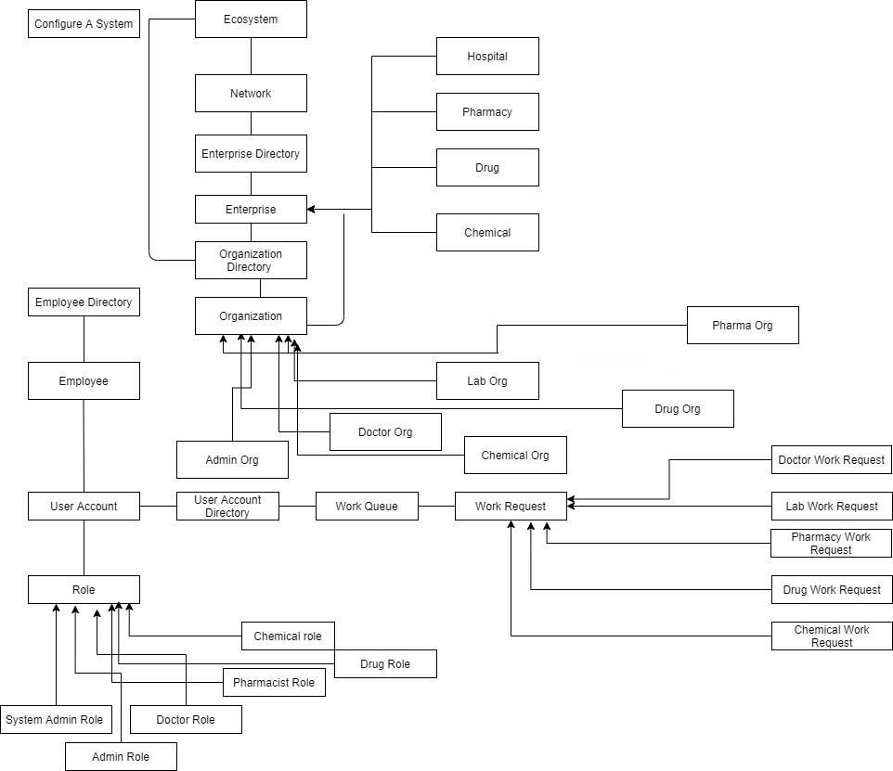
Architecture Diagram

Slide 7
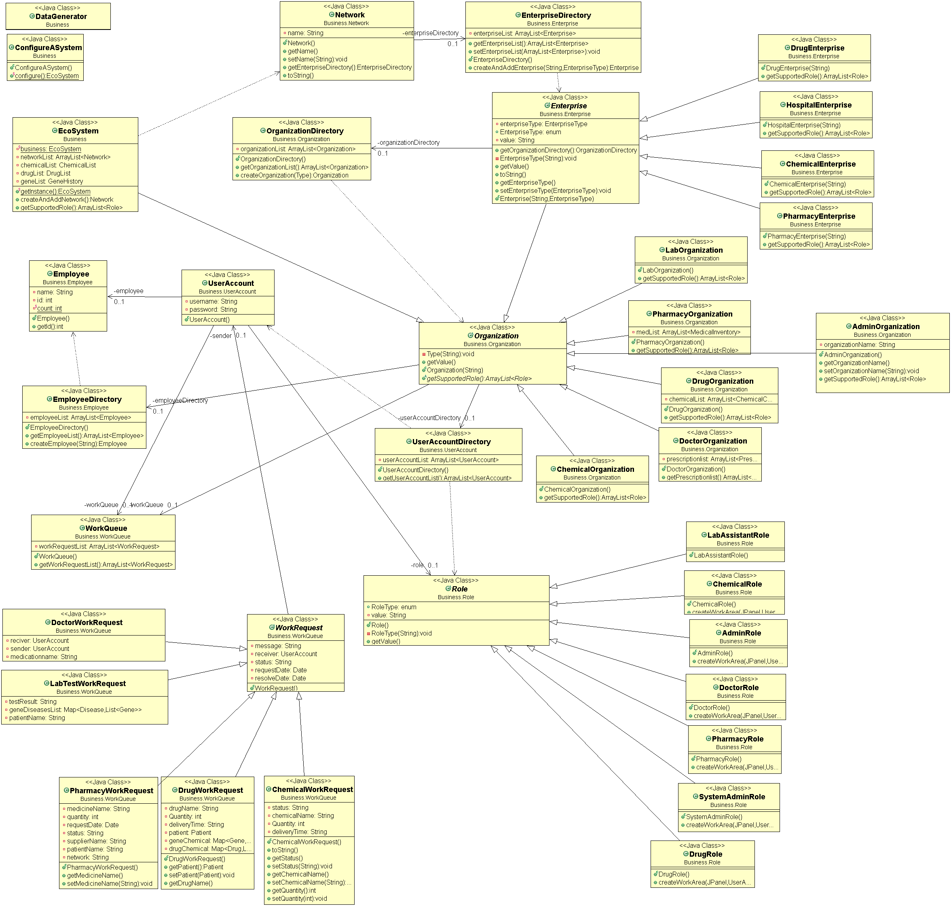
Object Model

Slide 8
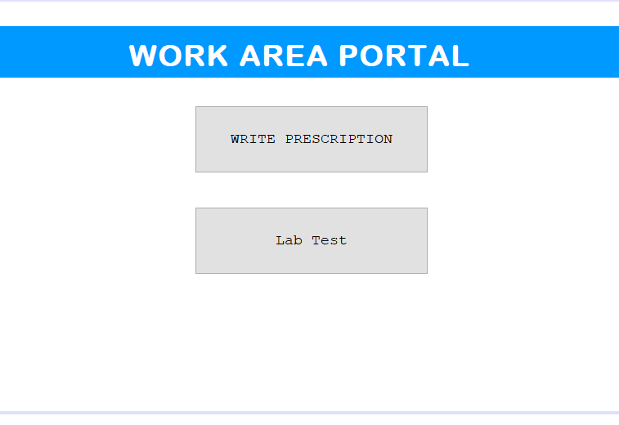
Doctor Work Area

Slide 9
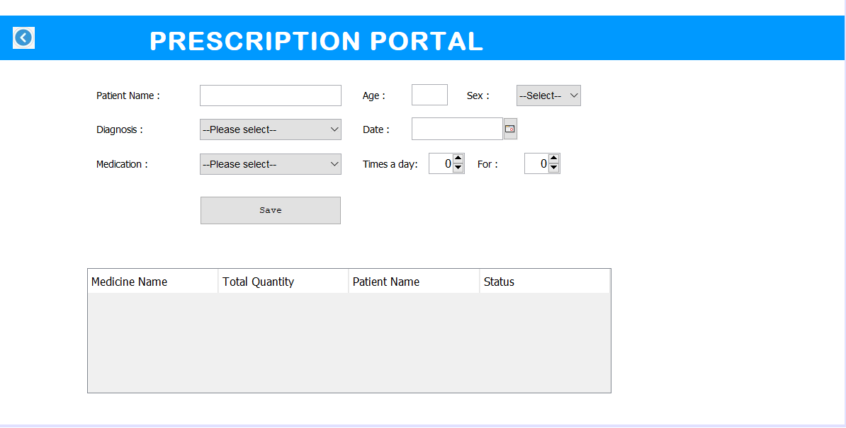

Slide 10
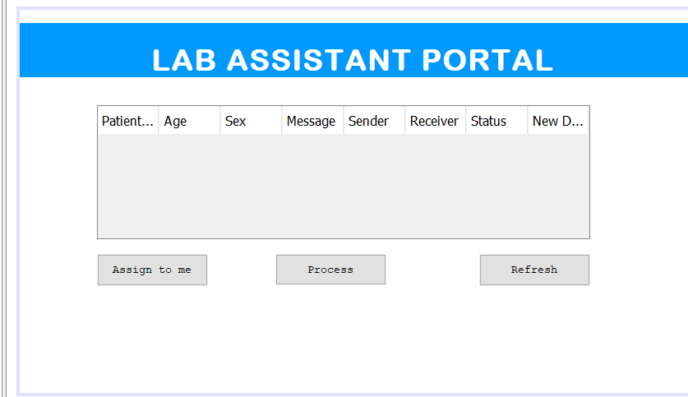

Slide 11
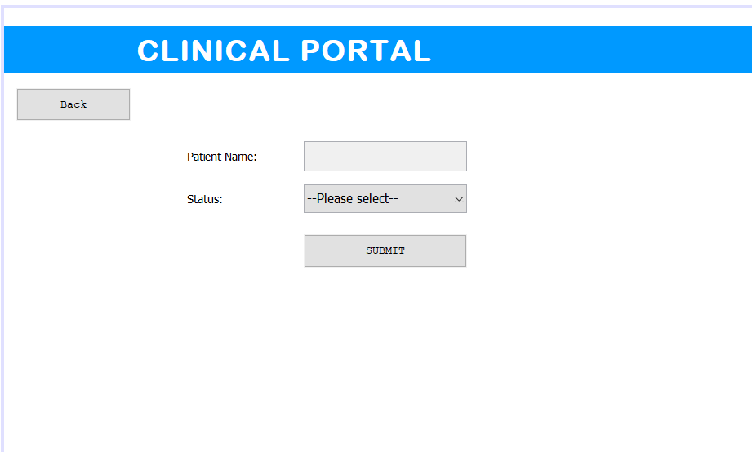

Slide 12
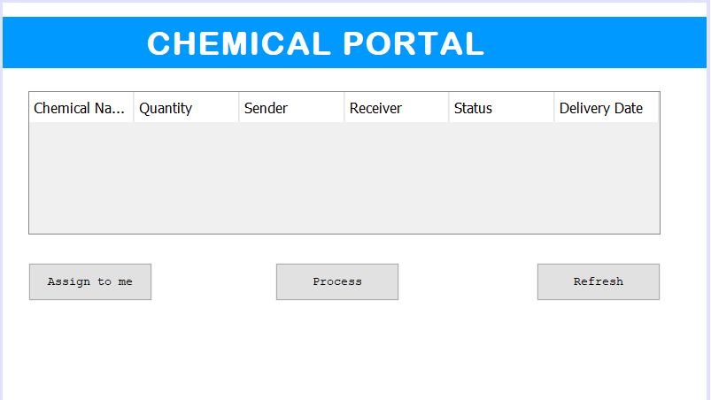

Slide 13
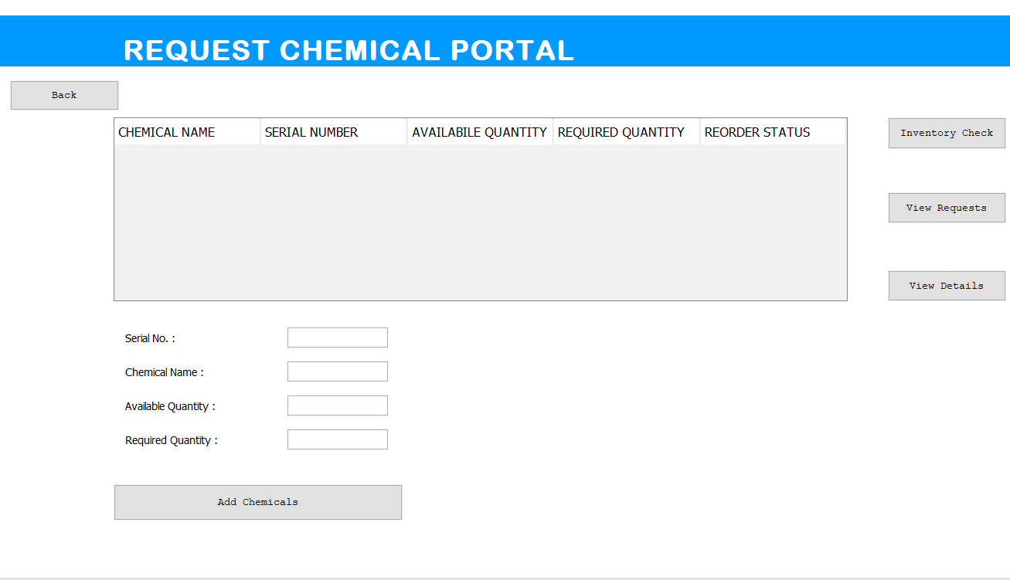

Slide 14
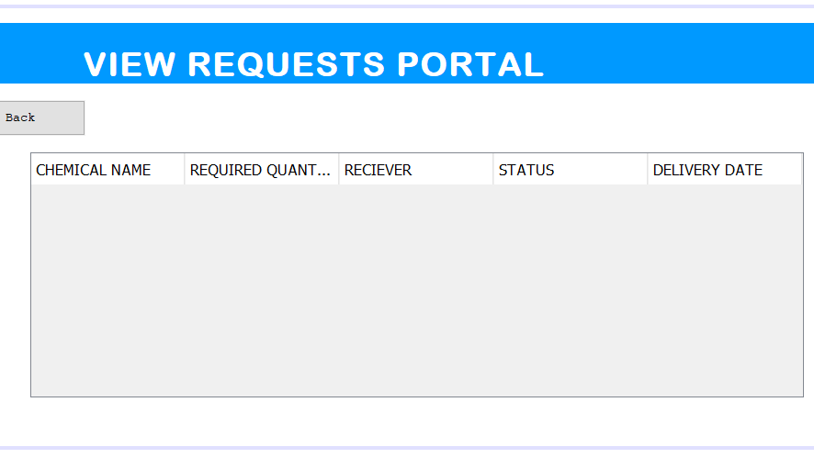

Slide 15
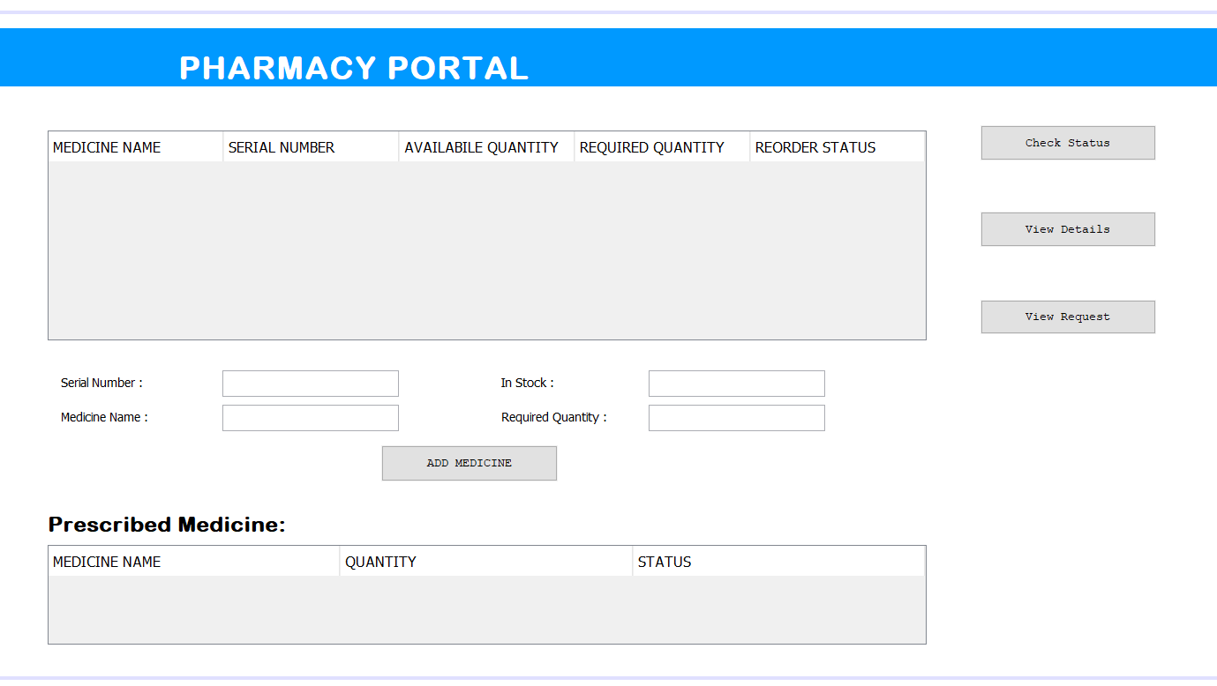

Slide 16
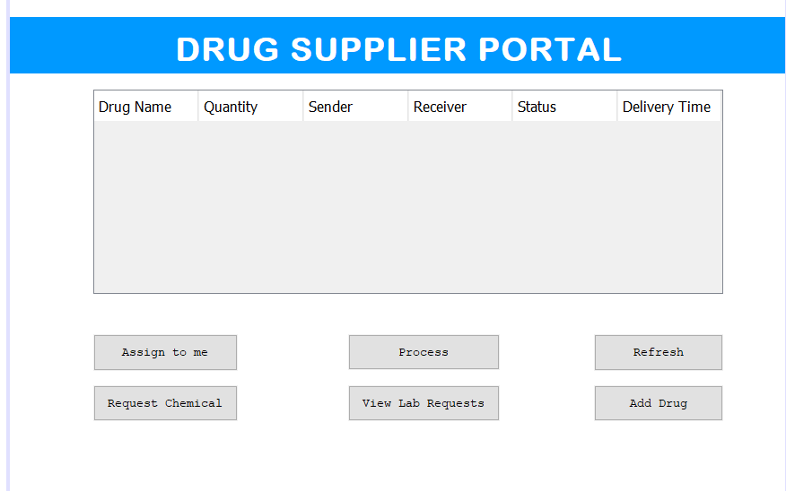

Slide 17
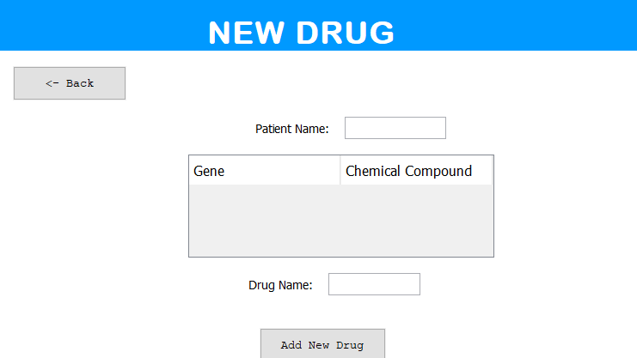

Slide 18
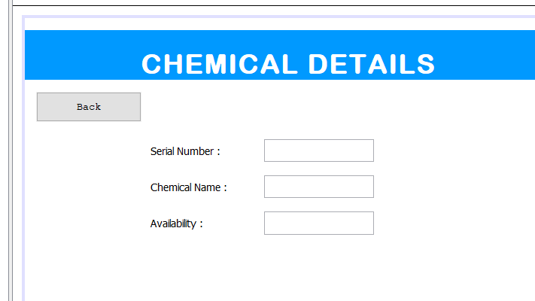

Slide 19
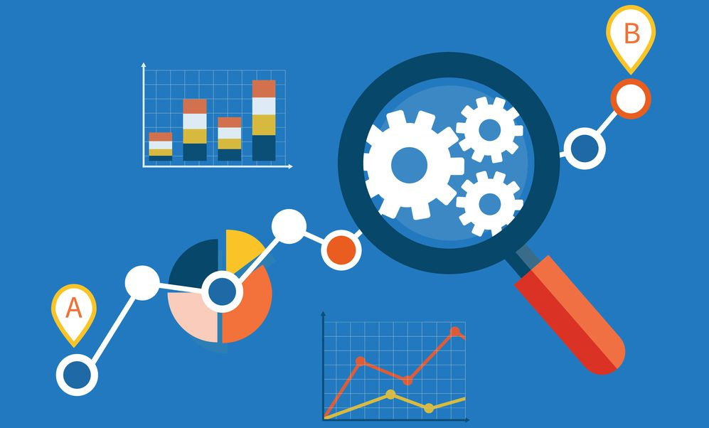
Analytical Part
This Photo by Unknown Author is licensed under CC BY-ND

Slide 20
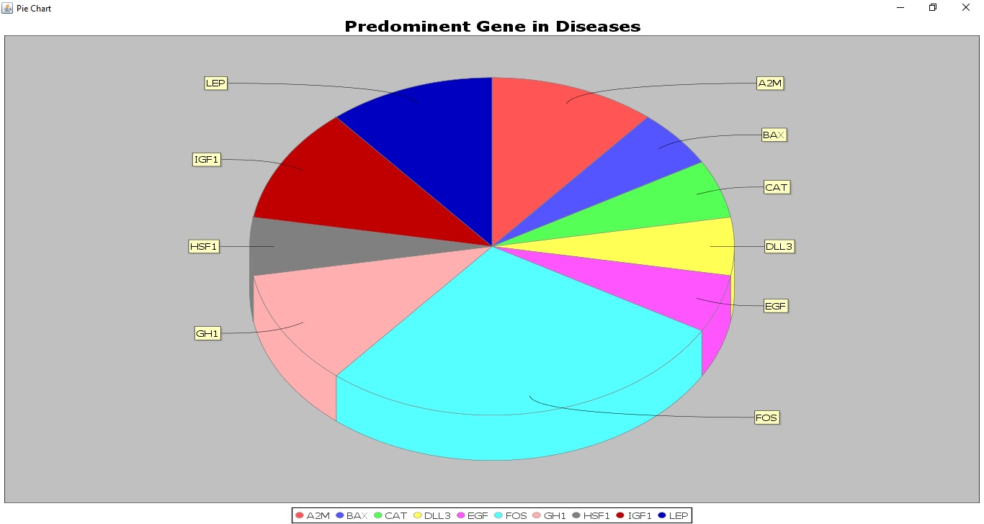

Slide 21
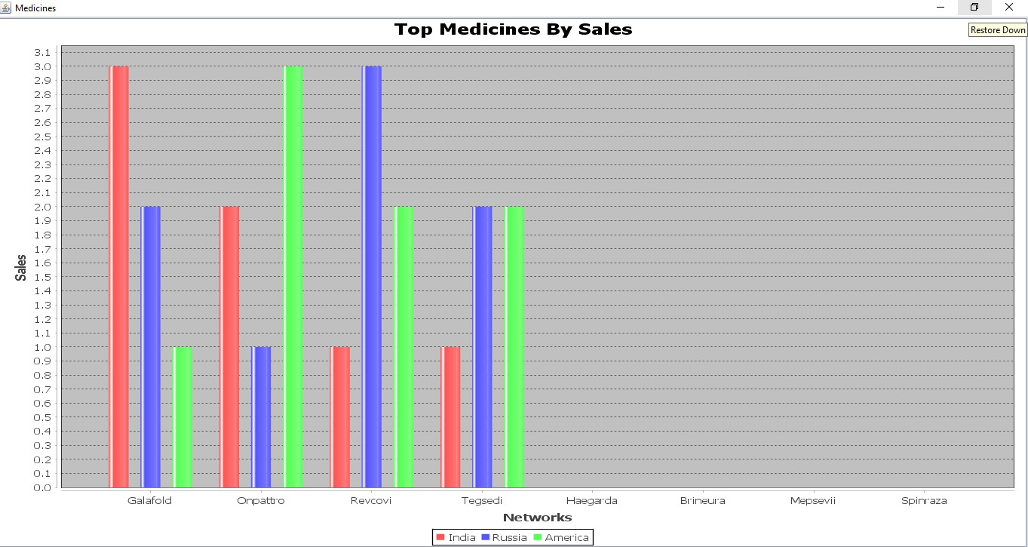

Slide 22
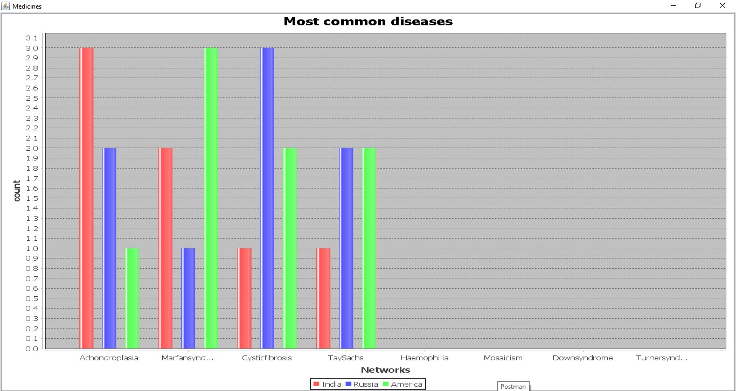

Slide 23
Possible Outcomes From the Model

Slide 24
We believe that adopting a common global data standard would benefit Global Health Network eco-system in further improvements of patient care.
Also, safer and cost effective healthcare services can be provided to millions of patients across the countries.
Keeping track of inventory across multiple enterprises helps in faster delivery of medicines to patients and helps the government to better prepare for an unforeseen epidemics.

Slide 25

Members
Name : Sumesh Harale NUID : 001069129
Name : Krishna Tejnaryan Singh NUID : 001028148
Name : Keshav Gupta NUID : 001378461

Slide 26


Thank You

