Slide 1
LEAD SCORE CASE STUDY

Slide 2
PROBLEM STATEMENT
An Education company named X Education, which sells online courses to industry professionals. The problem statement which was given to us was to determine lead scores which represent the conversion index for a particular lead whether given lead would become a potential customer.
On any given day, many professionals who are interested in the courses land on their website and browse for courses.
The company markets its courses on several websites and search engines like Google. Once these people land on the website, they might browse the courses or fill up a form for the course or watch some videos.

Slide 3
PROVIDED DATA
We have been provided with a leads dataset from the past with around 9000 data points. This dataset consists of various attributes such as Lead Source, Total Time Spent on Website, Total Visits, Last Activity, etc. which may or may not be useful in ultimately deciding whether a lead will be converted or not. The target variable, in this case, is the column ‘Converted’ which tells whether a past lead was converted or not wherein 1 means it was converted and 0 means it wasn’t converted.
The company has provided the data of previous conversions and non- conversions along with other parametric variables of each lead. using these variables we are building a logistic regression model.

Slide 4
GOAL
To Build a logistic regression model to assign a lead score between 0 and 100 to each of the leads which can be used by the company to target potential leads.
A higher score would mean that the lead is hot, i.e. is most likely to convert whereas a lower score would mean that the lead is cold and will mostly not get converted.

Slide 5
APPROACH
Importing Libraries
Data reading
Data cleaning
Dropping Columns
EDA
Creation of Dummy variables
Splitting data into train and test set
Model Building
Model Evaluation
Precision and Recall
Prediction on Test Data

Slide 6
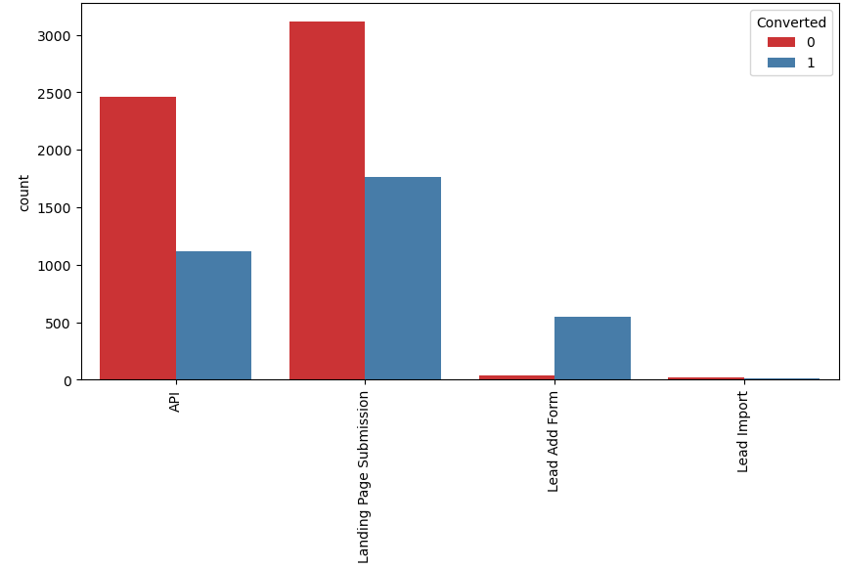
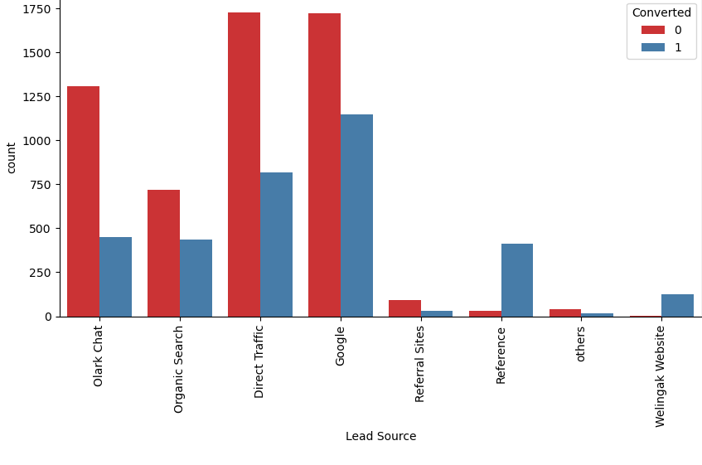
EDA ANALYSIS

Slide 7
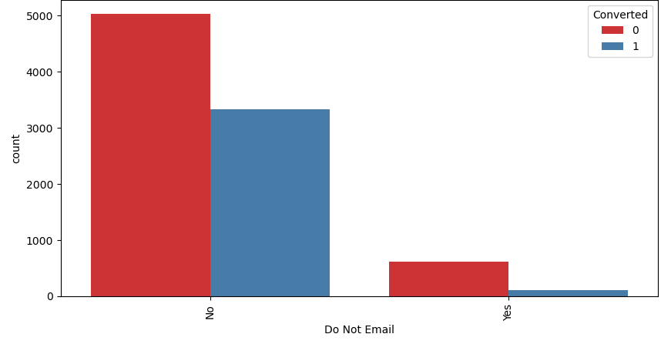
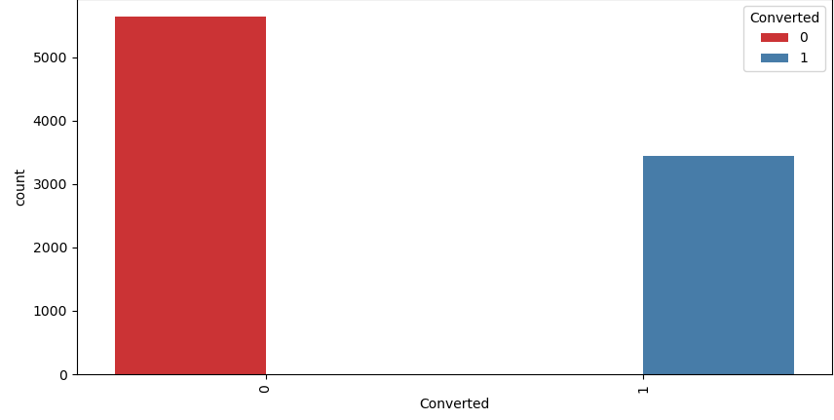

Slide 8
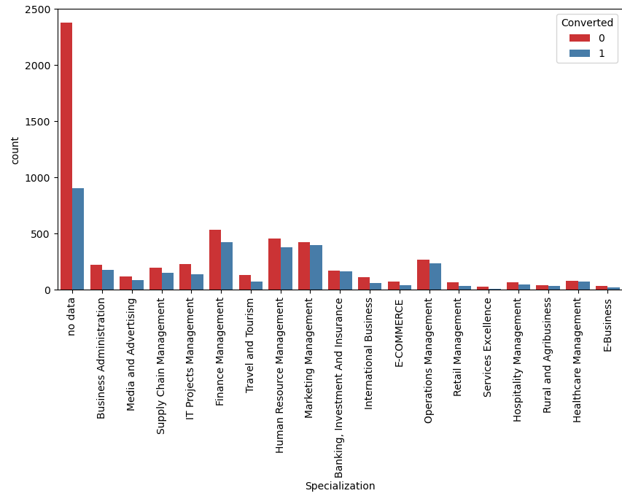
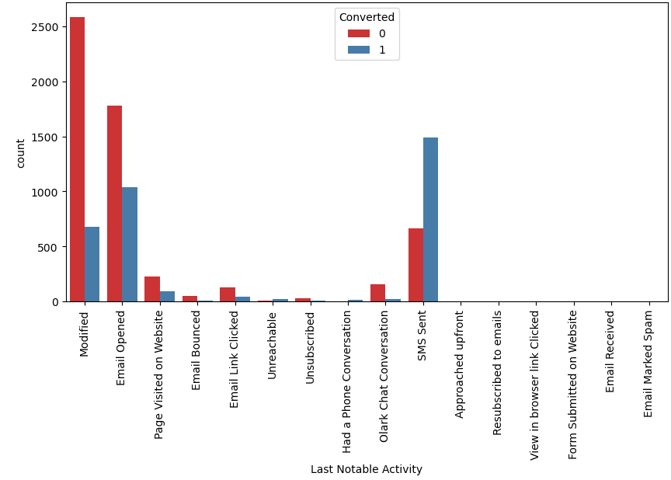

Slide 9
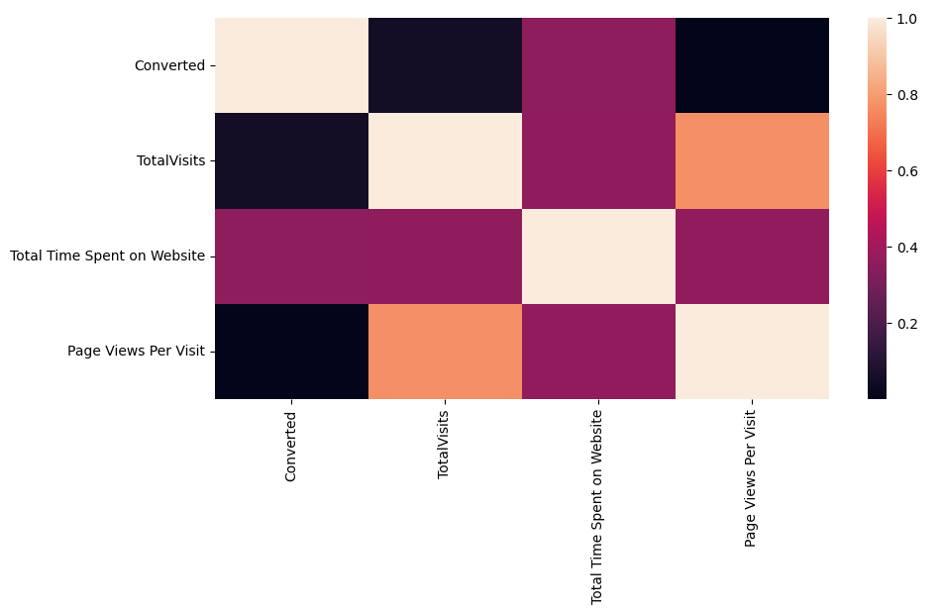
HEATMAP
Checking correlation between parameters.

Slide 10
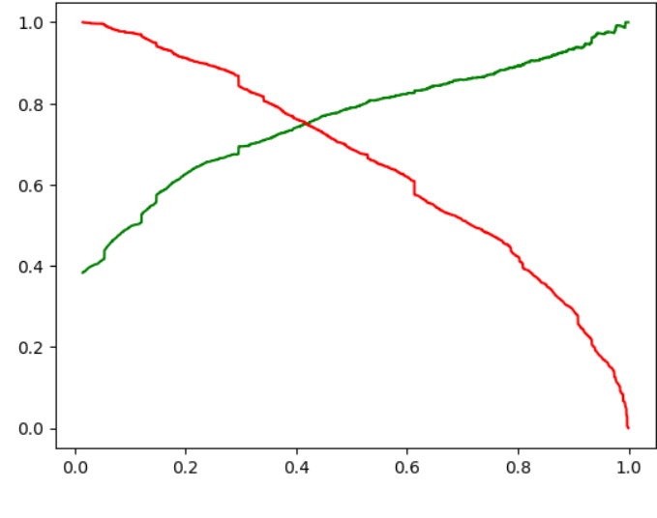
ROC CURVE
Trade-off curve between precision and recall

Slide 11
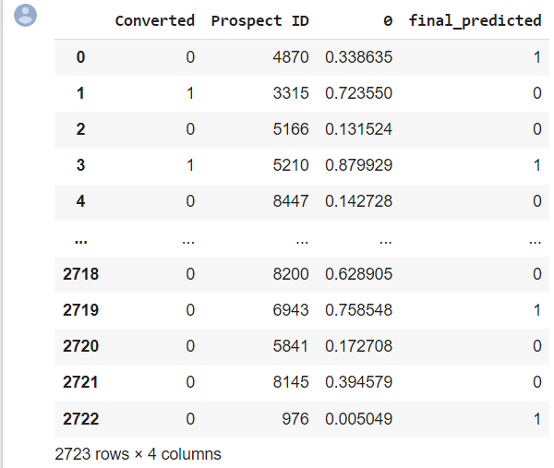
FINAL PREDICTION
Splitting the data into training and testing sets
Use RFE for feature selection
Prediction on test data set
Overall accuracy 51%

Slide 12
CONCLUSION
It was found that the variables that mattered the most in the potential buyers are (In descending order) :
The total time spend on the Website.
Total number of visits.
Logistic Regression:
The threshold has been selected from sensitivity, Accuracy, specificity, recall curves and precision
Sensitivity = 42%
Precision = 37%
Recall = 42%

