Slide 1
SECOND CURATORAI COMMENTS

Slide 2
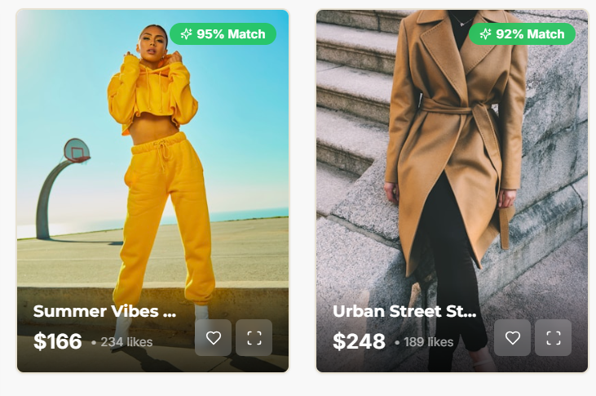
Comments
Having prices directly on the outfit cards makes the platform feel like an ecommerce store.
Even if we hide the store logos, the price tag pushes the user into a shopping mindset, not a styling mindset.
It breaks the “editorial, AI-personal stylist” experience we want.

Slide 3
We want users to feel like they’re browsing:
AI-curated outfits
Personalized looks
Editorial inspiration
Style guidance
A digital stylist feed
NOT a catalogue of products for sale.
So prices shouldn’t appear on the grid feed.
Why?
Because it:
Perverts the intention → becomes “choose what to buy”
Distracts from the outfit storytelling
Makes CuratorAI feel like SHEIN / Zara / Amazon / Jumia
Reduces engagement with our styling features (swap, why this was recommended, match %, etc.)
Shifts focus away from personalization
Confuses our brand positioning
Recommendation
Do NOT show prices on the outfit grid.
Instead, use:
Match %
Style title
Likes count
Short vibe tags (streetwear, minimal, classy, cozy, vacation, etc.)
Save/Favorite icon
Price appears only when:
User opens the outfit
Scrolls to “Items in the Outfit” breakdown
Clicks “View on Store” or “Add to Bag”
This preserves:
✔ Curation
✔ Editorial feel
✔ Premium stylist experience
✔ High engagement
✔ Clean, modern look
Final comments
❌ Remove prices from the main outfit grid.
✔ Show prices only inside the outfit page.
✔ Keep the home feed focused on aesthetic and personalization.
✔ Maintain CuratorAI's identity as a styling product, not a shopping app.

Slide 4
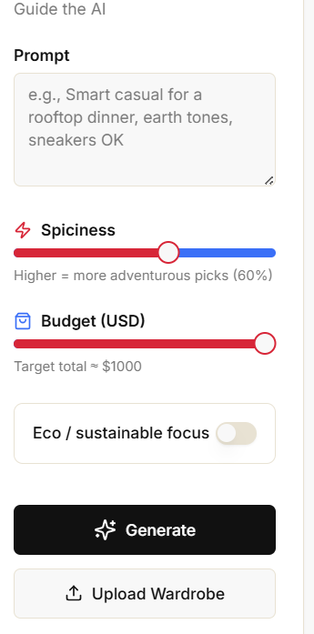
The Budget total ends in 1000 Dollars, can we think of
A bigger number or 1000+.
Lets think of an option that will expand the prompt box,
Can be like launching it full page if a user requires
(Not urgent)

Slide 5
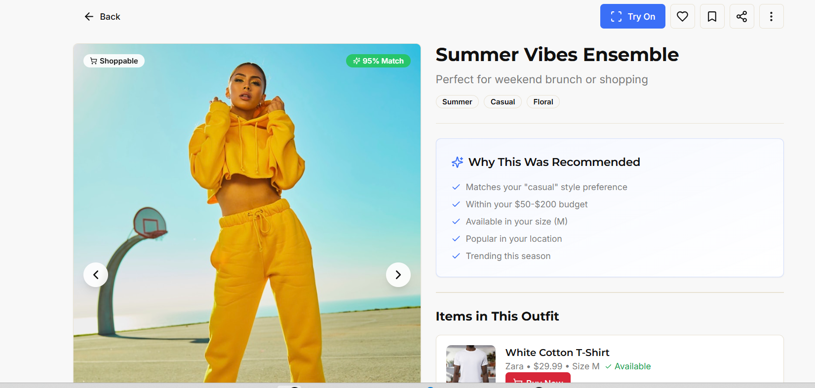
The share Button should be the same as the one in the feed but primary share should be in
The feed, if user is sharing on outside social media, should include watermark ( if no water
Mark required, user has to have premium subscription) – A free share number will be
decided later
Add download button (Maximum 3 per user in 24hours – More downloads will require
subscription)

Slide 6
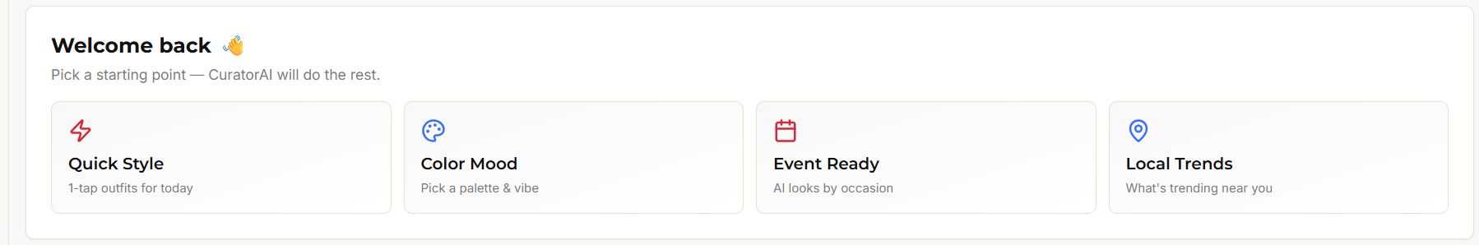
Create Clickable Directions for the above.

Slide 7
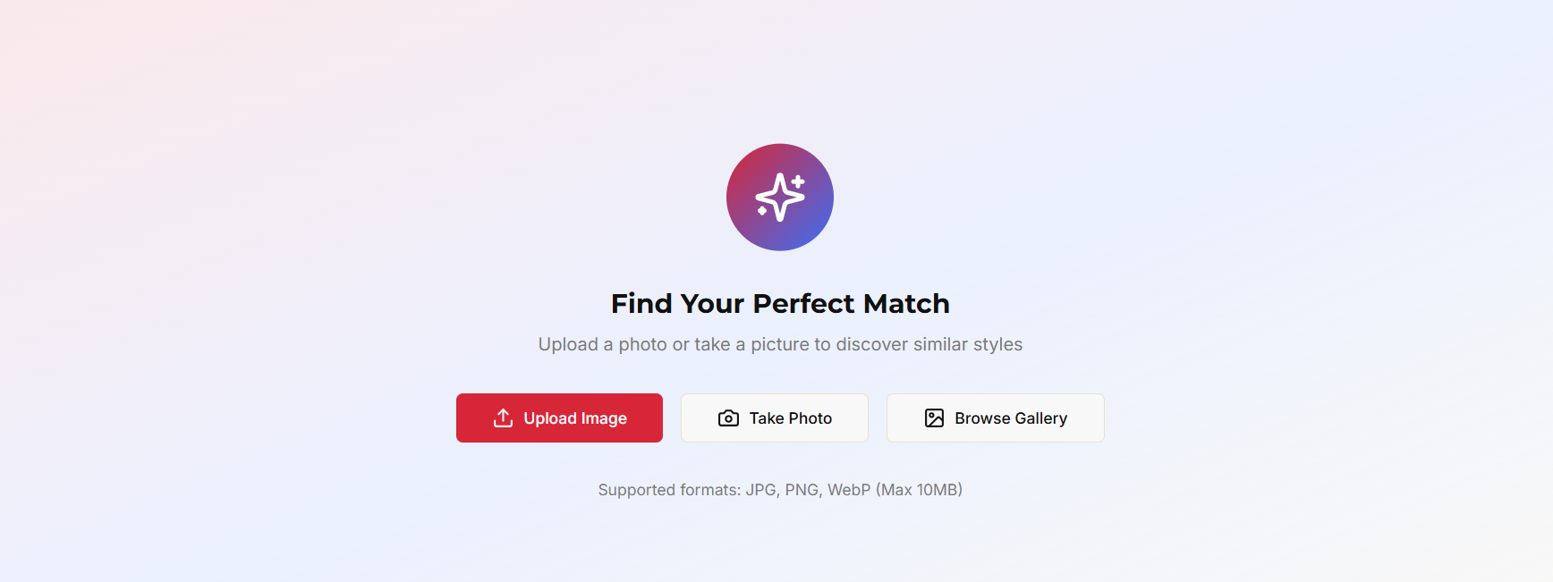
Include Mobile Options like – Google Drive

Slide 8
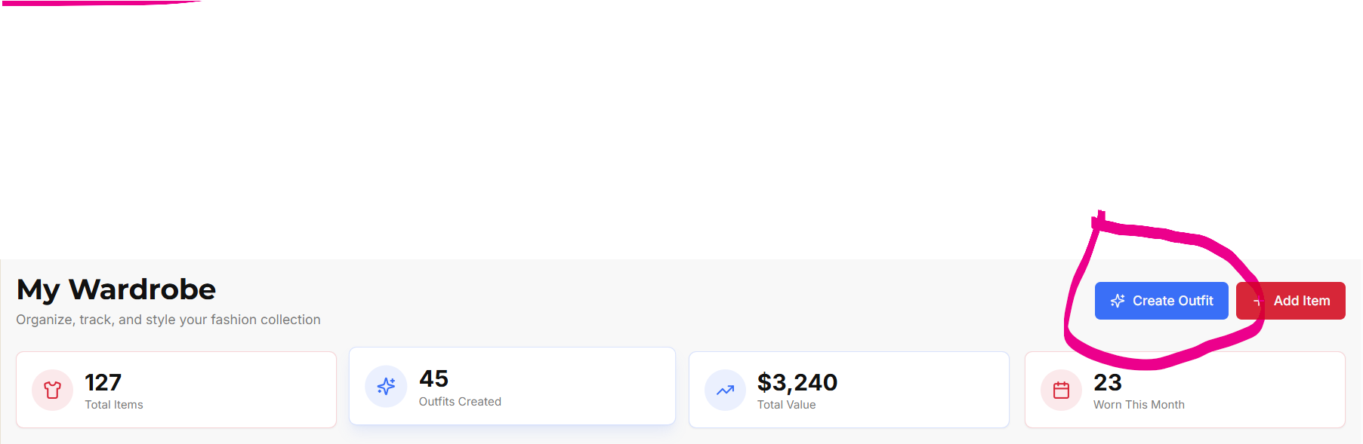
CREATE OUTFIT
⭐ The real question:
Should “Create Outfit” belong IN the wardrobe only
or
Should it be a GLOBAL primary action from anywhere?

Slide 9
Overview
The Create Outfit feature is a core part of CuratorAI’s styling experience. It should not function as a wardrobe-specific action only. Instead, it must be implemented as a global, persistent primary action available across the entire platform.
This ensures UX consistency, increases engagement, and aligns with our “Curation First — Ecommerce Second” philosophy.
⭐ Key Reasoning
1. Outfit Creation Is Not only a Wardrobe Tool
Users may create outfits using:
AI-generated items
Wardrobe items
Mixed items (AI + wardrobe)
Inspired feed looks
Therefore, “Create Outfit” cannot be tied to the wardrobe section.
It should be made a styling action, not a collection management action.

Slide 10
2. Users Must Be Able to Start Creating From Anywhere
Whether a user is on:
Home feed
Recommendation page
Outfit details
Wardrobe
Saved looks
They should always be able to start creating an outfit.
This mirrors UX patterns from:
Pinterest (“Create”) Instagram (“+”) Canva (“Create Design”)
3. Consistency Improves Engagement
Making “Create Outfit” global:
Increases usage frequency
Reduces navigation friction
Makes the platform feel more like a stylist workspace
Maintains feature visibility across flows
Wardrobe-only placement hides the feature and lowers adoption.

Slide 11
4. Helps Reinforce Brand Positioning
CuratorAI is a styling assistant, not a shopping platform or wardrobe app.
Placing “Create Outfit” globally reinforces:
Personalization
Creativity
Styling intelligence
AI-first experience
This aligns with CuratorAI’s identity.
Ensure Global Routing Works
No matter where the user is:
Clicking Create Outfit should open the outfit creation flow
The source page does not matter
Routing should work even if the user has no wardrobe items
Empty state fallback:
If wardrobe = empty → AI uses public dataset + mood inputs.
Final Summary
“Create Outfit” must be a global action, not only a wardrobe-local action.
Implement it as a floating primary action button available across all pages, with optional top-nav access. This aligns with CuratorAI’s core purpose and ensures users can initiate styling anytime.”

Slide 12
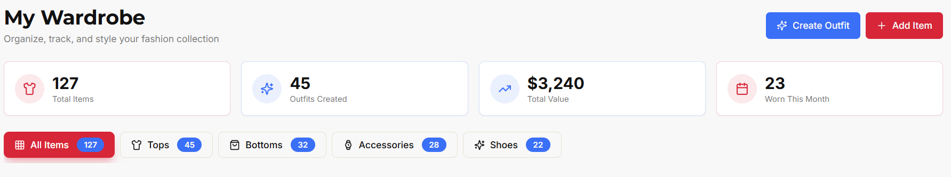
ADD ITEM
Lets define where a user can add wardrobe items from.

Slide 13
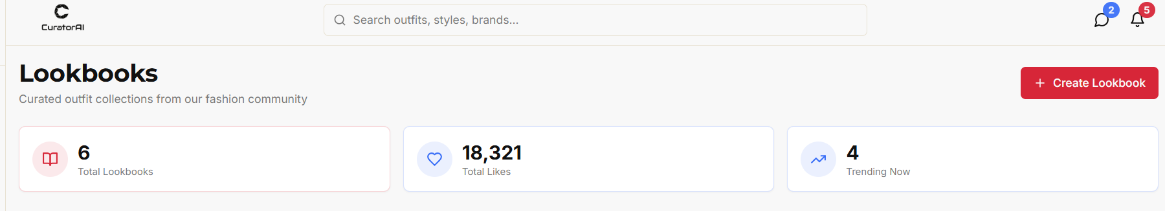
CREATE LOOKBOOK
Lets define how a user can create lookbooks and how the creation should look like

Slide 14
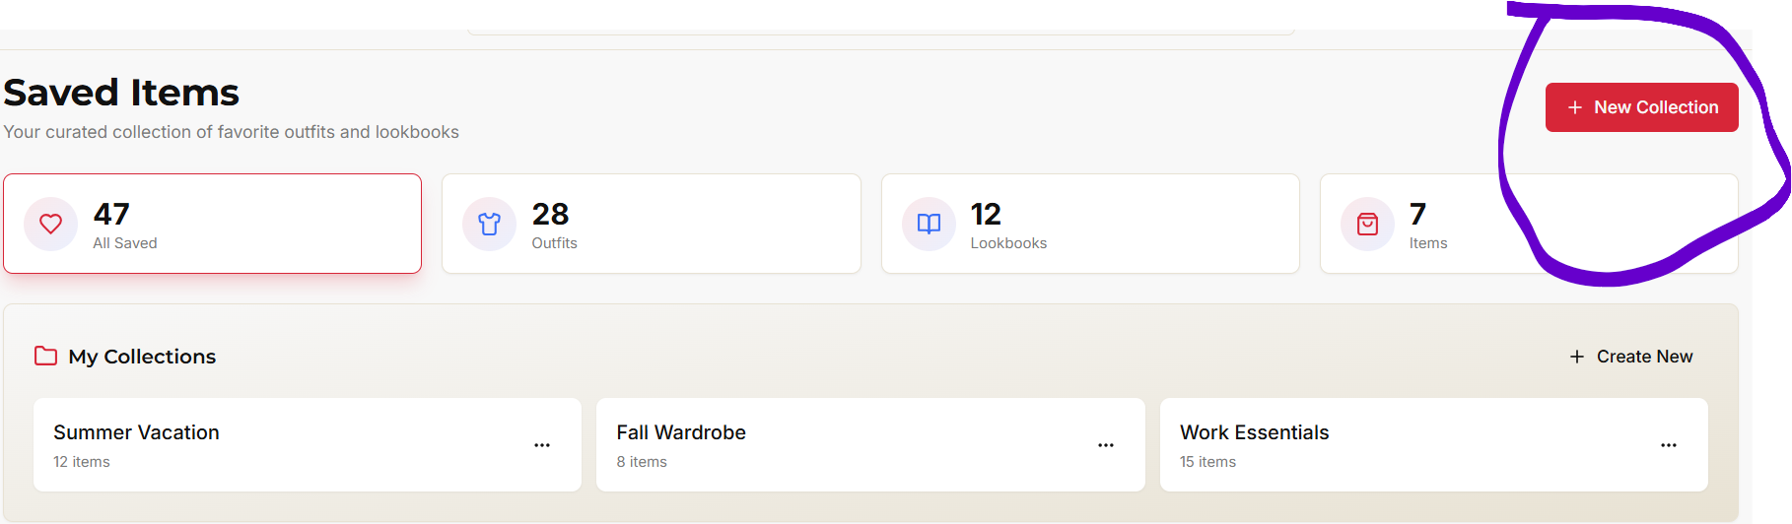
Lets Define the Circled

