Slide 1

Bubble War August 6th, 2015
Project Release Plan
Team: GoldMoon
Sumin Han - shan28@ucsc.edu / hsm6911@gmail.com (Product Owner, Developer)
Jaewook Woo - jwoo9@ucsc.edu / vbgb0926@gmail.com (Scrum Master, Designer)
Eojin Rho - erho@ucsc.edu / djwls9453@gmail.com (Developer)
Yihan Kim - yikim@ucsc.edu / kabi.kaist@gmail.com (Developer)
Taeyeon Kim - tkim41@ucsc.edu / kty5177@gmail.com (Director, Planner)

Slide 2
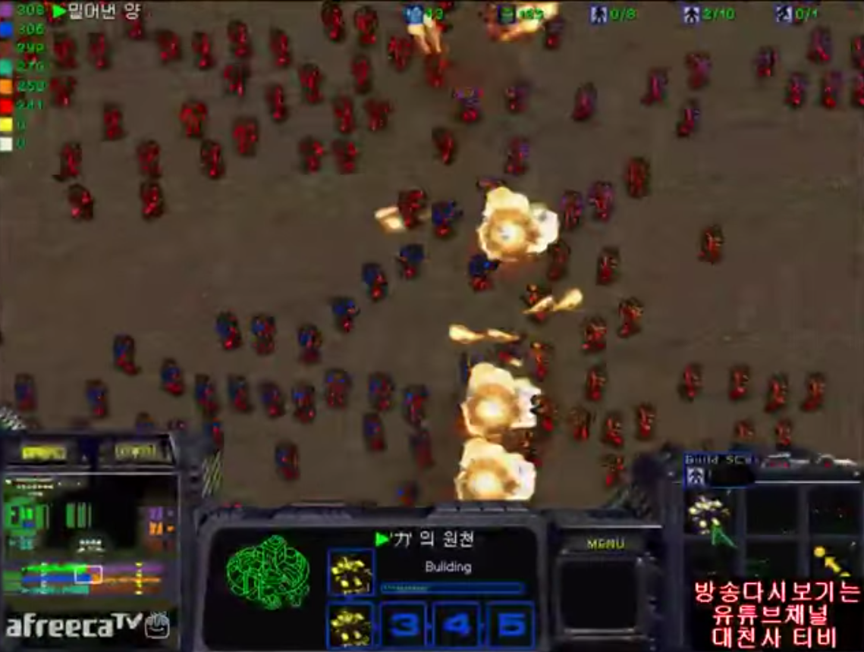
Bubble War
Project Release Plan
is a competition game played by two teams. Each team produces bubbles from each side by pressing space key to defeat each other. This is a realtime WebApp supported by Node.js and Socket.io.
← initial inspiration

Slide 3
GoldMoon/Bubble War
Project Release Plan – User Stories
Sprint 1. Complete design and basic functionality
As a player, I want to interact server with keyboard so that I can create bubble. (5 story points)
Implement bubble creation using keyboard keys (5 hours)
Design bubble and player UI (10 hours)
Server can receive keyboard pressed by player. (20 hours)
As a system, I want to make collision system so that bubble can destroy the bubble, and player can win the game. (3 story points)
When game object collide system awares it. (5 hours)
Design poping motion of bubble (2 hours)

Slide 4
GoldMoon/Bubble War
Project Release Plan – User Stories
Sprint 1. Complete design and basic functionality (Cont’d)
As a system, I want to connected with server so that player can match with other player. (5 story points)
System can be connected to server (3 hours)
Server can connect two players (20 hours)
As a team member, I want to learn the proper technologies so that I can develop my project. (2 story points)
Learn about programming languages such as Javasript (10 hours)
Learn about technologies for programming (10 hours)

Slide 5
GoldMoon/Bubble War
Project Release Plan – User Stories
Sprint 2. Improve function and stabilize the system
As a system, I want to make pressure system so that bubble can withstand certain amount of pressure. (5 story points)
New design of bubble after collision (3 hours)
Physics about how each bubbles withstand the pressure. (5 hours)
New collision system after bubble size has been changed. (10 hours)

Slide 6
GoldMoon/Bubble War
Project Release Plan – User Stories
Sprint 2. Improve function and stabilize system (Cont’d)
As a player, I want to use some items so that I can make situation go into reverse. (5 story points)
a. Make time system so that player can use item after surtain amount of time
(10 hours)
b. Make bubble destory count so that player can use item after surtain amount of
bubble destory count (5 hours)
c. Item design (10 hours)
As a player, I want to make a waiting room in game so that we can play many-to-many bubble war. (8 story points)
Set up database for waiting room (20 hours)
Design UI for waiting room (10 hours)
Program waiting room features for player (5 hours)

Slide 7
Project Release Plan – Architecture
Client 1 from team 1
Client 2 from team 2
Client 3 from team 1
Main
Server
Client 4 from team 2
DB
(if need)

Slide 8
Bubble War
Project Release Plan – Challenges/Risks
Challenge/Risk 1: Building basic server.
Challenge/Risk 2: Motion of bubble and mechanics.
Challenge/Risk 3: Linkage between key board and creation of bubble.
Challenge/Risk 4: Managing user connection to server.

Slide 9
Bubble War
Project Release Plan – Technologies
Technology 1 JavaScript
Technology 2 Node.js
Technology 3 Socket.io
Technology 4 Jquery
Technology 5 CSS

