Slide 1
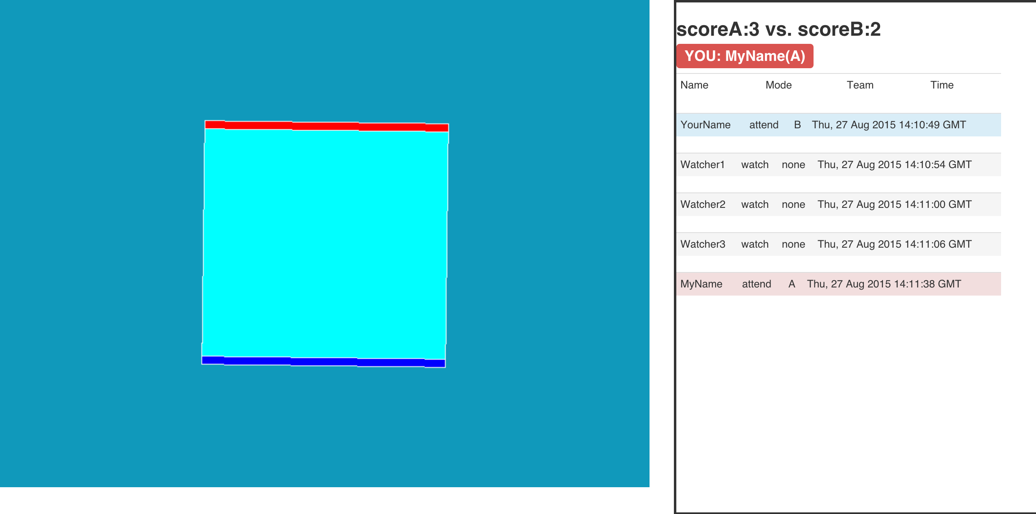
Bubblewar
Sumin Han (Product Owner)
Jaewook Woo (Scrum Master of Sprint 1)
Eojin Rho (Scrum Master of Sprint 2)
Taeyeon Kim
Yihan Kim
27 Aug 2015
Team Goldmoon

Slide 2
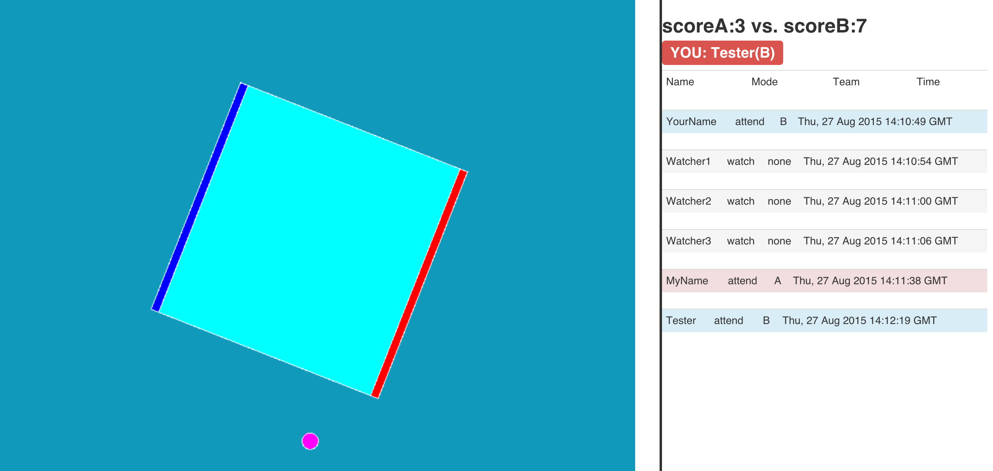
Goals
Each team produces bubbles from each side by pressing space key to defeat each other.

Slide 3
Challenges
Sprint 1
Sprint 2
It was difficult to build the basic server by nodeJS & Socket.io
Motion of bubble and mechanics – PhysicsJS has a limitation to express bubble mechanics and collisions.
Get used to technologies.
There is time gap between two clients on same server.
Designing user interface & considering user conveni-ence.

Slide 4
Accomplishments
Sprint 1
Sprint 2
We Built the basic server by nodeJS & Socket.io
We solved the problem of bubble mechanics by Mathematical algorithms.
We learned the new technologies like Jquery, HTML/CSS and Javascript.
We synchronized two clients using Pixi.js.
//Designing user interface & considering user convenience.

Slide 5






Technologies
HTML+CSS+JS
PhysicsJS, Socket.IO
Jquery
Pixi, TweenLite

Slide 6
System architecture
Server
User data
(mode, name, time)
Client
Physics.js
keypress
Pixi.js (Renderer)
ball-list (bodies)
behavior: collision, …
Circle : x, y, r
Rectangle : x, y, w, h
World
sync, signal
User data
(mode, name, time)
TweenLite.js
(smooth movement generator)
Socket.IO
Socket.io
Json
{‘rectangle’:
x:100,
y:200,
r:50}
setInterval
emit

Slide 7
Project management techniques
Development techniques : Scrum
Programming techniques : Pair programming
Code management: GitHub
Development environment: Sublime text 2, Vim

Slide 8
Showcase

Slide 9
Conclusion
Enjoyed
First experience to working as a team
Reflect everyone’s opinion using Scrum
Didn’t enjoyed
Time limited with doing homework together
Lessons learned
Synchronization processing
New technologies
We need more development experience

Slide 10
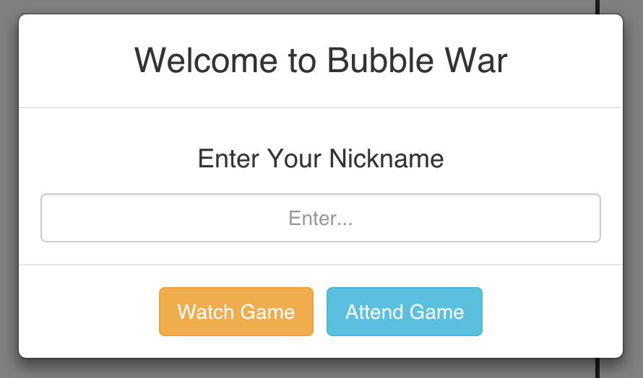
Thanks.
Goldmoon – Bubblewar
https://github.com/goldmoonkaist/bubblewar

