Slide 1
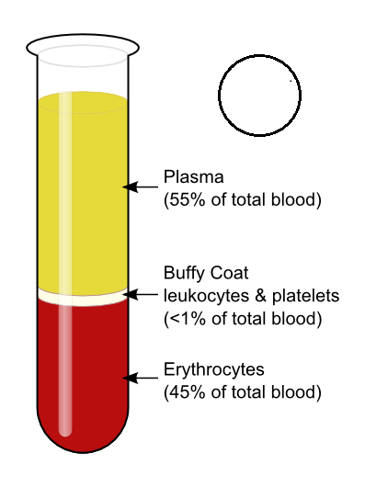

Slide 2
Group A
has only the A antigen on red cells (and B antibody in the plasma)
B
A

Slide 3
Group B
has only the B antigen on red cells (and A antibody in the plasma)
A
B

Slide 4
Group AB
has both A and B antigens on red cells (but neither A nor B antibody in the plasma)
B
A

Slide 5
Group O
has neither A nor B antigens on red cells (but both A and B antibody are in the plasma)
A
B

