Slide 1
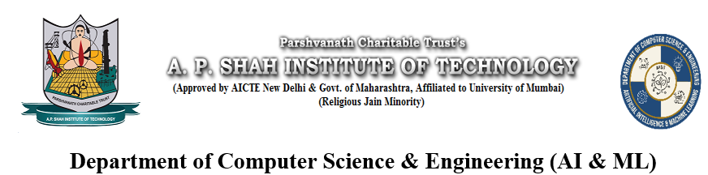
Code Converter using NLP
Group members with Student Id
23106036 - Sumit Thakur
23106120 - Tejas Thorat
23106037 - Mayank Tiwari
23106083 - Reva G. Tol
Project Guide
Ms. Vijaya Bharti
Academic year 2024-25

Slide 2
Introduction
Code Converter Using NLP is a web-based tool that converts C code to Python automatically.
Motivation Behind the Project
Manual code translation between programming languages is often labor-intensive and susceptible to human error.
C and Python differ significantly in syntax, structure, and programming paradigms, making direct translation complex.
There is a growing demand for tools that support cross-language development, particularly in educational and software migration contexts.
Existing rule-based translation tools are limited in flexibility and often fail to preserve semantic accuracy.
Our NLP-based approach solves these issues by:
Manual code conversion is time-consuming
Understanding semantics and context
Understanding semantics and context

Slide 3
Literature Survey:
Initially, models like BERT and GPT were adapted for code but struggled with semantics and syntax due to their design for natural language.
CodeBERT and PLBART improved on earlier models by training specifically on source code and natural language pairs.
However, CodeBERT couldn't perform generative tasks due to its encoder-only architecture, and PLBART had issues with identifying meaningful code tokens.
CodeT5 introduced a transformer-based encoder-decoder architecture with objectives like:Masked Identifier PredictionMasked Span PredictionIdentifier Tagging Need for Custom Fine-TuningEven though CodeT5 was pretrained on large code datasets, it lacked direct understanding of C-to-Python mappings.
Your team fine-tuned the model using a custom dataset of aligned C and Python code pairs, starting from basic syntax to full functions.

Slide 4
Problem statement
Converting code from C to Python manually is slow, error-prone, and requires deep expertise.
Structural and syntactic differences between the languages create confusion, especially for beginners.
Existing tools fail to understand the context of code, leading to inaccurate and unreliable conversions.

Slide 5
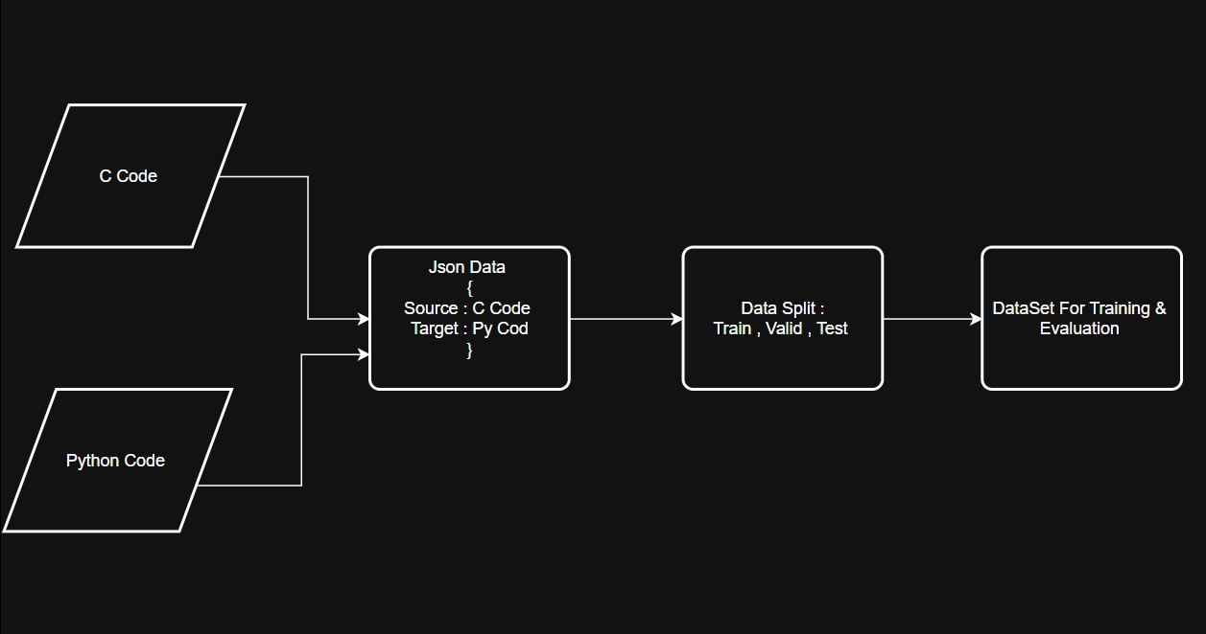
Overview of System Design
(Dataset Creation)
Dataset Creation PipelineC and Python code pairs are collected as raw input.
Data is structured in JSON format with "source" as C code and "target" as Python code.
The dataset is split into Train, Validation, and Test sets to support model training and evaluation.
Final dataset is prepared and formatted for training and evaluation tasks.

Slide 6
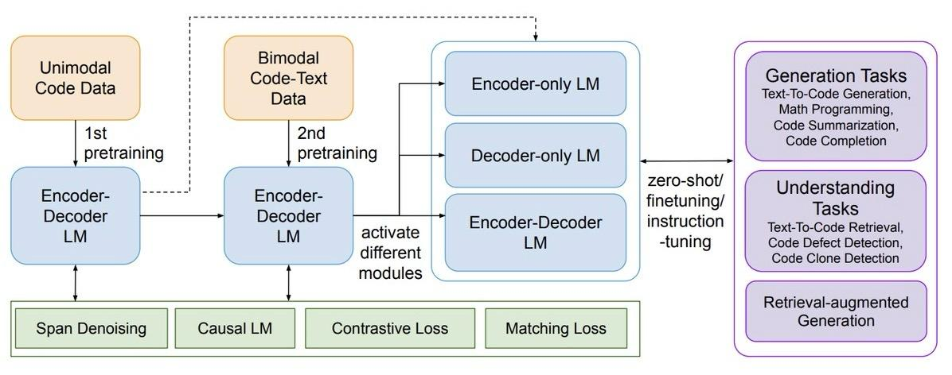
Overview of System Design
(CodT5 Architecture)
Source: https://www.marktechpost.com

Slide 7
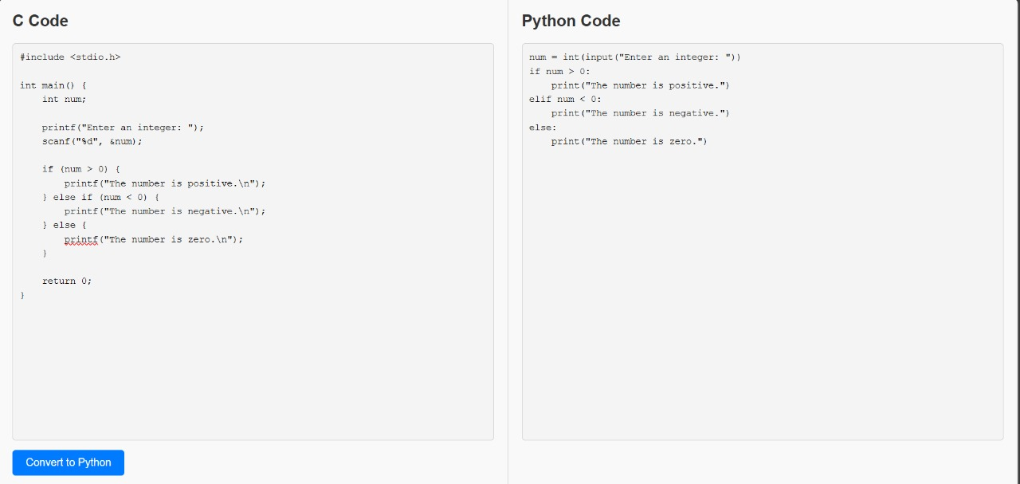
Implementation

Slide 8
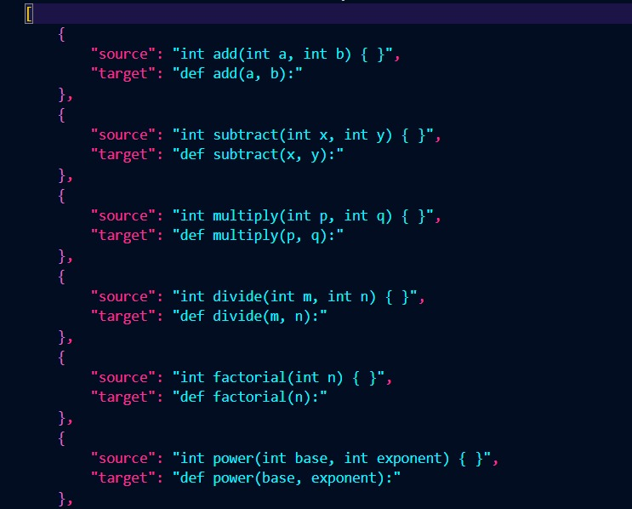
Dataset sample

Slide 9
Technology Stack
Frontend:
HTML: Used for structuring the web pages.
CSS: Used for styling the web pages.
Backend:
Flask: A lightweight WSGI web application framework in Python.
Other Tools:
Pre-trained Model: Utilized for code conversion.

Slide 10
Conclusion
Our NLP-based Code Converter offers an innovative solution for developers, students, and businesses looking to migrate C programs to Python efficiently. By leveraging machine learning and NLP, we ensure accurate, context-aware, and scalable code translation. This project represents a step towards intelligent automation in programming.

Slide 11
Thank You...!!

