Slide 1
0x18000ab90
push rbx
sub rsp, 0x20
loc_abbc
loc_abc4
add rax, 2
test ecx, ecx
test edx, edx
je 0x...abff
AI ASSEMBLY EXPLAINER
An evidence-grounded reverse-engineering assistant for Windows DLLs
The disassembler supplies the facts · the model only explains them · every claim is validated
Project Work — Reverse Engineering
Sumit · special.projects@rru.ac.in · Oct 2026
Notes:
Title. Pitch: I built a tool that explains real disassembled Windows DLLs in plain English, grounded on a real disassembler so it can't make up facts. Replace [Your Name] and add the repo link on the last slide.

Slide 2
WHY I BUILT THIS
From Ghidra, IDA Free & ILSpy — to an explainer
G
Ghidra
I
IDA Free
I
ILSpy
NSA's free decompiler. Superb pseudo-C and CFGs — but reading them still demands fluent assembly.
The gold-standard graph view and the green/red/blue edge convention I learned RE on.
Turns a .NET DLL straight into C# — the 'just explain it to me' feel I wanted for native code too.
The gap
All three show you the code. None explain what it does in plain English, fully offline, with guardrails against making things up. So I built a pipeline where a real disassembler produces the facts and a local LLM only narrates them — and a validator catches it when it names something that isn't in the bytes.
Notes:
Motivation. I genuinely used Ghidra, IDA Free and ILSpy. They're powerful but assume you can read assembly. ILSpy's instant C# for .NET is the experience I wanted for native DLLs. The gap: none explain intent in plain English, offline, with anti-hallucination guards.

Slide 3
PROBLEM & SCOPE
What it analyses — and the one rule
In scope
Out of scope
Native x86 / x64 Windows DLLs (PE)
Static .lib archives and Linux .so (ELF)
.NET DLLs → ILSpy-style C# branch
Your own, open-source, or licensed binaries
Packed / obfuscated (VMProtect, Themida)
— UPX can be unpacked first (upx -d)
Running the binary — analysis is read-only
Guessing facts the tools didn't observe
GOAL
Explain any supported DLL in plain English, 100% offline, where the model may never state a fact the disassembler did not produce.
Notes:
Scope keeps it a realistic student project. The hard rule — the model never invents facts — is what the whole architecture is built to enforce.

Slide 4
CORE PRINCIPLE
Never let the LLM disassemble
Stages 1–4 are ordinary, deterministic code — always correct. Only stage 5 uses the model, and stage 6 catches it when it names something not in the assembly.
1 Parse
2 Disassemble
3 Decompile
4 Build context
5 Explain
6 Validate
LIEF / pefile
radare2 · Capstone
r2ghidra pseudo-C
calls · strings · C
Qwen2.5-Coder
name + JSON check
Deterministic — cannot hallucinate
The model — explains only
Validator — rejects invented facts
Trust boundary: everything true about the binary is produced before the model speaks. The LLM reasons over those facts and is checked afterwards — it is the one component that is never trusted on its own.
Notes:
The single most important design decision. A 7B model cannot reliably turn bytes into instructions, so it never tries. It only explains facts the disassembler already produced, and the validator checks every claim.

Slide 5
SYSTEM ARCHITECTURE · PART 1
The explain pipeline
1 · Input
2 · Parse
3 · Disassemble
4 · Context
DLL / LIB / .so
x86 / x64 native
arch, exports,
imports, strings
functions, blocks,
CFG, pseudo-C
per block: asm +
calls, strings, C
7 · Graph + report
6 · Validate
5 · Explain
SVG · interactive
HTML · Markdown
names checked vs asm
re-ask on mismatch
Qwen2.5-Coder 7B
strict JSON output
optional: a Qwen2.5-VL screenshot path can feed the same output
Caching: explanations are keyed by basic-block hash in SQLite — re-runs are instant, and a block explained once is never re-billed to the model.
Notes:
The Part 1 fixed pipeline. Bottom-up: explain every block, then each function from its block notes, then a whole-DLL overview. The dashed screenshot path (Qwen-VL) is an optional experiment.

Slide 6
BUILT ON PRIOR ART
Standing on Ghidra, IDA, ILSpy & REA
Ghidra
Decompiler & CFG recovery
Its decompiler (via the r2ghidra plugin) gives the model pseudo-C context; its basic-block model shapes my extraction.
IDA Free
Graph view & edge colours
I emulate its function graph and the green=taken / red=fall-through / blue=unconditional edge convention.
ILSpy
.NET decompilation
The managed-code branch: a CLR header routes the DLL to ILSpy-style C# instead of the native pipeline.
REA
Agentic, evidence-first RE
Reverse Engineering Assistant's pattern: the LLM plans which tool to call, tools observe, and every claim carries evidence.
Notes:
Credit where due. I didn't reinvent disassembly — I reuse Ghidra/radare2 for facts, borrow IDA's graph UX, route .NET to ILSpy, and take the agent-with-evidence pattern from REA. My contribution is wiring these into an offline, validated, plain-English explainer.

Slide 7
TECH STACK
Everything free, offline, Python 3.11+
Binary parsing
pefile / LIEF
Arch, exports, imports, sections, entropy, .NET detection
Disassembly (Windows)
Capstone
Pure-Python x86/x64 — real CFG recovery with no WSL
Disassembly + decompile
radare2 + r2ghidra
Functions, CFG, xrefs and pseudo-C on the Linux VM
LLM runtime
Ollama + Qwen2.5-Coder 7B
Local, offline model that only explains the facts
Graphs
Graphviz + Cytoscape.js
Static SVG and an interactive clickable CFG
Cache / evidence
SQLite
Block-hash cache + the agent's tamper-evident evidence log
Interfaces
Tkinter GUI · MCP server
DLL browser + graph view; same tools for Claude Code
Notes:
Whole stack is free and runs offline. The headline addition over the plan: Capstone, so the disassembly and graph work on plain Windows — radare2/Ghidra stay the richer backend on the VM.

Slide 8
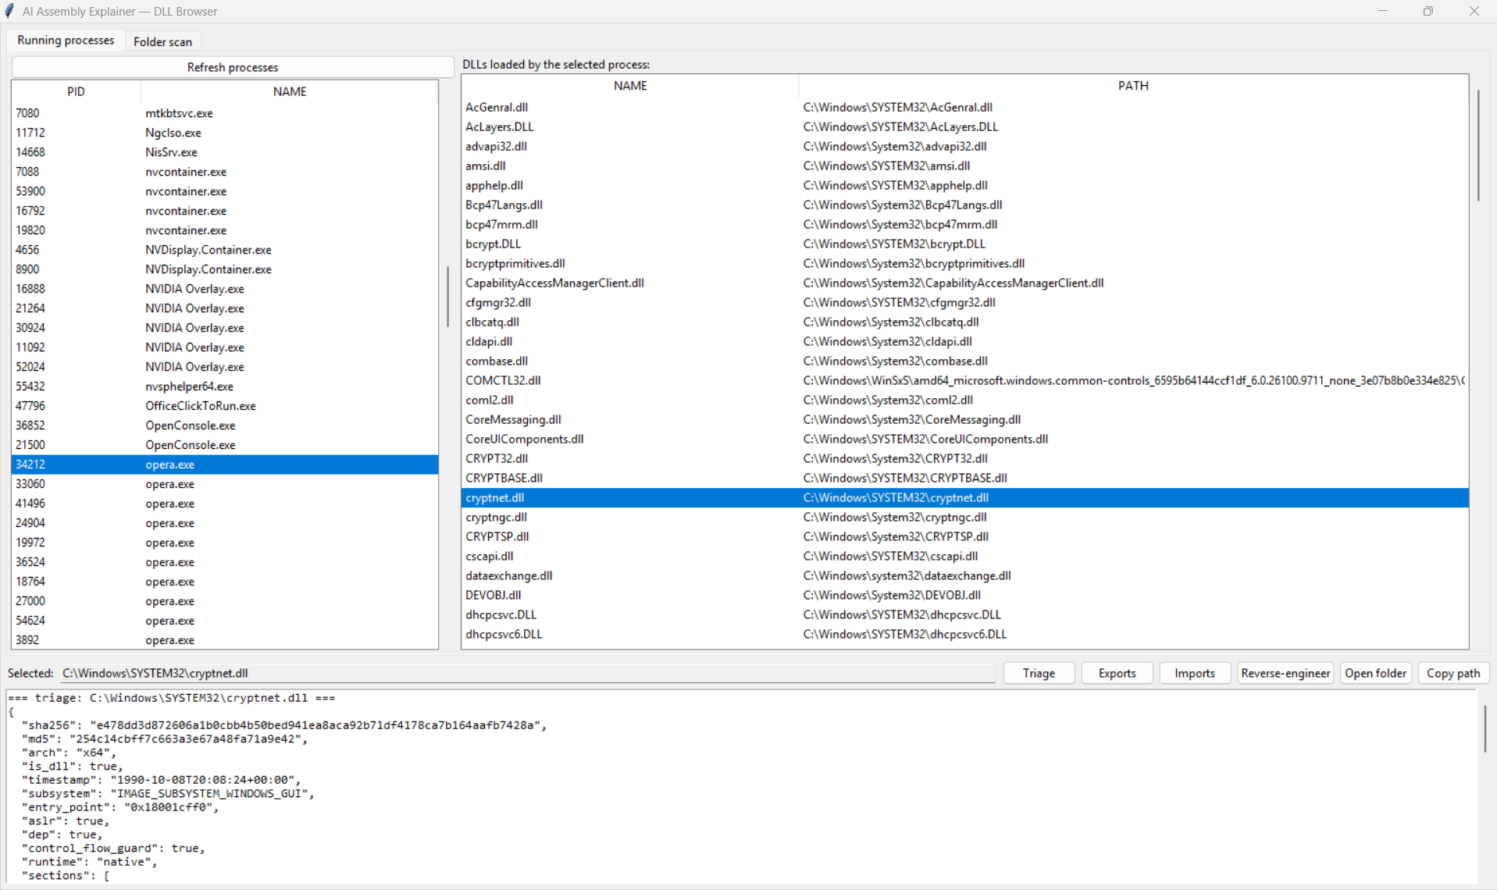
THE TOOL · 1
DLL browser — no more hunting for paths
Running processes
Folder scan
One-click analysis
Enumerated via ctypes
Notes:
Demo 1. The process/DLL browser solves the real annoyance: finding the DLL. ToolHelp32 via ctypes lists loaded modules with paths. Shown: live triage of cryptnet.dll — arch, hashes, ASLR/DEP/CFG.

Slide 9
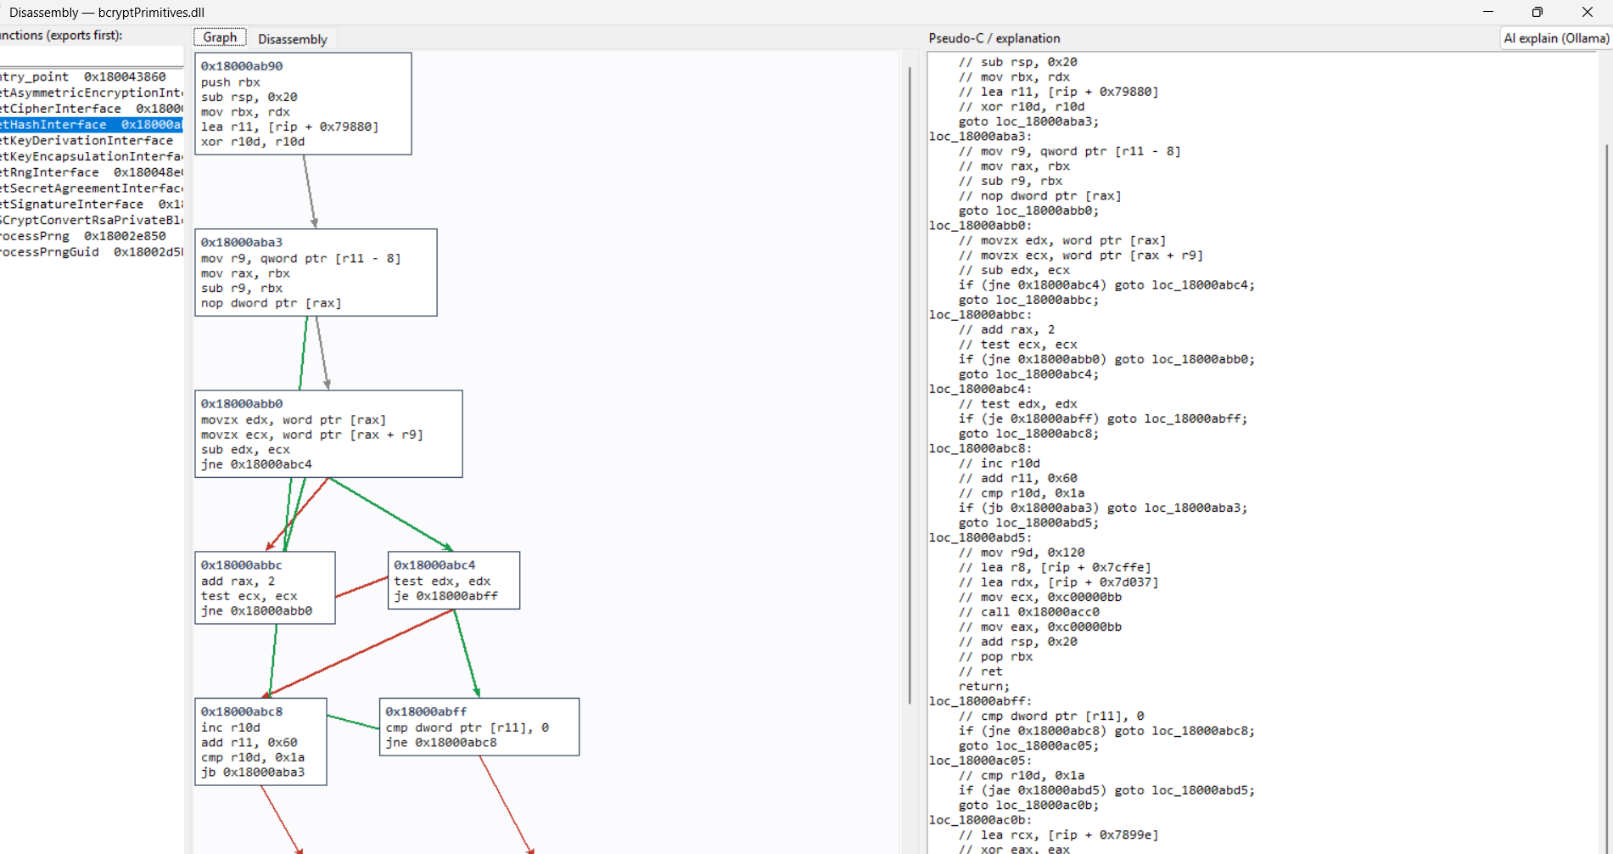
THE TOOL · 2 — HEADLINE FEATURE
IDA-style graph view, on Windows, no WSL
Control-flow graph
IDA edge colours
Pseudo-C panel
Proven on bcryptPrimitives.dll &
cryptnet.dll — 132 blocks / 215
edges recovered, all four edge
types, prologue correct.
Notes:
Demo 2, the headline. Real recursive-descent CFG recovery with Capstone — runs on plain Windows, no WSL. Screenshot is bcryptPrimitives.dll. Honest line: full C decompilation is Ghidra/Hex-Rays; I show the true branch skeleton and the LLM supplies intent.

Slide 10
TRUST THE OUTPUT
Hallucination control: the validator
A 7B model explains well with rich context and a strict format — and invents things without. Five guards keep it honest:
Name check
JSON check
1
Every API the model names must appear in the block's asm or imports — else re-ask once, then mark 'unverified'.
2
Output must parse to the fixed schema; Ollama's format=json makes failures rare, rejected ones retry.
Low temperature
Few-shot examples
Guarantee
3
0.1 keeps explanations stable and repeatable between runs.
4
2–3 hand-written examples from my own test DLLs noticeably lift small-model quality.
The model may never state an API, constant or address that the tools did not observe. If it does, the claim is downgraded — never shown as fact.
Chunking
5
Large functions are explained block-by-block, so nothing falls outside the context window.
Notes:
This is what makes the output trustworthy. The name check is pure Python and unit-tested. Emphasise: an invented API is caught automatically and flagged, not presented as truth.

Slide 11
SYSTEM ARCHITECTURE · PART 2
REA-style agent over an MCP server
Ask a question; the model picks which analysis tool to call next, reads the result, and loops until it can answer with evidence.
Your question
Agent loop
MCP server
"Does it touch the network? Where?"
Qwen picks the next
tool · max 15 steps
11 read-only tools
(also for Claude Code)
Report
Evidence log
4 backends
observed · inferred ·
unknown + graphs
every call → E1, E2…
in SQLite
pefile · radare2
capa/FLOSS · dnfile
Same tools, two front-ends: my local Qwen agent for the offline demo, and Claude Code over MCP as a strong-model upper-bound reference.
Notes:
Part 2 turns the fixed pipeline into an agent, exactly the REA idea. The model plans; the tools observe; the evidence log records every call. The same MCP server can be driven by Claude Code to measure how far the local model is from a frontier model.

Slide 12
WHAT SEPARATES IT FROM A CHATBOT
Every statement carries a label
OBSERVED
INFERRED
UNKNOWN
Read directly from the binary by a tool.
The model's reading of observed facts.
Asked but not answerable statically.
"imports RegSetValueExW [E3]"
"likely writes a config value [E3,E7]"
"which registry hive at runtime"
Validator
Before the report is written, every cited E-id must exist and every API/address in an 'observed' line must appear in that evidence. Statements that fail are downgraded to 'inferred' or dropped.
Notes:
The evidence model is the spine. Observed/inferred/unknown with citations, and a validator that mechanically downgrades any 'observed' claim it can't back up. This is unit-tested and runs with no backend.

Slide 13
HOW I MEASURE IT
Evaluation on DLLs I compiled myself
When you compile the test DLLs, the C source is the answer key for every explanation — so accuracy is gradable.
Metrics
Experiments
Purpose accuracy (1–5 vs source)
Name-check pass rate
Function-name guess on stripped DLLs
Evidence validity & false 'observed' rate
Tool calls and seconds per question
Qwen 7B vs 14B as planner
With vs without pseudo-C in the prompt
-O0 vs -O2 (optimised is harder)
Text input vs screenshot (Qwen-VL)
Local model vs Claude Code over MCP
Test set
~15–20 C functions (array sum, string ops, XOR cipher, checksum, state machine, recursion, a registry-writing WinAPI call) × 4 builds each: -O0 / -O2 × with / without symbols.
Notes:
Rigorous eval because I own the ground truth. Four variants per function stress the model on optimisation and stripping. The results table from the four experiments is the strongest part of the written report.

Slide 14
WHERE IT STANDS TODAY
Working now
132 / 215
11
100%
blocks / edges recovered on cryptnet.dll (Capstone)
read-only MCP analysis tools, shared by both front-ends
offline — no data leaves the machine
Shipped components
Static triage, exports & imports — tested on Windows
Windows-native CFG graph view (Capstone) — no WSL
Process / DLL browser GUI with one-click analysis
Evidence log, labels & report validator — unit-tested
MCP server + local Qwen agent loop — wired end to end
Notes:
Concrete results. The 132/215 number is a real run against a Windows system DLL. Everything in the static + native-graph + evidence path works today; the radare2/Ollama-heavy stages run on the VM.

Slide 15
HONESTY
Limitations & ethics
Optimised code is hard
Scale
Small models still slip on -O2; the name check catches invented APIs, not every wrong explanation.
Large DLLs have thousands of functions — explain exports first, cache everything, let the user pick the rest.
Not a decompiler
Packed binaries
The C panel is a CFG skeleton + LLM intent, not Ghidra/Hex-Rays output.
VMProtect / Themida are out of scope by design.
ETHICS
Analyse only DLLs you compiled yourself, open-source libraries, or software whose licence permits reverse engineering — many commercial EULAs forbid it. The tool is strictly read-only and never executes the binary. This is stated in the report; examiners look for it.
Notes:
Stating limits and ethics earns marks and is just correct. Key ethical line: only your own / open-source / licensed binaries, and the tool never runs the target.

Slide 16
WHAT'S NEXT
Roadmap & links
Fine-tune
ARM64
1
LoRA on (assembly, C) pairs — referencing the LLM4Decompile project.
2
radare2 already handles it; only the prompts change.
Xref navigation
Decompiler integration
3
Double-click a call/jmp target to jump to that function.
4
Wire Ghidra headless for true pseudo-C alongside the skeleton.
Source code & repository
github.com/Sumit-2004/RE_Assembler
Full Python source, the Tkinter GUI, the MCP server, test DLLs and this deck are in the repo. · Thank you.
Notes:
Close on momentum and the deliverables: source, GitHub, test DLLs, slides. Fill in the repo URL and your username. Stretch goals show you know where it goes next (LoRA/LLM4Decompile, ARM64, xrefs, real decompiler).

