Slide 1

Sentiment Analysis on Social Media Data
Analyzing Public Opinion Using Machine Learning Models
Name – Sumit Baviskar
Date – 14 Jan 2025

Slide 2
Overview
Analyze sentiment (positive, negative, neutral, irrelevant) in social media posts (e.g., Twitter).
Understand public opinion trends, brand perception, and campaign impact.

Slide 3

Problem Statement
Problem: Social media platforms generate vast amounts of data that express public sentiment. Analyzing this unstructured data to extract actionable insights is challenging.
Goal: Build a sentiment analysis model that can efficiently classify social media posts into different sentiment categories (positive, negative, neutral, irrelevant).

Slide 4
Methodology
Data Collection: Extracted tweets and user reactions from social media.
Preprocessing: Cleaned data by removing stopwords, stemming, and tokenizing the text.
Model Selection: Evaluated multiple models—Naive Bayes, Logistic Regression, Random Forest, K-Nearest Neighbors (KNN).
Evaluation Metrics: Used confusion matrix, accuracy score, MSE, and R² to evaluate model performance.

Slide 5

Data Preprocessing
Text Cleaning:
Removed non-alphabetical characters.
Lowercased text and split into words.
Removed stopwords and applied stemming.
Feature Extraction:
Converted text into numerical data using CountVectorizer.

Slide 6
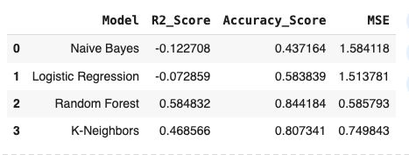
Model Evaluation - Results
Random Forest achieved the highest accuracy and lowest MSE, making it the most effective model.
KNN performed well with accuracy above 80%.
Logistic Regression and Naive Bayes underperformed in comparison.

Slide 7
Recommendation
Best Model: Use Random Forest for sentiment analysis due to its superior performanc
01
Experiment with hyperparameter tuning for Random Forest and KNN.
02
Explore advanced features like TF-IDF, word embeddings, or ensemble models (e.g., XGBoost).
03
Additional Data: Consider adding more labeled data for training to improve model performance.
04

Slide 8
Conclusion
Summary: The project demonstrated how sentiment analysis can be used to analyze social media data. The Random Forest model was the most effective in classifying sentiments, achieving an accuracy of 84.22%.
Future Work: Focus on enhancing feature extraction methods and exploring more complex models like deep learning for text classification.

Slide 9
Thank You
Questions? Open for Discussion

