Slide 1
Octa -Cradle 2.0 Smart kid , Smart crib
By:-
The Infinite loop

Slide 2
PRESENT HEATH SECTOR:-
Nurses are appointed to monitor infants, Cameras are introduced and more records are kept to enhance the health conditions.
But, nurses can’t monitor a particular kid 24*7 so there is a need for an automatized system so that health treatment could be improved.
Hospitals and Health-Care institutes have always focused on increasing the staff for more concentration on the babies but in this techno-savvy world where everything is automated.

Slide 3
NEED..
Have any one ever thought about the new life which just came into existence a few hours or minutes back…?
Technology has always attracted people in every sector, so why should heath care industry be back in it, and in case of new born baby it is a case of life and we should design a solution so that their vital life moments can be spent safe.
Our solution is entirely unique and solves the problem fully by giving each and every information related to the infant and linking the entire information to the parents via mobile application as well as web portal so that they can also feel that their child is safe and under proper surveillance.

Slide 4
Use Case…
Primarily, it is an automated solution so it will reduce the manpower.
Secondly, the way our product will enhance the monitoring systems prevailing in the present health sector is inevitable. No such system is introduced in the market making our product a unique and efficient one.
It will reduce the impending problem of ignorance and delay in diagnostics.

Slide 5
Salient Features: -
Cry Alert
Urination Alert
Excessive motion alert
Insect protection
Radiation Protector
Lullaby Speaker
Alert through web portal
Lcd Display
Surveillance Through Camera
Temperature
Display
Cradle Swinger
Pulse rate
Heart Beat Monitor
Inactiveness
Check
Feeding time alert
Water demand alert
Alert for unrecognized person
Notification Alert
Live Check access to parents
Bluetooth connection oriented

Slide 6
Novelty and Clarity of the idea
Our idea is entirely different and has not been implemented in any health care sector yet.
Our approach prioritizes the child care with the help of an automatic baby cradle monitoring system.
Keep a check on child’s every moment which would decrease the cases of any mishap by many folds.
Our product is not only innovative and creative but actually provides a real solution to the problem and in a efficient way.

Slide 7
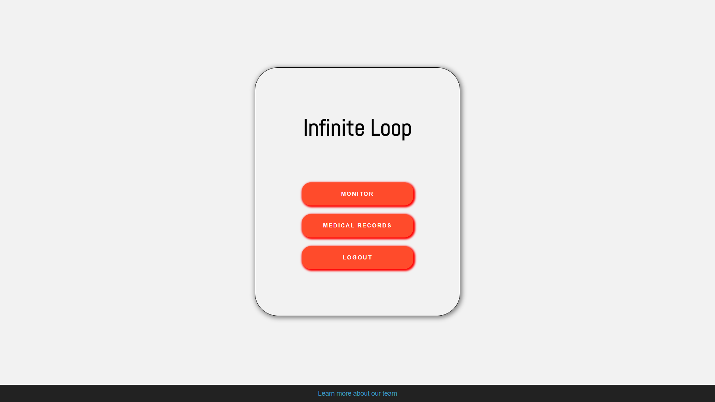
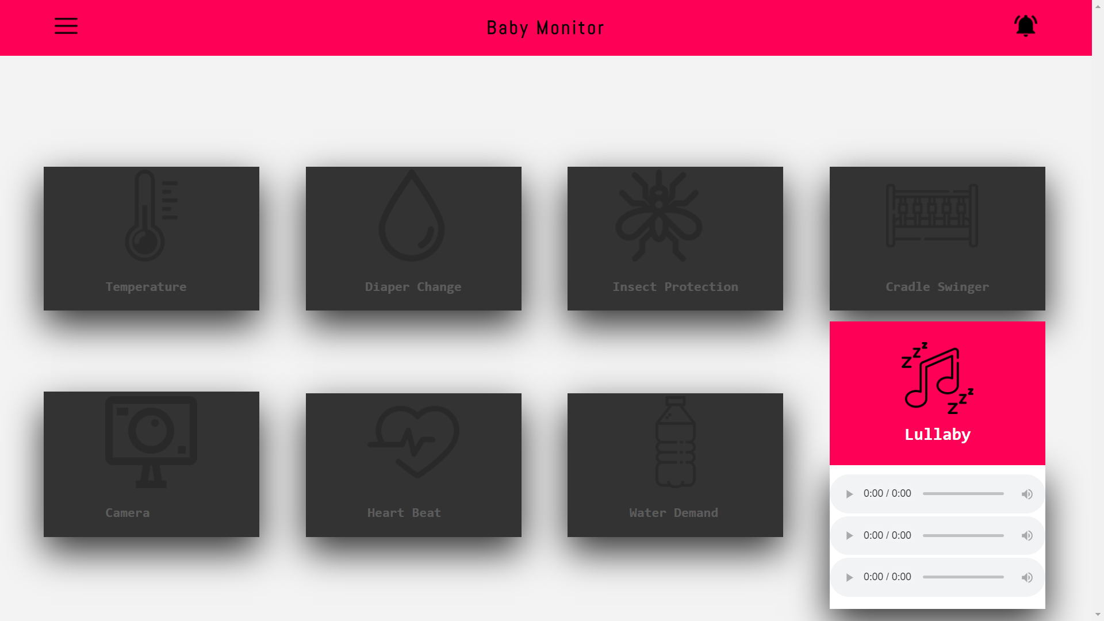
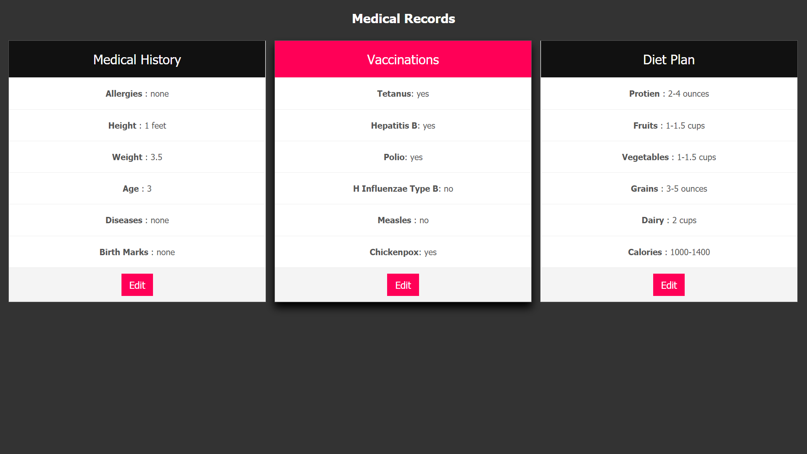
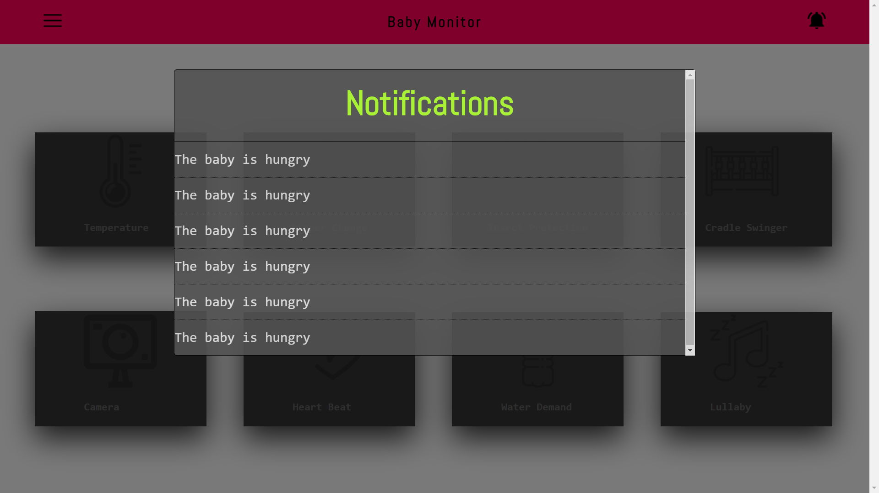
-User friendly
-Entire Records
-Complete info
-Notification alert
-Hunger Alert
-Vaccination Record

Slide 8
Scale of impact, user experience & future potential
The users will be mesmerized with the interface as it would give them a chance to explore each and every detail about the child releasing the tension level.
In future, we have plans to sync the data about vaccinations, diet plans and future doctor appointments so as to ease parents to keep check on the health of their child.
The user will be able to contact the medical services within seconds and book an appointment for their child.

Slide 9
Thank you …
HAVE A NICE DAY AHEAD…!!
Team: - The Infinite Loop

