Slide 1
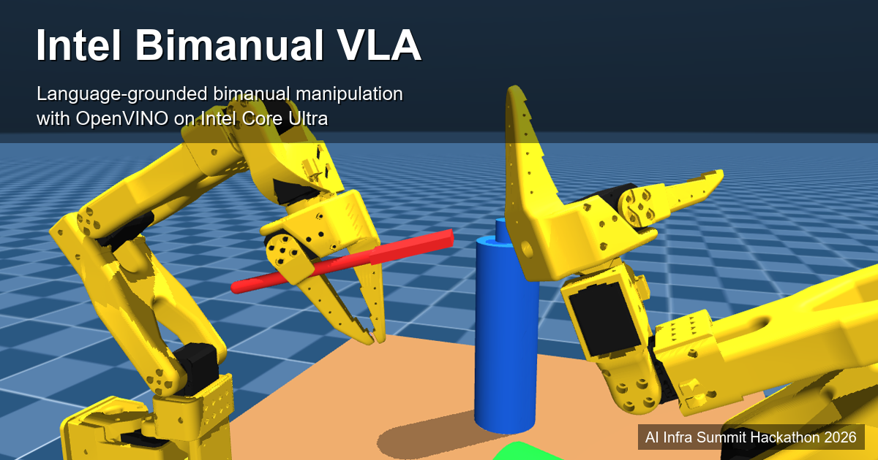
github.com/Sumit-Dwivedi/intel-bimanual-vla

Slide 2
The challenge
Two SO-101 arms, one shared workspace, one language command
• Two SO-101 arms in MuJoCo; language-conditioned table setting
• Inference on Intel Core Ultra Series 3 (Panther Lake) via OpenVINO 2026.3 — CPU, iGPU (Arc B390), NPU (NPU5010)
• Simulation-first: no physical robot anywhere in the pipeline
• The hard part is not the language. It is getting two 5-DoF arms to share one workspace without colliding — and knowing whether they did
CONSTRAINTS.md · ADR-016 (SO-101: 6 actuators, 5 positioning DoF)

Slide 3
What we built
• Four scripted skills, end to end: pick(A, fork), place(A, fork, table), pick(A, water_bottle), handoff(A→B, fork)
• Bimanual handoff with sequential choreography (ADR-037) — one arm moves, the other genuinely frozen
• Voice → plan → execution: Speechmatics transcript at 0.983 confidence → rule-based grounder (43 tests) → executor (ADR-058)
• Perception: PoseNet trained on Arc B390, 2.6–3.2 mm MAE, exported to OpenVINO IR. Opt-in; the demo path uses oracle positions by default (ADR-046)
• One entry point: run_demo.py → 4/4 PASS on the Intel target
Grasping is an explicit MuJoCo weld-constraint abstraction, not friction contact (ADR-029, disclosed per ADR-015)

Slide 4
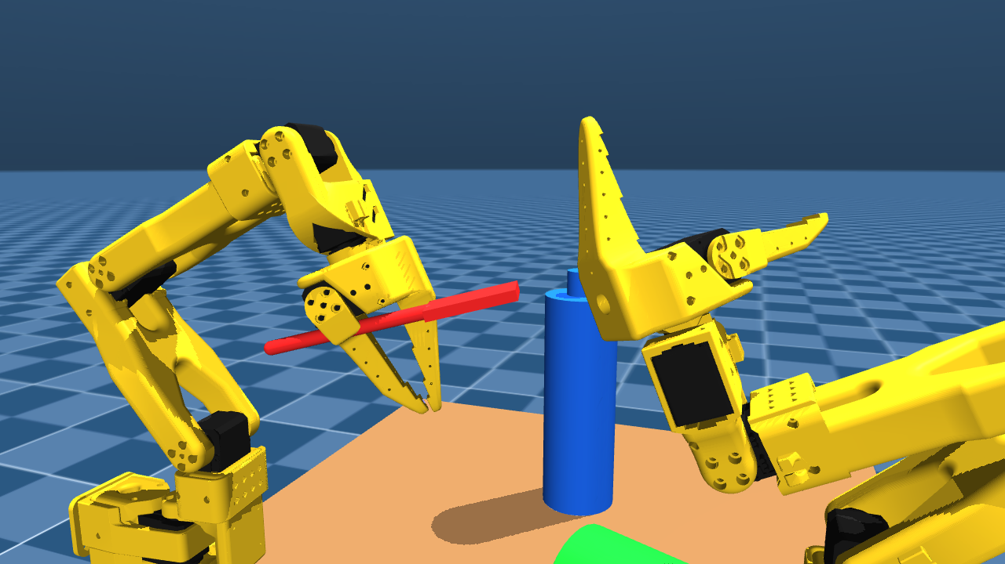
Working demo
handoff(A→B, fork), verified by direct measurement
• weld.is_holding('B') == 'fork'
• weld.is_holding('A') is None
• from_arm_clear = True
• Final lateral separation 0.1946 m
• frames_used = 6610
• Full 40 s continuous take: docs/videos/full-sequence-demo.mp4
docs/images/m06-handoff-complete.png · handoff 20/20 across seeds is degenerate — single-point envelope; it measures determinism, not robustness

Slide 5
OpenVINO on Core Ultra, and the evidence map
PoseNet inference, batch 1 (ADR-045)
Rubric evidence map
Device | Precision | Latency | Throughput
iGPU (Arc B390) | FP16 | 0.683 ms | 1465 Hz
NPU (NPU5010) | FP16 | 1.099 ms | 910 Hz
CPU | FP16 | 6.492 ms | 154 Hz
Criterion | Status
End-to-end + bimanual (30) | 4 skills; handoff(A→B) 4/4 PASS
VLA / multi-modal (20) | Text + voice grounding; perception demoed
OpenVINO on Core Ultra (20) | 3 devices × 3 precisions + batch scaling
Robustness (15) | 20-seed eval, per-skill rates
Reproducibility (10) | One entry point, pinned envs, 59 ADRs
Innovation (5) | Three measured negative results
Batch 16: GPU **5800 Hz**, NPU 1478 Hz, CPU 231 Hz — latency grows slower than batch on every device, so throughput keeps climbing.
docs/hardware/m10-phase4-benchmark.md · docs/slides-rubric-map.md · pick(A, water_bottle) is 45% (9/20, ADR-053's 20-seed extension)

Slide 6
Honest engineering
Three findings we measured, then acted against our own interest
• 1. INT8 quantization — declined (ADR-050). 36–37 mm deviation against the model's own 2.6–3.2 mm MAE. Faster, and not shippable. We kept FP16.
• 2. Position-only geometry redesign — rejected (ADR-062). Two of three kinematic walls did dissolve at 0.40 m separation; net result 1 of 8 skills passing versus master's 4 of 9. Branch preserved as the evidence.
• 3. Motion-stack rewrite — partly worked (ADR-074). Skills had only ever been scored on whether the target moved. Re-scored on five scene-integrity criteria, master passes 0 of 3: place displaces the mug 63.2 mm; handoff spends 3179 of 6610 steps (48%) with the arms in contact, at 6.937 rad/s peak. The rebuilt stack passes 2 of 3 individual skills, and a six-stage bimanual relay passes all five scene-integrity criteria at every stage (worst peak 2.362 rad/s against a 2.6 gate).
• The relay moves the fork via the table. v2 has no working direct hand-to-hand handoff — diagnosed, unsolved, named fix in ADR-073.
• v2's pick pass required fixing the grasp geometry first (the ADR-025 pinch point is not the grasp centre in top-down poses; a 4 mm clearance window). An earlier passing claim was retracted.
• v2 cannot reach the water bottle at all — a regression against master.
• Spline vs direct commands: 11.9× lower peak velocity, 21× lower peak acceleration, identical 0.00014 rad final error. Idle-arm drift 0.000774 rad settled, bounded transient at step 12 disclosed.
• Two shortcuts refused: widening the grasp gate 0.05→0.12 m and the weld gate to 0.115 m each turned a failure into a passing number — both measured and rejected, the second after a per-step check proved the receiving pads never touch the fork.
docs/hardware/v2-verdict.md · ADR-074 · docs/videos/v2-relay-demo.mp4

Slide 7
Reproducibility
• One command: ./run_demo.sh → run_demo.py → 4/4 PASS on the Intel target, from a clean anonymous clone
• Pinned environments: scripts/requirements-dev.txt / requirements-bmptl.txt, checked by scripts/verify_env.py
• 59 ADR entries in ARCHITECTURE.md (ADR-001–058; 43 in DECISIONS.md), plus ADR-070–074 for the v2 rebuild on the redesign-v2 branch
• Public repo: github.com/Sumit-Dwivedi/intel-bimanual-vla
• Verified by cloning anonymously onto a clean host and following the README with no prior knowledge — which is how we found the repo was still private, and three defects in our own environment check
What does not work, stated plainly: pick(A, mug), open_drawer, place(A, water_bottle, table), handoff(B→A, fork). pour is out of scope (ADR-023), so the challenge brief's literal example command does not run end to end. pytest tests/ is 66 passed / 4 failed.
Rendered from docs/slides.md by scripts/render_slides.py — the markdown is canonical

