Slide 1
IBM CAPSTONE PROJECT – The Battle of Neighborhoods:
Best neighborhood to open a French restaurant

Slide 2
Introduction
Toronto has a high demand for foods from different cultures.
Toronto → financial capital of Canada
A gourmet restaurant may proper and attract high spenders.
A famous French chef wants to open a gourmet restaurant in Toronto.
The problem: Find the best neighborhood with a high demand for French cuisine and has room for a top restaurant to prosper.

Slide 3
The Business Problem
Question: "Which neighborhood in Toronto is the best place to open a new top French restaurant?"

Slide 4
Solution
Find the neighborhoods that has the most French restaurants → high demand
Check which of these neighborhoods with high demand has room for a top French restaurant:
Average rating of their French restaurants is low.

Slide 5
Data and Methodology
Data: merging data on Toronto neighborhoods, their geospace data and venue information from FourSquare API interface.
Mehodology:
Collection of Data
Exploration and Understanding of Data
Data preparation and preprocessing
Modeling
Analysis

Slide 6
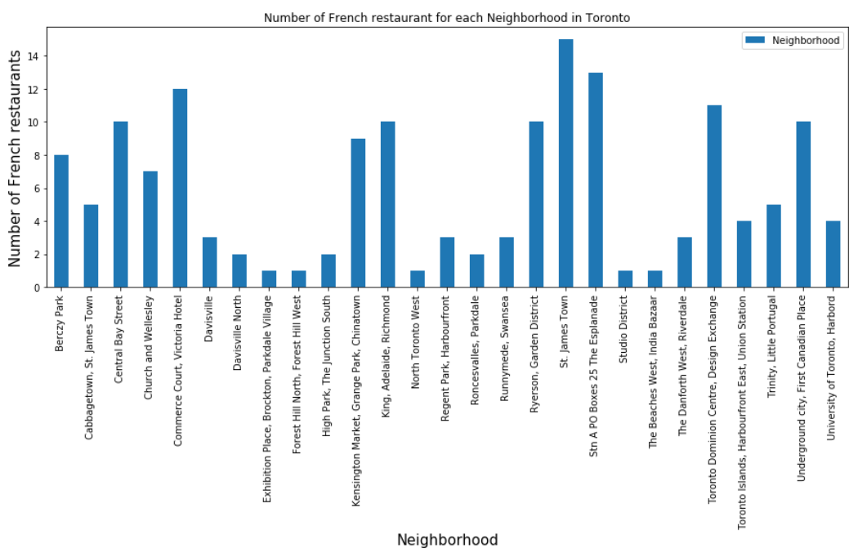
Results
Four neighborhoods has more than 10 French restaurants and are considered with a high demand.

Slide 7
Results
This neighborhoods are:
Commerce Court, Victoria Hotel
'St. James Town
Stn A PO Boxes 25 The Esplanade
Toronto Dominion Centre, Design Exchange

Slide 8
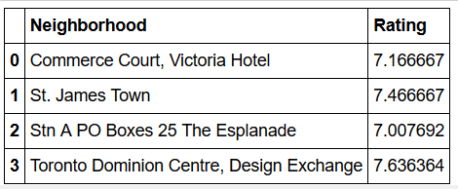
Results
By analyzing the mean ratings of French restaurants in these four neighborhoods:
Stn A PO Boxes 25 The Esplanade has the lowest rating, so it has an opportunity for a top restaurant to prosper.

Slide 9
Results
By clustering all Toronto neighborhoods, the four high demanding neighborhoods are clustered together.
They are similar, so ‘Stn A PO Boxes 25 The Esplanade’ provides similar resources them the other neighborhoods with higher ratings.

Slide 10
Conclusions
Stn A PO Boxes 25 The Esplanade is the best neighborhood to open a gourmet French restaurant.

