Slide 1
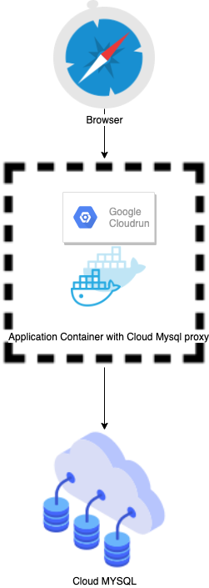
Architecture
Application installed with Cloud mysql proxy will execute in container
Cloud Mysql proxy will communicate with Cloud MySQL

Slide 2
Advantages
Low Cost(Approx $1500 max)
Pay per use
HTTPS URLs
Fast autoscaling
Fully Managed
Secured Transection with Database
Integrated logging and monitoring
Strict container isolation
Custom domains

