Slide 1

Basic Details of the Team and Problem Statement
HackToFuture-2024
In Association with
The Institution of Engineers (India)
IEI Local Centre, Belagavi
Domain : IoT
PS Code: 03
Problem Statement Title: Develop an loT enabled Android application to give real time parking space available on the campus.
Team Name: TechForge
Team Leader Name: Sphurti.M.Sanadi
Table Code Assigned: 1.7
Institute Name: K.L.S Gogte Institute of technology

Slide 2
Overview
Introduction
Problem Statement
Solution Overview
Block Diagram
Application Features
Implementation Details
Participants Details

Slide 3
Introduction
Traditional parking systems often struggle to meet the demands of the pandemic, necessitating innovative solutions.
Our project aims to address this need by developing an IoT-based Android application for real-time parking space availability.
By leveraging IoT technology, we offer a seamless and contactless parking experience, enhancing safety and efficiency on campus.

Slide 4
Problem Statement
In the present scenario of covid pandemic automatic parking system is one of the important prototypes that we need . Hence design a Iot based android application of parking system to detect an available parking slot in a parking space

Slide 5
Solution Overview:
Our solution involves the development of an IoT-enabled Android application tailored for campus parking management.
Utilizing IoT technology, the application provides real-time updates on parking space availability, ensuring users can quickly locate vacant spots.
By integrating with sensors installed in parking spaces, the app accurately detects the status of each spot, facilitating efficient parking.
The user-friendly interface offers intuitive navigation, reservation options, and notifications, enhancing the overall parking experience.
Our solution aims to alleviate the challenges posed by the COVID-19 pandemic, offering a safer and more convenient parking solution for campus communities.

Slide 6
Block Diagram:
PARKING AREA
DATASET FROM PARKING AREA
SERVER
ANDROID APPLICATION
USER

Slide 7
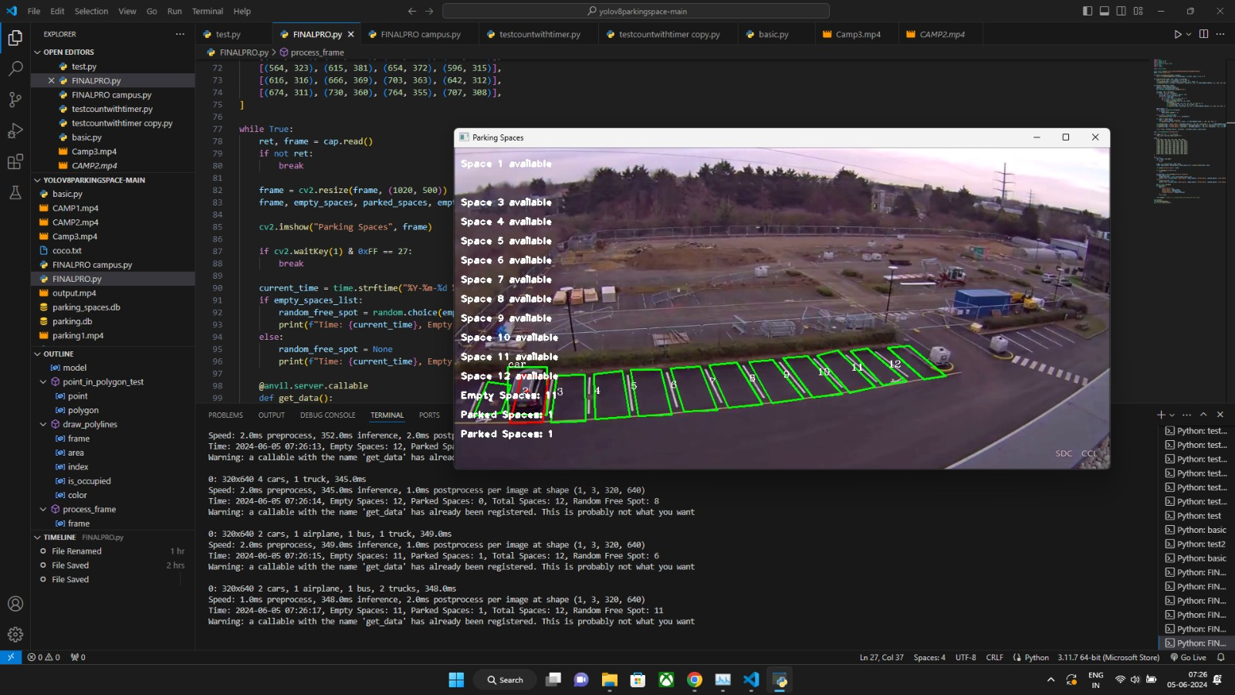
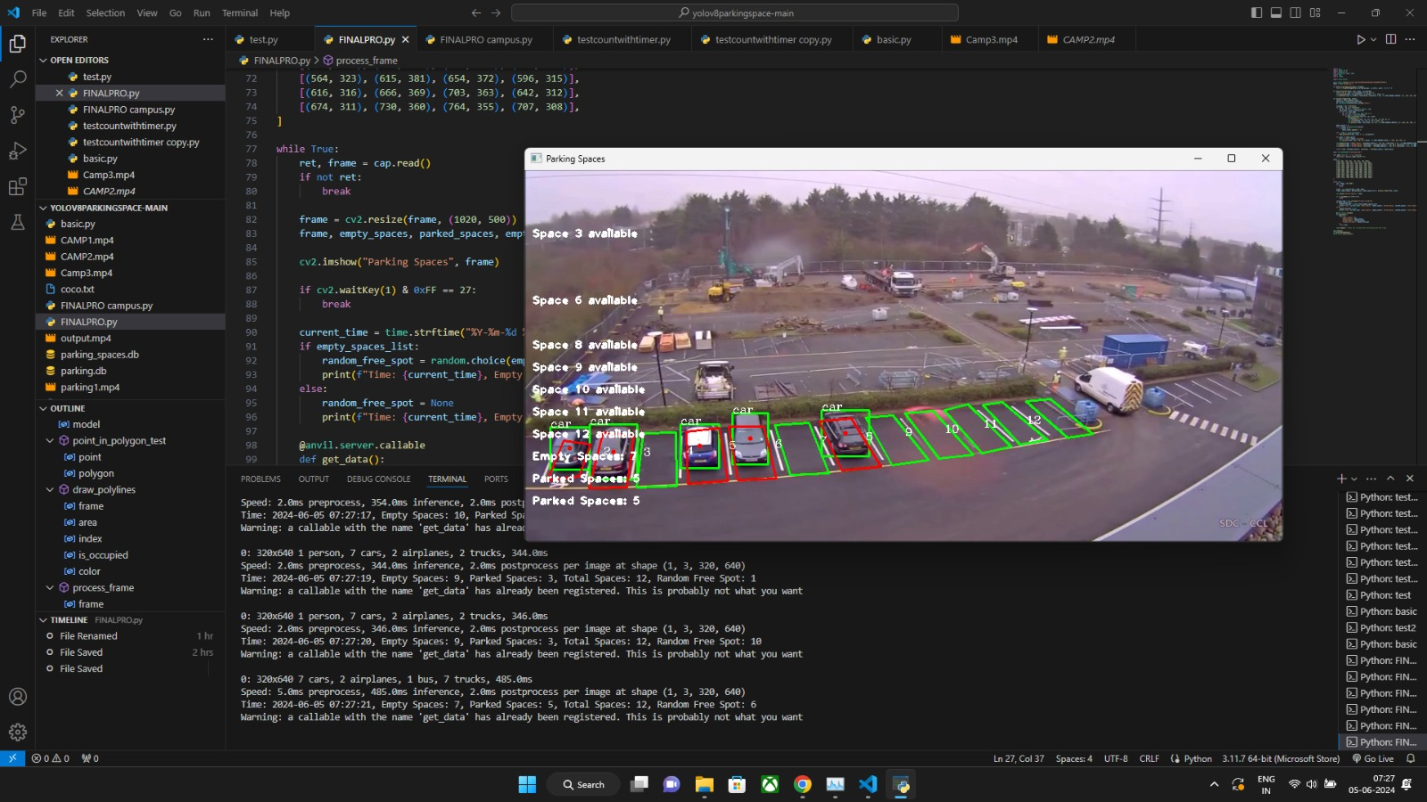
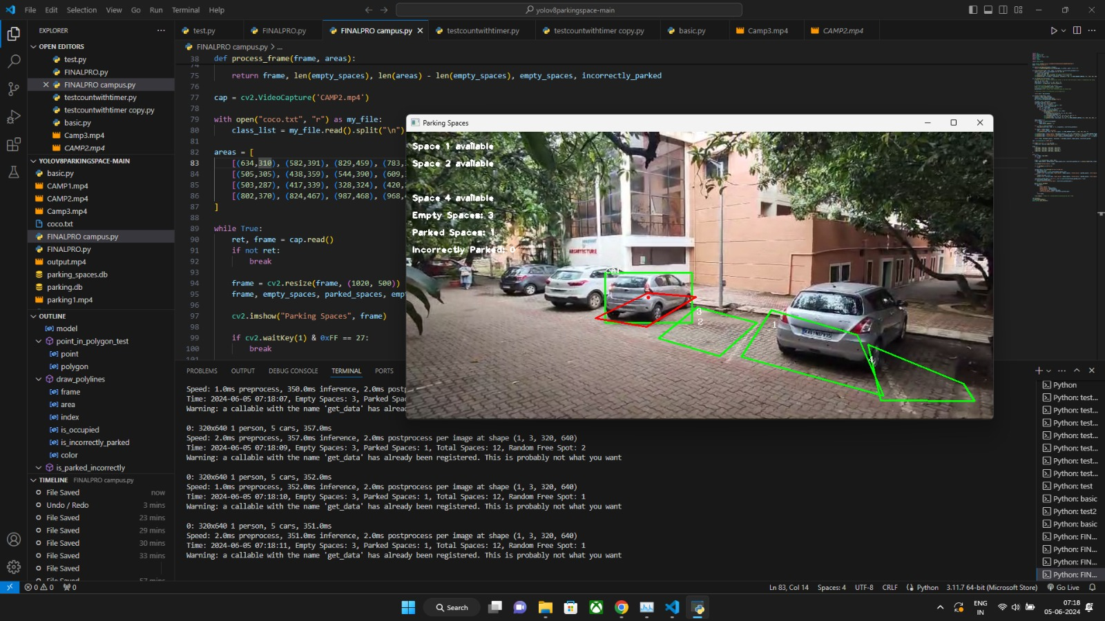
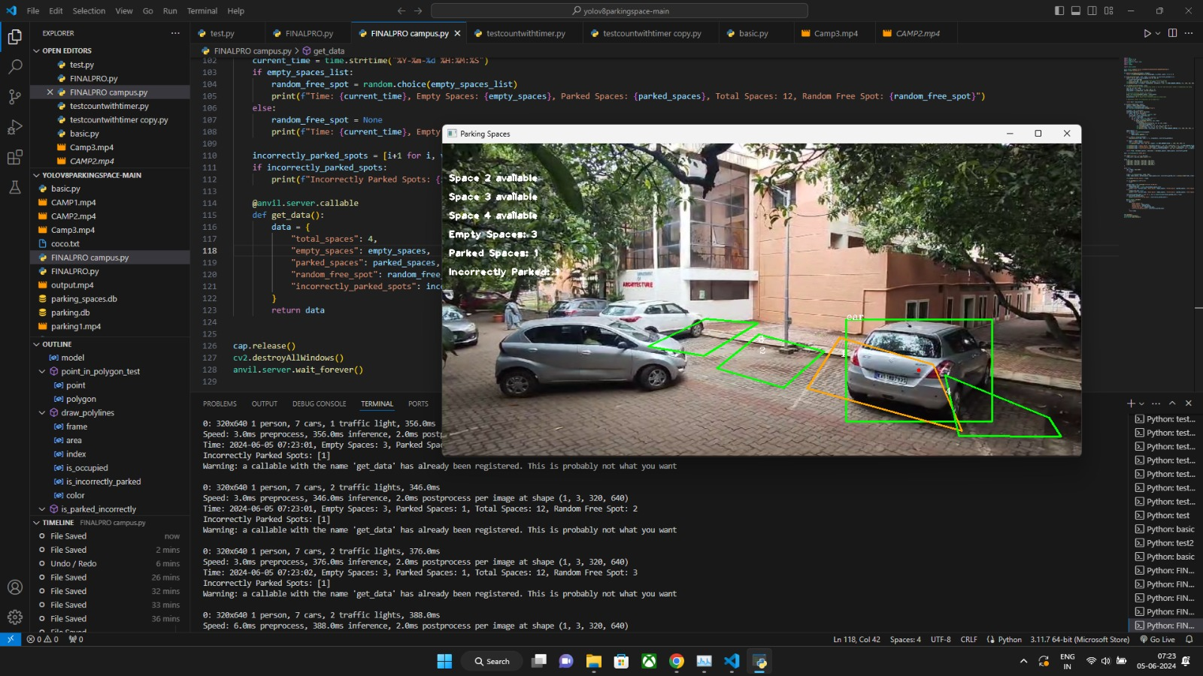

Slide 8
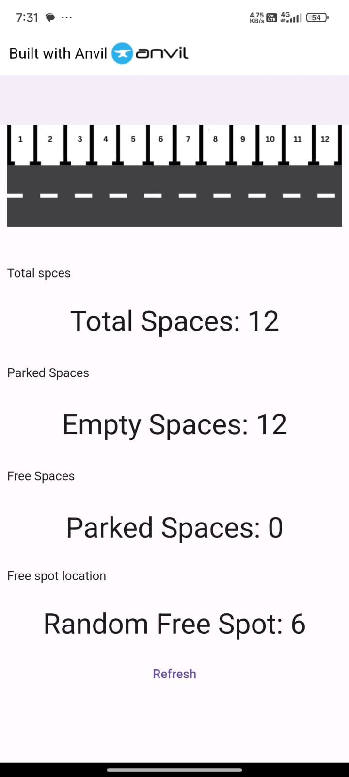
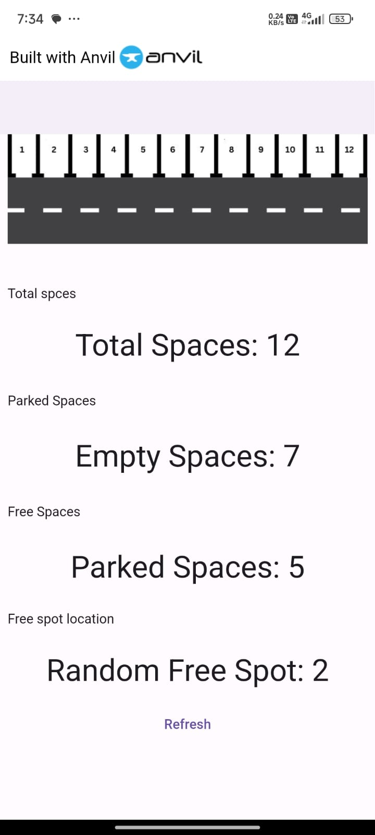
App Features:

Slide 9
Participants Details
Team Leader Name: Sphurti Sanadi
Branch: BE, Stream :ECE, Year: II.
Team Member 1 Name: Sumit Patil
Branch: BE, Stream: ECE, Year: II
Team Member 2 Name: Yash Amasi
Branch: BE, Stream: ECE, Year: II
Team Member 3 Name: Sudarshan
Branch: BE, Stream: ECE, Year: II

Slide 10
THANK
YOU

