Slide 1
Agile Software Development & Scrum
5CS024

Slide 2

1. Objectives
1. Objectives
2. What is Agile?
Agile
Agile Manifesto
12 Agile Principles
Agile over Traditional

Slide 3
2. What is Agile?
2. What is Agile?
2.1 Agile Practices
2.2 Agile Manifesto
2.3 Agile Principles
Agile is a mindset
Ability to create and respond to change
A practice that promotes continuous iteration of development and testing throughout the software development lifecycle of the project

Slide 4
2.1 Agile Practices
2. What is Agile?
2.1 Agile Practices
2.2 Agile Manifesto
2.3 Agile Principles
Practices are techniques, guidelines, or rules that help to develop the software product or to manage the software project.
Agile Practices are based upon the Manifesto for Agile Software Development

Slide 5
2.2 Agile Manifesto
2. What is Agile?
2.1 Agile Practices
2.2 Agile Manifesto
2.3 Agile Principles
Written in 2001 by seventeen independent-minded software practitioners.
Companies were so focused on excessively planning and documenting their software development cycles that they lost sight of what really mattered
68 words, and the short and sweet document went on to change software development forever.

Slide 6
2.2 Agile Manifesto
2. What is Agile?
2.1 Agile Practices
2.2 Agile Manifesto
2.3 Agile Principles
Individuals and interactions over processes and tools
Working software over comprehensive documentation
Customer collaboration over contract negotiation
Responding to change over following a plan

Slide 7
2.3 Agile Principles
2. What is Agile?
2.1 Agile Practices
2.2 Agile Manifesto
2.3 Agile Principles
Our highest priority is to satisfy the customer through early and continuous delivery of valuable software.
Welcome changing requirements, even late in development. Agile processes harness change for the customer’s competitive advantage.
Deliver working software frequently, from a couple of weeks to a couple of months, with preference to the shorter timescale.

Slide 8
2.3 Agile Principles
2. What is Agile?
2.1 Agile Practices
2.2 Agile Manifesto
2.3 Agile Principles
Business people and developers must work together daily throughout the project.
Build projects around motivated individuals. Give them the environment and support they need, and trust them to get the job done.
The most efficient and effective method of conveying information to and within a development team is face-to-face conversation.
Working software is the primary measure of progress.
Agile processes promote sustainable development. The sponsors, developers, and users should be able to maintain a constant pace indefinitely.

Slide 9
2.3 Agile Principles
2. What is Agile?
2.1 Agile Practices
2.2 Agile Manifesto
2.3 Agile Principles
Continuous attention to technical excellence and good design enhances agility.
Simplicity, the art of maximizing the amount of work not done is essential.
The best architectures, requirements, and designs emerge from self-organizing teams.
At regular intervals, the team reflects on how to become more effective, then tunes and adjusts its behavior accordingly

Slide 10
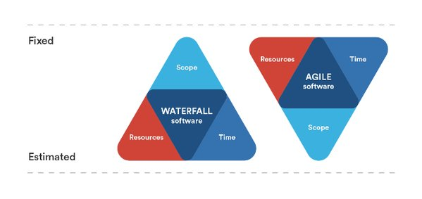
3. Iron Triangle of Project Management
3. Iron Triangle of Project Management
4. SCRUM

Slide 11
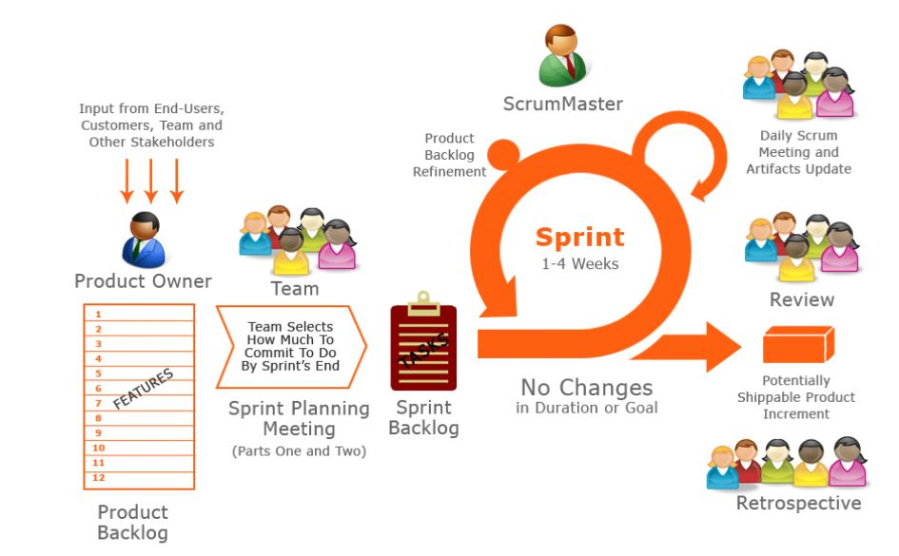

Slide 12
4. SCRUM
4. SCRUM
4.1 Scrum Theory
4.2 Uses of Scrum
4.3 Scrum Values
4.4 The Scrum Team
A framework within which people can address complex adaptive problems, while productively and creatively delivering products of the highest possible value.
Scrum is:
Lightweight
Simple to understand
Difficult to master

Slide 13
4.1 Scrum Theory
4. SCRUM
4.1 Scrum Theory
4.2 Uses of Scrum
4.3 Scrum Values
4.4 The Scrum Team
Scrum is founded on empirical process control theory, or empiricism.
Empiricism asserts that knowledge comes from experience and making decisions based on what is known.
Three pillars uphold every implementation of empirical process control: transparency, inspection, and adaptation.

Slide 14
4.1 Scrum Theory
4. SCRUM
4.1 Scrum Theory
4.2 Uses of Scrum
4.3 Scrum Values
4.4 The Scrum Team
Transparency: Significant aspects of the process must be visible to those responsible for the outcome.
For example:
A common language referring to the process must be shared by all participants
Those performing the work and those inspecting the resulting increment must share a common definition of “Done”.

Slide 15
4.1 Scrum Theory
4. SCRUM
4.1 Scrum Theory
4.2 Uses of Scrum
4.3 Scrum Values
4.4 The Scrum Team
Inspection: Scrum users must frequently inspect Scrum artifacts and progress toward a Sprint Goal to detect undesirable variances.
Adaptation: If an inspector determines that one or more aspects of a process deviate outside acceptable limits, and that the resulting product will be unacceptable, the process or the material being processed must be adjusted. An adjustment must be made as soon as possible to minimize further deviation.

Slide 16
4.1 Scrum Theory
4. SCRUM
4.1 Scrum Theory
4.2 Uses of Scrum
4.3 Scrum Values
4.4 The Scrum Team
Scrum prescribes four formal events for inspection and adaptation:
Sprint Planning
Daily Scrum
Sprint Review
Sprint Retrospective

Slide 17
4.2 Uses of Scrum
4. SCRUM
4.1 Scrum Theory
4.2 Uses of Scrum
4.3 Scrum Values
4.4 The Scrum Team
Research and identify viable markets, technologies, and product capabilities
Develop products and enhancements
Release products and enhancements, as frequently as many times per day
Develop and sustain Cloud and other operational environments
Sustain and renew products

Slide 18
4.3 Scrum Values
4. SCRUM
4.1 Scrum Theory
4.2 Uses of Scrum
4.3 Scrum Values
4.4 The Scrum Team
Commitment: People personally commit to achieving the goals of the Scrum Team.
Courage: The Scrum Team members have courage to do the right thing and work on tough problems.
Focus: Everyone focuses on the work of the Sprint and the goals of the Scrum Team.
Openness: The Scrum Team and its stakeholders agree to be open about all the work and the challenges with performing the work.
Respect: Scrum Team members respect each other to be capable, independent people

Slide 19
4.4 The Scrum Team
4. SCRUM
4.1 Scrum Theory
4.2 Uses of Scrum
4.3 Scrum Values
4.4 The Scrum Team
The product Owner
The Development Team
The Scrum Master

Slide 20
4.4.1 Product Owner
4.4 The Scrum Team
4.4.1 Product Owner
4.4.2 The Development Team
4.4.3 The Scrum Master
Sole person responsible for managing the Product Backlog. Product Backlog management includes:
• Clearly expressing Product Backlog items
• Ordering the items in the Product Backlog
• Optimizing the value of the work the Development Team performs
• Ensuring that the Product Backlog is visible, transparent, and clear to all
• Ensuring the Development Team understands items in the Product Backlog to the level needed.

Slide 21
4.4.2 The Development Team
4.4 The Scrum Team
4.4.1 Product Owner
4.4.2 The Development Team
4.4.3 The Scrum Master
Consists of professionals who do the work of delivering a potentially releasable Increment of “Done” product at the end of each Sprint Development Teams have the following characteristics:
They are self-organizing.
Development Teams are cross-functional.
Scrum recognizes no titles for Development Team members.
Scrum recognizes no sub-teams in the Development Team.
Individual Development Team members may have specialized skills and areas of focus, but accountability belongs to the Development Team as a whole.

Slide 22
Development Team Size
4.4.2 The Development Team
Development Team Size
Optimal Development Team size is small enough to remain nimble and large enough to complete significant work within a Sprint.
Fewer than three Development Team members decrease interaction and results in smaller productivity gains.
Having more than nine members requires too much coordination.
The Product Owner and Scrum Master roles are not included in this count unless they are also executing the work of the Sprint Backlog.

Slide 23
4.4.3 The Scrum Master
4.4 The Scrum Team
4.4.1 Product Owner
4.4.2 The Development Team
4.4.3 The Scrum Master
Responsible for promoting and supporting Scrum.
Do this by helping everyone understand Scrum.
The Scrum Master is a servant-leader for the Scrum Team.

Slide 24
4.4.3 The Scrum Master
4.4 The Scrum Team
4.4.1 Product Owner
4.4.2 The Development Team
4.4.3 The Scrum Master
The Scrum Master serves the Product Owner, Development team, Organization in several ways, including:
• Finding techniques for effective Product Backlog management.
• Helping the Scrum Team understand the need for clear and concise Product Backlog items.
• Ensuring the Product Owner knows how to arrange the Product Backlog to maximize value.

Slide 25
The Scrum Master
4.4.3 The Scrum Master
The Scrum Team
The Scrum Master serves the Product Owner, Development team, Organization in several ways, including:
• Coaching the Development Team in self-organization and cross functionality.
• Removing impediments to the Development Team’s progress.
• Leading and coaching the organization in its Scrum adoption.
• Planning Scrum implementations within the organization.

Slide 26
5. Yet to come in the next lecture
Scrum Artifacts
Scrum Ceremonies
User Stories
5. Yet to come in the next lecture
6. Summary

Slide 27
6. Summary
Agile Manifesto
Agile Principles
Scrum
Scrum Theory
Scrum Values
5. Yet to come in the next lecture
6. Summary

Slide 28

Any Questions

