Slide 1
Risk Analysis & SRS
5CS024

Slide 2

1. Objectives
Risk
Risk Management
Positive risk
Requirement Types
SRS
1.Objectives
2. Risk
3. Risk Management-Definition

Slide 3
2.Risk
1.Objectives
2. Risk
3. Risk Management-Definition
SHIT HAPPENS
Projects – Change - Risk
Assessing and managing risks is the best weapon you have against project catastrophes. By evaluating your plan for potential problems and developing strategies to address them, you’ll improve your chances of a successful, if not perfect, project.

Slide 4
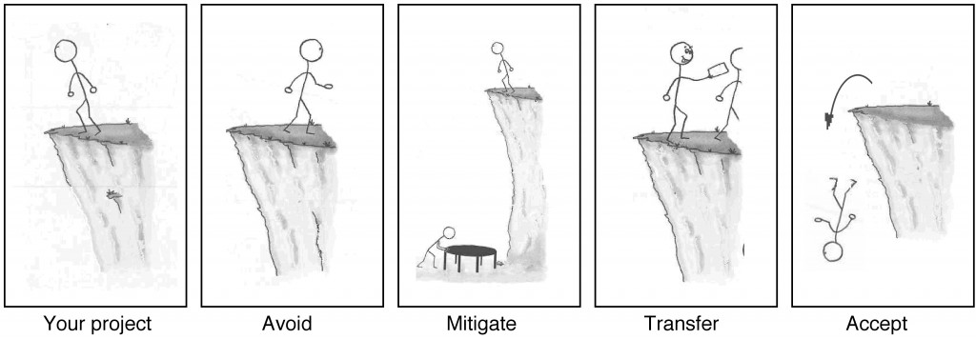
3.Risk Management - Definition
Project risk is defined by PMI as, "an uncertain event or condition that, if it occurs, has a positive or negative effect on a project's objectives."
2. Risk
3. Risk Management-Definition
4. Risk Management Processes

Slide 5
4.Risk Management Processes
3. Risk Management-Definition
4. Risk Management Processes
5.Project Risk Management-Need
Plan Risk Management
Identify Risks
Perform Qualitative Risk Analysis
Plan Risk Responses
Control Risks

Slide 6
5.Project Risk Management - Need
4. Risk Management Processes
5.Project Risk Management-Need
6.Project Risk Management
Project failure seems to be almost endemic at the moment. There are frequent press reports of massively over-spent Government projects, and major commercial project delayed or cancelled

Slide 7
6.Project Risk Management
Project risk is an uncertain event or condition that, if it occurs, has a positive or negative effect on one or more project objectives such as scope, schedule, cost, and quality.
A risk may have one or more causes and, if it occurs, it may have one or more impacts.
A cause may be a given or potential requirement, assumption, constraint, or condition that creates the possibility of negative or positive outcomes.
5.Project Risk Management-Need
6.Project Risk Management
7.Risk and Issue

Slide 8
7.Risk and Issue
6.Project Risk Management
7.Risk and Issue
8.Risk Management Strategy
Risk
Issue
A risk is a specific event or condition that may occur in the future which would be a problem if it does.
Risks are in the future; as they carry uncertainty, they may or may not happen at some time in the future.
An issue is a known or existing problem
An issue is a matter of fact (no uncertainty) that either is or will cause a problem or a constraint on the project, that needs to be resolved.

Slide 9
8.Risk Management Strategy
8.Risk Management Strategy
8.1 Avoid
8.2 Transfer
8.3 Mitigate
8.4 Accept
Avoid
Transfer
Mitigate
Accept

Slide 10
8.1 Avoid
8.Risk Management Strategy
8.1 Avoid
8.2 Transfer
8.3 Mitigate
8.4 Accept
Risk avoidance is a risk response strategy whereby the project team acts to eliminate the threat or protect the project from its impact.
It usually involves changing the project management plan to eliminate the threat entirely.

Slide 11
8.2 Transfer
8.Risk Management Strategy
8.1 Avoid
8.2 Transfer
8.3 Mitigate
8.4 Accept
Risk transference is a risk response strategy whereby the project team shifts the impact of a threat to a third party, together with ownership of the response.
Transferring the risk simply gives another party responsibility for its management—it does not eliminate it.

Slide 12
8.3 Mitigate
8.Risk Management Strategy
8.1 Avoid
8.2 Transfer
8.3 Mitigate
8.4 Accept
Risk mitigation is a risk response strategy whereby the project team acts to reduce the probability of occurrence or impact of a risk.
It implies a reduction in the probability and/or impact of an adverse risk to be within acceptable threshold limits.

Slide 13
8.4 Accept
8.Risk Management Strategy
8.1 Avoid
8.2 Transfer
8.3 Mitigate
8.4 Accept
Risk acceptance is a risk response strategy whereby the project team decides to acknowledge the risk and not take any action unless the risk occurs.
This strategy is adopted where it is not possible or cost-effective to address a specific risk in any other way.

Slide 14
9.Positive Risk
We often think of it as a hazard, or a dangerous chance.
Risk is the thin line that lies between a threat and an opportunity.
A positive risk is any condition, event, occurrence, or situation that provides a possible positive impact for a project or enterprise.
Tools for an effective risk management strategy:
SWOT risk analysis,
ERM framework,
Risk assessment matrix.
8.Risk Management Strategy
9.Positive Risk
10.Requirements

Slide 15
10.Requirements
8.Risk Management Strategy
9.Positive Risk
10.Requirements
Functional Requirement
Non functional Requirement
Usability Requirement

Slide 16
10.1 Functional Requirement
10. Requirements
10.1 Functional Requirement
10.2 Non-Functional Requirement
10.3 Usability Requirement
Functional requirement defines a system or its component
Functional software requirements captures the intended behavior of the system.
Focus on user requirement
Describe what the product does
Eg. The software validates customers and let them login into the system

Slide 17
10.2 Non Functional Requirement
10. Requirements
10.1 Functional Requirement
10.2 Non-Functional Requirement
10.3 Usability Requirement
Non-functional requirement defines the quality attribute of a software system.
It is essential to ensure the usability and effectiveness of the entire software system
Concentrates on the user's expectation.
Describes how the product works
Eg. Users must change the initially assigned login password immediately after the first successful login. Moreover, the initial should never be reused.
Eg. , the site should load in 3 seconds when the number of simultaneous users are > 10000.

Slide 18
10.3 Usability Requirement
10. Requirements
10.1 Functional Requirement
10.2 Non-Functional Requirement
10.3 Usability Requirement
Usability requirements deal with how easy it is for an operator to make use of the system
Usability requirements cannot be directed verified, since they involve subjective behaviors that often have to be collected over time.
HCI relates with the usability requirement

Slide 19
11.Functional Decomposition Diagram(FDD)
Functional decomposition breaks down a large, complex process into an array of smaller, simpler units or tasks, fostering better understanding of the overall process.
A functional decomposition diagram contains the whole function or project along with all of the necessary sub-tasks needed to complete it.
10.Requirements
11. Functional Decomposition Diagram (FDD)
12. SRS

Slide 20
12. SRS
A software requirements specification (SRS) helps you lay the groundwork for product development.
SRS is a document that describes what the software will do and how it will be expected to perform.
10.Requirements
11. Functional Decomposition Diagram (FDD)
12. SRS

Slide 21
SRS Template
Link

