Slide 1
Software Testing
5CS024

Slide 2

1. Objective
Brief overview of Testing
Validation and Verification
Testing Techniques
Test Design Technique
Test Case Content
Bug Report
1.Objective
2.Verification vs. Validation
3. Verification

Slide 3
2. Verification vs Validation
•Verification
–Are we building the product right?
•Validation
–Are we building the right product?
1.Objective
2.Verification vs. Validation
3. Verification

Slide 4
3. Verification
The purpose of Verification is to ensure that selected work products meet their specified requirements.
“According to the Capability Maturity Model(CMMI-SW v1.1) we can also define verification as the process of evaluating software to determine whether the products of a given development phase satisfy the conditions imposed at the start of that phase.” [IEEE-STD-610].
2.Verification vs. Validation
3. Verification
4. Validation
Slide ‹#› of 33

Slide 5
4. Validation
The purpose of Validation is to demonstrate that a product or product component fulfills its intended use when placed in its intended environment.
“According to the Capability Maturity Model(CMMI-SW v1.1) we can also define validation as The process of evaluating software during or at the end of the development process to determine whether it satisfies specified requirements.” [IEEE-STD-610].
3. Verification
4. Validation
5. V & V Benefits
Slide ‹#› of 33

Slide 6
5. V&V Benefits
Ensure that requirements are met.
Remove defects from the product throughout a project’s life cycle, reduce rework, and reduce the cost of poor quality.
Ensure that user needs are met and ensure the the product fulfills its intended use when placed in its intended environment.
Improve the quality of the process and the product.
Improve productivity and performance.
4. Validation
5. V & V Benefits
6. Software testing
Slide ‹#› of 33

Slide 7
6. Software testing
… the process of executing computer sw in order to determine whether the results it produces are correct (Glass, 1979)
… the process of executing a program with the intent of finding errors (Myers, 1979)
… the process of exercising or evaluating a system by manual or automatic means to verify that it satisfies specified requirements or to identify differences between expected and actual results (IEEE 1983)
5. V & V Benefits
6. Software testing
7. Testing Questions
Slide ‹#› of 33

Slide 8
7. Testing Questions
What do we test?
Why do we want to test?
How to Test?
6. Software testing
7. Testing Questions
8. What do we test?

Slide 9
8. What do we test?
Applications / websites
All possible paths in code
All possible combinations of User Interface
Load testing
7. Testing Questions
8. What do we test?
9. Why do we want to test?

Slide 10
9. Why do we want to test?
Verification(Static Testing):
Validation(Dynamic testing):
8. What do we test?
9. Why do we want to test?
10. Testing principles
Notes:
Different types of systems have different testing requirements.
Medical systems
Safety systems
Data processing

Slide 11
10. Testing principles
All tests should be traceable to customer req.
Tests should be planned long before testing begins.
The Pareto principle applies to sw testing.(80/20)
80 % of all errors uncovered during testing will likely be traceable to 20% of all program modules.
Testing should begin “in small” and progress towards “in the large”.
Exhaustive testing is not possible
Testing should be conducted by a third party.
9. Why do we want to test?
10. Testing principles
11. Characteristics of a testable software
Slide ‹#› of 33

Slide 12
11. Characteristics of a testable software
Operability. The better it works, the more efficiently it can be tested.
Stability. The fewer the changes, the fewer the disruptions to testing.
Simplicity. The less there is to test, the more quickly we can test it.
Understandability. The more info. we have, the smarter we will test.
10. Testing principles
11. Characteristics of a testable software
12. Verification
Slide ‹#› of 33

Slide 13
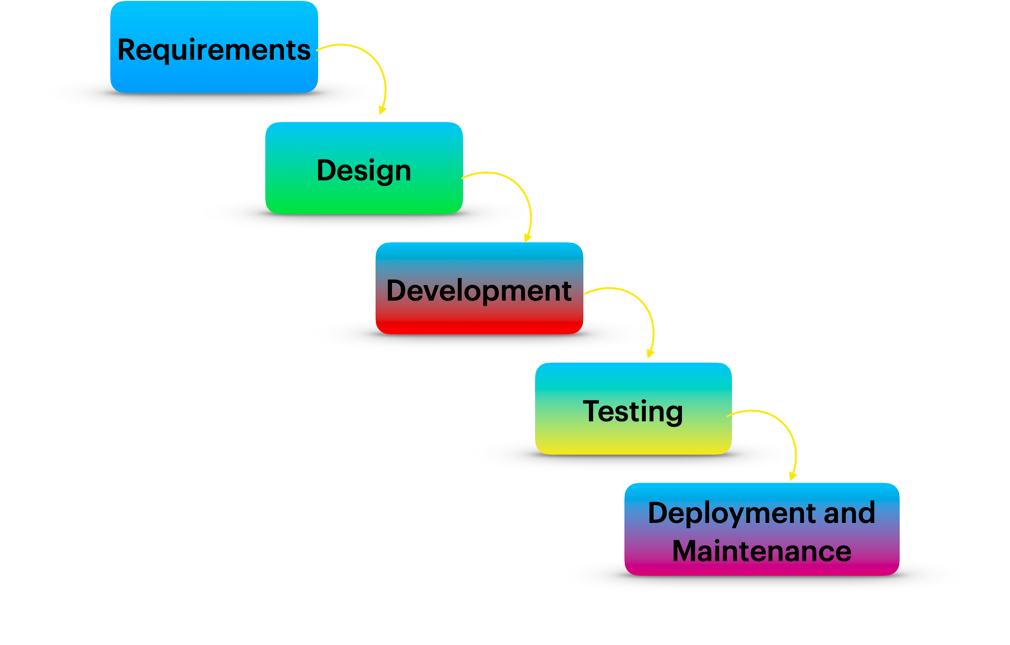
Verification
Validation
SDLC

Slide 14
12. Verification
Proof of compliance with the stated requirements.
" Did we proceed correctly when building the system?“
The software should conform to its specification.
Does it meet the requirements
Read the user requirements and design tests around the brief
Logical Errors
Logical errors are caused by the programmer writing code that compiles and runs but causes the wrong actions.
An example might be where the programmer has subtracted rather than added VAT to a total.
11. Characteristics of a testable software
12. Verification
13. Human factors testing

Slide 15
13. Human factors testing
A system may meet all functional requirements, yet still fail to meet the user's expectations.
Areas to test human factors include:
Correctness - Do buttons do what their labels indicate
Completeness Interface provides all required functionality
Efficiency
Program is efficient & allows user to work efficiently
Easy navigation
Aesthetics - Pleasing to use – nice colours etc
Conformance to business flow
Software logic operates same as the business logic.
12. Verification
13. Human factors testing
14.Verification Technique

Slide 16
14. Verification Technique
Review
Whether the document is correct or not and the information provided in the document is complete or not.
Each individual in a team can review their document.
Example
Requirement Review, Design Review,Test Case review
Walkthrough
It is formal review and we can discuss/raise the issues at the peer level.
Done with team
Does Not have minutes of meet.
Inspection
Formal review
Schedule meeting with a team
Member involves: Author,writer,moderator
13. Human factors testing
14. Verification Technique
15. Validation

Slide 17
15. Validation
Proof of fitness for expected use
" Did we build the right system ?“
The software should do what the user really requires
More focus on software
It comes after verification
It can find bugs that the verification process can not catch
14. Verification Technique
15. Validation
16. Validation Technique

Slide 18
16. Validation Technique
Unit Testing
Involves the testing of each unit or an individual component of the software application
single testable part of a software system and tested during the development phase of the application software.
Integration testing
Units or individual components of the software are tested in a group.
The focus of the integration testing level is to expose defects at the time of interaction between integrated components or units.
System testing
Testing of a fully integrated software system.
Acceptance testing
Involves testing the system before it is accepted for operational use (Somerville 1995)
Pilot, Benchmark
15. Validation
16. Validation Technique
17. White box/Black box testing
Notes:
WB – See the code and look at testing all paths through the code
If statements
Loops
BB – Can’t see the code, all you can test is the interface.

Slide 19
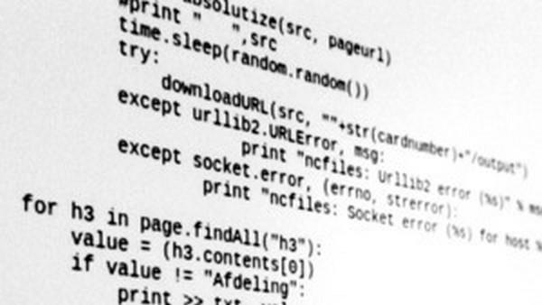
17. White Box / Black box testing
WB – See the code and look at testing all paths through the code
If statements
Loops
BB – Can’t see the code, all you can test is the interface.
16. Validation Technique
17. White box/Black box testing
18. Use case,Test Scenario and Test Case

Slide 20
18. Use case, Test Scenerio and Test Case
17. White box/Black box testing
18. Use case,Test Scenario and Test Case
19. Test Design Technique
Use Case:
- Describes the requirement.
-Contains Three items: Actor, Action/Flow, Outcome
Test Scenario is “What to be tested” and Test Case is “How to be tested”
Test case consists of set of input values, execution precondition, expected results and executed post condition, developed to cover certain test condition. While Test scenario is nothing but test procedure.

Slide 21
19. Test Design Technique
18. Use case,Test Scenario and Test Case
19. Test Design Technique
20. Boundary Value Analysis (BVA)
Software testing technique help you design better cases. Since exhaustive testing is not possible; Testing help reduce the number of test cases to be executed while increasing test coverage. They identify test conditions that are otherwise difficult to recognize.
Boundary Value Analysis(BVA)
Equivalence Partitioning(ECP)
Decision Table based testing
State Transition
Error guessing

Slide 22
20. Boundary Value Analysis(BVA)
Boundary value analysis is based on testing at the boundaries between partitions
Includes maximum, minimum, inside or outside boundaries.
Dividing boundary
Range of data check
19. Test Design Technique
20. Boundary Value Analysis (BVA)
21. Equivalence partitioning

Slide 23
Example
Minimum boundary value is 18
Maximum boundary value is 56 AGE *Accepts value 18 to 56
Valid Inputs: 18,19,55,56
Invalid Inputs:17 and 57
Test case 1: Enter the value 17(18-1) = Invalid
Test case 2: Enter the value 18 = Valid
Test case 3: Enter the value 19(18+1) =Valid
Test case 4: Enter the value 55(56-1)= Valid
Test case 5: Enter the value 56 = Valid
Test case 6: Enter the value 57(56+1) = Invalid
Enter Age
BOUNDARY VALUE ANALYSIS
Invalid (min-1) | Valid (min, +min, -max, max) | Invalid (max +1)
17 | 18, 19, 55, 56 | 57

Slide 24
21. Equivalence partitioning
Inputs to the software or system are divided into groups that are expected exhibit similar behavior, so they are likely to be proposed in the same way. Hence selecting one input from each group to design the test cases.
It helps to reduce the total number of test cases from infinite to finite.
The selected test cases from these groups ensure coverage of all possible scenarios.
20. Boundary Value Analysis (BVA)
21. Equivalence partitioning
22. Example

Slide 25
Example
Valid input: 10 digits
Invalid input: 9 digits, 11 digits
Valid Class: Enter 10 digit mobile number = 9876543210
MOBILE NUMBER
* Must be 10 digits
Enter Mobile No.
EQUIVALENCE PARTITIONING
Invalid | Valid | Invalid
987654321 | 9876543210 | 98765432109

Slide 26
22. Example
Test Scenario : Checking the functionality of login button
TC1: Click the button without entering username and password.
TC2: Click the button only entering Username.
TC3: Click the button while entering wrong username and wrong password.
21. Equivalence partitioning
22. Example
23. Test Case Contents

Slide 27
23. Test Case Contents
Test Case ID
Test Case Title
Description
Pre-condition
Priority(P0, P1, P2, P3)- order
Requirement ID
Steps/Actions
Expected Result
Actual Result
Test Data
22. Example
23. Test Case Contents
24. Bug

Slide 28
23. Test Case Contents (Cont..)
Sample : Login Test Case
22. Example
23. Test Case Contents
24. Bug

Slide 29
24. Bug
The Bug is the informal name of defects, which means that software or application is not working as per the requirement.
In software testing, a software bug can also be issue, error, fault, or failure. The bug occurred when developers made any mistake or error while developing the product.
23. Test Case Contents
24. Bug
25. Bug Report Sample

Slide 30
25. Bug Report Sample
Muncha.com Bug Report sample
24. Bug
25. Bug Report Sample
26. Summary

Slide 31
26. Summary
Brief overview of Testing
Validation and Verification
Testing Techniques
Test Design Technique
Test Case Content
Bug Report
24. Bug
25. Bug Report Sample
26. Summary

Slide 32
Thank You

