Slide 1
DSDM
5CS024

Slide 2

1. Objectives
Dynamic System Development Method (DSDM)
Principles of DSDM
Process of DSDM
Practices of DSDM
Roles in DSDM
1. Objectives
2. DSDM
3. Principles of DSDM

Slide 3
2. DSDM
DSDM was created in 1994 after the project managers using Rapid Application Development (RAD) seek for more governance and discipline to this new iterative way of working.
an agile approach which focuses in the full process life cycle which provides best practice guidance for on-time, in-budget delivery of projects.
DSDM has proven scalability to address projects of all sizes and any business sector.
1. Objectives
2. DSDM
3. Principles of DSDM

Slide 4
2. DSDM Continue
DSDM is based upon the philosophy “that any project must be aligned to clearly defined strategic goals and focus upon early delivery of real benefits to the business.” ( Agile Business Consortium, n.d.)
It is a framework made up of eight principles, a lifecycle and products, roles and responsibilities and several best practice techniques.
1. Objectives
2. DSDM
3. Principles of DSDM

Slide 5
3. Principles of DSDM
2. DSDM
3. Principles of DSDM
4. Process of DSDM
DSDM consist of eight principles which represents the way of working.
If a principle gets compromised, it represents risk to the successful execution and completion of a project.
I. Focus on the business need:
Deliver what business needs when it needs it.
Business priorities must be understood and establish a business case.
Seek for continuous business sponsorship and commitment, and guarantee minimum usable subset.

Slide 6
3. Principles of DSDM
2. DSDM
3. Principles of DSDM
4. Process of DSDM
II. Deliver on time:
Various time boxes are planned in advance and the time frameset.
The set dates do not change. Features may be varied according to the business priorities in order to meet the deadlines.
III. Collaborate:
Active cooperation and commitment among the team members are required.
It encourages the understanding, speed and shared ownership.
The team must be empowered and should include the business representative as well.

Slide 7
3. Principles of DSDM
2. DSDM
3. Principles of DSDM
4. Process of DSDM
IV. Never compromise quality:
The level of quality is agreed at the start or outset.
Then the work is aimed at achieving that level, no more, no less.
The project must test early and continuously and review constantly with the customer.
V. Build incrementally from firm foundations:
Increments allows the business to take advantage of work before the final completion.
It encourages the stakeholder’s confidence and regular and constant feedback.

Slide 8
3. Principles of DSDM
2. DSDM
3. Principles of DSDM
4. Process of DSDM
VI. Develop iteratively:
The work might not be perfect at first time. Timeboxes can be used to allow for the changes continuously in order the secure the right solution.
VII. Communicate continuously and clearly:
Visibility and transparency is encouraged through regular communication and collaboration amongst all the project stakeholders. Facilitated workshops, daily stand-ups, modelling, prototyping, presentations and informal face-to-face communication can be used for this.
VIII. Demonstrate control:
The teams should be proactive while monitoring and controlling the progress. The team need to constantly evaluate the project viability based on the business objective.

Slide 9
4. Process of DSDM
2. DSDM
3. Principles of DSDM
4. Process of DSDM
The approach of DSDM in the development and delivery of the project is both iterative and incremental.
The important features are addressed early and the less important part are delivered later.
There are four main phases in the DSDM i.e. Feasibility, Foundations, Evolutionary Development and deployment.

Slide 10
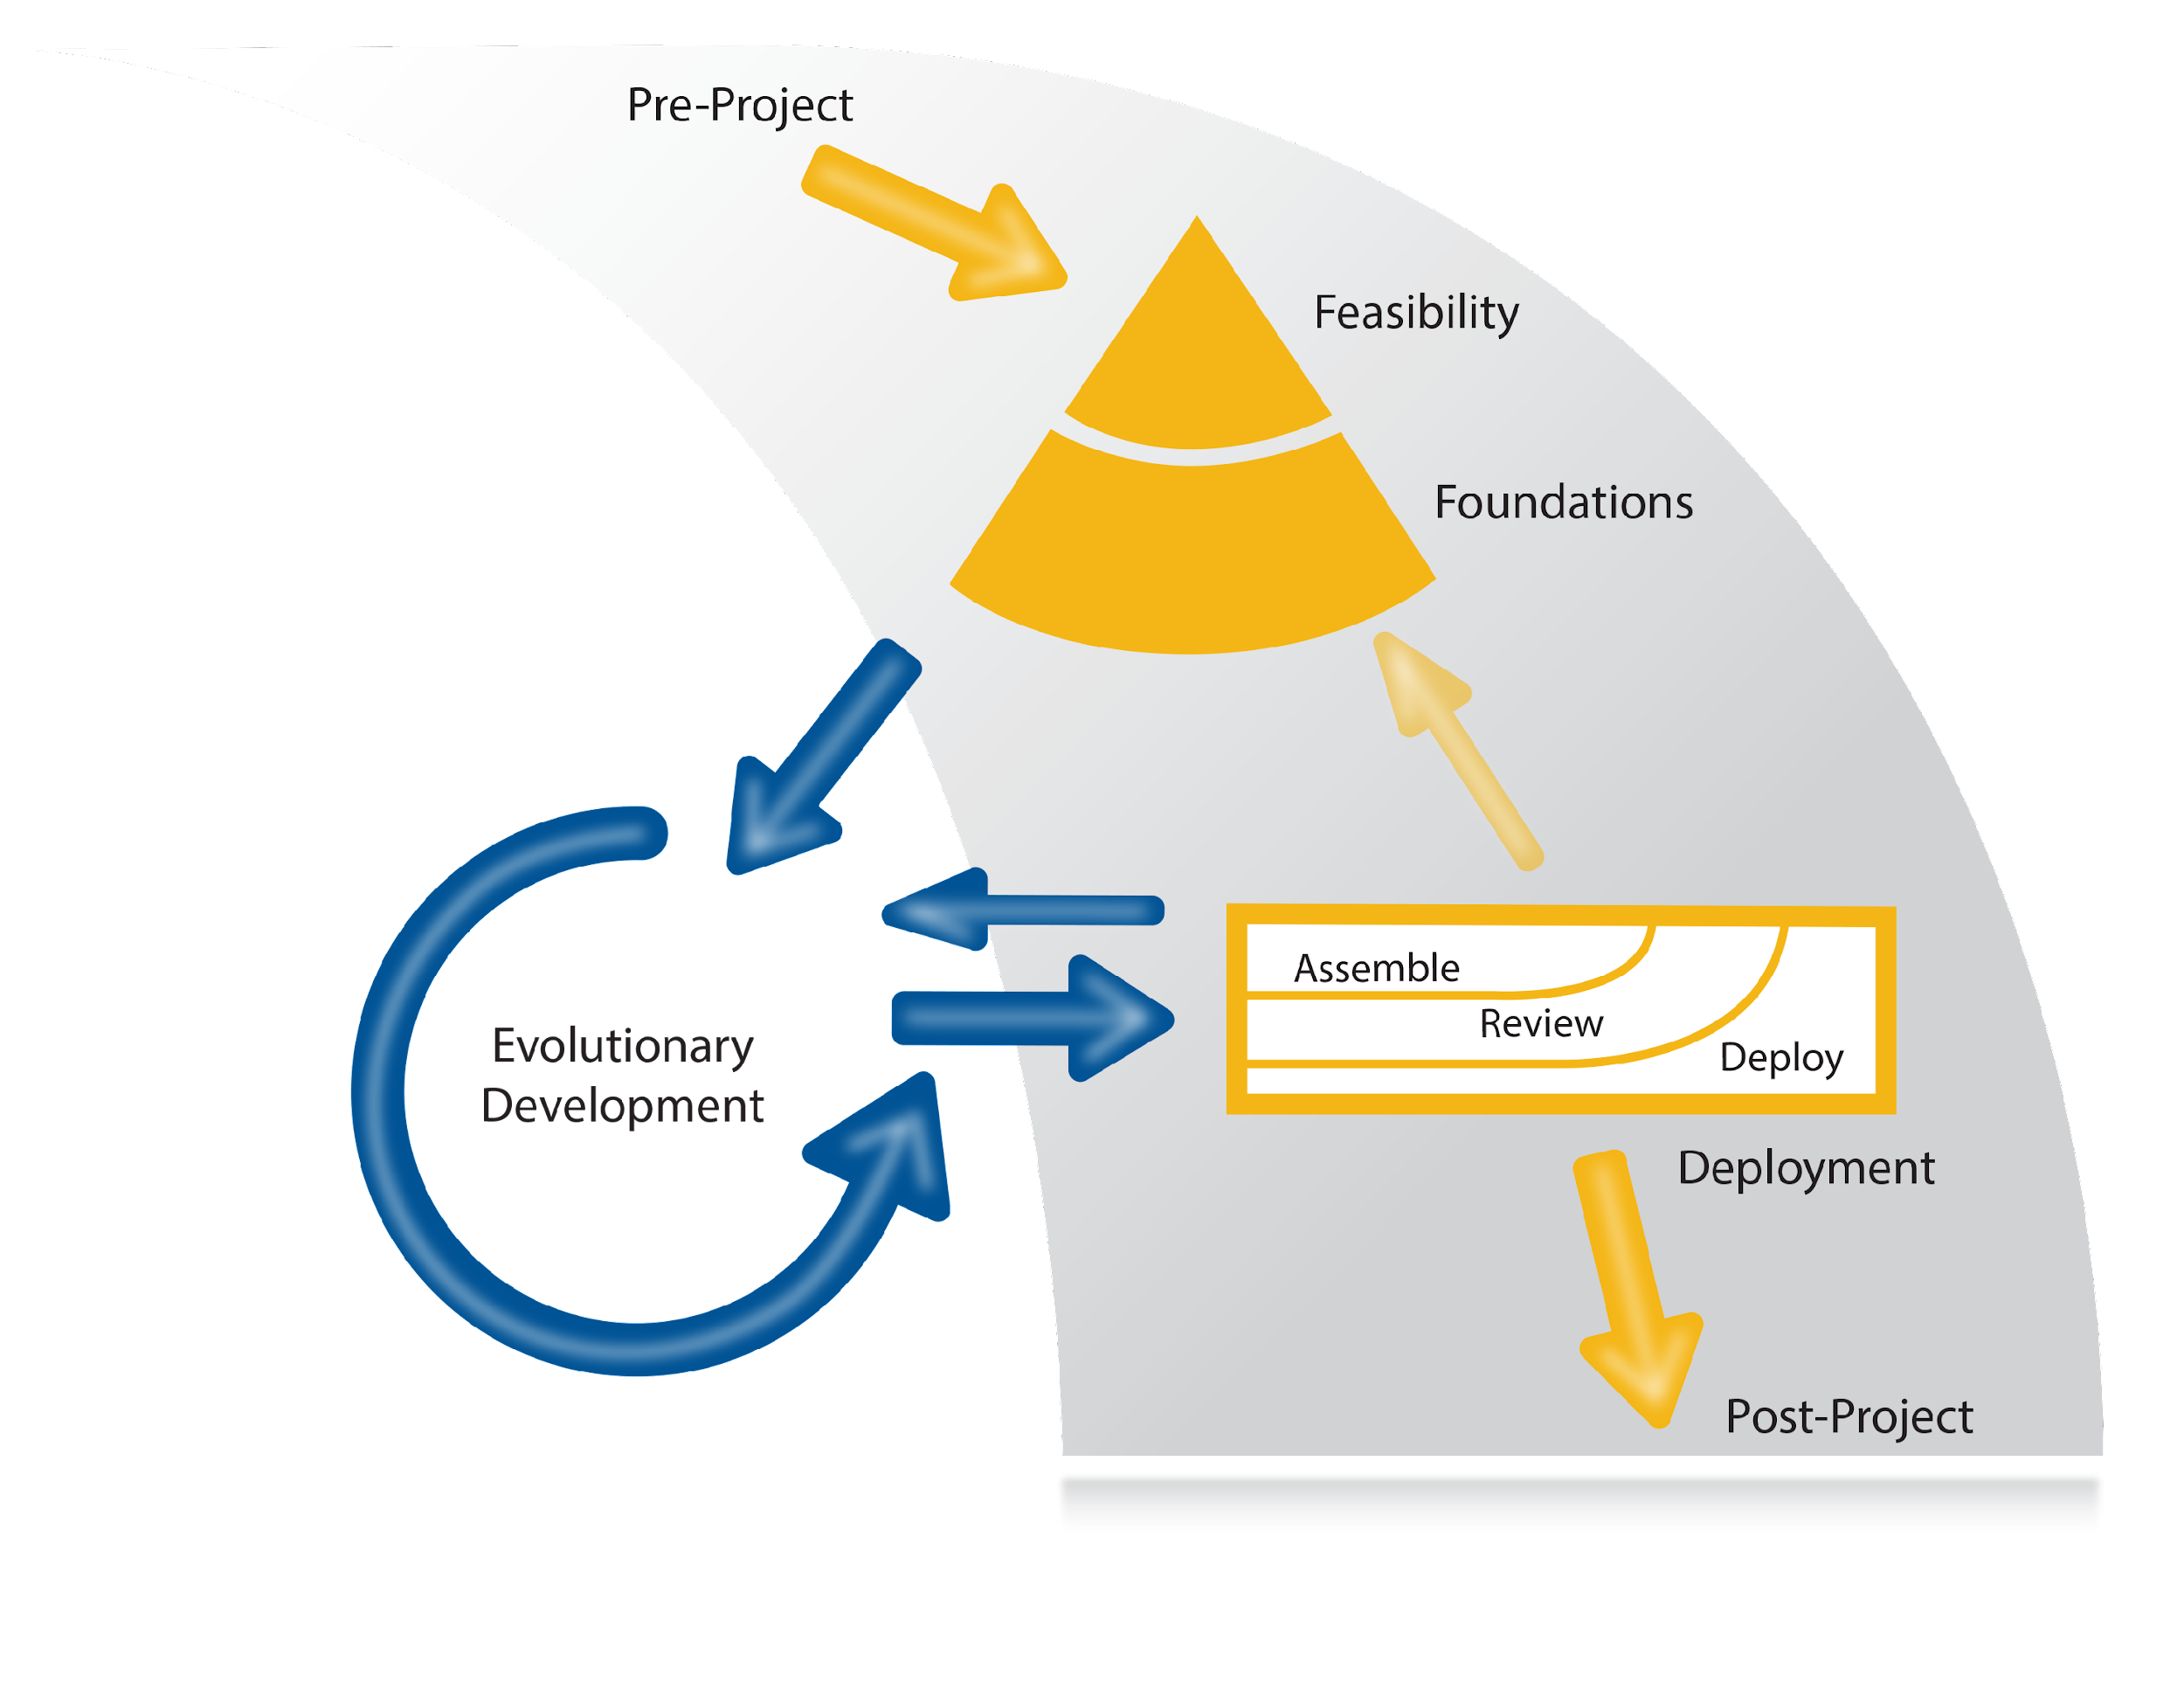
4. Process of DSDM
2. DSDM
3. Principles of DSDM
4. Process of DSDM

Slide 11
4.1 Process of DSDM: Pre- Project phase
4. Process of DSDM
4.1 Process of DSDM: Pre-Project Phase
4.2 Process of DSDM: Feasibility Phase
4.3 Process of DSDM: Foundation Phase
4.4 Process of DSDM: Evolutionary Development Phase
4.5 Process of DSDM: Deployment Phase
4.6 Process of DSDM: Post project Phase
The main work of this phase is to ensure that only the right project is started.
it is made sure that the project is set up correctly according to the clearly defined objective of the project
follows the DSDM philosophy i.e. “that best business value emerges when projects are aligned to clear business goals”.

Slide 12
4.2 Process of DSDM: Feasibility Phase
4. Process of DSDM
4.1 Process of DSDM: Pre-Project Phase
4.2 Process of DSDM: Feasibility Phase
4.3 Process of DSDM: Foundation Phase
4.4 Process of DSDM: Evolutionary Development Phase
4.5 Process of DSDM: Deployment Phase
4.6 Process of DSDM: Post project Phase
This phase is primarily intended to establish whether the project is technically feasible or not and also whether it is cost effective from the business point of view.
This phase decides whether the project should be stopped, considering the feasibility of the project form both technical and business perspective or carry on with the project.

Slide 13
4.3 Process of DSDM: Foundation Phase
4. Process of DSDM
4.1 Process of DSDM: Pre-Project Phase
4.2 Process of DSDM: Feasibility Phase
4.3 Process of DSDM: Foundation Phase
4.4 Process of DSDM: Evolutionary Development Phase
4.5 Process of DSDM: Deployment Phase
4.6 Process of DSDM: Post project Phase
This phase takes the preliminary investigation of the Feasibility phase to the next level or in more detail.
The fundamental understanding of the business rationale of the project is established.
The potential solution, and how the development and delivery of the solution will be managed will be decided in this phase.
Low-level details are intentionally avoided.
The details of the requirement and how the requirement meets the solution is left for the evolutionary phase.
this phase lasts up to few weeks depending on the complexity of the project
Sometimes this phase is revisited even after the deployment phase, if the deployment phase produces an unexpected outcome.

Slide 14
4.4 Process of DSDM: Evolutionary Development Phase
4. Process of DSDM
4.1 Process of DSDM: Pre-Project Phase
4.2 Process of DSDM: Feasibility Phase
4.3 Process of DSDM: Foundation Phase
4.4 Process of DSDM: Evolutionary Development Phase
4.5 Process of DSDM: Deployment Phase
4.6 Process of DSDM: Post project Phase
Main purpose of this phase is to evolve the solution.
the Solution Development Team to apply the practice like iterative development, timeboxing, MoSCoW prioritization.
By working with the time boxes the team creates the increments, iteratively completing all the low-level details of the requirements.

Slide 15
4.5 Process of DSDM: Deployment Phase
4. Process of DSDM
4.1 Process of DSDM: Pre-Project Phase
4.2 Process of DSDM: Feasibility Phase
4.3 Process of DSDM: Foundation Phase
4.4 Process of DSDM: Evolutionary Development Phase
4.5 Process of DSDM: Deployment Phase
4.6 Process of DSDM: Post project Phase
The main objective of the deployment phase is that it brings the baseline of an evolving solution into the operational use.
The release that is deploys may be the final solution or just the part of the final solution as the development is done Iteratively.

Slide 16
4.6 Process of DSDM: Post-project Phase
4. Process of DSDM
4.1 Process of DSDM: Pre-Project Phase
4.2 Process of DSDM: Feasibility Phase
4.3 Process of DSDM: Foundation Phase
4.4 Process of DSDM: Evolutionary Development Phase
4.5 Process of DSDM: Deployment Phase
4.6 Process of DSDM: Post project Phase
This post-project phase checks how well the expected business benefits have been met.
some of the immediate benefits can be highlighted but rest of them will accrue over some time of live use of the solution.
The benefits can be assessed for the individual releases or the overall final product release depending upon the needs of the organization.

Slide 17
5. Practices of DSDM
4. Process of DSDM
5. Practices of DSDM
6. Roles in DSDM
Facilitated Workshops:
Facilitated workshops is a specialized type of meeting where the team can work on a clear objective of the pre-set deliverables.
An independent person is made Workshop Facilitator to enable the effective achievement of the object of the project.
The team or a set of people for the facilitated workshops are specifically chosen and empowered to deliver the required outcome.

Slide 18
5. Practices of DSDM
4. Process of DSDM
5. Practices of DSDM
6. Roles in DSDM
Modelling:
It is used to communicate between the teams of mixed specialization.
This practice is used in order to improve understanding through visual representations
It can be anything which helps to boost up the understanding of any project.
Eg. An architectural blue-prints to define a housing development.
Iterative Development:
It is a process in which, evolving solution, or a part of it, evolves form high level concept to something having an acknowledged business value.

Slide 19
5. Practices of DSDM
4. Process of DSDM
5. Practices of DSDM
6. Roles in DSDM
MoSCoW Prioritization:
MoSCoW is a simple prioritizing technique, which helps in understanding and prioritizing the tasks to be performed.
The letters of MoSCoW stands for Must Have, Should Have, Could Have and Won’t have and the prioritization takes place according to these letters.

Slide 20
5. Practices of DSDM
4. Process of DSDM
5. Practices of DSDM
6. Roles in DSDM
Time Boxing:
Time boxing is like a milestone is in the tradition software development approach or a sprint is in the Scrum Framework of Agile Method.
Time boxing is the amount of work to be done in a fixed given time.
One software development project will have multiple time boxes, and every time box is assigned with one specific objective.

Slide 21
6. Roles in DSDM
5. Practices of DSDM
6. Roles in DSDM
7. Any Questions
Project Level:
The project level is concerned with the managing aspect of the project.
The roles in the project level is responsible for interacting with the stakeholders and providing project governance.
This role provides the required vision of the project and works to ensure the vision is achieved.

Slide 22
6. Roles in DSDM
5. Practices of DSDM
6. Roles in DSDM
7. Any Questions
Solution Development Team:
The Solution Development Team ensures that the vision is brought to life.
The team works together collaboratively to build the planned product.
The people those who are assigned in this roles should not be changed or replaces as far as possible.
The main goal is to create a stable solution development team which can take ownership of their work.

Slide 23
6. Roles in DSDM
5. Practices of DSDM
6. Roles in DSDM
7. Any Questions
Supporting Roles:
The supporting roles provides the required guideline.
They might support multiple projects or have their roles in the organization.
The mainly advice or support the Solution Development Team in their respective specialized areas.

Slide 24
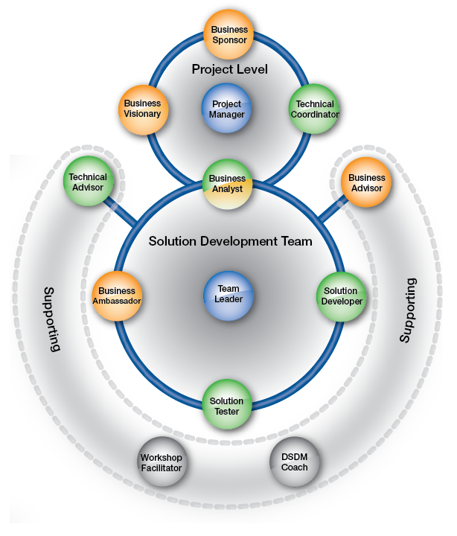

Slide 25

Any Questions

