Slide 1

Human Computer Interaction (HCI)
5CS020
Tutorial 1

Slide 2
What will we do today?
Play Quiz
Do the Lecture Revision
Discuss Task 1 with project criteria
Brainstorming
List of Example Industry

Slide 3
Lets Play
Quiz

Slide 4
1
How many tasks/assignments are there to full-fill HCI requirement?

Slide 5
1
How many tasks/assignments are there to full-fill HCI requirement?
3

Slide 6
2
What topic is not included in HCI module?

Slide 7
2
What topic is not included in HCI module?
Augmented Reality (AR)

Slide 8
3
When was a mouse first shipped with a computer?

Slide 9
3
When was a mouse first shipped with a computer?
1981

Slide 10
4
How many pixels does mouse pointer interacts with?

Slide 11
4
How many pixels does mouse pointer interacts with?
1

Slide 12
5
For what purpose was the Joystick invented?

Slide 13
5
For what purpose was the Joystick invented?
Flying planes

Slide 14
6
Which was the first touch screen phone available for public?

Slide 15
6
Which was the first touch screen phone available for public?
IBM Simon

Slide 16
Lecture
Revision

Slide 17
﻿How interfaces have evolved from punch card to keyboard to mouse to touchscreens to VUI?
﻿How small/touch screens have changed the UI design paradigms?
Large Buttons and Spacing
Declutter / Minimalism
Card based UI and Stackable Layout
High Contrast
Feedback Mechanism (Haptics/Visual)

Slide 18
Brain
Storming

Slide 19
Early Steps in Design Process
Brain
Stroming
User Persona
Task Flow
User Flow
Wire Flow
Mood
Board

Slide 20
Early Steps in Design Process
Brain
Stroming
User Persona
Task Flow
User Flow
Wire Flow
Mood
Board

Slide 21
Early Steps in Design Process
Brain
Stroming
User Persona
Task Flow
User Flow
Wire Flow
Mood
Board
In upcoming workshop

Slide 22
Brain Stroming
Problem-solving method that involves the spontaneous contribution of creative ideas and solutions
Also known as Ideation Phase
Can be done
Individually or,
In a group

Slide 23
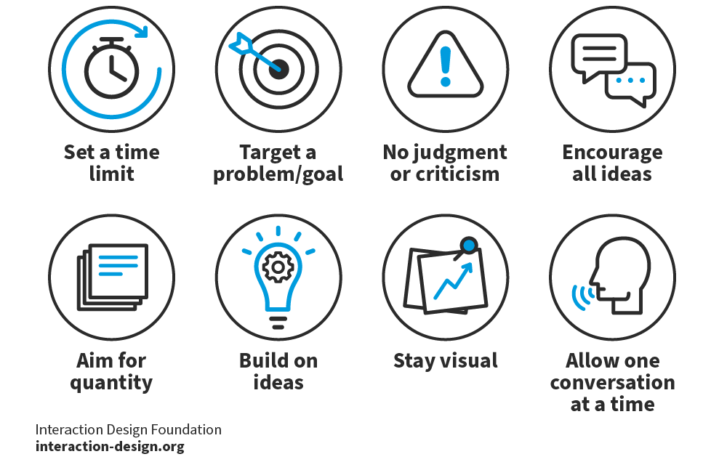
Brain Stroming
8 house rules
+
1 Facilitator
+
1 Scribber

Slide 24

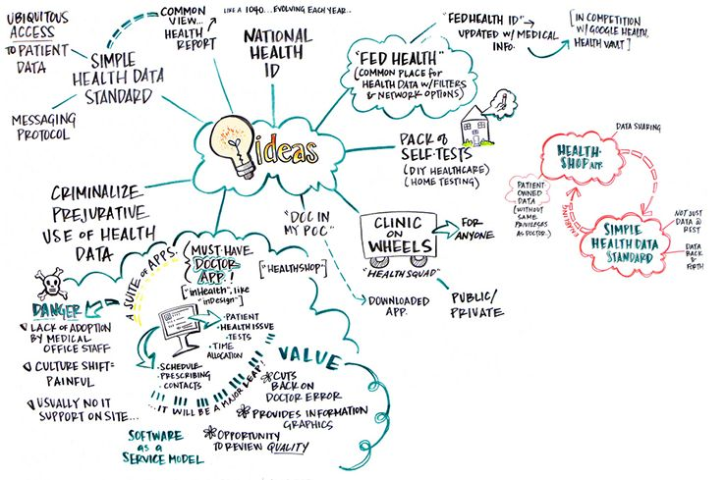

Slide 25
About
Task 1

Slide 26
The report part of Task-1 will be more clear after the second lecture
In the meantime, please start thinking about your project ideas
We will start making wireframes in the workshop so try and come up with ideas for the project
Request to Everyone
Be ready with your topic for upcoming workshop

Slide 27
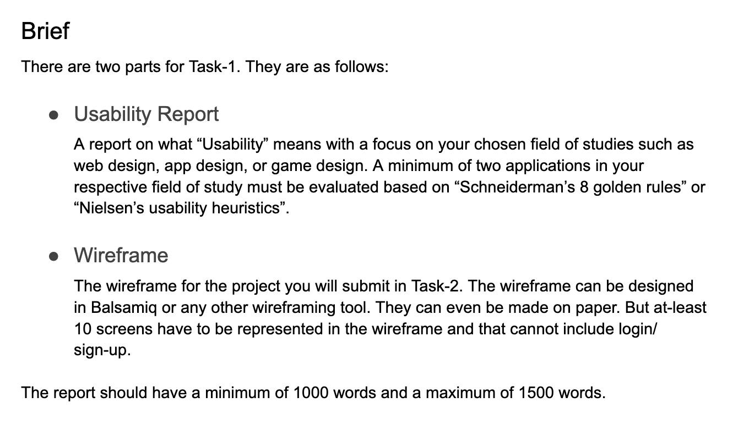

Slide 28
Wire Frame Requirement
10 keyframes with decision mapping
What will be counted
Main content screens
Setting screen (2 max)
Profile/ Account screen (2 max)
What won’t be counted but is needed
Splash Screen
Notifications
Login/ Signup screens

Slide 29
For Workshop
Bring your laptop with Figma installed in it
Think about various project idea and shortlist what you would like to do

Slide 30
Thank You!!!
Have a good day!!!

