Slide 1
Early steps in design process

Slide 2
About
Moodboard
User persona
User flow
Task flow
Wireframes
Wireflows

Slide 3
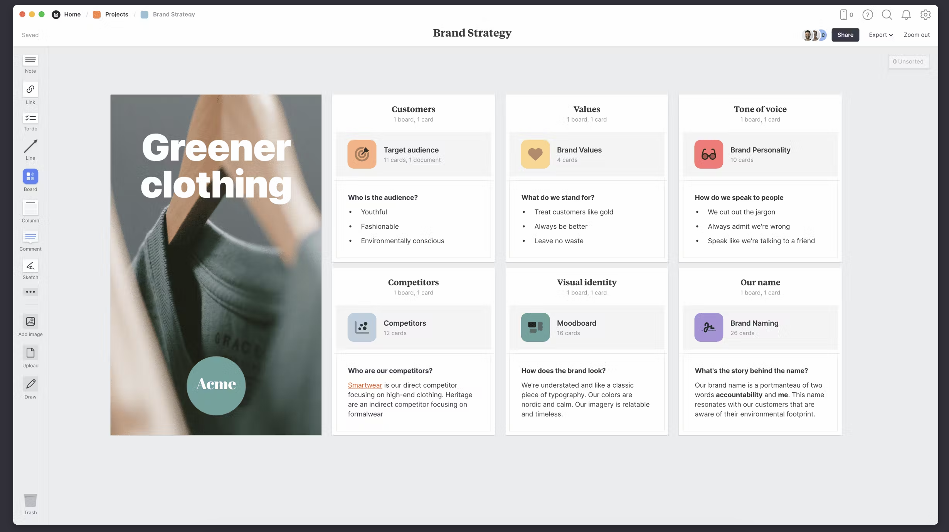
Moodboard
Visuals tools used in various creative field.
Contains Images, Texture, Color, Typography and other visual elements that communicate ideas or mood.

Slide 4
Moodboard (Contd…)
Visuals tools used in various creative field (Graphic design, fashion design, interior design and more).
Contains Images, Texture, Color, Typography ( use to arrange typefaces in a user interface to ensure text is legible, readable, and scalable. ) and other visual elements that communicate ideas or mood.

Slide 5
Moodboard (Contd…)
Visual Representation: representation of ideas to understand proposed style or direction.
Inspiration & Exploration: Designers can brainstorm ideas & experiment.
Client Communication: Useful for communicating ideas to clients or collaborators.
Consistency: Maintain consistency throughout the project.
Decision making: Assists in decision making by allowing stakehodlers to compare different design directions.
Alignment: Insecure alignment between clients or team members.

Slide 6
Moodboard (Contd…)
https://milanote.com/guide/create-better-moodboards

Slide 7
User persona
Fictional Character which you create based upon your research
Understanding the Audience: understanding the demographics, behaviors, and needs of your target audience.
Guiding the design process: provide designers and developers with a clear understanding of who they are designing for
Enchance user experience: tailor the user experience to cater to their preferences, behaviors, and pain points
Prioritizing Features: prioritize features/ functionalities based on the needs and preferences of the target audience.
Iterative Improvement: updated and refined based on user feedback and data analytics.

Slide 8
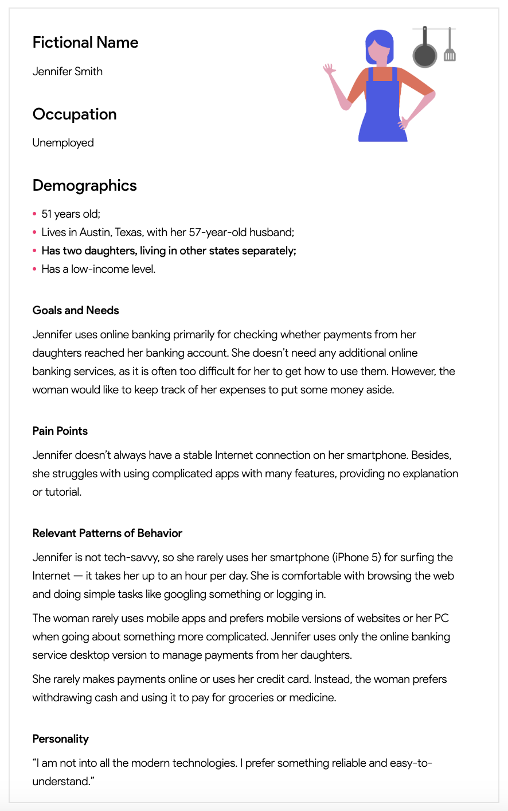
User persona
Example: https://qubstudio.com/blog/4-examples-of-ux-personas/

Slide 9
User persona (Contd…)
Reading material
https://www.interaction-design.org/literature/article/personas-why-and-how-you-should-use-them
https://www.nngroup.com/articles/personas-study-guide/
https://blog.adobe.com/en/publish/2017/09/29/putting-personas-to-work-in-ux-design-what-they-are-and-why-theyre-important

Slide 10
user flow
Path that a user takes through a website, application, or any interactive system to accomplish a particular task or goal.
Understanding User Behaviour: help in understanding how users navigate through a system to achieve their goals.
Identifying Pain Points: designers and developers can identify potential bottlenecks, obstacles, or confusing steps in the user journey.
Ensuring Task Completion: ensure that users can successfully complete tasks or achieve their goals without getting lost or frustrated along the way.

Slide 11
user flow (CONTD..)
Testing and Iteration: used as a basis for usability testing, allowing designers to observe how users interact with the system in real-world scenarios
Aligning with Business Goals: ultimately align with the business objectives of the website or application

Slide 12
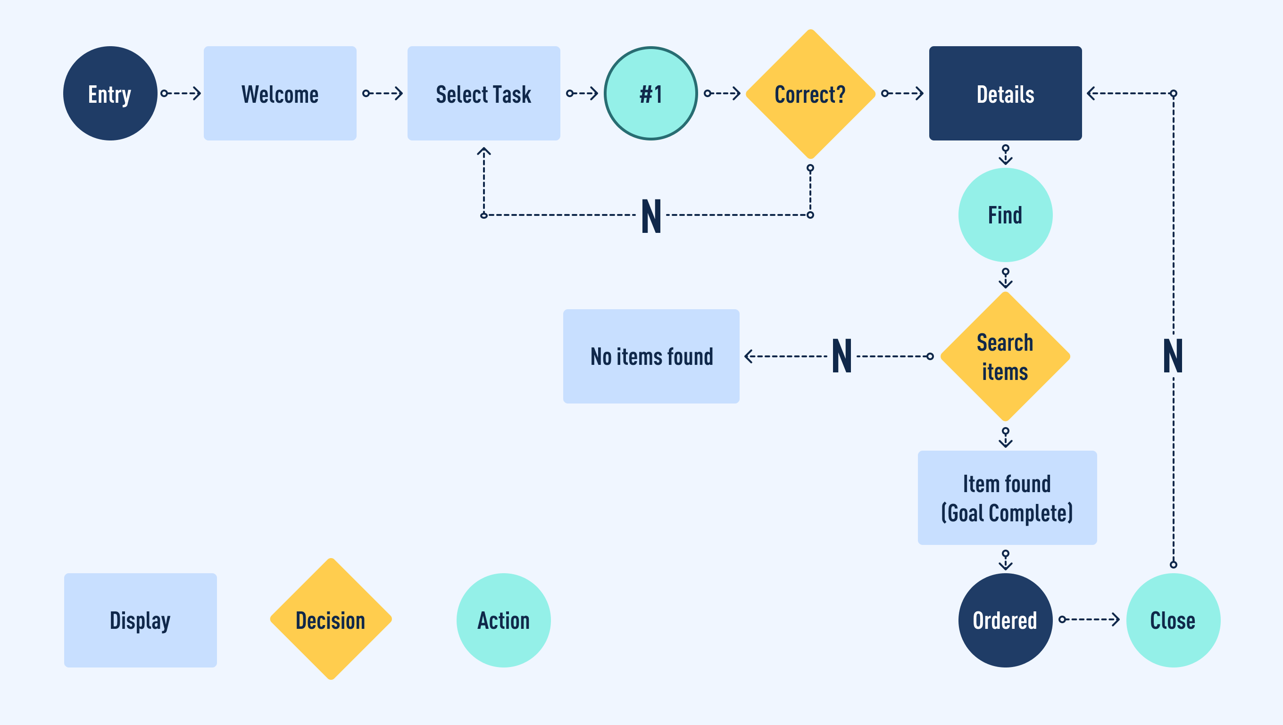
user flow (CONTD..)

Slide 13
user flow (Contd…)
Reading Material
https://careerfoundry.com/en/blog/ux-design/what-are-user-flows/
https://www.interaction-design.org/literature/topics/user-flows
https://xd.adobe.com/ideas/process/user-research/user-journey-vs-user-flow/

Slide 14
task flow
A sequential series of steps that a user follows to complete a specific task or achieve a particular goal within a digital product or service
Clarifying User Paths: a clear and detailed breakdown of the steps users need to take to accomplish a specific task within a digital product or service.
Optimizing User Experience: designers and developers can identify opportunities to streamline the user journey and eliminate unnecessary steps or friction points.
Ensuring Consistency: maintain consistency in user interactions across different parts of a digital product or service.
Supporting Accessiblity: adapted to accommodate users with disabilities or special needs, ensuring that all users can successfully complete tasks within a digital product or service.
Iterative Improvement: iterated upon and refined based on user feedback and data analytics.

Slide 15
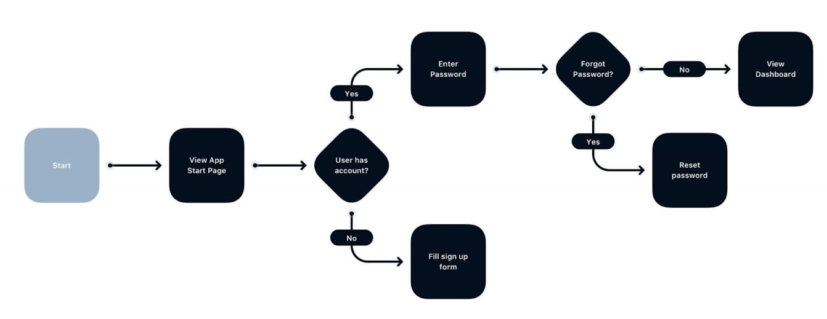
task flow (Contd…)

Slide 16
task flow (Contd…)
Reading Material
https://bootcamp.uxdesign.cc/user-flow-and-task-flow-explained-bf229332a16d

Slide 17
wire frames
Skeletal outlines or blueprints of a website, application, or digital product.
Visualizing Structure: Wireframes provide a visual representation of the layout and structure of a digital product, allowing designers and stakeholders to see how different elements will be organized on the screen.
Clarifying Functionality: By outlining the basic functionality of each page or screen, wireframes help clarify how users will interact with the interface and what actions they can perform.
Iterative Design Process: Wireframes facilitate an iterative design process by allowing designers to quickly explore and iterate on different layout options and user flows without investing time in detailed visual design.

Slide 18
wire frames (contd..)
Identifying Requirements: Creating wireframes helps identify the functional requirements of the interface, including the placement of navigation elements, calls to action, and content sections.
User Feedback: Wireframes can be used to gather feedback from stakeholders and potential users early in the design process.
Facilitating Communication: Wireframes serve as a communication tool between designers, developers, and stakeholders, helping to ensure that everyone is aligned on the overall design direction and objectives.
Saving Time and Resources: Wireframes allow designers to focus on the structure and functionality of the interface without getting bogged down in detailed visual design. This saves time and resources during the initial stages of the design process.

Slide 19
wire frames (Contd…)
Schematics or blueprints that is used to communicate about the design
Help go through quick changes and revisions and saves a lot of time and money
Two phases of wireframe design
Ideation Phase
Where you just go through ideas and try to find different ways to solve an issue
Validation Phase
Where you check if your proposed idea will be successful

Slide 20
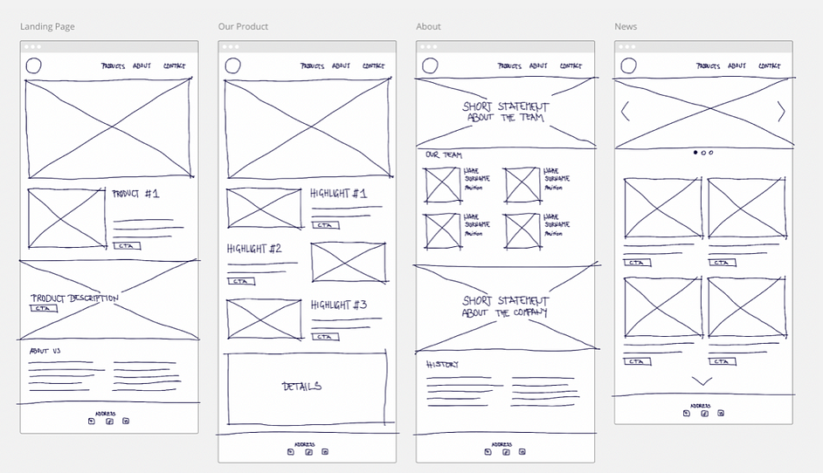
wire frames (Contd…)

Slide 21
wire frames (Contd…)
Reading Material
https://balsamiq.com/learn/articles/what-are-wireframes/
https://www.interaction-design.org/literature/topics/wireframing
https://balsamiq.com/learn/articles/wireframing-phases-ideation-validation/

Slide 22
Wire flows
combine the concepts of wireframes and user flows, providing a visual representation of both the layout and structure of a digital product as well as the sequential steps users take to accomplish specific tasks or goals within that product.
Integration of Structure and Flow: structural layout of wireframes with the sequential flow of user tasks, providing a comprehensive view of both aspects of the user experience in a single document.
Holistic Understanding: By combining wireframes with user flows, wireflows offer a holistic understanding of how the interface is organized and how users navigate through it to achieve their goals.

Slide 23
Wire flows (Contd…)
Identifying Design-Flow Alignment: ensure alignment between the design layout and the user flow, ensuring that the interface structure supports the intended user interactions and goals.
Validating User Flows: used to validate user flows through usability testing and feedback sessions with stakeholders and users.
Supporting Collaboration: encourage collaboration between different teams involved in the design and development process by providing a shared visual reference that integrates both structural and flow aspects of the interface.
Enhancing Documentation: enhance design documentation by providing a visual representation of both the interface layout and user interactions, making it easier to communicate design decisions and requirements.

Slide 24
Wire flows (Contd…)
A combination of wireframes and flowcharts
Document dynamic changes in screens
Helps define interactions and adds more clarity to wireframes

Slide 25
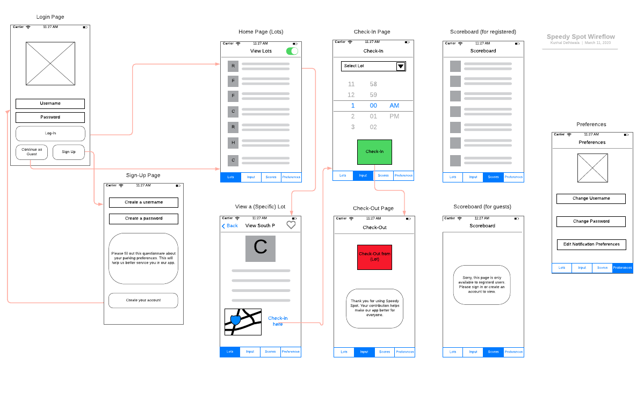
Wire flows (Example)

Slide 26
Wire flows (Contd…)
Reading material
https://www.nngroup.com/articles/wireflows/
https://balsamiq.com/learn/articles/wireflows/#:~:text=A%20wireflow%20is%20a%20hybrid,take%20while%20using%20your%20product
https://circle.visual-paradigm.com/docs/user-experience-design/wireflow/what-is-a-wireflow/

Slide 27
Thank you ☺

