Slide 1

5CS021 Numerical Methods and Concurrency
Multithreading

Slide 2
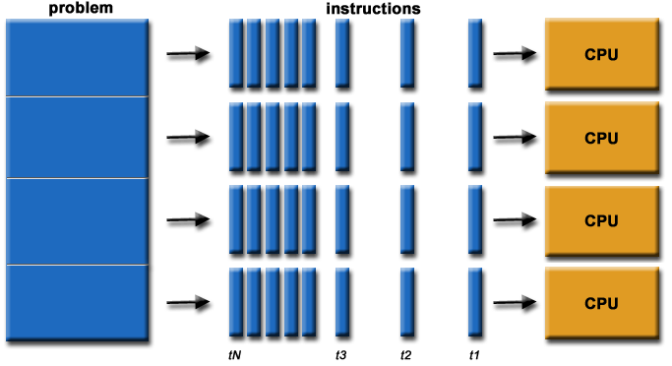
Parallelism
Parallelism is performing many task at the same time.
It is the use of multiple resources(e.g. Cores) to solve a problem.
Parallelism is doing lots of things at once.

Slide 3
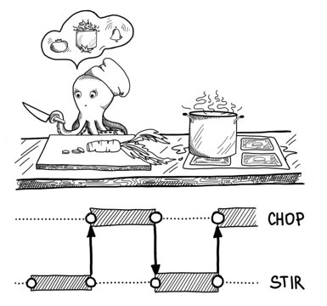
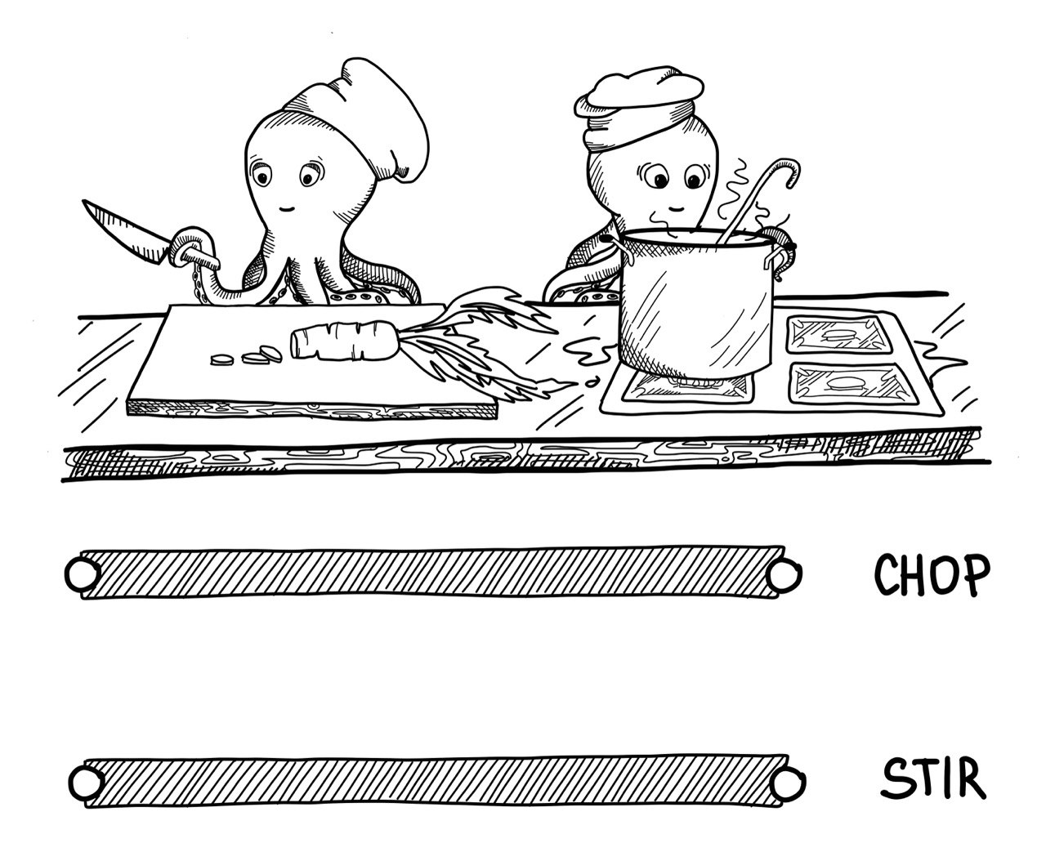
Concurrency vs Parallelism

Slide 4
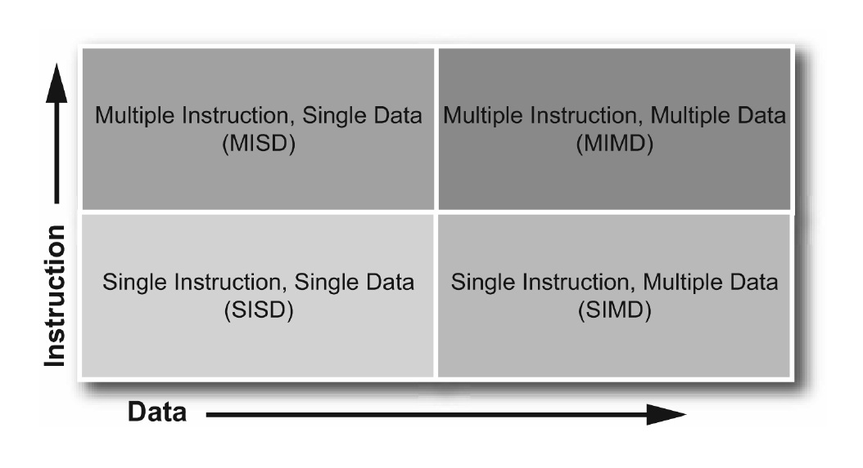
Flynn’s Taxonomy on Parallelism

Slide 5
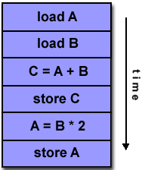
Single Instruction, Single Data (SISD)
Provides no parallelism in hardware
1 data stream processed by the CPU in 1 clock cycle
Instructions executed in serial fashion

Slide 6
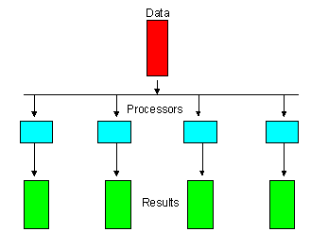
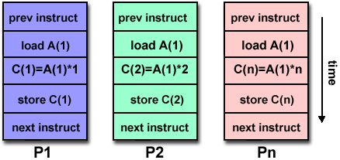
Multiple Instruction, Single Data (MISD)
Process single data stream using multiple instruction streams simultaneously

Slide 7
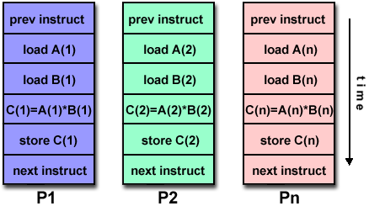
Single Instruction, Multiple Data (SIMD)
Single instruction steam has ability to process multiple data streams in 1 clock cycle
Takes operation specified in one instruction and applies it to more than 1 set of data elements at 1 time
Suitable for graphics and image processing

Slide 8
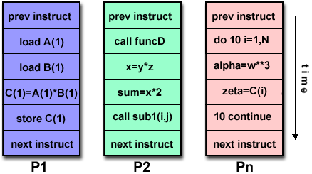
Multiple Instruction, Multiple Data (MIMD)
Different processors can execute different instructions on different pieces of data
Each processor can run independent task

Slide 9
What is Multitasking?
Multitasking is running multiple programs at the same time in a single operating system.
On a single-core CPU computer, only one task/program is running at any one time on the CPU.
At predetermined intervals, the operating system pauses the current task, saves its state and loads another task into the CPU an runs it.
This is called context-switching.

Slide 10
A
B
C
D
Processing Element
X
Y
Z
M

Slide 11
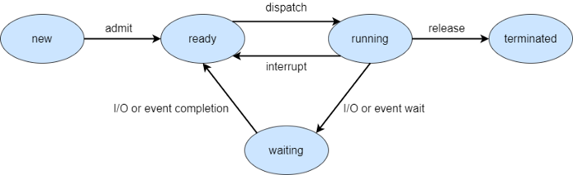
Process States

Slide 12
What is Multithreading?
Multithreading is the concurrent parallel execution of multiple instances of your program's code, within the same process.
Multithreading is similar to multitasking except that all the running programs(threads) share same the same memory, the same variables and everything else in the program.

Slide 13
Why multithreading?
Modern processor have more than one CPU core: up to 18 cores on the Intel i9-7980XE
The Nvidia Tesla V100 has 5120 cores.
Single-threaded programs can only use 1 core at a time.
Multi-threaded programs can spread the processing load across all the cores available.
For example an image processing program can divide up an image into 16 equal parts and process each parts using a separate thread, and this will run up to 16 times faster than a single-thread program

Slide 14
Why not Multithreading Everywhere?
It is not always possible to break a problem down into separate equal parts, for example, processing a file that is received over the network, one character at a time.
It is sometimes difficult to organise and manage the work divided between threads: Imagine a fast food kitchen with multiple cooks reading items from a large order screen. Who cooks what when?

Slide 15
a=m+n b=p+q
a b
1
a b a b
2.
a b a b
a
a
3 b
b
TIME

Slide 16
a=m+n b=p+q x=a+b
a b x
1
a b a b x
2
a x
3
b
TIME

Slide 17
How to use threading in C?
The POSIX(Portable Operating System Interface) Threads standard is the most widely used threading API, also known as pthreads.
To use pthreads, you have to include the header file <pthread.h>
To create and start a thread, you have to call the API pthread_create()
To wait for a thread to finish, you have to call the API pthread_join()

Slide 18
pthread_create()
int pthread_create( pthread_t *threadID, pthread_attr_t *attr, void *(*thread_function) (void *), void *targ);
Creates a thread and executes thread_function
threadID - pointer to a thread ID variable to identify the thread after it has been created.
attr - thread attributes - normally NULL;
thread_function - the main thread function.
targ - pointer to the parameter. Can be NULL;
On success, pthread_create() returns 0; on error, it returns an error number

Slide 19
pthread_join()
int pthread_join(pthread_t threadID, void **retval);
Waits for the thread with threadID to finish.
threadID - the id of the thread specified by pthread_create()
retval - a thread can return a value via the function pthread_exit(). retval is a pointer to the return value.
On success, pthread_join() returns 0; on error, it returns an error number.

Slide 20
Pthread Example
#include <pthread.h>
#include <stdio.h>
void *threadOne(void *p){
for(int i=0; i<1000; i++)
printf("Thread One: i=%d\n",i);
}
void *threadTwo(void *p){
for(int i=0; i<1000; i++)
printf("Thread Two: i=%d\n",i);
}
void main(){
pthread_t thrID1, thrID2;
pthread_create(&thrID1, NULL, threadOne, NULL);
pthread_create(&thrID2, NULL, threadTwo, NULL);
pthread_join(thrID1, NULL);
pthread_join(thrID2, NULL);
}

Slide 21
Converting Single Thread to Multithreaded – Single Thread Version
#include <stdio.h>
void main()
{
int i, c;
int nstart=1, nfinish=20000;
printf("Prime numbers between %d and %d are :\n",
nstart, nfinish);
for(i=nstart; i<=nfinish; i++)
{
for(c=2; c<=i-1; c++)
{
if ( i%c==0 )
break;
}
if ( c==i )
printf("%d\n", i);
}
}

Slide 22
Multithreaded Version - 2 threads
#include <stdio.h>
#include <pthread.h>
void *threadOne(void *p){
int i, c;
int nstart=1, nfinish=10000;
//printf("threadOne : Prime numbers between %d and %d are :\n",
nstart, nfinish);
for(i=nstart; i<=nfinish; i++)
{
for(c=2; c<=i-1; c++)
{
if ( i%c==0 )
break;
}
if ( c==i ) ;
printf("threadOne : %d\n", i);
}
return 0;
}
void main(){
pthread_t thrID1, thrID2;
pthread_create(&thrID1, NULL, threadOne, NULL);
pthread_create(&thrID2, NULL, threadTwo, NULL);
pthread_join(thrID1, NULL);
pthread_join(thrID2, NULL);
}
void *threadTwo(void *p){
int i, c;
int nstart=10001, nfinish=20000;
for(i=nstart; i<=nfinish; i++)
{
for(c=2; c<=i-1; c++)
{
if ( i%c==0 )
break;
}
if ( c==i ) ;
printf("threadTwo : %d\n", i);
}
return 0;
}

