Slide 1
5CSO21
Introduction to Numerical Methods and Basics of C programming
By Hiran Patel

Slide 2
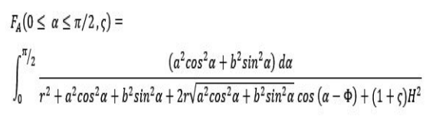
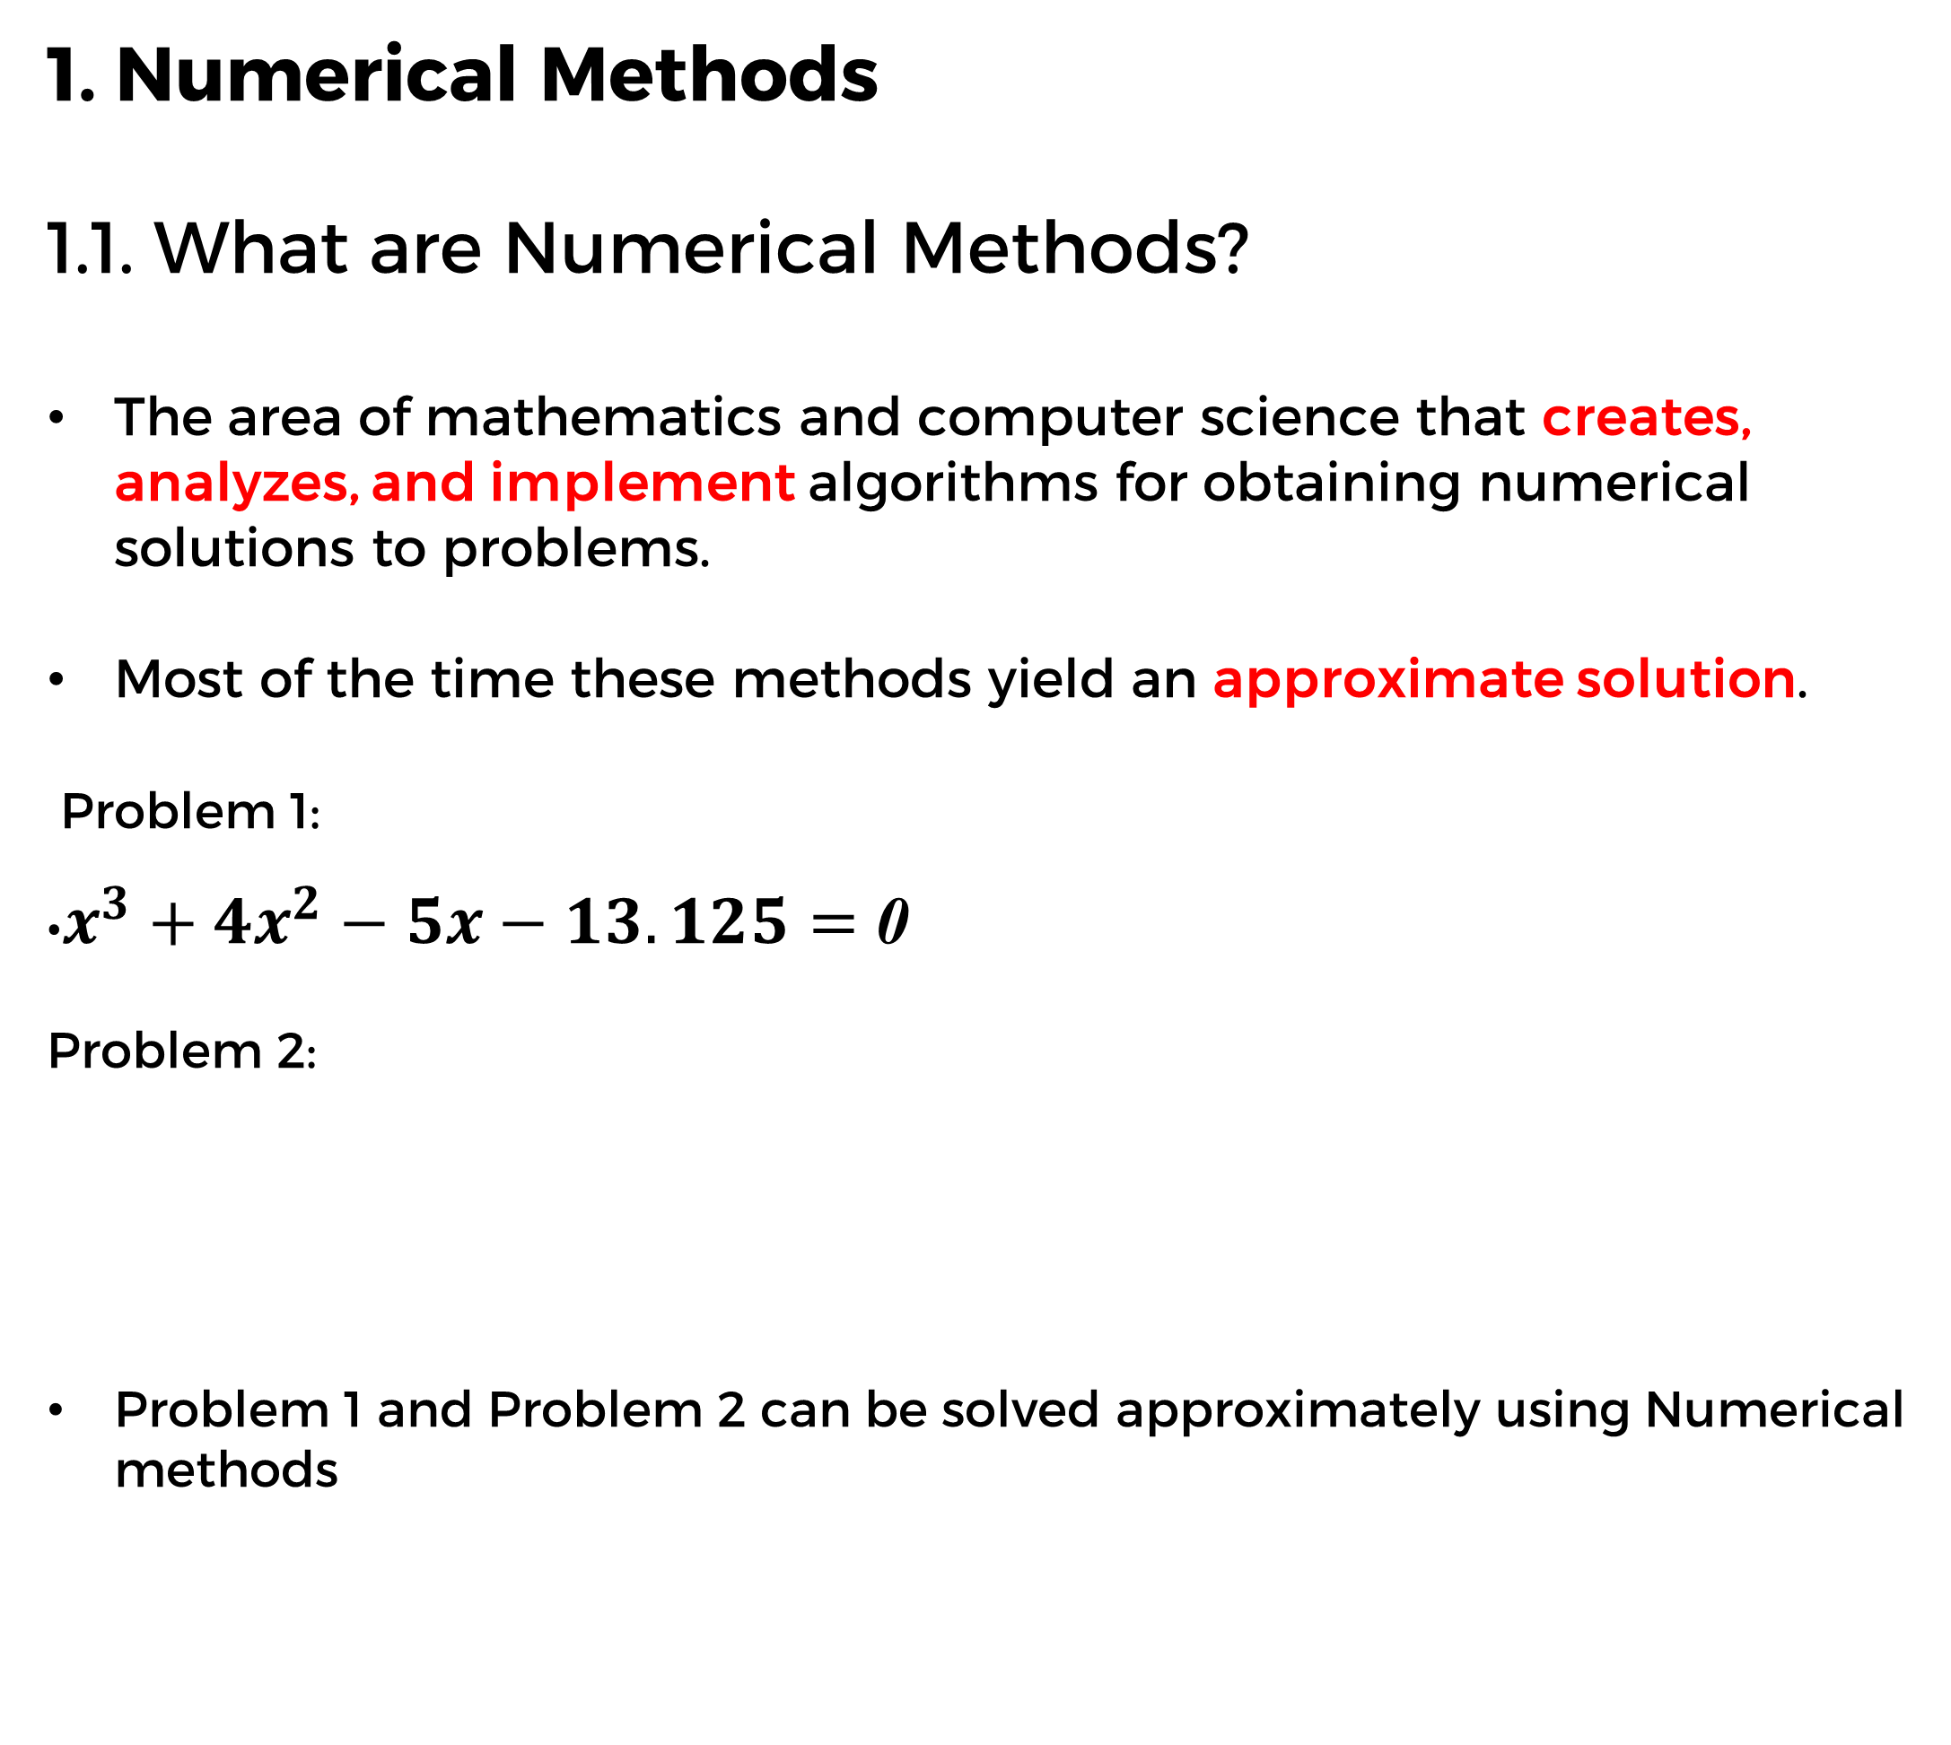
01
Numerical methods
1. Numerical Methods
1.1. What are Numerical Methods?
The area of mathematics and computer science that creates, analyzes, and implement algorithms for obtaining numerical solutions to problems.
Most of the time these methods yield an approximate solution.
Problem 1:
•$x^{3}+4x^{2}−5x−13.125=$ 0
Problem 2:
Problem 1 and Problem 2 can be solved approximately using Numerical methods
02
Parallelism
03
Concurrency
04
Comparison between Parallelism and concurrency
05
History of C programming
06
Introduction to C programming
07
Basic C program template
08
Data types
09
Variables
10
printf
11
scanf
12
Format Specifiers
13
Conditional Statements
14
Loops

Slide 3
01
Numerical methods
02
Parallelism
1.2. Real-life application of Numerical Methods
Making Weather Predictions
Image Recognition
Google Search
Speech Recognition
Credit Card Fraud Detection
E-payments
Google Map so on......
03
Concurrency
04
Comparison between Parallelism and concurrency
05
History of C programming
06
Introduction to C programming
07
Basic C program template
08
Data types
09
Variables
10
printf
11
scanf
12
Format Specifiers
13
Conditional Statements
14
Loops

Slide 4
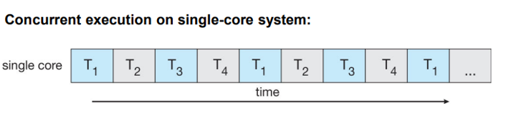
01
Numerical methods
3. Concurrency
3.1. What is Concurrency?
Concurrency is the execution of the multiple instruction sequences at the same time.
Concurrency is the programming concept in which two or more processes start, run in interleaved fashion in a single core CPU.
02
Parallelism
03
Concurrency
04
Comparison between Parallelism and concurrency
05
History of C programming
06
Introduction to C programming
07
Basic C program template
08
Data types
09
Variables
10
printf
11
scanf
12
Format Specifiers
13
Conditional Statements
14
Loops

Slide 5
01
Numerical methods
3.2. Characteristics of Concurrency
It is the way of dealing with multiple things at a time.
The important detail here is that the tasks don’t necessarily execute at the same time, but they can be divided into smaller tasks that can be interleaved.
02
Parallelism
03
Concurrency
04
Comparison between Parallelism and concurrency
05
History of C programming
06
Introduction to C programming
07
Basic C program template
08
Data types
09
Variables
10
printf
11
scanf
12
Format Specifiers
13
Conditional Statements
14
Loops

Slide 6
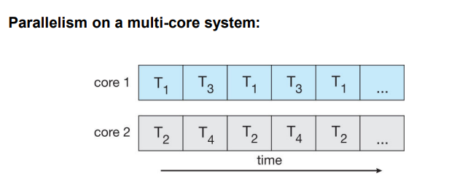
01
Numerical methods
2. Parallelism
2.1. What is Parallelism?
Parallelism is performing multiple tasks at the same time.
Parallelism is about doing lots of things at once.
It is the use of multiple resources(e.g. Cores) to solve a problem.
02
Parallelism
03
Concurrency
04
Comparison between Parallelism and concurrency
05
History of C programming
06
Introduction to C programming
07
Basic C program template
08
Data types
09
Variables
10
printf
11
scanf
12
Format Specifiers
13
Conditional Statements
14
Loops

Slide 7
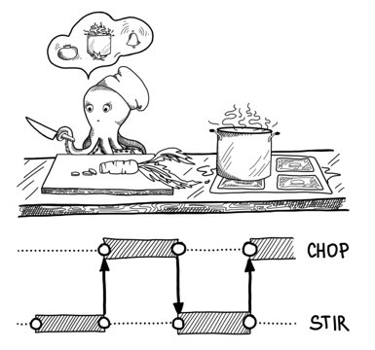
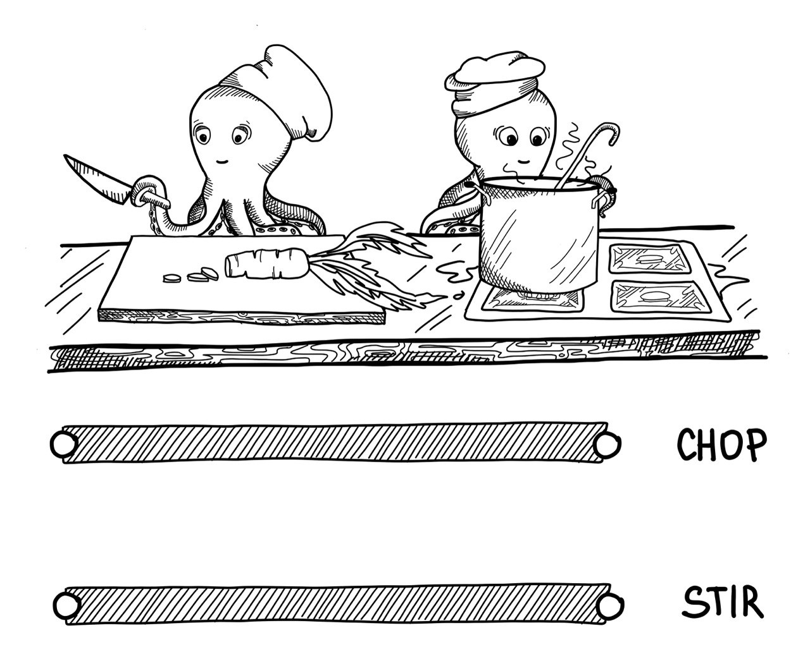
01
Numerical methods
4. Comparison Between Parallelism and
Concurrency
02
Parallelism
03
Concurrency
04
Comparison between Parallelism and concurrency
05
History of C programming
06
Introduction to C programming
07
Basic C program template
08
Data types
09
Variables
10
printf
11
scanf
12
Format Specifiers
13
Conditional Statements
14
Loops

Slide 8
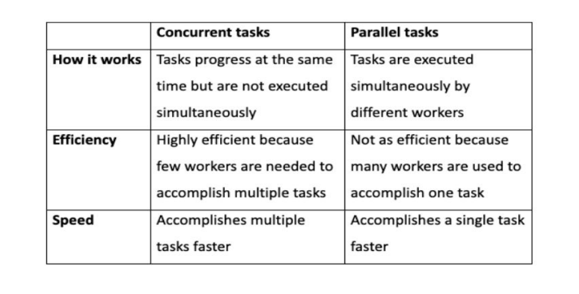
01
Numerical methods
4. Comparison Between Parallelism and
Concurrency
02
Parallelism
03
Concurrency
04
Comparison between Parallelism and concurrency
05
History of C programming
06
Introduction to C programming
07
Basic C program template
08
Data types
09
Variables
10
printf
11
scanf
12
Format Specifiers
13
Conditional Statements
14
Loops

Slide 9

01
Numerical methods
5. History of C programming
Developed by Dennis Ritchie at the Bell Laboratories in 1972.
C was invented to write an operating system called UNIX.
C is a successor of B language which was introduced around 1970.
formalized in 1988 by the American National Standard Institute (ANSI)
02
Parallelism
03
Concurrency
04
Comparison between Parallelism and concurrency
05
History of C programming
06
Introduction to C programming
07
Basic C program template
08
Data types
09
Variables
10
printf
11
scanf
12
Format Specifiers
13
Conditional Statements
14
Loops

Slide 10
01
Numerical methods
6. Introduction to C programming
C is high-level and general-purpose programming language.
Procedural Language
Portable
Speed
General Purpose
02
Parallelism
03
Concurrency
04
Comparison between Parallelism and concurrency
05
History of C programming
06
Introduction to C programming
07
Basic C program template
08
Data types
09
Variables
10
printf
11
scanf
12
Format Specifiers
13
Conditional Statements
14
Loops

Slide 11
01
Numerical methods
7. Basic C program template
02
Parallelism
03
Concurrency
Comparison between Parallelism and concurrency
#include <stdio.h>
//standard input and output library
//you need the above line to import the printing function
void main(){
printf(“Hello world”);
// printf() is a used to send formatted output to the screen.
}
04
05
History of C programming
06
Introduction to C programming
07
Basic C program template
08
Data types
09
Variables
10
printf
11
scanf
12
Format Specifiers
13
Conditional Statements
14
Loops

Slide 12
01
Numerical methods
02
Parallelism
8. Data types
8.1. What are Data types
It is declarations for variables.
8.2. Need of data types
It tells the computer system how to interpret its value.
It ensures that data is collected in the preferred format and the value of each property is as expected.
03
Concurrency
04
Comparison between Parallelism and concurrency
05
History of C programming
06
Introduction to C programming
07
Basic C program template
08
Data types
09
Variables
10
printf
11
scanf
12
Format Specifiers
13
Conditional Statements
14
Loops

Slide 13
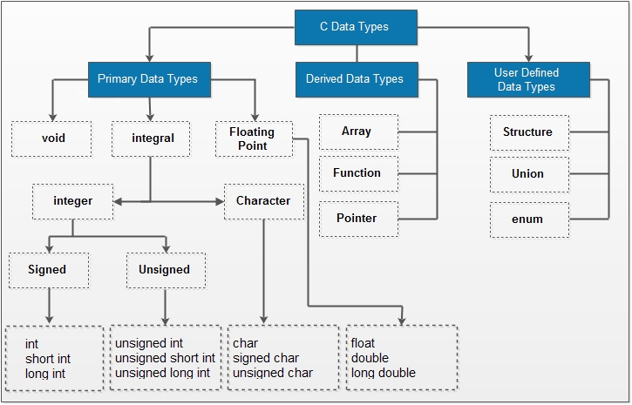
01
Numerical methods
02
Parallelism
03
Concurrency
04
Comparison between Parallelism and concurrency
05
History of C programming
06
Introduction to C programming
07
Basic C program template
08
Data types
09
Variables
10
printf
11
scanf
12
Format Specifiers
13
Conditional Statements
14
Loops

Slide 14
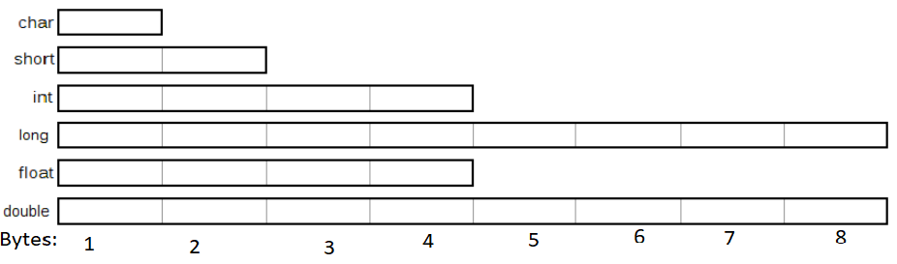
01
Numerical methods
02
Parallelism
Relative Size of Data Types (64-bit complier)
03
Concurrency
04
Comparison between Parallelism and concurrency
05
History of C programming
06
Introduction to C programming
07
Basic C program template
08
Data types
09
Variables
10
printf
11
scanf
12
Format Specifiers
13
Conditional Statements
14
Loops

Slide 15
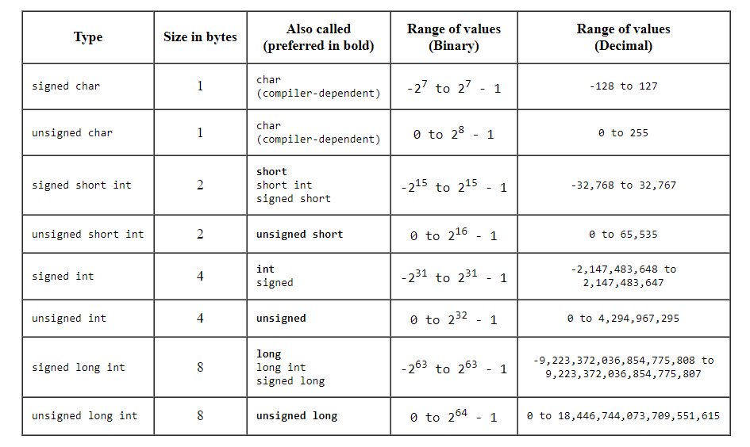
01
Numerical methods
02
Parallelism
03
Concurrency
04
Comparison between Parallelism and concurrency
05
History of C programming
06
Introduction to C programming
07
Basic C program template
08
Data types
09
Variables
10
printf
11
scanf
12
Format Specifiers
13
Conditional Statements
14
Loops

Slide 16
01
Numerical methods
8.3. Types of data types
8.3.1. Numbers
8.3.1.1. int (integer) – whole number
8.3.1.2. double – decimal number
8.3.1.3. float – similar to double but less precision (only use when
computing thousands of low decimal point numbers)
8.3.1.4. long – whole number but allows bigger numbers than int
8.3.1.5. long long – whole number (bigger than long)
Unsigned variables hold just positive numbers.
8.3.1.6. Unsigned int – whole number (0 to 4,294,967,295)
8.3.2. Character with examples
8.3.2.1. Char- single character
e.g. char ch=‘A’
8.3.2.2. Strings in C are known as char arrays
• Char name[] = “Hiran”
• Char name[5] = “Hiran”
02
Parallelism
03
Concurrency
04
Comparison between Parallelism and concurrency
05
History of C programming
06
Introduction to C programming
07
Basic C program template
08
Data types
09
Variables
10
printf
11
scanf
12
Format Specifiers
13
Conditional Statements
14
Loops

Slide 17
01
Numerical methods
02
Parallelism
9. Variables
9.1. What are variables
•It is a container to hold data.
9.2. Need for variables
To store information to be referenced and manipulated in a computer program.
Provides a way of labeling data with a meaningful name, so that our program can be understood more clearly.
03
Concurrency
04
Comparison between Parallelism and concurrency
05
History of C programming
06
Introduction to C programming
07
Basic C program template
08
Data types
09
Variables
10
printf
11
scanf
12
Format Specifiers
13
Conditional Statements
14
Loops

Slide 18
01
Numerical methods
02
Parallelism
9.3. Rules for naming a variable
A variable name can have alphabets (lowercase and uppercase letters) digits, and underscore(_).
The first letter of a variable should be either a letter or an underscore.
No whitespace is allowed within the variable name.
A variable name must not be any reserved word or keyword, e.g. int, goto, etc.
Valid variable names: salary, first_name, Address1, _id etc.
Invalid variable names: salary$, user name, @username, 1stname, int, float etc.
03
Concurrency
04
Comparison between Parallelism and concurrency
05
History of C programming
06
Introduction to C programming
07
Basic C program template
08
Data types
09
Variables
10
printf
11
scanf
12
Format Specifiers
13
Conditional Statements
14
Loops

Slide 19
01
Numerical methods
10. Printf
10.1. Use of Printf with example
C uses format specifiers to print out certain types of variables. In java,
you can use just the variable name, in C, you need to specify the type
of variable within a printing function known as printf.
Simple print in C:
•Printf(“Hello World”)
int num = 10;
printf(“%d”, num) or….. printf(“num = %d”, num)
Output? 10 or.... num = 10
To print a char array: char name[] = “Hiran”;
printf(“My name is %s”, name);
Output ? My name is Hiran
02
Parallelism
03
Concurrency
04
Comparison between Parallelism and concurrency
05
History of C programming
06
Introduction to C programming
07
Basic C program template
08
Data types
09
Variables
10
printf
11
scanf
12
Format Specifiers
13
Conditional Statements
14
Loops

Slide 20
01
Numerical methods
11. Scanf
11.1. Use of scanf with example
scanf() is used to take user input (stdin)
& (address operator) gives address of a variable
Needed because scanf() places input value at a variable address
int age;
printf(“Enter your age:”);
scanf(“%d”,&age);
printf(“Your age is: %d”,age);
02
Parallelism
03
Concurrency
04
Comparison between Parallelism and concurrency
05
History of C programming
06
Introduction to C programming
07
Basic C program template
08
Data types
09
Variables
10
printf
11
scanf
12
Format Specifiers
13
Conditional Statements
14
Loops

Slide 21
01
Numerical methods
02
Parallelism
12. Format specifiers
12.1. What are format Specifiers?
Format specifiers in C are used to take inputs and print the output of a type.
12.2. Need of format Specifiers
Used in c for input and output purposes
Helps compiler to understand what type of data is used in variable.
03
Concurrency
04
Comparison between Parallelism and concurrency
05
History of C programming
06
Introduction to C programming
07
Basic C program template
08
Data types
09
Variables
10
printf
11
scanf
12
Format Specifiers
13
Conditional Statements
14
Loops

Slide 22
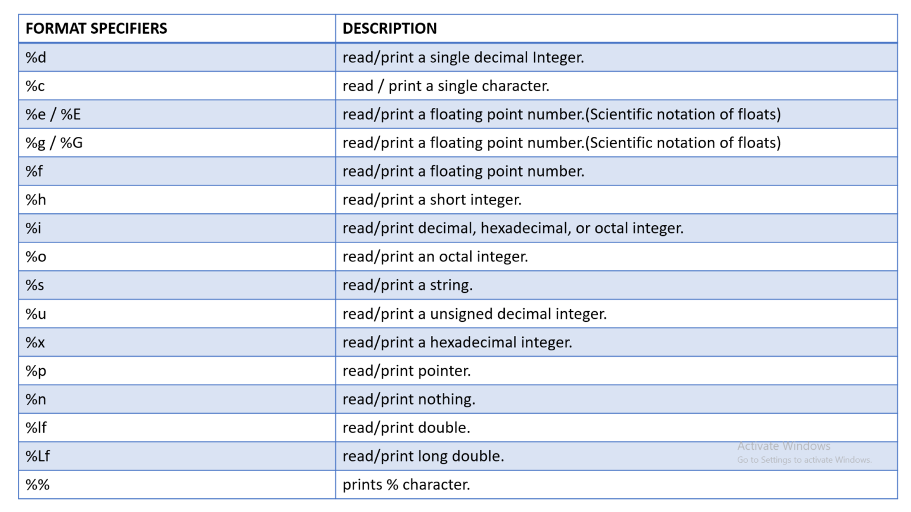
01
Numerical methods
02
Parallelism
03
Concurrency
04
Comparison between Parallelism and concurrency
05
History of C programming
06
Introduction to C programming
07
Basic C program template
08
Data types
09
Variables
10
printf
11
scanf
12
Format Specifiers
13
Conditional Statements
14
Loops

Slide 23
01
Numerical methods
13. Conditional Statement (if…else)..with examples
13.1. If statements
If statements in C are the same as Java. E.g.
int num = 10;
if(num < 20)
{
printf(“Num is less than 20”);
}
printf(“Bye”);
02
Parallelism
03
Concurrency
04
Comparison between Parallelism and concurrency
05
History of C programming
06
Introduction to C programming
07
Basic C program template
08
Data types
09
Variables
10
printf
11
scanf
12
Format Specifiers
13
Conditional Statements
14
Loops

Slide 24
01
Numerical methods
13.2. If/else statements
If statements in C are the same as Java. E.g.
Int num = 10;
If(num < 20) {
printf(“Num is less than 20”);
}
else{
printf(“Num is not less than 20”);
}
02
Parallelism
03
Concurrency
04
Comparison between Parallelism and concurrency
05
History of C programming
06
Introduction to C programming
07
Basic C program template
08
Data types
09
Variables
10
printf
11
scanf
12
Format Specifiers
13
Conditional Statements
14
Loops

Slide 25
01
Numerical methods
13.3. If…elseif..else statement
int a,b,c;
printf("Enter three numbers: \n");
scanf("%d%d%d", &a, &b, &c);
if(a>b && a>c)
{
printf("Largest = %d", a);
}
else if(b>a && b>c)
{
printf("Largest = %d", b);
}
else
{
printf("Largest = %d", c);
}
02
Parallelism
03
Concurrency
04
Comparison between Parallelism and concurrency
05
History of C programming
06
Introduction to C programming
07
Basic C program template
08
Data types
09
Variables
10
printf
11
scanf
12
Format Specifiers
13
Conditional Statements
14
Loops

Slide 26
01
Numerical methods
13.4. Switch statement
int num = 8;
switch (num) {
case 7:
printf("Value is 7");
break;
case 8:
printf("Value is 8");
break;
case 9:
printf("Value is 9");
break;
default:
printf("Out of range");
break;
}
02
Parallelism
03
Concurrency
04
Comparison between Parallelism and concurrency
05
History of C programming
06
Introduction to C programming
07
Basic C program template
08
Data types
09
Variables
10
printf
11
scanf
12
Format Specifiers
13
Conditional Statements
14
Loops

Slide 27
01
Numerical methods
14. Loops
14.1.For Loop
Loops are the same in C as they are in Java. E.g.
int i;
for (i=1; i<= 5; i++){
printf(“Hello”);
}
02
Parallelism
03
Concurrency
04
Comparison between Parallelism and concurrency
05
History of C programming
06
Introduction to C programming
07
Basic C program template
08
Data types
09
Variables
10
printf
11
scanf
12
Format Specifiers
13
Conditional Statements
14
Loops

Slide 28
01
Numerical methods
14.2. For…Nested
int n;// variable declaration
printf("Enter the value of n :");
// Displaying the n tables.
for(int i=1;i<=n;i++) // outer loop
{
for(int j=1;j<=10;j++) // inner loop
{
printf("%d\t",(i*j)); // printing the value.
}
printf("\n");
02
Parallelism
03
Concurrency
04
Comparison between Parallelism and concurrency
05
History of C programming
06
Introduction to C programming
07
Basic C program template
08
Data types
09
Variables
10
printf
11
scanf
12
Format Specifiers
13
Conditional Statements
14
Loops

Slide 29
01
Numerical methods
14.3. While
#include <stdio.h>
void main(){
int i = 1;
while(i <=5){
printf("i=%d\n",i);
i=i+1;
}
printf("Now value of i is %d",i);
}
02
Parallelism
03
Concurrency
04
Comparison between Parallelism and concurrency
05
History of C programming
06
Introduction to C programming
07
Basic C program template
08
Data types
09
Variables
10
printf
11
scanf
12
Format Specifiers
13
Conditional Statements
14
Loops

Slide 30
01
Numerical methods
14.4. Do...While
#include <stdio.h>
void main() {
int i = 1;
do{
printf("i=%d\n",i);
i=i+1;
} while(i < 1);
}
02
Parallelism
03
Concurrency
04
Comparison between Parallelism and concurrency
05
History of C programming
06
Introduction to C programming
07
Basic C program template
08
Data types
09
Variables
10
printf
11
scanf
12
Format Specifiers
13
Conditional Statements
14
Loops

