Slide 1
Array, String and Pointer
Week 03
Compiled by Subash Khatiwada

Slide 2
Array in C

Slide 3

Array in C
Navigation Table
Array in C
Size of an Array
sizeof( ) function
Length of an Array
Multi-dimensional Array
String in C
Different ways of taking string input
Different ways to print string
String Operations
strlen(s
strcat(s,t)
strcmp(s,t)
strcpy(s,t)
Pointer in C
Size of pointer variable
Referencing and Dereferencing
An array is a group of homogenous data.
Array size = 5
10
20
5
12
24
Indices
0
1
2
3
4

Slide 4
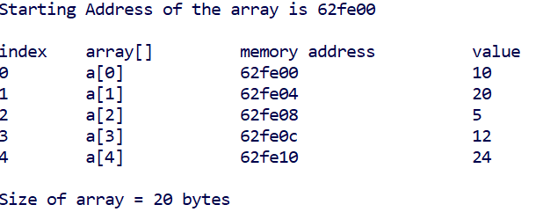
Array in C
Navigation Table
Array in C
Size of an Array
sizeof( ) function
Length of an Array
Multi-dimensional Array
String in C
Different ways of taking string input
Different ways to print string
String Operations
strlen(s
strcat(s,t)
strcmp(s,t)
strcpy(s,t)
Pointer in C
Size of pointer variable
Referencing and Dereferencing
How much space is required to store given array?
4 Bytes x 5 = 20 Bytes

Slide 5
Size of an Array
Navigation Table
Array in C
Size of an Array
sizeof( ) function
Length of an Array
Multi-dimensional Array
String in C
Different ways of taking string input
Different ways to print string
String Operations
strlen(s
strcat(s,t)
strcmp(s,t)
strcpy(s,t)
Pointer in C
Size of pointer variable
Referencing and Dereferencing
Size of array = memory required to store a data x number of data
int a[3] = {1, 2, 3};
Size of array = memory allocated to store integer data (4 Bytes) x number of data(3)

Slide 6

sizeof( ) function
Navigation Table
Array in C
Size of an Array
sizeof( ) function
Length of an Array
Multi-dimensional Array
String in C
Different ways of taking string input
Different ways to print string
String Operations
strlen(s
strcat(s,t)
strcmp(s,t)
strcpy(s,t)
Pointer in C
Size of pointer variable
Referencing and Dereferencing
sizeof( ) function is used to calculate the size memory allocated by the complier to store the array in memory. It returns the size of object in Bytes.
sizeof(a) =
sizeof(a[0]) =
8 Bytes x 5 = 40 Bytes
???
8 Bytes x 1
???

Slide 7

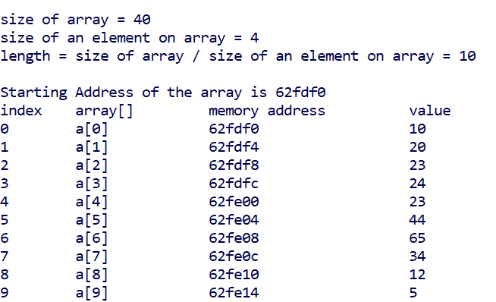
Length of an Array
Navigation Table
Array in C
Size of an Array
sizeof( ) function
Length of an Array
Multi-dimensional Array
String in C
Different ways of taking string input
Different ways to print string
String Operations
strlen(s
strcat(s,t)
strcmp(s,t)
strcpy(s,t)
Pointer in C
Size of pointer variable
Referencing and Dereferencing

Slide 8
Multi-dimensional Array
Navigation Table
Array in C
Size of an Array
sizeof( ) function
Length of an Array
Multi-dimensional Array
String in C
Different ways of taking string input
Different ways to print string
String Operations
strlen(s
strcat(s,t)
strcmp(s,t)
strcpy(s,t)
Pointer in C
Size of pointer variable
Referencing and Dereferencing
Multi-dimensional array can be termed as an array of arrays.
int a[4][3] = { {2,3,5} , {6,7,9} , {8,7,9} , {8,0,1}}
 | 0 | 1 | 2
0 | 2 | 3 | 5
1 | 6 | 7 | 9
2 | 8 | 7 | 9
3 | 8 | 0 | 1
Size of multi-dimensional array =
dimension x size of an element in array = 4 x 3 x 4 bytes

Slide 9
Strings

Slide 10
String in C
Navigation Table
Array in C
Size of an Array
sizeof( ) function
Length of an Array
Multi-dimensional Array
String in C
Different ways of taking string input
Different ways to print string
String Operations
strlen(s
strcat(s,t)
strcmp(s,t)
strcpy(s,t)
Pointer in C
Size of pointer variable
Referencing and Dereferencing
The string can be defined as the one-dimensional array of characters terminated by a null ('\0’).
char name[6] = “Alice”;
Or
char name[6] = {“A”, “l”, “i”, “c”, “e”, “\0”}
A
l
i
c
e
\0
name[0]
name[1]
name[2]
name[3]
name[4]
name[5]
we have declared a string of 5 characters and 1 bytes is left for \0.

Slide 11
Different ways to take string input from console
Navigation Table
Array in C
Size of an Array
sizeof( ) function
Length of an Array
Multi-dimensional Array
String in C
Different ways of taking string input
Different ways to print string
String Operations
strlen(s
strcat(s,t)
strcmp(s,t)
strcpy(s,t)
Pointer in C
Size of pointer variable
Referencing and Dereferencing
scanf( )
char name[20];
scanf(“%s”, name);
gets( ): is used to take user input from stdin(standard input)
char name[20];
gets(name);
fgets( )
char name[20];
fgets(name, 20, stdin);

Slide 12
Different ways to print string input in console
Navigation Table
Array in C
Size of an Array
sizeof( ) function
Length of an Array
Multi-dimensional Array
String in C
Different ways of taking string input
Different ways to print string
String Operations
strlen(s
strcat(s,t)
strcmp(s,t)
strcpy(s,t)
Pointer in C
Size of pointer variable
Referencing and Dereferencing
printf( )
printf(“%s”, variableName);
puts( ) : used to write a line or string to the output (stdout) stream.
puts(variableName);
fputs( ): writes a string to the specified stream (to print in console we use stdout)
fputs(variableName,stdout);

Slide 13
String Operations (string.h)
Navigation Table
Array in C
Size of an Array
sizeof( ) function
Length of an Array
Multi-dimensional Array
String in C
Different ways of taking string input
Different ways to print string
String Operations
strlen(s
strcat(s,t)
strcmp(s,t)
strcpy(s,t)
Pointer in C
Size of pointer variable
Referencing and Dereferencing
Calculating the length of string, strlen()
Concatenating two strings, strcat()
Comparing two strings lexicographically, strcmp()
Copying a string to another string variable, strcpy()

Slide 14
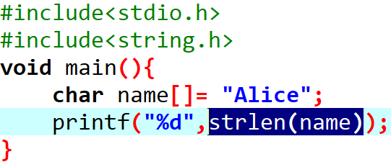
strlen(s)
Navigation Table
Array in C
Size of an Array
sizeof( ) function
Length of an Array
Multi-dimensional Array
String in C
Different ways of taking string input
Different ways to print string
String Operations
strlen(s
strcat(s,t)
strcmp(s,t)
strcpy(s,t)
Pointer in C
Size of pointer variable
Referencing and Dereferencing
strlen() function returns the length of characters.

Slide 15
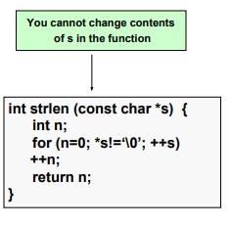
How does strlen() function work?
Navigation Table
Array in C
Size of an Array
sizeof( ) function
Length of an Array
Multi-dimensional Array
String in C
Different ways of taking string input
Different ways to print string
String Operations
strlen(s
strcat(s,t)
strcmp(s,t)
strcpy(s,t)
Pointer in C
Size of pointer variable
Referencing and Dereferencing
strlen() function returns the length of characters in integer.

Slide 16
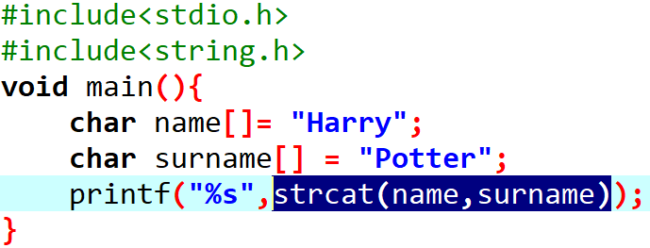

strcat(s,t)
Navigation Table
Array in C
Size of an Array
sizeof( ) function
Length of an Array
Multi-dimensional Array
String in C
Different ways of taking string input
Different ways to print string
String Operations
strlen(s)
strcat(s,t)
strcmp(s,t)
strcpy(s,t)
Pointer in C
Size of pointer variable
Referencing and Dereferencing
This function is used to concatenate t in s. strcat() returns a pointer to the destination string.

Slide 17
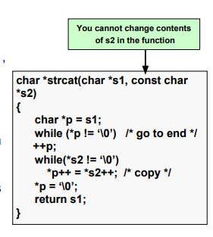
How does strcat() function work?
Navigation Table
Array in C
Size of an Array
sizeof( ) function
Length of an Array
Multi-dimensional Array
String in C
Different ways of taking string input
Different ways to print string
String Operations
strlen(s)
strcat(s,t)
strcmp(s,t)
strcpy(s,t)
Pointer in C
Size of pointer variable
Referencing and Dereferencing

Slide 18


Be back in 10 minutes…

Slide 19
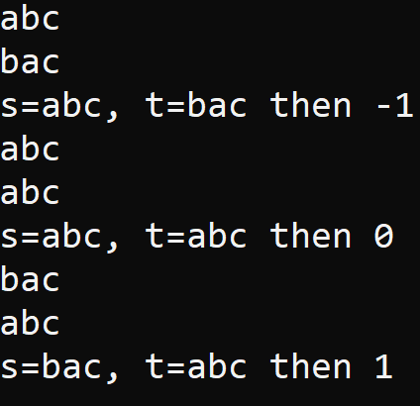
strcmp(s,t)
Navigation Table
Array in C
Size of an Array
sizeof( ) function
Length of an Array
Multi-dimensional Array
String in C
Different ways of taking string input
Different ways to print string
String Operations
strlen(s)
strcat(s,t)
strcmp(s,t)
strcpy(s,t)
Pointer in C
Size of pointer variable
Referencing and Dereferencing
Comparing two strings lexicographically
strcmp(s,t) returns:
Negative (-1) if s < t,
Zero (0) if s == t
Positive (1) if s > t
S = ‘abc’
T = ‘acb’
Strcmp(S,T) = ??

Slide 20
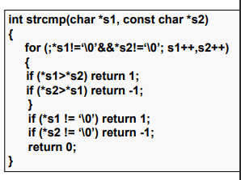
How does strcmp() function work?
Navigation Table
Array in C
Size of an Array
sizeof( ) function
Length of an Array
Multi-dimensional Array
String in C
Different ways of taking string input
Different ways to print string
String Operations
strlen(s)
strcat(s,t)
strcmp(s,t)
strcpy(s,t)
Pointer in C
Size of pointer variable
Referencing and Dereferencing

Slide 21
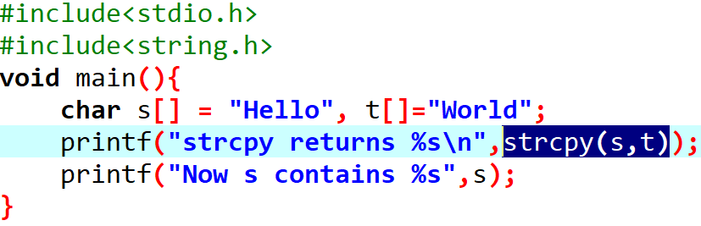

strcpy(s,t)
Navigation Table
Array in C
Size of an Array
sizeof( ) function
Length of an Array
Multi-dimensional Array
String in C
Different ways of taking string input
Different ways to print string
String Operations
strlen(s)
strcat(s,t)
strcmp(s,t)
strcpy(s,t)
Pointer in C
Size of pointer variable
Referencing and Dereferencing
Strcpy(s,t) function is used to copy string from t to s.

Slide 22
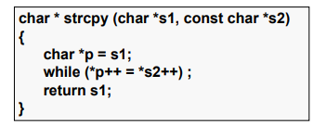
How does strcpy() function work?
Navigation Table
Array in C
Size of an Array
sizeof( ) function
Length of an Array
Multi-dimensional Array
String in C
Different ways of taking string input
Different ways to print string
String Operations
strlen(s)
strcat(s,t)
strcmp(s,t)
strcpy(s,t)
Pointer in C
Size of pointer variable
Referencing and Dereferencing

Slide 23
Pointer

Slide 24



Pointer in C
Navigation Table
Array in C
Size of an Array
sizeof( ) function
Length of an Array
Multi-dimensional Array
String in C
Different ways of taking string input
Different ways to print string
String Operations
strlen(s)
strcat(s,t)
strcmp(s,t)
strcpy(s,t)
Pointer in C
Size of pointer variable
Referencing and Dereferencing
A pointer variable is a variable that stores memory address of another variable.
a
10
62fe14
p
62fe14
62fe10
a = ???
&a = ???
p = 62fe14
&p = 62fe10
*p = 10
a = 10
&a = 62fe14
p = ???
&p = ???
*p = ???

Slide 25



Size of pointer variable
Navigation Table
Array in C
Size of an Array
sizeof( ) function
Length of an Array
Multi-dimensional Array
String in C
Different ways of taking string input
Different ways to print string
String Operations
strlen(s)
strcat(s,t)
strcmp(s,t)
strcpy(s,t)
Pointer in C
Size of pointer variable
Referencing and Dereferencing
Size of a pointer would be 4 bytes in 32-bit computer machine meanwhile for a 64-bit computer machine, it would be 8 bytes.
4 bytes or 8 bytes

Slide 26
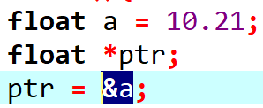
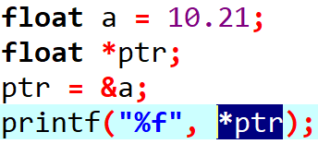
Referencing and Dereferencing in Pointer
Navigation Table
Array in C
Size of an Array
sizeof( ) function
Length of an Array
Multi-dimensional Array
String in C
Different ways of taking string input
Different ways to print string
String Operations
strlen(s)
strcat(s,t)
strcmp(s,t)
strcpy(s,t)
Pointer in C
Size of pointer variable
Referencing and Dereferencing
Referencing
a
10.21
62fe18
*ptr
Dereferencing
62fe18
62fe10
ptr

Slide 27
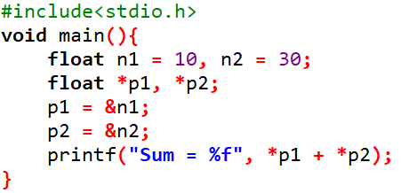
Program for printing sum of two numbers using pointer variables
n2
10
62fe20
n1
30
62fe18
//Declaring pointer variable
//referencing
p1
62fe18
62fe10
p2
62fe20
62fe08
//dereferencing

Slide 28
Difference between Array and Pointer
Array
Pointer
An array is a collection of similar data.
Size of an array is decided by the number of element it contains.
Arrays are static in nature.
Arrays are allocated at compile time.
Syntax: datatype variable[10];
A pointer is a variable that stores the address of another variable.
It takes 4 or 8-bytes memory to allocate a pointer variable as it stores address of only one variable in it.
Pointers are dynamic in nature.
Pointers are allocated in runtime.
Syntax: datytype *variable;

Slide 29
END

