Slide 1
Pointer and Memory Management
Week 04
Compiled by Subash Khatiwada

Slide 2



Pointer in C
Navigation Table
Pointer in C
Referencing and Dereferencing in Pointer
Extended concept of pointer
Scale Factor in Pointer
Store and fetch value from memory using pointer
Memory management in C
Local and Global Variable
Memory Layout of C program
Static and Dynamic memory allocation
Dynamic Memory Allocation in C
Malloc()
Calloc()
Realloc()
Freee()
A pointer variable is a variable that stores memory address of another variable.
a
10
62fe14
p
62fe14
62fe10

Slide 3
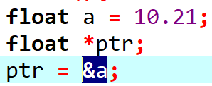
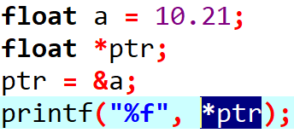
Referencing and Dereferencing in Pointer
Navigation Table
Pointer in C
Referencing and Dereferencing in Pointer
Extended concept of pointer
Scale Factor in Pointer
Store and fetch value from memory using pointer
Memory management in C
Local and Global Variable
Memory Layout of C program
Static and Dynamic memory allocation
Dynamic Memory Allocation in C
Malloc()
Calloc()
Realloc()
Freee()
Referencing
a
10.21
62fe18
*ptr
Dereferencing
62fe18
62fe10
ptr

Slide 4
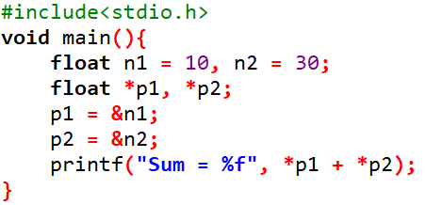
Program for printing sum of two numbers using pointer variables
n2
10
62fe20
n1
30
62fe18
//Declaring pointer variable
//referencing
p1
62fe18
62fe10
p2
62fe20
62fe08
//dereferencing

Slide 5
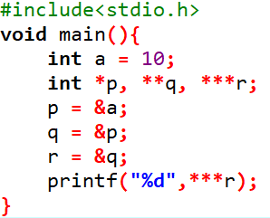
Extended concept of pointer
Navigation Table
Pointer in C
Referencing and Dereferencing in Pointer
Extended concept of pointer
Scale Factor in Pointer
Store and fetch value from memory using pointer
Memory management in C
Local and Global Variable
Memory Layout of C program
Static and Dynamic memory allocation
Dynamic Memory Allocation in C
Malloc()
Calloc()
Realloc()
Freee()
// Declaring an integer variable
// Declaring pointer variables, pointer to pointer
// referencing
// dereferencing
a
p
q
r
10
62fe1c
62fe10
62fe08
62fe1c
62fe10
62fe08
62fe00

Slide 6
Scale Factor in Pointer
Navigation Table
Pointer in C
Referencing and Dereferencing in Pointer
Extended concept of pointer
Scale Factor in Pointer
Store and fetch value from memory using pointer
Memory management in C
Local and Global Variable
Memory Layout of C program
Static and Dynamic memory allocation
Dynamic Memory Allocation in C
Malloc()
Calloc()
Realloc()
Freee()
int i = 1;
i = i + 1; (Arithmetic increment); [i = 2]
What happens if:
int a, *i;
i = &a;
i = i+1; ?
When a pointer is incremented, its value is increased by the size of the datatype that it points to.
pointer + n = pointer + sizeof(type of pointer) x n
(byte increment)

Slide 7
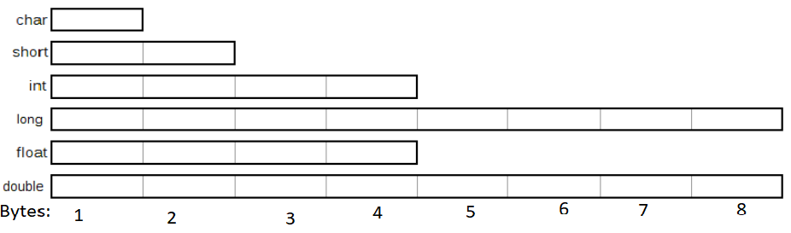
Scale factor in pointer
Navigation Table
Pointer in C
Referencing and Dereferencing in Pointer
Extended concept of pointer
Scale Factor in Pointer
Store and fetch value from memory using pointer
Memory management in C
Local and Global Variable
Memory Layout of C program
Static and Dynamic memory allocation
Dynamic Memory Allocation in C
Malloc()
Calloc()
Realloc()
Freee()
int a, *p1;
double b, *p2;
p1 = &a; //&a = 62fe0c
p2 = &b; //&b = 62fe08
p1 + 1; pointing address + 4 bytes
p2 + 2; pointing address + 8 bytesx2

Slide 8
Store and fetch 5 integers value in memory using pointer.
Navigation Table
Pointer in C
Referencing and Dereferencing in Pointer
Extended concept of pointer
Scale Factor in Pointer
Store and fetch value from memory using pointer
Memory management in C
Local and Global Variable
Memory Layout of C program
Static and Dynamic memory allocation
Dynamic Memory Allocation in C
Malloc()
Calloc()
Realloc()
Freee()
ptr
ptr
int a[5]; // First, allocate 20 bytes memory.
int *ptr;
ptr
ptr = &a[0];
n = 5
ptr
1
1f1400
ptr
20
1f1404
ptr
20 bytes
12
1f1408
65
1f140c
17
1f1410

Slide 9
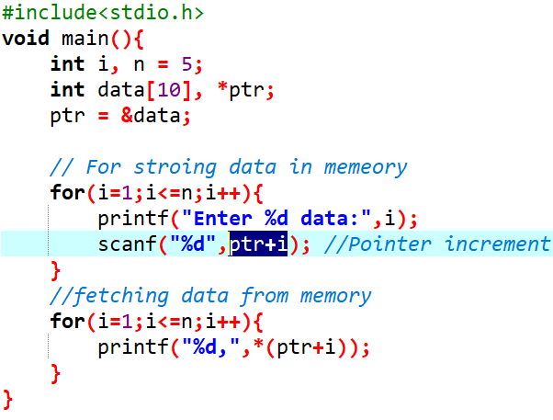
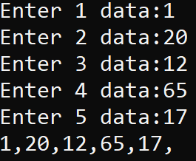
Store and fetch 5 integer data from memory.
Navigation Table
Pointer in C
Referencing and Dereferencing in Pointer
Extended concept of pointer
Scale Factor in Pointer
Store and fetch value from memory using pointer
Memory management in C
Local and Global Variable
Memory Layout of C program
Static and Dynamic memory allocation
Dynamic Memory Allocation in C
Malloc()
Calloc()
Realloc()
Freee()

Slide 10
Memory management in C

Slide 11
Local vs Global Variables
Navigation Table
Pointer in C
Referencing and Dereferencing in Pointer
Extended concept of pointer
Scale Factor in Pointer
Store and fetch value from memory using pointer
Memory management in C
Local and Global Variable
Memory Layout of C program
Static and Dynamic memory allocation
Dynamic Memory Allocation in C
Malloc()
Calloc()
Realloc()
Free()
A local variable is defined inside a function and is not accessible outside the function. A block of memory is allocated, and it gets destroyed as the function ends.
A static local variable not get destroyed as the function ends but it is not accessible outside the function.
The variables that are declared outside the function block(main() also) are known as global variables.

Slide 12
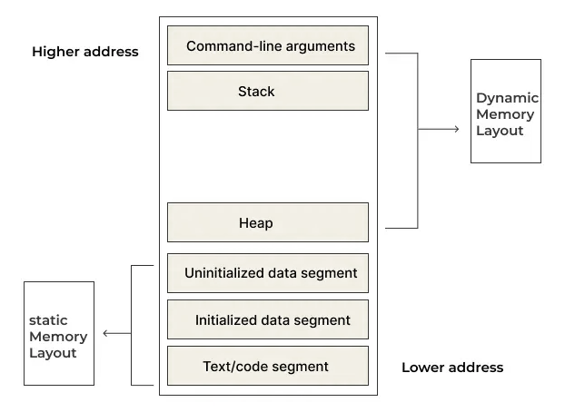
Memory Layout of C Programs
Navigation Table
Pointer in C
Referencing and Dereferencing in Pointer
Extended concept of pointer
Scale Factor in Pointer
Store and fetch value from memory using pointer
Memory management in C
Local and Global Variable
Memory Layout of C program
Static and Dynamic memory allocation
Dynamic Memory Allocation in C
Malloc()
Calloc()
Realloc()
Free()

Slide 13
Where does variable live?
Navigation Table
Pointer in C
Referencing and Dereferencing in Pointer
Extended concept of pointer
Scale Factor in Pointer
Store and fetch value from memory using pointer
Memory management in C
Local and Global Variable
Memory Layout of C program
Static and Dynamic memory allocation
Dynamic Memory Allocation in C
Malloc()
Calloc()
Realloc()
Free()
Code Segment: Contains the executable code of the program.
Data Segment:
Initialized Data Segment:
Contains global and static variables that are initialized with a value.
The size of this segment is determined during compile-time.
Uninitialized Data Segment:
Contains global and static variables that are uninitialized or initialized to zero.
The space is reserved, but the actual initialization is done at runtime.

Slide 14
Where does variable live?
Navigation Table
Pointer in C
Referencing and Dereferencing in Pointer
Extended concept of pointer
Scale Factor in Pointer
Store and fetch value from memory using pointer
Memory management in C
Local and Global Variable
Memory Layout of C program
Static and Dynamic memory allocation
Dynamic Memory Allocation in C
Malloc()
Calloc()
Realloc()
Free()
3. Heap: Used for dynamic memory allocation during the program's execution.
4. Stack: Used for storing local variables

Slide 15
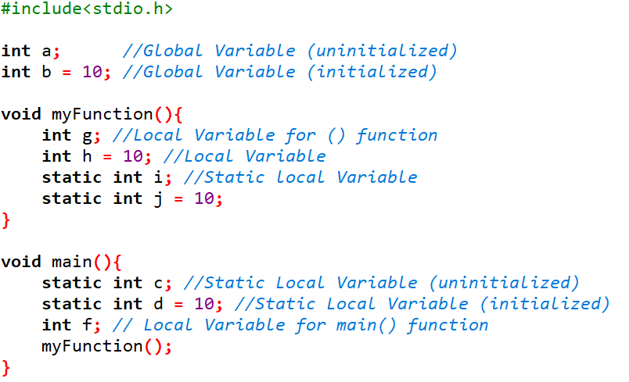

Slide 16
Static memory allocation
Navigation Table
Pointer in C
Referencing and Dereferencing in Pointer
Extended concept of pointer
Scale Factor in Pointer
Store and fetch value from memory using pointer
Memory management in C
Local and Global Variable
Memory Layout of C program
Static and Dynamic memory allocation
Dynamic Memory Allocation in C
Malloc()
Calloc()
Realloc()
Free()
Static memory allocation is an allocation technique in which memory is allocated at compile time.
Once the memory is allocated, it cannot be changed.
For example:
int a = 20;

Slide 17
Dynamic memory allocation
Navigation Table
Pointer in C
Referencing and Dereferencing in Pointer
Extended concept of pointer
Scale Factor in Pointer
Store and fetch value from memory using pointer
Memory management in C
Local and Global Variable
Memory Layout of C program
Static and Dynamic memory allocation
Dynamic Memory Allocation in C
Malloc()
Calloc()
Realloc()
Free()
Dynamic memory allocation is the process of assigning the memory space during the execution time or the run time.
Many a time we face situations where data is dynamic in nature.
Amount of data cannot be predicted beforehand.
Number of data item keeps changing during program execution.
C language requires the number of elements in an array to be specified at compile time.

Slide 18
Dynamic Memory Allocation in C
Navigation Table
Pointer in C
Referencing and Dereferencing in Pointer
Extended concept of pointer
Scale Factor in Pointer
Store and fetch value from memory using pointer
Memory management in C
Local and Global Variable
Memory Layout of C program
Static and Dynamic memory allocation
Dynamic Memory Allocation in C
Malloc()
Calloc()
Realloc()
Free()
Dynamic memory allocation in c language is possible by 4 functions of stdlib.h header file.
malloc()
calloc()
realloc()
free()

Slide 19


Be back in 10 minutes…

Slide 20
malloc() function – memory allocation
Navigation Table
Pointer in C
Referencing and Dereferencing in Pointer
Extended concept of pointer
Scale Factor in Pointer
Store and fetch value from memory using pointer
Memory management in C
Local and Global Variable
Memory Layout of C program
Static and Dynamic memory allocation
Dynamic Memory Allocation in C
Malloc()
Calloc()
Realloc()
Free()
A single block of memory can be allocated using the malloc function.
Reserves a block of memory of specified size and returns a pointer of type void.
Syntax:
datatype *pointer_variable;
ptr = (type*) malloc (byte_size);
Example:
void *ptr;
ptr = malloc(46); // return void pointer to base of allocated block

Slide 21
Example:
A memory space equivalent to “10 times the size of an int” bytes is reserved.
The address of the first byte of the allocated memory is assigned to the pointer p of type int.
P
40 bytes

Slide 22
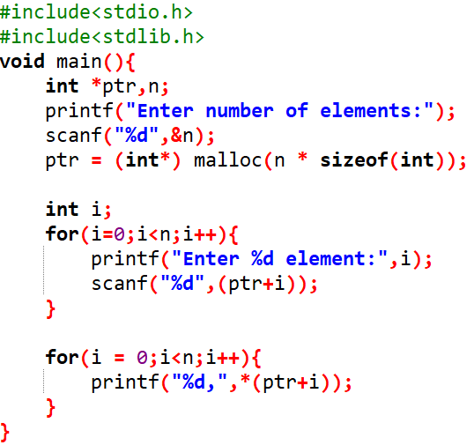
Program for allocating memory for n integers using malloc function.
ptr
n = 5
1f1400
1f1404
20 bytes
1f1408
1f140c
1f1410

Slide 23
calloc() function – contiguous allocation
Navigation Table
Pointer in C
Referencing and Dereferencing in Pointer
Extended concept of pointer
Scale Factor in Pointer
Store and fetch value from memory using pointer
Memory management in C
Local and Global Variable
Memory Layout of C program
Static and Dynamic memory allocation
Dynamic Memory Allocation in C
Malloc()
Calloc()
Realloc()
Free()
Dynamically allocates the specified number of blocks of memory of the specified type.
it is very much similar to malloc() but has two different points and these are:
It initializes each block with a default value ‘0’.
It has two parameters or arguments as compared to malloc().
Syntax:
ptr = (type*) calloc(n, element-size);

Slide 24
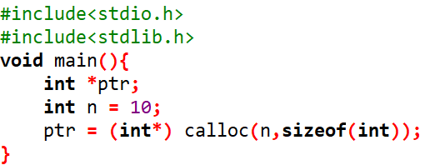
Syntax:
ptr = (type*) calloc(n, element-size);
ptr
n = 5
0
1f1400
0
1f1404
20 bytes
0
1f1408
0
1f140c
0
1f1410

Slide 25
Points to Note
Navigation Table
Pointer in C
Referencing and Dereferencing in Pointer
Extended concept of pointer
Scale Factor in Pointer
Store and fetch value from memory using pointer
Memory management in C
Local and Global Variable
Memory Layout of C program
Static and Dynamic memory allocation
Dynamic Memory Allocation in C
Malloc()
Calloc()
Realloc()
Free()
malloc always allocates a block of contiguous bytes.
The allocation can fail if sufficient contiguous memory space is not available.
If it fails, malloc returns NULL.

Slide 26
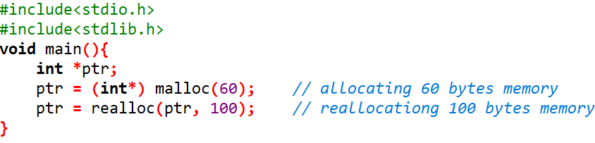
Altering the Size of a Block using realloc()
Navigation Table
Pointer in C
Referencing and Dereferencing in Pointer
Extended concept of pointer
Scale Factor in Pointer
Store and fetch value from memory using pointer
Memory management in C
Local and Global Variable
Memory Layout of C program
Static and Dynamic memory allocation
Dynamic Memory Allocation in C
Malloc()
Calloc()
Realloc()
Free()
Sometimes we need to alter the size of some previously allocated memory block.
More memory needed.
Memory allocated is larger than necessary.

Slide 27
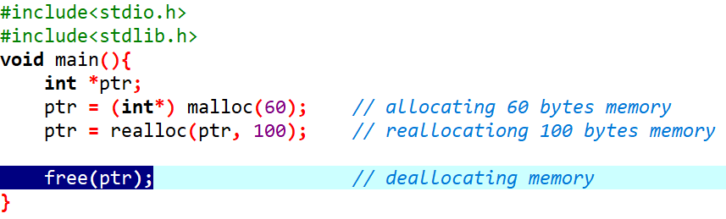
free() - releasing the used space
Navigation Table
Pointer in C
Referencing and Dereferencing in Pointer
Extended concept of pointer
Scale Factor in Pointer
Store and fetch value from memory using pointer
Memory management in C
Local and Global Variable
Memory Layout of C program
Static and Dynamic memory allocation
Dynamic Memory Allocation in C
Malloc()
Calloc()
Realloc()
Free()

Slide 28
END

