Slide 1
Structure
Week 05
Compiled by Subash Khatiwada

Slide 2
Previously…
Navigation Table
Revise
Primitive data types
Derived data types
User defined types
Structure
Creating a structure datatype
Creating a structure variable
along with structure definition
After the definition
Accessing the members of structure
Using dot operator
Using arrow operator
Array of structure
Structure of structure
Structure and the function
Call by value
Call by reference
Data types in C:
Primitive Data Types (Primary)
Primitive data types are a set of basic data types from which all other data types are constructed.
For examples: Integer, Float, Char, Double
Derived Data Types
The derived data types are basically derived out of the fundamental data types.
For examples: Array, Function, Pointer, Structure, Union, Enumeration
User Defined Data Type
Datatype that is created by user himself. Example: Structure

Slide 3


Primitive Data Types
Navigation Table
Revise
Primitive data types
Derived data types
User defined types
Structure
Creating a structure datatype
Creating a structure variable
along with structure definition
After the definition
Accessing the members of structure
Using dot operator
Using arrow operator
Array of structure
Structure of structure
Structure and the function
Call by value
Call by reference
a
Derived Data Types
a[0]
a[1]
a[2]
a[3]
a[4]

Slide 4
User Defined Data Type
Book: char title[30], char author[20], short year, float price
Book
title
author
year
price

Slide 5
Structure
Navigation Table
Revise
Primitive data types
Derived data types
User defined types
Structure
Creating a structure datatype
Creating a structure variable
along with structure definition
After the definition
Accessing the members of structure
Using dot operator
Using arrow operator
Array of structure
Structure of structure
Structure and the function
Call by value
Call by reference
In C programming, a struct (or structure) is a collection of variables (can be of different types) under a single name.
A structure of a collection of heterogenous data under a single name.
Example:
Student: name, roll number, address, mobile number etc.

Slide 6
Continue…
Navigation Table
Revise
Primitive data types
Derived data types
User defined types
Structure
Creating a structure datatype
Creating a structure variable
along with structure definition
After the definition
Accessing the members of structure
Using dot operator
Using arrow operator
Array of structure
Structure of structure
Structure and the function
Call by value
Call by reference
Employee: name, id, address, salary, grade
Book: title, author, publish year, price
Date: year, month, day
Address: province, district, city, ward
Structure is a user defined data type.
It is a collection of different data types, to create a new data type.

Slide 7
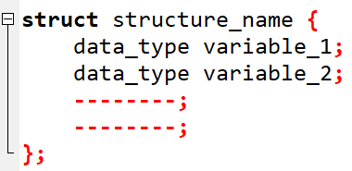
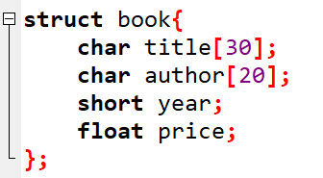
How to create a structure datatype?
Navigation Table
Revise
Primitive data types
Derived data types
User defined types
Structure
Creating a structure datatype
Creating a structure variable
along with structure definition
After the definition
Accessing the members of structure
Using dot operator
Using arrow operator
Array of structure
Structure of structure
Structure and the function
Call by value
Call by reference
Structure members
For example:
//user defined datatype

Slide 8
How to create structure variable?
Navigation Table
Revise
Primitive data types
Derived data types
User defined types
Structure
Creating a structure datatype
Creating a structure variable
along with structure definition
After the definition
Accessing the members of structure
Using dot operator
Using arrow operator
Array of structure
Structure of structure
Structure and the function
Call by value
Call by reference
A data type is useless without variables. A data type defines various properties about data stored in memory.
In C programming, there are two ways to declare a structure variable:
Along with structure definition
After structure definition

Slide 9
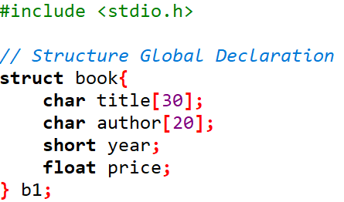
Defining structure variable along with structure definition
Navigation Table
Revise
Primitive data types
Derived data types
User defined types
Structure
Creating a structure datatype
Creating a structure variable
along with structure definition
After the definition
Accessing the members of structure
Using dot operator
Using arrow operator
Array of structure
Structure of structure
Structure and the function
Call by value
Call by reference
//Defining structure variable along with structure definition

Slide 10
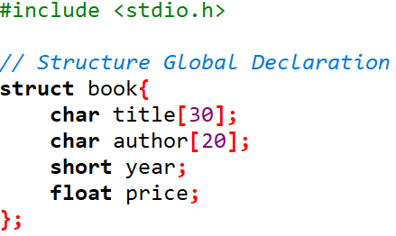
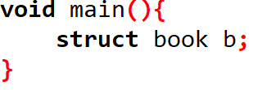
Defining structure variable after definition
Navigation Table
Revise
Primitive data types
Derived data types
User defined types
Structure
Creating a structure datatype
Creating a structure variable
along with structure definition
After the definition
Accessing the members of structure
Using dot operator
Using arrow operator
Array of structure
Structure of structure
Structure and the function
Call by value
Call by reference
Defining structure variable after definition

Slide 11
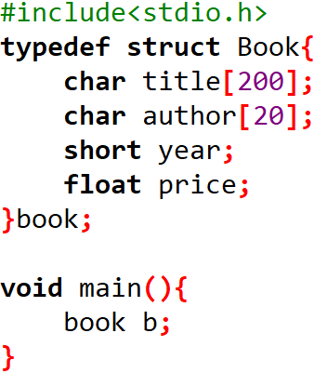
Typedef keyword in c
typedef, which can be used to give a type a new name.
// Without typedef
// With typedef

Slide 12
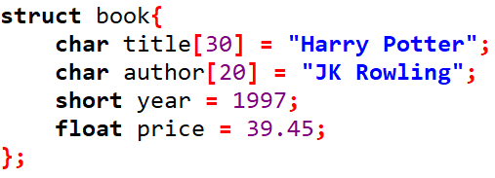
Points to remember…
Navigation Table
Revise
Primitive data types
Derived data types
User defined types
Structure
Creating a structure datatype
Creating a structure variable
along with structure definition
After the definition
Accessing the members of structure
Using dot operator
Using arrow operator
Array of structure
Structure of structure
Structure and the function
Call by value
Call by reference
You must terminate structure definition with semicolon ;
You can define a structure anywhere like global scope (accessible by all functions) or local scope (accessible by function).
You cannot assign value to members inside the structure definition, it will cause compilation error. Since you are defining type, you aren't associating data.
INVALID!!!

Slide 13
How to access structure members?
Navigation Table
Revise
Primitive data types
Derived data types
User defined types
Structure
Creating a structure datatype
Creating a structure variable
along with structure definition
After the definition
Accessing the members of structure
Using dot operator
Using arrow operator
Array of structure
Structure of structure
Structure and the function
Call by value
Call by reference
There are two ways to access the members of structure:
Using dot operator (.)
Using arrow operator (->)

Slide 14
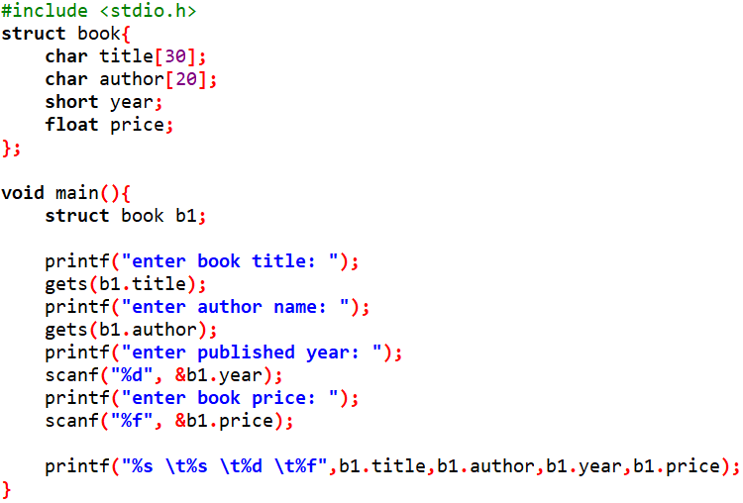
Accessing members using dot operators
Creating a user defined datatype, i.e., struct book
// Defining a variable of book datatype

Slide 15
Classwork:
Create a structure named student that has a name, roll number and marks as members. Assume appropriate types and size of members.

Slide 16
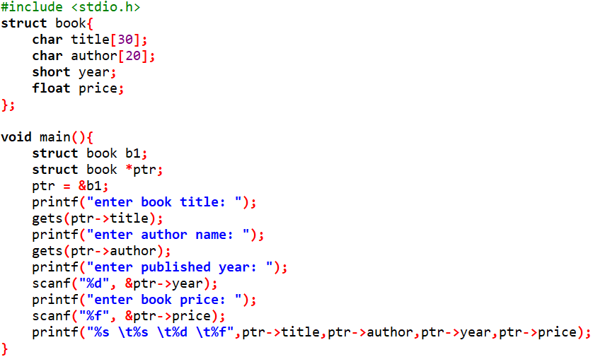
Using arrow operator

Slide 17
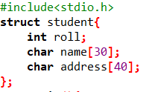

Array of structure
Navigation Table
Revise
Primitive data types
Derived data types
User defined types
Structure
Creating a structure datatype
Creating a structure variable
along with structure definition
After the definition
Accessing the members of structure
Using dot operator
Using arrow operator
Array of structure
Structure of structure
Structure and the function
Call by value
Call by reference
An array of structures is simply an array in which each element is a structure of the same type.

Slide 18
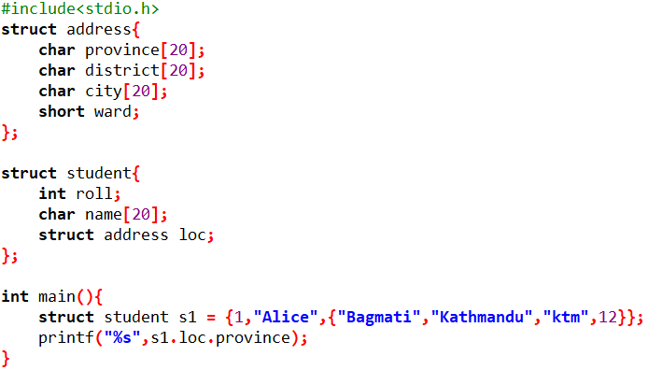
Structure of structure
Navigation Table
Revise
Primitive data types
Derived data types
User defined types
Structure
Creating a structure datatype
Creating a structure variable
along with structure definition
After the definition
Accessing the members of structure
Using dot operator
Using arrow operator
Array of structure
Structure of structure
Structure and the function
Call by value
Call by reference

Slide 19
Structure and function
Navigation Table
Revise
Primitive data types
Derived data types
User defined types
Structure
Creating a structure datatype
Creating a structure variable
along with structure definition
After the definition
Accessing the members of structure
Using dot operator
Using arrow operator
Array of structure
Structure of structure
Structure and the function
Call by value
Call by reference
C supports passing of structures as argument to functions.
There are two methods by which the value of structure can be passed from one functions to another.
Call by value
Call by reference

Slide 20
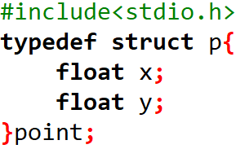
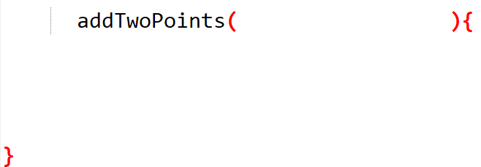




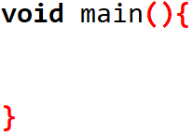
Call by Value (Passing structure in Function)
//Defining user defined datatype, point
//Declaring variables having point datatype

Slide 21

Call by reference
//Defining user defined datatype, point
//Declaring variables having point datatype

Slide 22
END

