Slide 1

5CS021 Numerical Methods and Concurrency
File Handling

Slide 2
Operations on Files
Typical operations on a file are:
Open : To open a file to store/retrieve data in it
Read : The file is used as an input
Write : The file is used as output
Close : Preserve the file for a later use
Access: Random accessing data in a file

Slide 3
File Handling Commands
Include header file <stdio.h> to access all file handling utilities.
A data type called FILE is there to create a pointer to a file. Sometimes also called a file stream.
FILE *fptr; // fptr is a pointer to a // FILE structure
To open a file, use fopen() function
FILE* fopen(char *filename, char *mode);
To close a file, use fclose() function
int fclose(FILE *fptr);

Slide 4
fopen(char *filename, char *mode)
The first argument is a string to characters indicating the name of the file to be opened.
The second argument is to specify the mode of file opening. There are five file opening modes in C :
"r" : Opens a file for reading
"w" : Creates a file for writing (overwrite, if it contains data)
"a" : Opens a file for appending to the end of the file
It returns the special value NULL to indicate that it couldn't open the file.

Slide 5
fopen() function
If a file that does not exist is opened for writing or appending, it is created as a new.
Opening an existing file for writing causes the old contents to be discarded.
Opening an existing file for appending preserves the old contents, and new contents will be added at the end.
File opening error :
Trying to read a file that does not exist.
Trying to read a file that doesn’t have permission.
If there is an error, fopen() returns NULL.

Slide 6
File Opening Modes | Purposes
“r” (i.e read) | Opens a file for reading purpose only. If the specified file doesn’t exist, it returns NULL. (The file must already exist.)
“r+” (read and write) | Opens a file for both reading and writing purpose. If the specified file doesn’t exist, it returns NULL. (The file must already exist.)
3. “w”(i.e write) | Opens a file for writing purpose. If the specified file already exist, the content within the file are overwritten (i.e content is deleted first and then written) If the file doesn’t exist, a new file is created implicitly.
4. “w+” (read and write) | Same of 3 but data can be read too.
5. “a” (i.e append) | Opens an existing file for adding new information at the end of file purpose. If the file doesn’t exist, a new file is created implicitly.
6. “a+” (append + read) | Opens an existing file for both reading and appending purpose. A new file is created if specified file doesn’t exist.

Slide 7
fopen() example
#include <stdio.h>
#include <stdlib.h>
void main()
{
FILE *fptr;
char filename[]= "file01.txt";
fptr = fopen(filename,"w");
if (fptr == NULL) {
printf("Error creating file %s\n", filename);
exit(-1);
}
else {
printf("Success creating file %s\n", filename);
}
fclose(fptr);
}

Slide 8
Writing into a File
Following functions in C are usually used for writing simple data into a file :
int fputc(int c, FILE *fptr)
int fprintf(FILE *fptr, char *format,...)
int fputs(char *s, FILE *fptr)

Slide 9
int fputc(int c, FILE *fptr);
The fputc() function writes the character c to file fptr and returns the character written, or EOF if an error occurs.
FILE *fptr;
char ch=‘a’;
int i;
fptr = fopen("test3.txt","w");
fputc(ch, fptr);
fclose(fptr);

Slide 10
int fprintf(FILE *fptr, char *format,...);
fprintf() formats and writes output to the fptr stream fptr under the control of format string.
The function is identical to the printf() function except the first argument which is a file pointer that specifies the file to be written.
The fprintf() returns the number of characters written, or negative if an error occur.
Example: fprintf(stdout, "Hello"); //stdout is a file pointer that points to standard output(console screen)

Slide 11
fprintf() Example
#include <stdio.h>
void main(){
FILE *fptr;
fptr = fopen("test6.txt", "w");
fprintf(fptr, "Number is %d\n", 123);
fclose(fptr);
}

Slide 12
int fputs(char *s, FILE *fptr)
The fputs() function writes a string (which need not contain a newline) to a file.
It returns non-negative, or EOF if an error occurs.
void main(){
FILE *fptr;
fptr = fopen("test7.txt", "w");
fputs("Hello World!",fptr);
fclose(fptr);
}

Slide 13
Reading from a File
Following functions in C are usually used for reading simple data from a file :
fgetc(…)
fscanf(…)
fgets(…)
getc(…)

Slide 14
int fgetc(FILE *fptr);
The fgetc() function returns the next character in the stream fptr as an unsigned char
It returns the special value EOF, if end of file or error occurs.
FILE *fptr;
fptr = fopen("test.txt","r");
char c,c1;
c = fgetc(fptr)//reading character from a file.
c1= fgetc(fptr);
printf ("%c",c);
fclose(fptr);

Slide 15
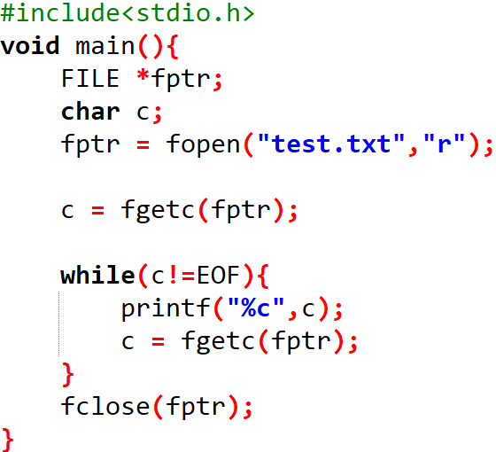

Example: fgetc(FILE *fptr);
Suppose we have a file test.txt which contains “Hello World”.
Output

Slide 16
int fscanf(FILE *fptr, char *format, ...);
fscanf() reads from the stream fptr under control of format and assigns converted values through subsequent assignments, each of which must be a pointer.
It returns when format is exhausted.
fscanf() returns EOF if end of file or an error occurs before any conversion.
It returns the number of input items converted and assigned.

Slide 17


fscanf() Example
FILE *fptr;
int x,y,n;
fptr = fopen("test.txt","r");
n = fscanf(fptr,"%d,%d",&x,&y);
printf ("x=%d, y=%d \n",x,y);
fclose(fptr);
Output

Slide 18
char *fgets(char *s, int n, FILE *fptr);
s - The array where the characters will be stored.
n - The size of s.
fptr - The file stream to read.
fgets() reads at most n-1 characters into the array s, stopping if a newline is encountered.
The newline is included in the array, which is terminated by ‘\0’.
The fgets() function returns s.
If an error occurs, it returns NULL;

Slide 19


fgets() Example
FILE *fptr;
char line [100];
fptr = fopen("test.txt","r");
fgets(line,100,fptr);//reads at most 99 characters from the file.(remaining one for null character)
printf ("Line: %s\n",line);
fclose(fptr);

Slide 20
int feof(FILE *fptr)
feof() returns true when End-of-File indicator associated with the file is set, else false is returned.
FILE *fptr;
char line [1000];
fptr = fopen("test.txt","r");
while (!feof(fptr)){
fgets(line,1000,fptr);
printf("Line %s\n",line);
}
fclose(fptr);
https://app.mysecondteacher.com.np/subjects/489/classroom/20028/content

