Slide 1
FUNCTIONS
C
Ashish Acharya

Slide 2
OBJECTIVES
Create functions
Function prototypes
Parameters
Pass by value or reference
Sending a reference
Return values
Math functions

Slide 3
INTRODUCTION
Why :
Divide and conquer
Reuse abstractions
Don’t rebuild the bridge
What :
Used prepackaged functions printf, scanf, rand()
Create our own main
Pass parameters
Accept return values

Slide 4
Math
#include <math.h>
Use any math function
If c1 = 13.0, d = 3.0 and f = 4.0, then the statement
printf( "%.2f", sqrt( c1 + d * f ) );

Slide 5
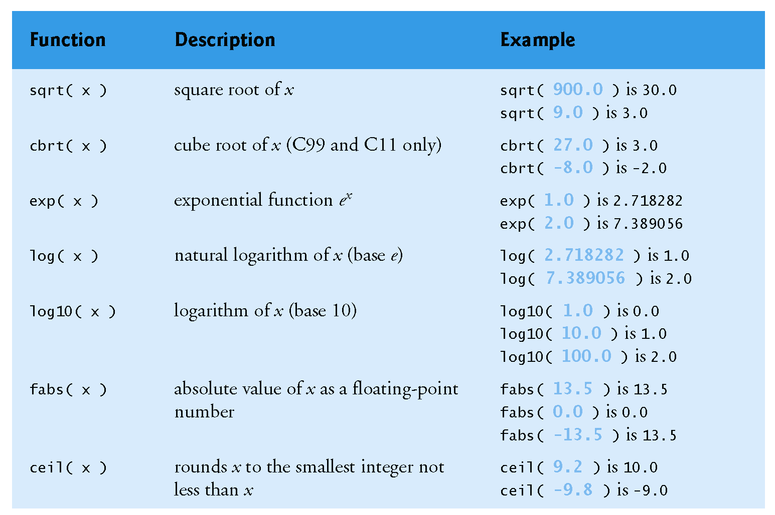

Slide 6
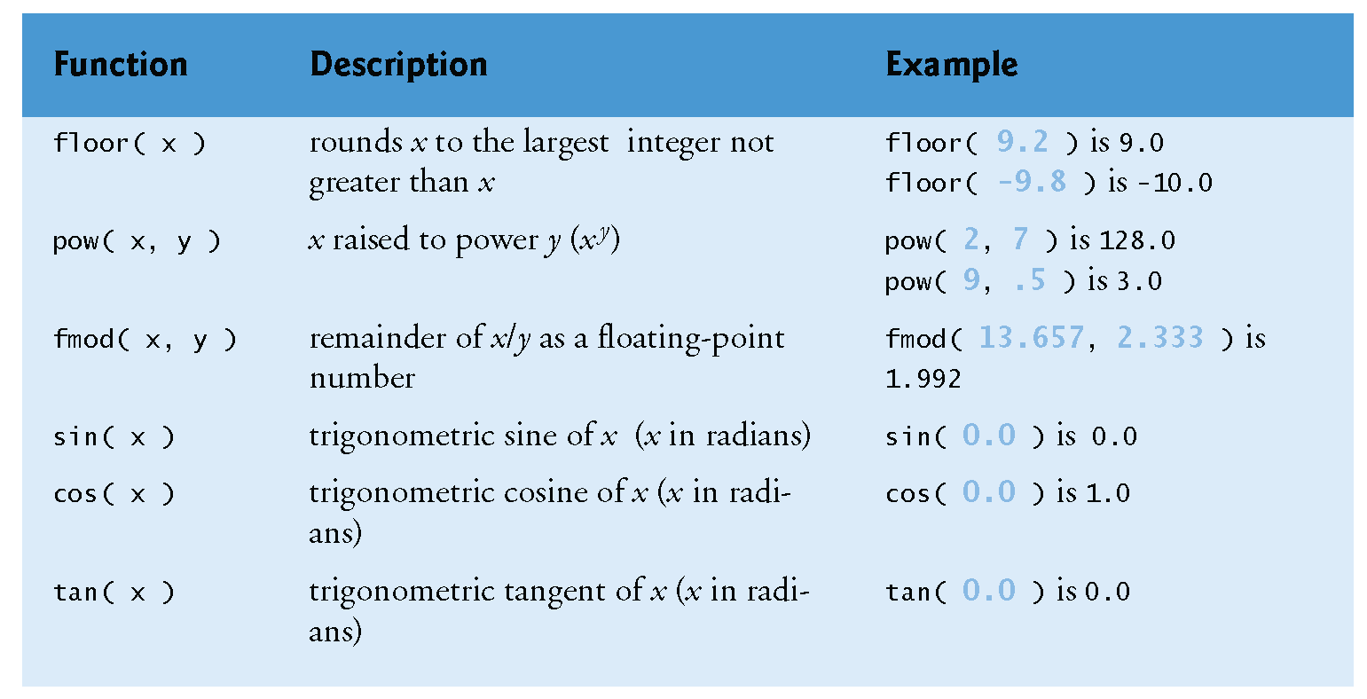

Slide 7
CREATE YOUR FUNCTION
Choose a name
Function should perform a single well defined task
If you can’t find a concise descriptive name, you may have too many jobs for the function
Define a contract
Inputs
Arguments – choose type
None should be noted as void
Will the function change the parameter’s value?
Output
Only one

Slide 8
CREATE YOUR FUNCTION
Write prototype
Looks like function header but has ;
int square( int y );
Tells compiler what is valid input and output
Forces type conversion
Write body
Call the function

Slide 9
SAMPLE FUNCTION
#include <stdio.h>
int square ( int y ); // function prototype
// function main begins program execution
int main ( void )
{ int x; // counter
for ( x = 1; x <= 10; x++ ) { // loop 10 times and calc square of x each time
printf ( "%d ", square ( x ) ); // function call
}
puts (""); // add a blank line
}
// square function returns the square of its parameter
int square ( int y ) // y is a copy of the x sent
{
return y * y; // returns square of y as an int
}

Slide 10
return
return serves two purposes:
It tells the computer the value to return as the result
It tells the computer to leave the function immediately and return the calling function (or the main program).
Void return:
Ex: void printit ( int x );
You can still return to leave, but without a value

Slide 11
PROTOTYPES
A function prototype is simply the declaration of a function that specifies function's name, parameters and return type. It doesn't contain function body.
A function prototype gives information to the compiler that the function may later be used in the program.

Slide 12
PROTOTYPES
returnType functionName(type1 argument1, type2 argument2, ...);
In the above example,
int addNumbers(int a, int b); is the function prototype which provides the following information to the compiler:
name of the function is addNumbers()
return type of the function is int
two arguments of type int are passed to the function

Slide 13
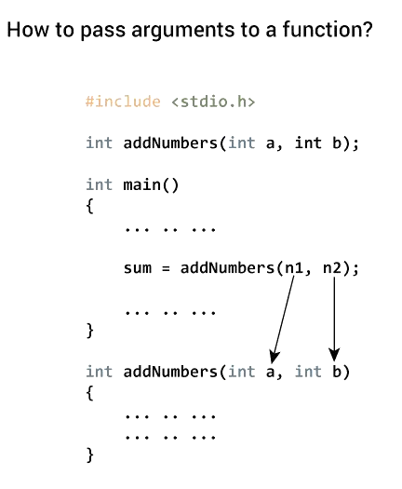
Passing arguments to a function
In programming, argument refers to the variable passed to the function. In the above example, two variables n1 and n2 are passed during the function call.
The parameters a and b accepts the passed arguments in the function definition. These arguments are called formal parameters of the function.

Slide 14
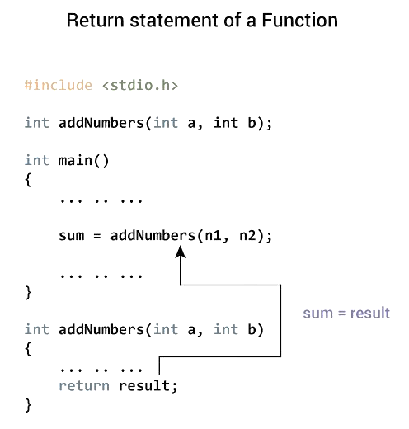
Return Statement
The return statement terminates the execution of a function and returns a value to the calling function. The program control is transferred to the calling function after the return statement.
In the above example, the value of the result variable is returned to the main function. The sum variable in the main() function is assigned this value.

Slide 15
WHERE DO THE VARIABLES LIVE ?
On Stack: (lives and dies with function)
Local – created in the function – automatic – on stack
Argument – same as local
On Heap: (lives with program life)
Use keyword static
static int x = 1;
When you return to the function it will retain old value
Global
declare outside a function block

Slide 16
FUNCTION CALL STACK
Pile like one of dishes
Access from the top
Call a function – push it on the stack
Execute function
Push on other functions from within function
Variables created in the stack
Finish executing a function – pop it off the stack
supports the creation, maintenance and destruction of each called function’s automatic variables (local variables, parameters)

Slide 17
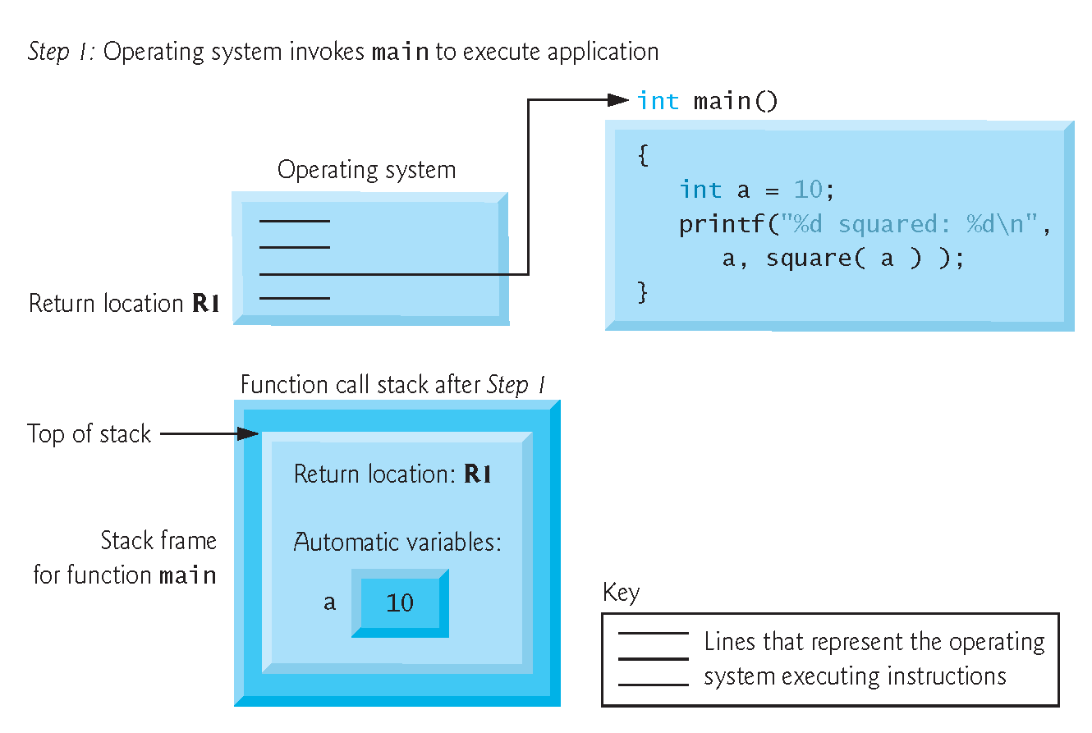

Slide 18
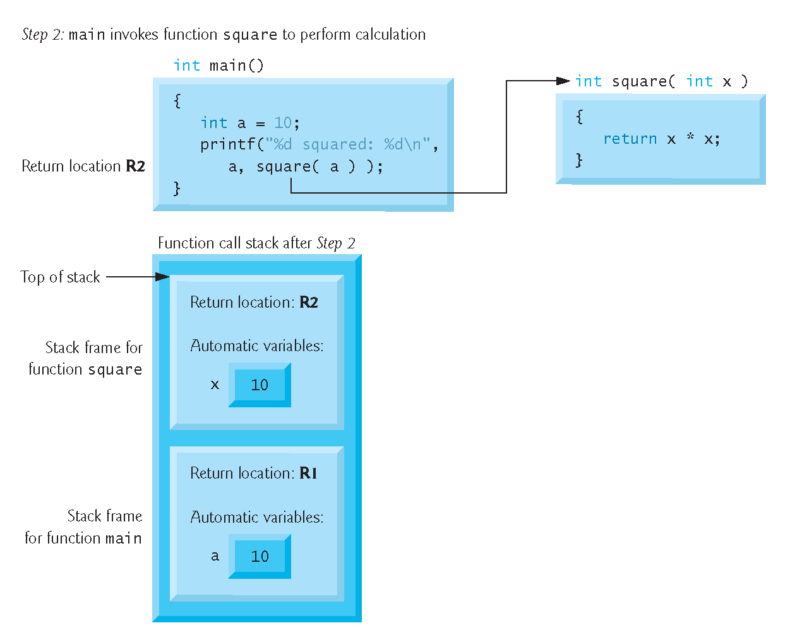

Slide 19
WHAT ARE REFERENCE PARAMETERS ?
Reference parameters do not copy the value of the parameter.
Instead, they give the function being called a copy of the address at which the data is stored. This way, the function works with the original data.
We call this passing by reference because we are making references to the parameters.

Slide 20
WRITE SQUAREINPLACE WITH REFERENCE PARAMETER
Tell the main program about the change in y by placing (*) between the data type and variable name:
int squareInPlace (int *y)
{ *y = *y * *y;
return 0;}
Send an address instead of the variable contents using (&) before variable name:
int number = 6;
squareInPlace (&number);
printf(“%d”, number);

Slide 21
PASSING REFERENCE PARAMETERS
Any data intended for y in the function goes to the location of number in the main program
4.0
number
y

Slide 22
WHEN TO USE VALUE AND REFERENCE PARAMETERS
We use value parameters when:
We are not going to change the parameters’ value
We may change it but the main program should not know about it
When we are simply printing the value
We use reference parameters when:
We are going to change the parameter’s value and the main program MUST know about it.
We are reading in a new value

Slide 23
Call by value
In call by value method, the value of the actual parameters is copied into the formal parameters. In other words, we can say that the value of the variable is used in the function call in the call by value method.
In call by value method, we can not modify the value of the actual parameter by the formal parameter.
In call by value, different memory is allocated for actual and formal parameters since the value of the actual parameter is copied into the formal parameter.
The actual parameter is the argument which is used in the function call whereas formal parameter is the argument which is used in the function definition.

Slide 24
Call by value : Example
OUTPUT:
Before function call x=100
Before adding value inside function num=100
After adding value inside function num=200
After function call x=100
#include<stdio.h>
void change(int num) {
printf("Before adding value inside function num=%d \n",num);
num=num+100;
printf("After adding value inside function num=%d \n", num);
}
int main() {
int x=100;
printf("Before function call x=%d \n", x);
change(x); //passing value in function
printf("After function call x=%d \n", x);
return 0;
}

Slide 25
Call by value : Swapping the values of the two variables
#include <stdio.h>
void swap(int , int); //prototype of the function
int main()
{ int a = 10;
int b = 20;
printf("Before swapping the values in main a = %d, b = %d\n",a,b); // printing the value of a and b in main
swap(a,b);
printf("After swapping values in main a = %d, b = %d\n",a,b); // The value of actual parameters do not change by changing the formal parameters in call by value, a = 10, b = 20
}
void swap (int a, int b)
{ int temp;
temp = a;
a=b;
b=temp;
printf("After swapping values in function a = %d, b = %d\n",a,b); // Formal parameters, a = 20, b = 10
}
OUTPUT:
Before swapping the values in main a = 10, b = 20
After swapping values in function a = 20, b = 10
After swapping values in main a = 10, b = 20

Slide 26
Call by Reference
In call by reference, the address of the variable is passed into the function call as the actual parameter.
The value of the actual parameters can be modified by changing the formal parameters since the address of the actual parameters is passed.
In call by reference, the memory allocation is similar for both formal parameters and actual parameters. All the operations in the function are performed on the value stored at the address of the actual parameters, and the modified value gets stored at the same address.

Slide 27
Call by Reference : Example
OUTPUT:
Before function call x=100
Before adding value inside function num=100
After adding value inside function num=200
After function call x=200
#include<stdio.h>
void change(int *num) {
printf("Before adding value inside function num=%d \n",*num);
(*num) += 100;
printf("After adding value inside function num=%d \n", *num);
}
int main() {
int x=100;
printf("Before function call x=%d \n", x);
change(&x); //passing reference in function
printf("After function call x=%d \n", x);
return 0;
}

Slide 28
Call by Reference : Swapping the values of the two variables
#include <stdio.h>
void swap(int *, int *); //prototype of the function
int main()
{ int a = 10;
int b = 20;
printf("Before swapping the values in main a = %d, b = %d\n",a,b); // printing the value of a and b in main
swap(&a,&b);
printf("After swapping values in main a = %d, b = %d\n",a,b); // The values of actual parameters do change in call by reference, a = 10, b = 20
}
void swap (int *a, int *b)
{ int temp;
temp = *a;
*a=*b;
*b=temp;
printf("After swapping values in function a = %d, b = %d\n",*a,*b); // Formal parameters, a = 20, b = 10
}
OUTPUT:
Before swapping the values in main a = 10, b = 20
After swapping values in function a = 20, b = 10
After swapping values in main a = 20, b = 10

Slide 29
Difference between call by value and call by reference
Call by value | Call by reference
A copy of the value is passed into the function | An address of value is passed into the function
Changes made inside the function is limited to the function only. The values of the actual parameters do not change by changing the formal parameters. | Changes made inside the function validate outside of the function also. The values of the actual parameters do change by changing the formal parameters.
Actual and formal arguments are created at the different memory location | Actual and formal arguments are created at the same memory location

Slide 30
RECURSION – FUNCTION CALLS ITSELF
Method for repetition
Need a stopping condition
Need to call with some way to reach the stop eventually
Pushes copies of itself onto the stack (memory use)

Slide 31
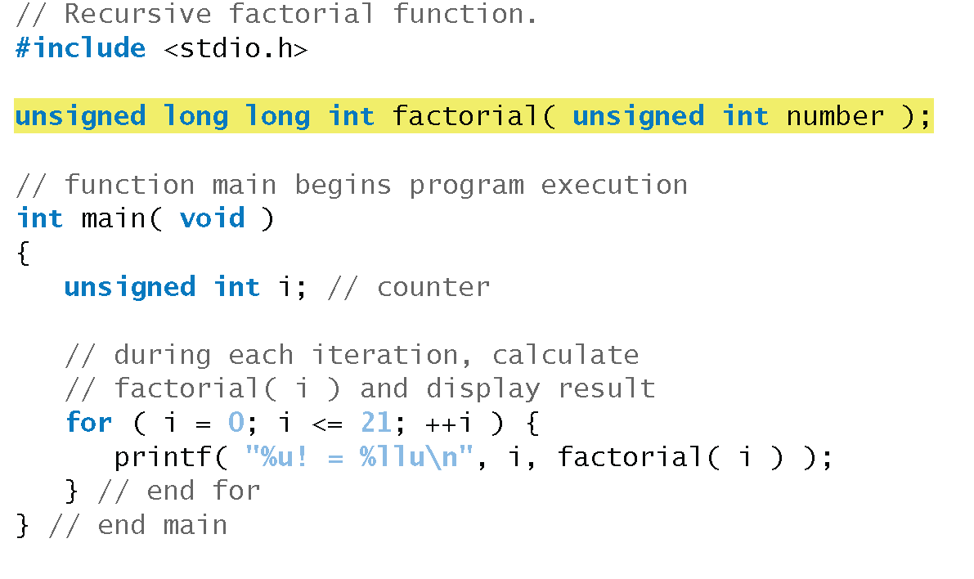

Slide 32
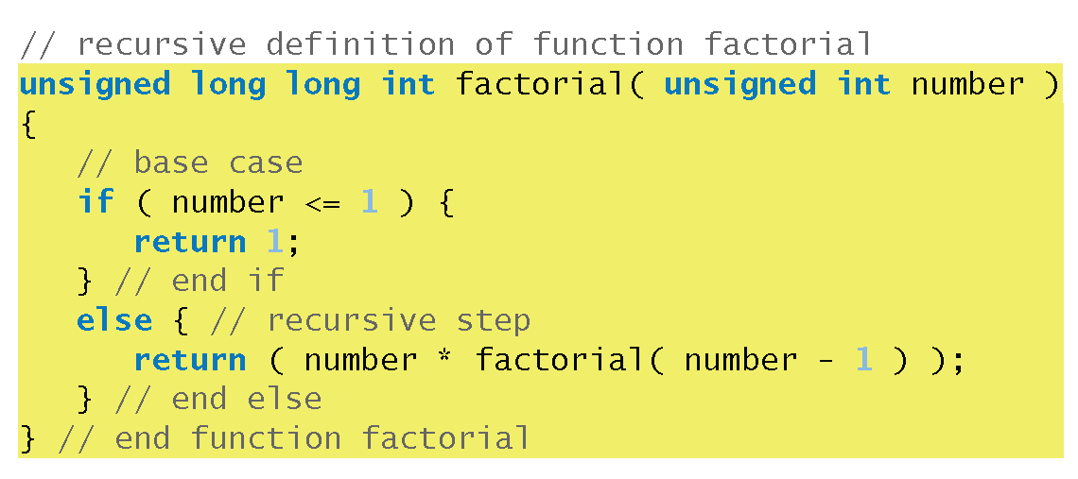

Slide 33
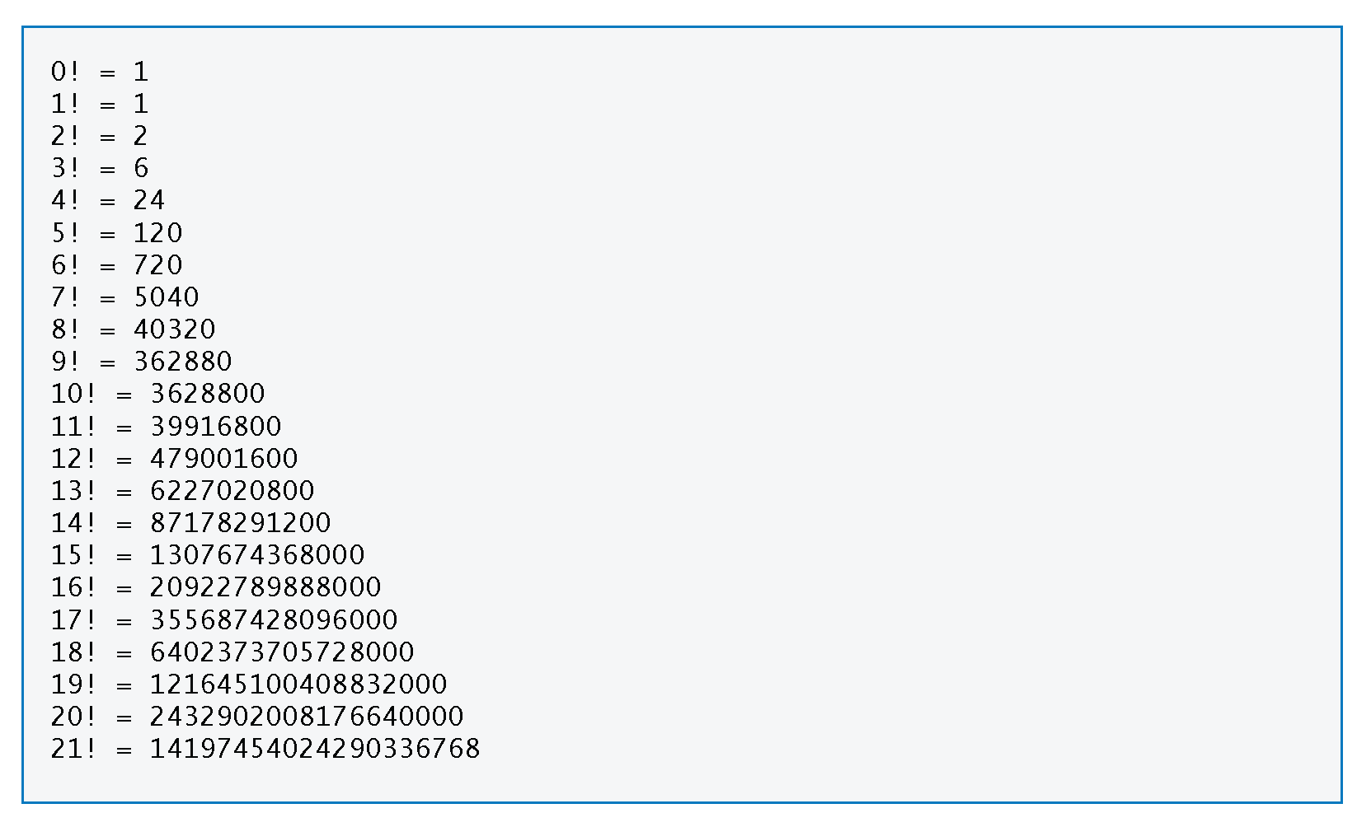

Slide 34
C & JAVA Comparison
Feature | C | Java
Including Math functions | #include "math.h" | part of base
Calling Math function | x = sqrt(2.2); | x = Math.sqrt(2.2);
functions | int max(int a, int b) | public static int max(int a, int b)
pass-by-value | primitive data types, structs, and pointers are passed by value; array decays to pointer | all primitive data types and references (which includes arrays), are passed by value
overloading | no | yes for methods, no for operators

Slide 35
SUMMARY
Create a function
<return type> <function name> (<type> <var> …)
Call a function (can call it recursively)
<function name> (<var>…)
Pass by reference
Argument accepts address: *<var name>
Caller sends address: &<var name>
Variable life
Local vs global

