Slide 1


Object Oriented Programming and Design WEEK 2 – Operators,Strings,and Conditional Statements

Slide 2
Revision Topic
Variables
Data Types
Variables Declaration
Expressions
Errors
Comments
Data TypeCasting

Slide 3
LET’S GET STARTED WITH LECTURE 2

Slide 4
Learning Outcomes
To understand how to implement operators in Java.
To understand how to implement decision statements using the if statement in Java
To understand how to implement switch in Java

Slide 5
Type Casting in Java
Java Type Casting
Type casting is when you assign a value of one primitive data type to another type.
In Java, there are two types of casting:
Widening Casting (automatically) - converting a smaller type to a larger type size byte -> short -> char -> int -> long -> float -> double
Narrowing Casting (manually) - converting a larger type to a smaller size type double -> float -> long -> int -> char -> short -> byte

Slide 6
Operators, Strings and Conditional Statements

Slide 7
1.Java Operators

Slide 8
Java Operators
1. Java Operators
1.1 Arithmetic Operator
1.2 Assignment Operator
1.3 Comparison Operator
1.4 Logical Operator
2. Strings
3.Conditional Statements
3.1Decision Making
Statements
3.1.1 if statement
3.1.1.1 simple if statement
3.1.1.2 if-else statement
3.1.1.3 if-else-if ladder
3.1.1.4 Nested if
3.1.2 switch statement
3.2 Loop Statements
3.3 Jump Statements
Operators in java is a symbol that is used to perform operations on variables and values/operands.
For example: +, -, *, / etc.
int x = 20+30;
There are different types of operators in Java which are given below:
Arithmetic Operator,
Assignment Operator,

Slide 9
Java Operators
1. Java Operators
1.1 Arithmetic Operator
1.2 Assignment Operator
1.3 Comparison Operator
1.4 Logical Operator
2. Strings
3.Conditional Statements
3.1Decision Making
Statements
3.1.1 if statement
3.1.1.1 simple if statement
3.1.1.2 if-else statement
3.1.1.3 if-else-if ladder
3.1.1.4 Nested if
3.1.2 switch statement
3.2 Loop Statements
3.3 Jump Statements
Comparison Operator,
Logical Operator,
Bitwise Operator

Slide 10
1. Java Operators
1.1 Arithmetic Operator
1.2 Assignment Operator
1.3 Comparison Operator
1.4 Logical Operator
2. Strings
3.Conditional Statements
3.1Decision Making
Statements
3.1.1 if statement
3.1.1.1 simple if statement
3.1.1.2 if-else statement
3.1.1.3 if-else-if ladder
3.1.1.4 Nested if
3.1.2 switch statement
3.2 Loop Statements
3.3 Jump Statements
Basics Syntax of Java Programming
public class MyFirstProgram
{
public static void main(String[]args)
{
System.out.println("Hello World");
}
}
Output
Hello World

Slide 11
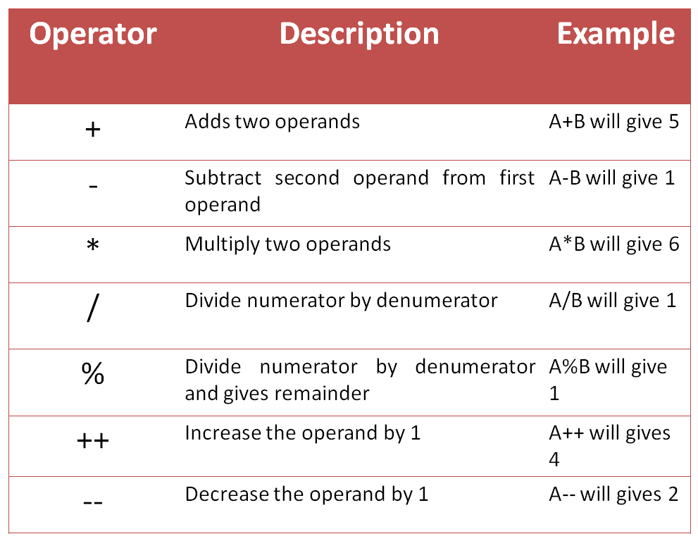
Arithmetic Operators
1. Java Operators
1.1 Arithmetic Operator
1.2 Assignment Operator
1.3 Comparison Operator
1.4 Logical Operator
2. Strings
3.Conditional Statements
3.1Decision Making
Statements
3.1.1 if statement
3.1.1.1 simple if statement
3.1.1.2 if-else statement
3.1.1.3 if-else-if ladder
3.1.1.4 Nested if
3.1.2 switch statement
3.2 Loop Statements
3.3 Jump Statements
Arithmetic Operators are used to perform mathematical operations.
Here is a list of arithmetic operators, assume A = 3, B=2.

Slide 12
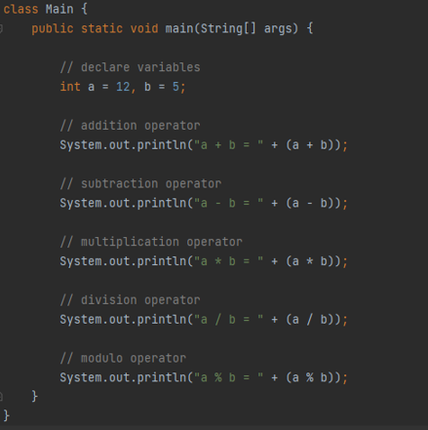
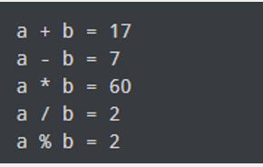
Arithmetic Operators
1. Java Operators
1.1 Arithmetic Operator
1.2 Assignment Operator
1.3 Comparison Operator
1.4 Logical Operator
2. Strings
3.Conditional Statements
3.1Decision Making
Statements
3.1.1 if statement
3.1.1.1 simple if statement
3.1.1.2 if-else statement
3.1.1.3 if-else-if ladder
3.1.1.4 Nested if
3.1.2 switch statement
3.2 Loop Statements
3.3 Jump Statements
Output

Slide 13
Assignment Operators
1. Java Operators
1.1 Arithmetic Operator
1.2 Assignment Operator
1.3 Comparison Operator
1.4 Logical Operator
2. Strings
3.Conditional Statements
3.1Decision Making
Statements
3.1.1 if statement
3.1.1.1 simple if statement
3.1.1.2 if-else statement
3.1.1.3 if-else-if ladder
3.1.1.4 Nested if
3.1.2 switch statement
3.2 Loop Statements
3.3 Jump Statements
Assignment operators are used to assign values to variables.
For example
int rollno;
rollno=18; //Here (=) is the assignment operator

Slide 14
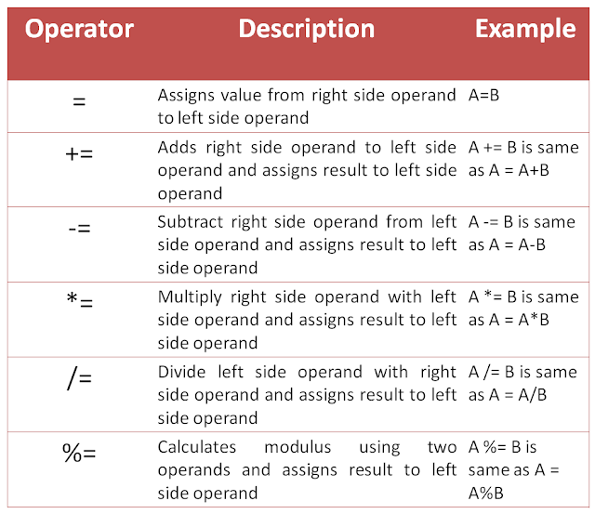
Assignment Operators
1. Java Operators
1.1 Arithmetic Operator
1.2 Assignment Operator
1.3 Comparison Operator
1.4 Logical Operator
2. Strings
3.Conditional Statements
3.1Decision Making
Statements
3.1.1 if statement
3.1.1.1 simple if statement
3.1.1.2 if-else statement
3.1.1.3 if-else-if ladder
3.1.1.4 Nested if
3.1.2 switch statement
3.2 Loop Statements
3.3 Jump Statements

Slide 15
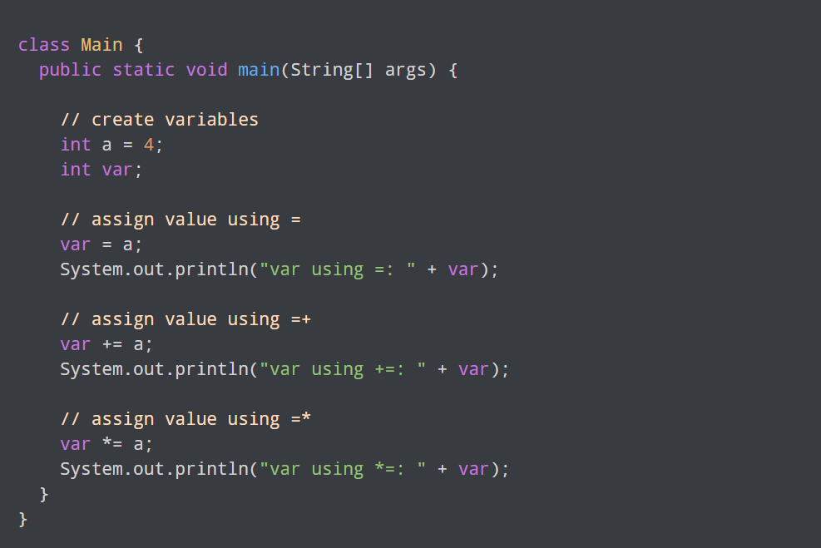
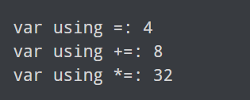
Assignment Operators
1. Java Operators
1.1 Arithmetic Operator
1.2 Assignment Operator
1.3 Comparison Operator
1.4 Logical Operator
2. Strings
3.Conditional Statements
3.1Decision Making
Statements
3.1.1 if statement
3.1.1.1 simple if statement
3.1.1.2 if-else statement
3.1.1.3 if-else-if ladder
3.1.1.4 Nested if
3.1.2 switch statement
3.2 Loop Statements
3.3 Jump Statements
Output

Slide 16
Comparison Operators
1. Java Operators
1.1 Arithmetic Operator
1.2 Assignment Operator
1.3 Comparison Operator
1.4 Logical Operator
2. Strings
3.Conditional Statements
3.1Decision Making
Statements
3.1.1 if statement
3.1.1.1 simple if statement
3.1.1.2 if-else statement
3.1.1.3 if-else-if ladder
3.1.1.4 Nested if
3.1.2 switch statement
3.2 Loop Statements
3.3 Jump Statements
Comparison operators are used to check the relationship between two operands.
It is also known as relational operator.
It returns the boolean values.

Slide 17
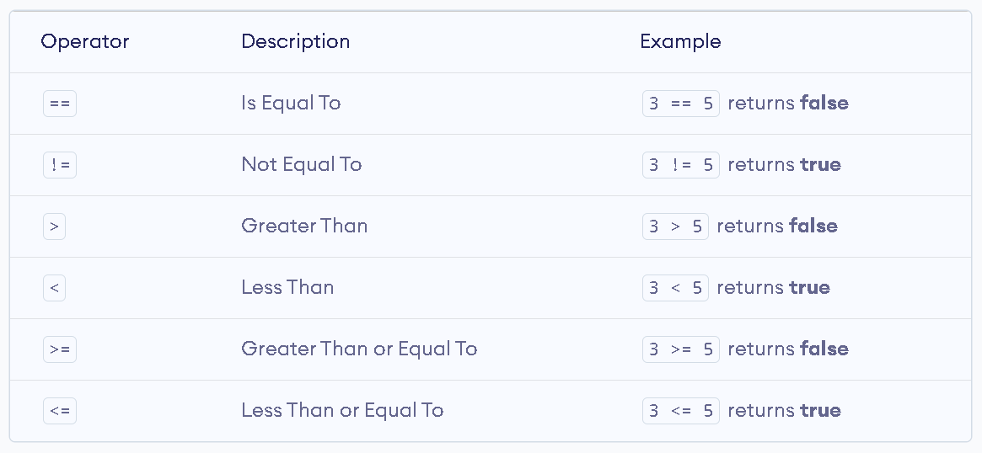
Comparison Operators
1. Java Operators
1.1 Arithmetic Operator
1.2 Assignment Operator
1.3 Comparison Operator
1.4 Logical Operator
2. Strings
3.Conditional Statements
3.1Decision Making
Statements
3.1.1 if statement
3.1.1.1 simple if statement
3.1.1.2 if-else statement
3.1.1.3 if-else-if ladder
3.1.1.4 Nested if
3.1.2 switch statement
3.2 Loop Statements
3.3 Jump Statements

Slide 18
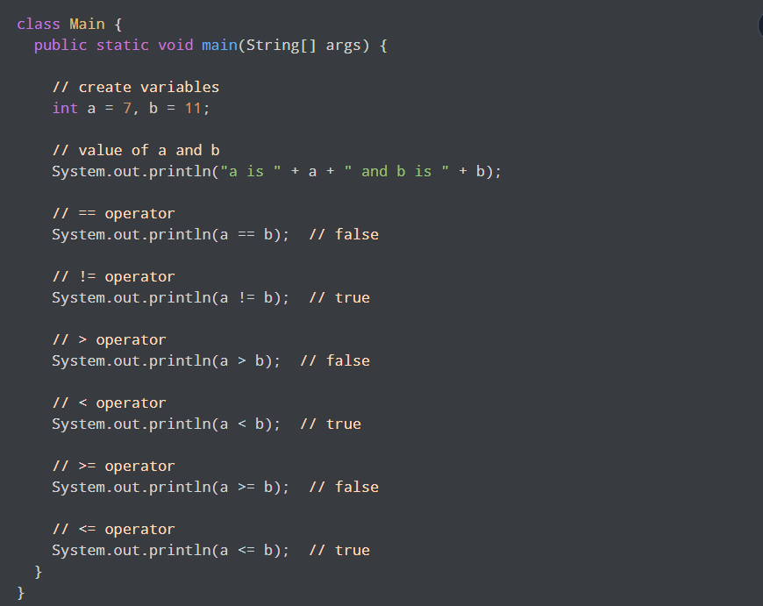
Comparison Operators
1. Java Operators
1.1 Arithmetic Operator
1.2 Assignment Operator
1.3 Comparison Operator
1.4 Logical Operator
2. Strings
3.Conditional Statements
3.1Decision Making
Statements
3.1.1 if statement
3.1.1.1 simple if statement
3.1.1.2 if-else statement
3.1.1.3 if-else-if ladder
3.1.1.4 Nested if
3.1.2 switch statement
3.2 Loop Statements
3.3 Jump Statements

Slide 19
Logical Operators
1. Java Operators
1.1 Arithmetic Operator
1.2 Assignment Operator
1.3 Comparison Operator
1.4 Logical Operator
2. Strings
3.Conditional Statements
3.1Decision Making
Statements
3.1.1 if statement
3.1.1.1 simple if statement
3.1.1.2 if-else statement
3.1.1.3 if-else-if ladder
3.1.1.4 Nested if
3.1.2 switch statement
3.2 Loop Statements
3.3 Jump Statements
Logical operators are used to check whether an expression is true or false.
It also returns boolean values.
Logical operators are used in decision making and loops.

Slide 20
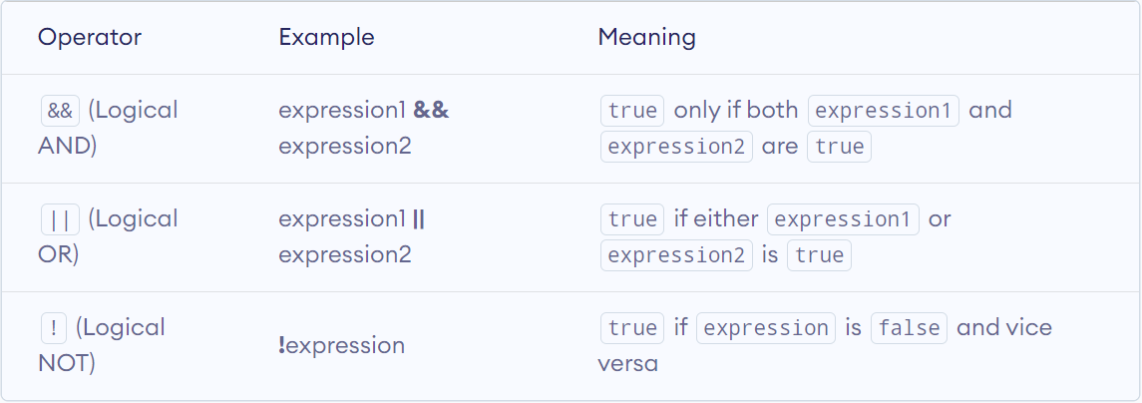
Logical Operators
1. Java Operators
1.1 Arithmetic Operator
1.2 Assignment Operator
1.3 Comparison Operator
1.4 Logical Operator
2. Strings
3.Conditional Statements
3.1Decision Making
Statements
3.1.1 if statement
3.1.1.1 simple if statement
3.1.1.2 if-else statement
3.1.1.3 if-else-if ladder
3.1.1.4 Nested if
3.1.2 switch statement
3.2 Loop Statements
3.3 Jump Statements

Slide 21
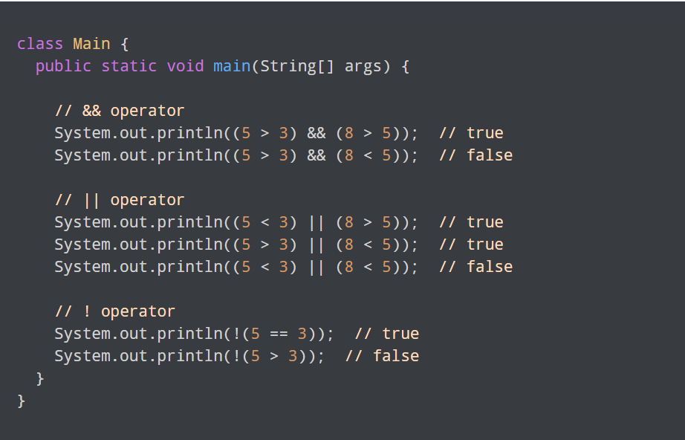
Logical Operators
1. Java Operators
1.1 Arithmetic Operator
1.2 Assignment Operator
1.3 Comparison Operator
1.4 Logical Operator
2. Strings
3.Conditional Statements
3.1Decision Making
Statements
3.1.1 if statement
3.1.1.1 simple if statement
3.1.1.2 if-else statement
3.1.1.3 if-else-if ladder
3.1.1.4 Nested if
3.1.2 switch statement
3.2 Loop Statements
3.3 Jump Statements

Slide 22
2. Strings

Slide 23
Strings
1. Java Operators
1.1 Arithmetic Operator
1.2 Assignment Operator
1.3 Comparison Operator
1.4 Logical Operator
2. Strings
3.Conditional Statements
3.1Decision Making
Statements
3.1.1 if statement
3.1.1.1 simple if statement
3.1.1.2 if-else statement
3.1.1.3 if-else-if ladder
3.1.1.4 Nested if
3.1.2 switch statement
3.2 Loop Statements
3.3 Jump Statements
In Java, string is basically an object that represents sequence of char values.
It is used to store text and character which will be surrounded by a double quotes (“ ”).
For example:
String collegeName = ”Herald”;

Slide 24
Importance of String
1. Java Operators
1.1 Arithmetic Operator
1.2 Assignment Operator
1.3 Comparison Operator
1.4 Logical Operator
2. Strings
3.Conditional Statements
3.1Decision Making
Statements
3.1.1 if statement
3.1.1.1 simple if statement
3.1.1.2 if-else statement
3.1.1.3 if-else-if ladder
3.1.1.4 Nested if
3.1.2 switch statement
3.2 Loop Statements
3.3 Jump Statements
String are not modifiable.
String are placed in String pool.
Comparison of Strings is done using equals method.

Slide 25
String Declaration and Initialization
1. Java Operators
1.1 Arithmetic Operator
1.2 Assignment Operator
1.3 Comparison Operator
1.4 Logical Operator
2. Strings
3.Conditional Statements
3.1Decision Making
Statements
3.1.1 if statement
3.1.1.1 simple if statement
3.1.1.2 if-else statement
3.1.1.3 if-else-if ladder
3.1.1.4 Nested if
3.1.2 switch statement
3.2 Loop Statements
3.3 Jump Statements
String str; // declaration of the string
String collegeName =“Herald”; // string initialization
String array initialization
- String[] collegeName = {“Herald”,”Islington”};
- String[] cName = new String[2];
cName[0] = “Herald”;
cName[1] = “Islington”;

Slide 26
Strings
1. Java Operators
1.1 Arithmetic Operator
1.2 Assignment Operator
1.3 Comparison Operator
1.4 Logical Operator
2. Strings
3.Conditional Statements
3.1Decision Making
Statements
3.1.1 if statement
3.1.1.1 simple if statement
3.1.1.2 if-else statement
3.1.1.3 if-else-if ladder
3.1.1.4 Nested if
3.1.2 switch statement
3.2 Loop Statements
3.3 Jump Statements
Java String class provides a lot of methods to perform operations on strings such as compare(), concat(), equals(), length(), replace(), compareTo(), toUpperCase(), tolowerCase(), charAt(), substring(),etc.
For example: calculating the length of above string
int stringSize = collegeName.length();
stringSize will be assigned as 6.

Slide 27
String Concatenation
1. Java Operators
1.1 Arithmetic Operator
1.2 Assignment Operator
1.3 Comparison Operator
1.4 Logical Operator
2. Strings
3.Conditional Statements
3.1Decision Making
Statements
3.1.1 if statement
3.1.1.1 simple if statement
3.1.1.2 if-else statement
3.1.1.3 if-else-if ladder
3.1.1.4 Nested if
3.1.2 switch statement
3.2 Loop Statements
3.3 Jump Statements
‘adding’ one String onto the end of another
String fName = “Romon”;
String lName = “James“;
String fullname = fName + lName; // RomonJames
for adding a space in between?
String name = fName + “ “ + lName; // Romon James
for concatenating a numeric value to a string
String name = “Romon”;
int rollno = 10;
String concat = name + rollno; // Romon10

Slide 28
Java Scanner Class
1. Java Operators
1.1 Arithmetic Operator
1.2 Assignment Operator
1.3 Comparison Operator
1.4 Logical Operator
2. Strings
3.Conditional Statements
3.1Decision Making
Statements
3.1.1 if statement
3.1.1.1 simple if statement
3.1.1.2 if-else statement
3.1.1.3 if-else-if ladder
3.1.1.4 Nested if
3.1.2 switch statement
3.2 Loop Statements
3.3 Jump Statements
Scanner class in Java is found in the java.util package.
Java provides various ways to read input from the keyboard, the java.util.Scanner class is one of them.
The Java Scanner class provides nextXXX() methods to return the type of value such as nextInt(), nextByte(), nextShort(), next(), nextLine(), nextDouble(), nextFloat(), nextBoolean(), etc.
Scanner in = new Scanner(System.in); //reads the input from the user

Slide 29
String Input
1. Java Operators
1.1 Arithmetic Operator
1.2 Assignment Operator
1.3 Comparison Operator
1.4 Logical Operator
2. Strings
3.Conditional Statements
3.1Decision Making
Statements
3.1.1 if statement
3.1.1.1 simple if statement
3.1.1.2 if-else statement
3.1.1.3 if-else-if ladder
3.1.1.4 Nested if
3.1.2 switch statement
3.2 Loop Statements
3.3 Jump Statements
Java next() method: Java next() method can read the input before the space id found. It cannot read two words separated by space.
Scanner in = new Scanner(System.in); // scanner object
System.out.print("Please enter your college name: ");
String name = in.next();
System.out.print(“Your college name is: “+name);
Output: Please enter your college name:
Herald College
-> Your college name is: Herald
Note: The next() method reads one word at a time and looks for ‘white space’ delimiters

Slide 30
String Input
1. Java Operators
1.1 Arithmetic Operator
1.2 Assignment Operator
1.3 Comparison Operator
1.4 Logical Operator
2. Strings
3.Conditional Statements
3.1Decision Making
Statements
3.1.1 if statement
3.1.1.1 simple if statement
3.1.1.2 if-else statement
3.1.1.3 if-else-if ladder
3.1.1.4 Nested if
3.1.2 switch statement
3.2 Loop Statements
3.3 Jump Statements
Java nextLine() method:The nextLine() method reads the text until the end of the line. After reading the line, it throws the cursor to the next line.
System.out.print("Please enter your address: ");
String address = in.nextLine(); // reads until hits ‘Enter’
Converting a String variable to a number
System.out.print("Please enter your age: ");
String input = in.nextLine();
int age = Integer.parseInt(input); // only digits!

Slide 31
String and Characters
1. Java Operators
1.1 Arithmetic Operator
1.2 Assignment Operator
1.3 Comparison Operator
1.4 Logical Operator
2. Strings
3.Conditional Statements
3.1Decision Making
Statements
3.1.1 if statement
3.1.1.1 simple if statement
3.1.1.2 if-else statement
3.1.1.3 if-else-if ladder
3.1.1.4 Nested if
3.1.2 switch statement
3.2 Loop Statements
3.3 Jump Statements
In Java Strings are sequences of Unicode characters like in Python
However, unlike Python:
Characters have their own type: char
Characters have numeric values
See the ASCII code chart
For example, the letter ‘H’ has a value of 72 if it were a number
Use single quotes around a char
char initial = ‘B’;
Use double quotes around a String
String initials = “BRL”;

Slide 32
String Methods
1. Java Operators
1.1 Arithmetic Operator
1.2 Assignment Operator
1.3 Comparison Operator
1.4 Logical Operator
2. Strings
3.Conditional Statements
3.1Decision Making
Statements
3.1.1 if statement
3.1.1.1 simple if statement
3.1.1.2 if-else statement
3.1.1.3 if-else-if ladder
3.1.1.4 Nested if
3.1.2 switch statement
3.2 Loop Statements
3.3 Jump Statements
Java length() method: The length() method finds the length of the string.
String s1= “Herald”;
String s2= “Java module”;
System.out.print(s1.length()); //6
System.out.print(s2.length()); //11
Java equals() method: The equals() method compares the two given string based on the content of the string.

Slide 33
String Methods
1. Java Operators
1.1 Arithmetic Operator
1.2 Assignment Operator
1.3 Comparison Operator
1.4 Logical Operator
2. Strings
3.Conditional Statements
3.1Decision Making
Statements
3.1.1 if statement
3.1.1.1 simple if statement
3.1.1.2 if-else statement
3.1.1.3 if-else-if ladder
3.1.1.4 Nested if
3.1.2 switch statement
3.2 Loop Statements
3.3 Jump Statements
String s1= “Herald”;
String s2= “Javamodule”;
String s3= “Herald”;
String s4= “JAVAMODULE”;
System.out.print(s1.equals(s2)); // returns false bocoz content is not same
System.out.print(s1.equals(s3)); // returns true becoz content and case is same
System.out.print(s2.equals(s4)); // returns false becoz content and case is different

Slide 34
String Methods
1. Java Operators
1.1 Arithmetic Operator
1.2 Assignment Operator
1.3 Comparison Operator
1.4 Logical Operator
2. Strings
3.Conditional Statements
3.1Decision Making
Statements
3.1.1 if statement
3.1.1.1 simple if statement
3.1.1.2 if-else statement
3.1.1.3 if-else-if ladder
3.1.1.4 Nested if
3.1.2 switch statement
3.2 Loop Statements
3.3 Jump Statements
Java compareTo() method: The compareTo() method compares the given string with the current string. It returns a positive number, negative number or 0.
String s1= “Herald”;
String s2= “Herald”;
System.out.print(s1.compareTo(s2)); //0 becoz both are equal

Slide 35
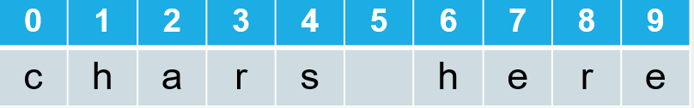
String Methods
1. Java Operators
1.1 Arithmetic Operator
1.2 Assignment Operator
1.3 Comparison Operator
1.4 Logical Operator
2. Strings
3.Conditional Statements
3.1Decision Making
Statements
3.1.1 if statement
3.1.1.1 simple if statement
3.1.1.2 if-else statement
3.1.1.3 if-else-if ladder
3.1.1.4 Nested if
3.1.2 switch statement
3.2 Loop Statements
3.3 Jump Statements
charAt() method: Each char inside a String has an index number:
The first char is index zero (0)
The charAt method returns a char at a given index inside a String:
String greeting = "Hello";
char start = greeting.charAt(0); // H
char last = greeting.charAt(4); // o

Slide 36
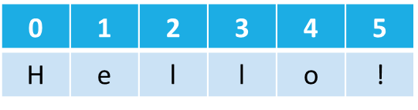
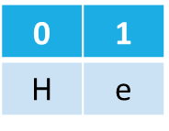
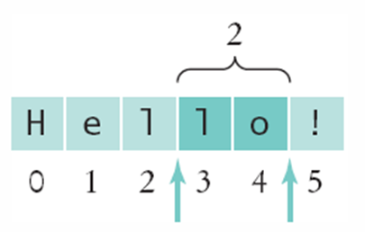
String Methods
1. Java Operators
1.1 Arithmetic Operator
1.2 Assignment Operator
1.3 Comparison Operator
1.4 Logical Operator
2. Strings
3.Conditional Statements
3.1Decision Making
Statements
3.1.1 if statement
3.1.1.1 simple if statement
3.1.1.2 if-else statement
3.1.1.3 if-else-if ladder
3.1.1.4 Nested if
3.1.2 switch statement
3.2 Loop Statements
3.3 Jump Statements
A substring is a portion of a String
The substring method returns a portion of a String at a given index for a number of chars, starting at an index:
String greeting = "Hello!";
String sub = greeting.substring(0, 2); //He
String sub2 = greeting.substring(3, 5); //lo

Slide 37
String Methods
1. Java Operators
1.1 Arithmetic Operator
1.2 Assignment Operator
1.3 Comparison Operator
1.4 Logical Operator
2. Strings
3.Conditional Statements
3.1Decision Making
Statements
3.1.1 if statement
3.1.1.1 simple if statement
3.1.1.2 if-else statement
3.1.1.3 if-else-if ladder
3.1.1.4 Nested if
3.1.2 switch statement
3.2 Loop Statements
3.3 Jump Statements
A substring is a portion of a String
The substring method returns a portion of a String at a given index for a number of chars, starting at an index:
String greeting = "Hello!";
String sub = greeting.substring(0, 2);
String sub2 = greeting.substring(3, 5);

Slide 38
3.Java Selection Control
Conditional Statements

Slide 39
Conditional Statements
1. Java Operators
1.1 Arithmetic Operator
1.2 Assignment Operator
1.3 Comparison Operator
1.4 Logical Operator
2. Strings
3.Conditional Statements
3.1Decision Making
Statements
3.1.1 if statement
3.1.1.1 simple if statement
3.1.1.2 if-else statement
3.1.1.3 if-else-if ladder
3.1.1.4 Nested if
3.1.2 switch statement
3.2 Loop Statements
3.3 Jump Statements
Java provides statements that can be used to control the flow of Java code.
It is one of the fundamental features of Java, which provides a smooth flow of program.
The statements in the code are executed according to the order in which they appear.

Slide 40
Importance of conditional statements
1. Java Operators
1.1 Arithmetic Operator
1.2 Assignment Operator
1.3 Comparison Operator
1.4 Logical Operator
2. Strings
3.Conditional Statements
3.1Decision Making
Statements
3.1.1 if statement
3.1.1.1 simple if statement
3.1.1.2 if-else statement
3.1.1.3 if-else-if ladder
3.1.1.4 Nested if
3.1.2 switch statement
3.2 Loop Statements
3.3 Jump Statements
It helps to reduce the code size and result in saving the time.
It improves the readability of the code.
It is useful for handling the large projects.

Slide 41
Types of Conditional Statements
1. Java Operators
1.1 Arithmetic Operator
1.2 Assignment Operator
1.3 Comparison Operator
1.4 Logical Operator
2. Strings
3.Conditional Statements
3.1Decision Making
Statements
3.1.1 if statement
3.1.1.1 simple if statement
3.1.1.2 if-else statement
3.1.1.3 if-else-if ladder
3.1.1.4 Nested if
3.1.2 switch statement
3.2 Loop Statements
3.3 Jump Statements
Decision Making statements
if statements
switch statement
Loop statements
do while loop
while loop
for loop
for-each loop
Jump statements
break statement
continue statement

Slide 42
1.Decision Making Statements
1. Java Operators
1.1 Arithmetic Operator
1.2 Assignment Operator
1.3 Comparison Operator
1.4 Logical Operator
2. Strings
3.Conditional Statements
3.1Decision Making
Statements
3.1.1 if statement
3.1.1.1 simple if statement
3.1.1.2 if-else statement
3.1.1.3 if-else-if ladder
3.1.1.4 Nested if
3.1.2 switch statement
3.2 Loop Statements
3.3 Jump Statements
As the name suggests, decision-making statements decide which statement to execute and when.
If Statement: In Java, the "if" statement is used to evaluate a condition.
There are four types of if-statements as given below.
1.1 Simple if statement
1.2 if-else statement
1.3 if-else-if ladder
1.4 Nested if-statement

Slide 43
1.1 Simple if Statement
1. Java Operators
1.1 Arithmetic Operator
1.2 Assignment Operator
1.3 Comparison Operator
1.4 Logical Operator
2. Strings
3.Conditional Statements
3.1Decision Making
Statements
3.1.1 if statement
3.1.1.1 simple if statement
3.1.1.2 if-else statement
3.1.1.3 if-else-if ladder
3.1.1.4 Nested if
3.1.2 switch statement
3.2 Loop Statements
3.3 Jump Statements
Simple if is the most basic statement among all control flow statements in Java.
It evaluates a Boolean expression and enables the program to enter a block of code if the expression evaluates to true.
Syntax:
if(condition) {
statement 1; //executes when condition is true
}

Slide 44
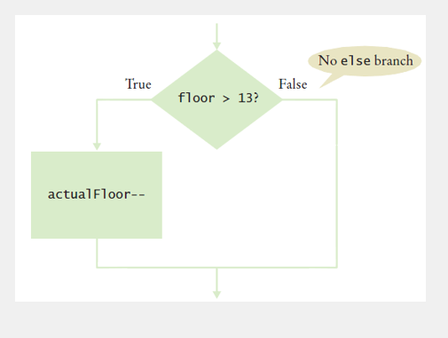
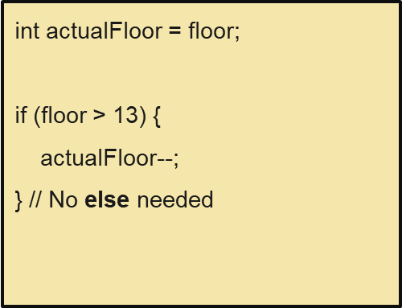
1.1 Simple if Statement
Flowchart
1. Java Operators
1.1 Arithmetic Operator
1.2 Assignment Operator
1.3 Comparison Operator
1.4 Logical Operator
2. Strings
3.Conditional Statements
3.1Decision Making
Statements
3.1.1 if statement
3.1.1.1 simple if statement
3.1.1.2 if-else statement
3.1.1.3 if-else-if ladder
3.1.1.4 Nested if
3.1.2 switch statement
3.2 Loop Statements
3.3 Jump Statements
Fig: Flowchart of simple if statement

Slide 45
1.2 if-else Statement
1. Java Operators
1.1 Arithmetic Operator
1.2 Assignment Operator
1.3 Comparison Operator
1.4 Logical Operator
2. Strings
3.Conditional Statements
3.1Decision Making
Statements
3.1.1 if statement
3.1.1.1 simple if statement
3.1.1.2 if-else statement
3.1.1.3 if-else-if ladder
3.1.1.4 Nested if
3.1.2 switch statement
3.2 Loop Statements
3.3 Jump Statements
The if-else statement is an extension to the if-statement, which uses another block of code, i.e., else block.
The else block is executed if the condition of the if-block is evaluated as false.

Slide 46
1.2 if-else Statement
1. Java Operators
1.1 Arithmetic Operator
1.2 Assignment Operator
1.3 Comparison Operator
1.4 Logical Operator
2. Strings
3.Conditional Statements
3.1Decision Making
Statements
3.1.1 if statement
3.1.1.1 simple if statement
3.1.1.2 if-else statement
3.1.1.3 if-else-if ladder
3.1.1.4 Nested if
3.1.2 switch statement
3.2 Loop Statements
3.3 Jump Statements
Syntax:
if(condition) {
statement 1; //executes when condition is true
}
else{
statement 2; //executes when condition is false
}

Slide 47
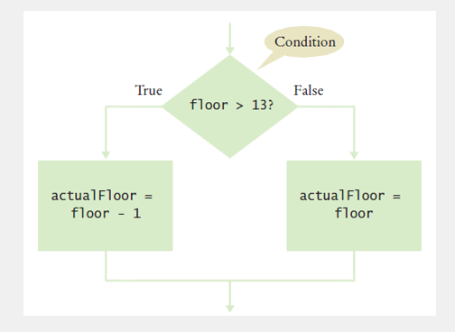
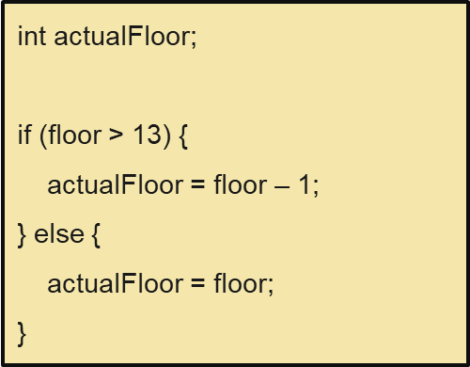
1.2 if-else Statement
Flowchart
1. Java Operators
1.1 Arithmetic Operator
1.2 Assignment Operator
1.3 Comparison Operator
1.4 Logical Operator
2. Strings
3.Conditional Statements
3.1Decision Making
Statements
3.1.1 if statement
3.1.1.1 simple if statement
3.1.1.2 if-else statement
3.1.1.3 if-else-if ladder
3.1.1.4 Nested if
3.1.2 switch statement
3.2 Loop Statements
3.3 Jump Statements
Fig: Flowchart of if-else statement

Slide 48
1.3 if-else-if ladder Statement
1. Java Operators
1.1 Arithmetic Operator
1.2 Assignment Operator
1.3 Comparison Operator
1.4 Logical Operator
2. Strings
3.Conditional Statements
3.1Decision Making
Statements
3.1.1 if statement
3.1.1.1 simple if statement
3.1.1.2 if-else statement
3.1.1.3 if-else-if ladder
3.1.1.4 Nested if
3.1.2 switch statement
3.2 Loop Statements
3.3 Jump Statements
The if-else-if ladder statement contains the if-statement followed by multiple else-if statements.
In other words, we can say that it is the chain of if-else statements that create a decision tree where the program may enter in the block of code where the condition is true.

Slide 49
1.3 if-else-if ladder Statement
1. Java Operators
1.1 Arithmetic Operator
1.2 Assignment Operator
1.3 Comparison Operator
1.4 Logical Operator
2. Strings
3.Conditional Statements
3.1Decision Making
Statements
3.1.1 if statement
3.1.1.1 simple if statement
3.1.1.2 if-else statement
3.1.1.3 if-else-if ladder
3.1.1.4 Nested if
3.1.2 switch statement
3.2 Loop Statements
3.3 Jump Statements
Syntax:
if(condition 1) {
statement 1; //executes when condition 1 is true
}
else if(condition 2) {
statement 2; //executes when condition 2 is true
}
else {
statement 2; //executes when all the conditions are false
}

Slide 50
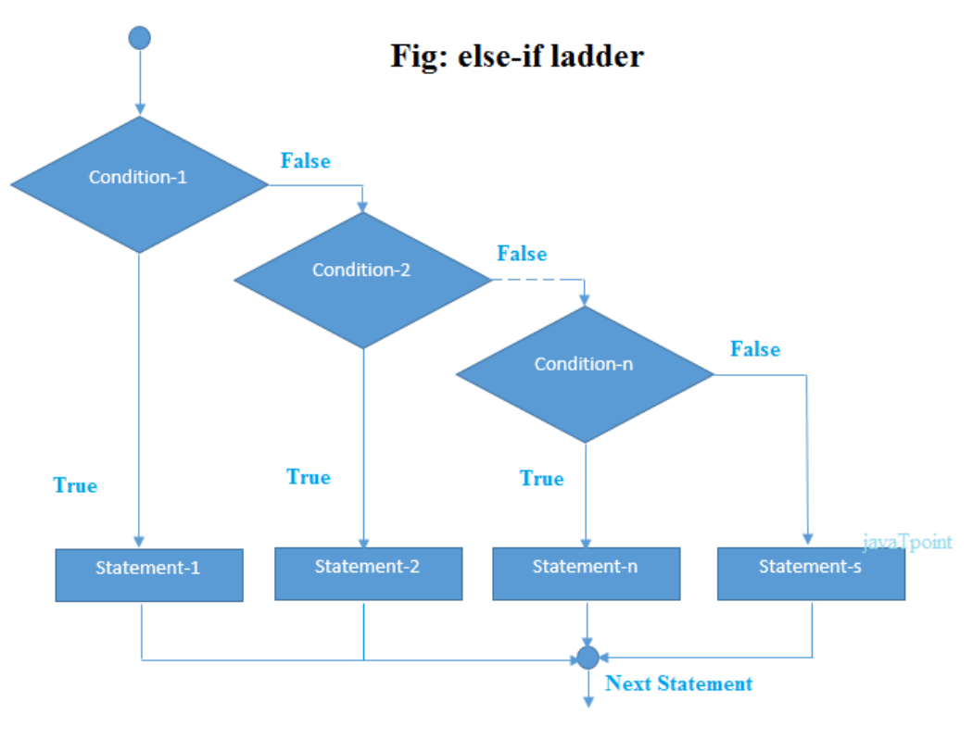
1.2 if-else-if ladder Statement
Flowchart
1. Java Operators
1.1 Arithmetic Operator
1.2 Assignment Operator
1.3 Comparison Operator
1.4 Logical Operator
2. Strings
3.Conditional Statements
3.1Decision Making
Statements
3.1.1 if statement
3.1.1.1 simple if statement
3.1.1.2 if-else statement
3.1.1.3 if-else-if ladder
3.1.1.4 Nested if
3.1.2 switch statement
3.2 Loop Statements
3.3 Jump Statements
Fig: Flowchart of if-else-if ladder statement

Slide 51
1.2 Nested-if Statement
1. Java Operators
1.1 Arithmetic Operator
1.2 Assignment Operator
1.3 Comparison Operator
1.4 Logical Operator
2. Strings
3.Conditional Statements
3.1Decision Making
Statements
3.1.1 if statement
3.1.1.1 simple if statement
3.1.1.2 if-else statement
3.1.1.3 if-else-if ladder
3.1.1.4 Nested if
3.1.2 switch statement
3.2 Loop Statements
3.3 Jump Statements
In nested if-statements, the if statement can contain a if or if-else statement inside another if or else-if statement.

Slide 52
1.2 Nested-if Statement
1. Java Operators
1.1 Arithmetic Operator
1.2 Assignment Operator
1.3 Comparison Operator
1.4 Logical Operator
2. Strings
3.Conditional Statements
3.1Decision Making
Statements
3.1.1 if statement
3.1.1.1 simple if statement
3.1.1.2 if-else statement
3.1.1.3 if-else-if ladder
3.1.1.4 Nested if
3.1.2 switch statement
3.2 Loop Statements
3.3 Jump Statements
Syntax:
if(condition 1) {
statement 1; //executes when condition 1 is true
if(condition 2) {
statement 2; //executes when condition 2 is true
}
else{
statement 2; //executes when condition 2 is false
}
}

Slide 53
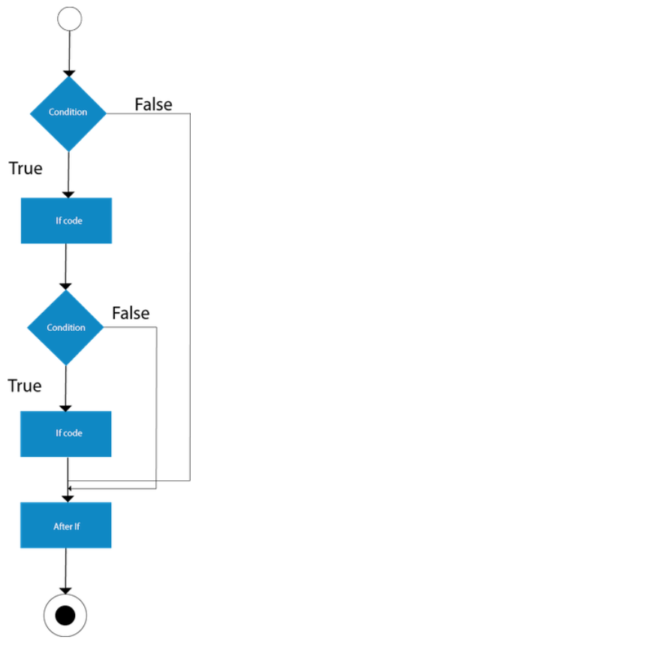
1.2 Nested if Statement
Flowchart
1. Java Operators
1.1 Arithmetic Operator
1.2 Assignment Operator
1.3 Comparison Operator
1.4 Logical Operator
2. Strings
3.Conditional Statements
3.1Decision Making
Statements
3.1.1 if statement
3.1.1.1 simple if statement
3.1.1.2 if-else statement
3.1.1.3 if-else-if ladder
3.1.1.4 Nested if
3.1.2 switch statement
3.2 Loop Statements
3.3 Jump Statements
Fig: Flowchart of nested if statement

Slide 54
2 Switch Statements
1. Java Operators
1.1 Arithmetic Operator
1.2 Assignment Operator
1.3 Comparison Operator
1.4 Logical Operator
2. Strings
3.Conditional Statements
3.1Decision Making
Statements
3.1.1 if statement
3.1.1.1 simple if statement
3.1.1.2 if-else statement
3.1.1.3 if-else-if ladder
3.1.1.4 Nested if
3.1.2 switch statement
3.2 Loop Statements
3.3 Jump Statements
The Switch statements contains multiple blocks of code called cases and a single case is executed based on the variable which is being switched.
In Java, Switch statements are similar to if-else-if statements.

Slide 55
2 Switch Statements
1. Java Operators
1.1 Arithmetic Operator
1.2 Assignment Operator
1.3 Comparison Operator
1.4 Logical Operator
2. Strings
3.Conditional Statements
3.1Decision Making
Statements
3.1.1 if statement
3.1.1.1 simple if statement
3.1.1.2 if-else statement
3.1.1.3 if-else-if ladder
3.1.1.4 Nested if
3.1.2 switch statement
3.2 Loop Statements
3.3 Jump Statements
Points to be remembered:
Cases cannot be duplicate
The case variables can be int, short, byte, char, or enumeration.
Default statement is executed when any of the case doesn't match the value of expression. It is optional.
Break statement terminates the switch block when the condition is satisfied. It is optional, if not used, next case is executed.
The case expression will be of the same type as the variable. However, it will also be a constant value.

Slide 56
1. Java Operators
1.1 Arithmetic Operator
1.2 Assignment Operator
1.3 Comparison Operator
1.4 Logical Operator
2. Strings
3.Conditional Statements
3.1Decision Making
Statements
3.1.1 if statement
3.1.1.1 simple if statement
3.1.1.2 if-else statement
3.1.1.3 if-else-if ladder
3.1.1.4 Nested if
3.1.2 switch statement
3.2 Loop Statements
3.3 Jump Statements
Syntax:
switch(expression) {
case x: // code block
break ;
case y: // code block
break;
default: // code block
}

Slide 57
Switch Statement Example
1. Java Operators
1.1 Arithmetic Operator
1.2 Assignment Operator
1.3 Comparison Operator
1.4 Logical Operator
2. Strings
3.Conditional Statements
3.1Decision Making
Statements
3.1.1 if statement
3.1.1.1 simple if statement
3.1.1.2 if-else statement
3.1.1.3 if-else-if ladder
3.1.1.4 Nested if
3.1.2 switch statement
3.2 Loop Statements
3.3 Jump Statements
public class Main {
public static void main(String[] args) {
int day = 4;
switch (day) {
case 1:
System.out.println("Monday");
break;
case 2:
System.out.println("Tuesday");
break;
case 3:
System.out.println("Wednesday");
break;
case 4:
System.out.println("Thursday");
break;
case 5:
System.out.println("Friday");
break;
case 6:
System.out.println("Saturday");
break;
case 7:
System.out.println("Sunday");
break;
}
}
}
Output
Thursday

Slide 58
The break Keyword
1. Java Operators
1.1 Arithmetic Operator
1.2 Assignment Operator
1.3 Comparison Operator
1.4 Logical Operator
2. Strings
3.Conditional Statements
3.1Decision Making
Statements
3.1.1 if statement
3.1.1.1 simple if statement
3.1.1.2 if-else statement
3.1.1.3 if-else-if ladder
3.1.1.4 Nested if
3.1.2 switch statement
3.2 Loop Statements
3.3 Jump Statements
When Java reaches a break keyword, it breaks out of the switch block.
This will stop the execution of more code and case testing inside the block.
When a match is found, and the job is done, it's time for a break. There is no need for more testing.
Note:A break can save a lot of execution time because it "ignores" the execution of all the rest of the code in the switch block.

Slide 59
The default Keyword
1. Java Operators
1.1 Arithmetic Operator
1.2 Assignment Operator
1.3 Comparison Operator
1.4 Logical Operator
2. Strings
3.Conditional Statements
3.1Decision Making
Statements
3.1.1 if statement
3.1.1.1 simple if statement
3.1.1.2 if-else statement
3.1.1.3 if-else-if ladder
3.1.1.4 Nested if
3.1.2 switch statement
3.2 Loop Statements
3.3 Jump Statements
The default keyword specifies some code to run if there is no case match:
Note:Note that if the default statement is used as the last statement in a switch block, it does not need a break.
int day = 4;
switch (day) {
case 6:
System.out.println("Today is Saturday");
break;
case 7:
System.out.println("Today is Sunday");
break;
default:
System.out.println("Looking forward to the Weekend");
}
Output
"Looking forward to the Weekend"

Slide 60


