Slide 1
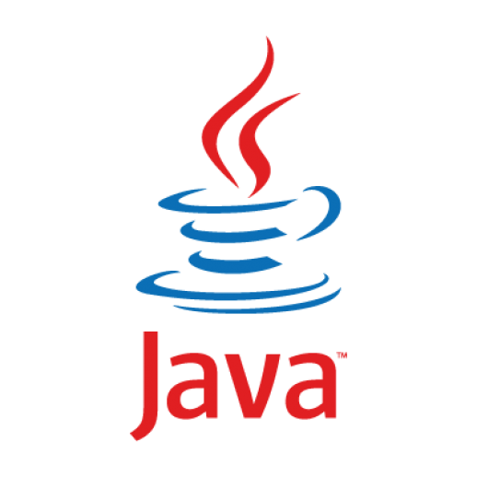

Object Oriented Programming and Design WEEK 1 – Introduction to OOP

Slide 2
INTRODUCTION TO YOUR INSTRUCTORS
Lecturers
Mr. Subhash Bista(Module Leader)
Mr. Biraj Dulal
Mr. Deepson Shrestha
Mr. Nischal Shakya

Slide 3
Tutors
Mr. Rukesh Shrestha
Mrs. Aashisna Thapaliya
Mr. Sajag Silwal
Ms. Jeshmi Rajak
Graduate Teaching Assistant (GTA)
Mr. Dhan Thapa

Slide 4

INTRODUCTION TO THE MODULE
Overview of Module
What can you expect?
Learning Objectives
How will you benefit?
Learning Strategy
How you will learn?
Assessment Overview
How you will be tested?

Slide 5

OVERVIEW OF MODULE
This is a beginner’s module aimed at introducing Object Oriented Programming concepts to students who have had no prior experience of programming.
The module will teach students to write, analyse and correct program codes using graphical interface IDE (Eclipse).
At the end of the course, students will be able to build Desktop Application using OOP concepts.

Slide 6


LEARNING OBJECTIVES
Object Oriented Design and Programming
Core Java Programming
6

Slide 7
ASSESSMENT DETAILS
100 % Coursework: Individual Coursework

Slide 8
ASSESSMENT DETAILS
More Information about the assessments will be provided in subsequent weeks.

Slide 9
ASSESSMENT DETAILS
Module Grading Standards in the UK
Range of Marks | Grade | Remarks
70 - 100 | A | Excellent: outstanding performance with only minor errors
60 - 69 | B | Very Good: above the average standard but with some errors
50 - 59 | C | Good: generally sound work with a number of notable errors
43 - 49 | D | Satisfactory: fair but with significant shortcomings
40 - 42 | E | Sufficient: performance meets the minimum criteria
0 - 39 | F | Fail: performance does not meet the minimum criteria and considerable further work is required

Slide 10
LET’S GET STARTED WITH LECTURE 1

Slide 11
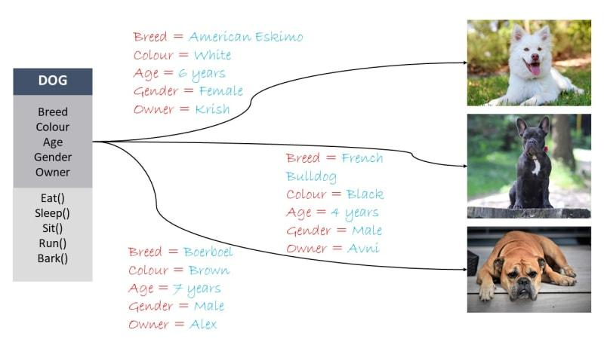
Introduction to Object Oriented Programming
1. Introduction to object oriented programming
2. Software Evolution
3. Procedural vs Object Oriented Programming
4.Introduction to Java
5. History of Java
6. Java Architecture
7. Features of Java
8.Java keywords
9. Simple Java Program
10. Analysing Java Program
11.Program Structure
12. Calling Java library Methods
13.Java Variables
14. Java Data Types
15. Declaring variables in Java
16.Java operators
17.Naming convention in Java
18. Java Expressions
19. Types of Error
20. Comments in Java
Object
components that have properties and behavior
each separate objects has its own properties
Example

Slide 12
Introduction to Object Oriented Programming
1. Introduction to object oriented programming
2. Software Evolution
3. Procedural vs Object Oriented Programming
4.Introduction to Java
5. History of Java
6. Java Architecture
7. Features of Java
8.Java keywords
9. Simple Java Program
10. Analysing Java Program
11.Program Structure
12. Calling Java library Methods
13.Java Variables
14. Java Data Types
15. Declaring variables in Java
16.Java operators
17.Naming convention in Java
18. Java Expressions
19. Types of Error
20. Comments in Java
In terms of programming,
Properties of the components such as: - breed, color, weight are data of that components
Behavior of the components such as: - eat, bark, sleep, run are operations of that components
In conclusion,
data + operations = object

Slide 13
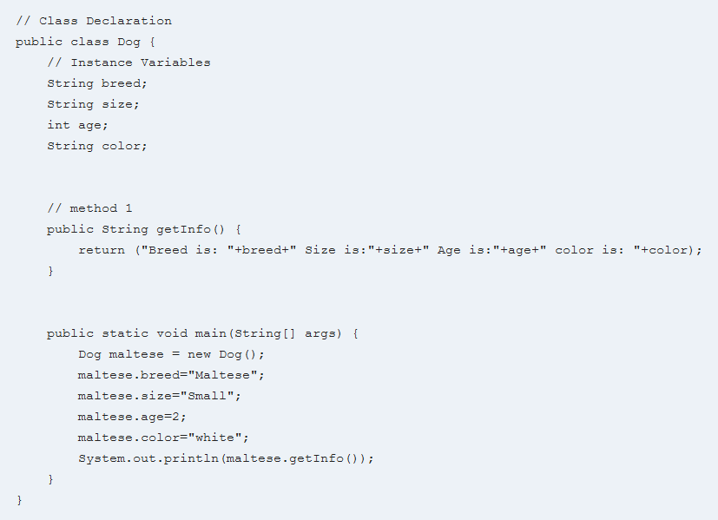
Introduction to Object Oriented Programming
1. Introduction to object oriented programming
2. Software Evolution
3. Procedural vs Object Oriented Programming
4.Introduction to Java
5. History of Java
6. Java Architecture
7. Features of Java
8.Java keywords
9. Simple Java Program
10. Analysing Java Program
11.Program Structure
12. Calling Java library Methods
13.Java Variables
14. Java Data Types
15. Declaring variables in Java
16.Java operators
17.Naming convention in Java
18. Java Expressions
19. Types of Error
20. Comments in Java
Class
collection of objects , what methods the object have
what the state of the objects are, or what kind of attributes the objects have
Example

Slide 14
Features of OOP
1. Introduction to object oriented programming
2. Software Evolution
3. Procedural vs Object Oriented Programming
4.Introduction to Java
5. History of Java
6. Java Architecture
7. Features of Java
8.Java keywords
9. Simple Java Program
10. Analysing Java Program
11.Program Structure
12. Calling Java library Methods
13.Java Variables
14. Java Data Types
15. Declaring variables in Java
16.Java operators
17.Naming convention in Java
18. Java Expressions
19. Types of Error
20. Comments in Java
Modularity
Code Reusability
Encapsulation
Abstraction
Ease of Maintenance
Flexibility and Extensibility
Real-world Modeling
Improved Problem Solving
Security
Code Readability

Slide 15
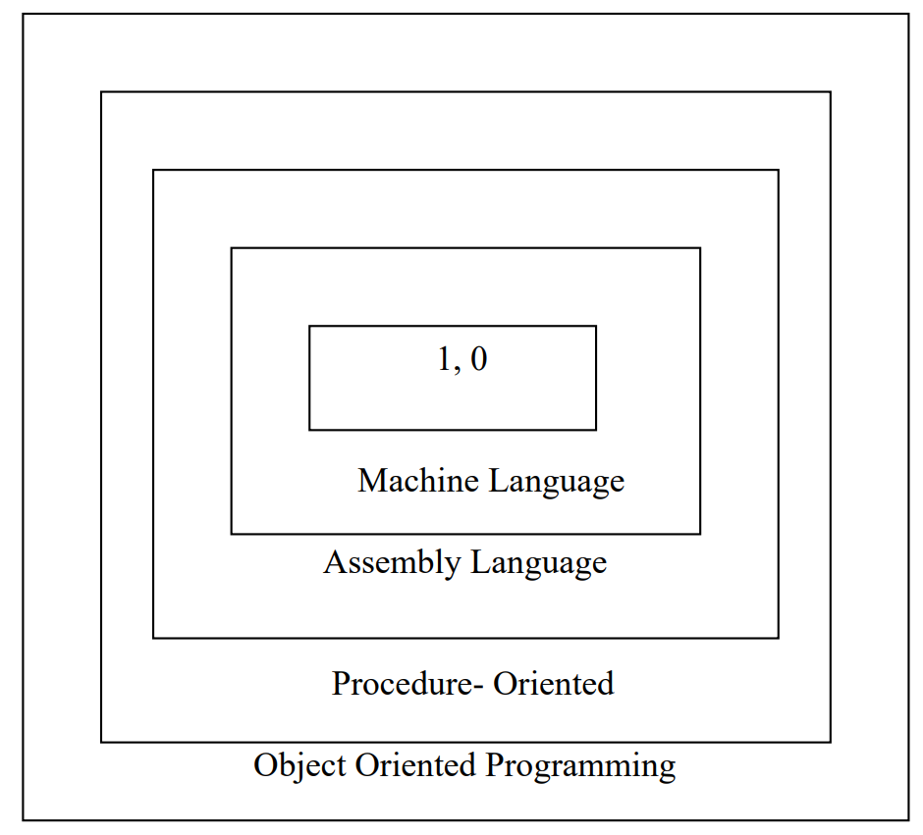
SOFTWARE EVOLUTION
1. Introduction to object oriented programming
2. Software Evolution
3. Procedural vs Object Oriented Programming
4.Introduction to Java
5. History of Java
6. Java Architecture
7. Features of Java
8.Java keywords
9. Simple Java Program
10. Analysing Java Program
11.Program Structure
12. Calling Java library Methods
13.Java Variables
14. Java Data Types
15. Declaring variables in Java
16.Java operators
17.Naming convention in Java
18. Java Expressions
19. Types of Error
20. Comments in Java

Slide 16
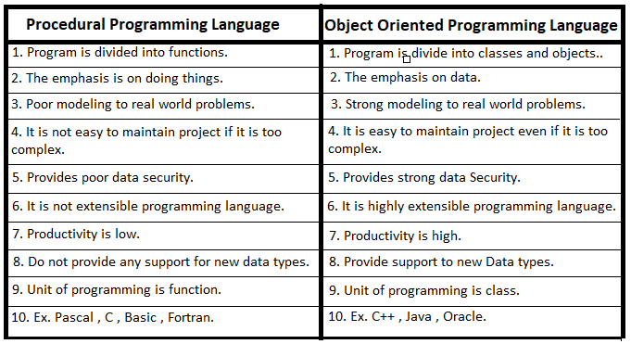
Procedural vs Object Oriented Programming
1. Introduction to object oriented programming
2. Software Evolution
3. Procedural vs Object Oriented Programming
4.Introduction to Java
5. History of Java
6. Java Architecture
7. Features of Java
8.Java keywords
9. Simple Java Program
10. Analysing Java Program
11.Program Structure
12. Calling Java library Methods
13.Java Variables
14. Java Data Types
15. Declaring variables in Java
16.Java operators
17.Naming convention in Java
18. Java Expressions
19. Types of Error
20. Comments in Java

Slide 17
Introduction to Java
Object Oriented Design and Programming
11

Slide 18
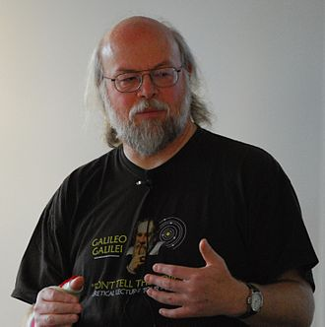
Introduction to Java
1. Introduction to object oriented programming
2. Software Evolution
3. Procedural vs Object Oriented Programming
4.Introduction to Java
5. History of Java
6. Java Architecture
7. Features of Java
8.Java keywords
9. Simple Java Program
10. Analysing Java Program
11.Program Structure
12. Calling Java library Methods
13.Java Variables
14. Java Data Types
15. Declaring variables in Java
16.Java operators
17.Naming convention in Java
18. Java Expressions
19. Types of Error
20. Comments in Java
Java Features:
Object Oriented Programming language (Objects)
Automatic Memory management
Huge set of class libraries
Some Facts about Java:
Java is used primarily for developing Android applications.
Influenced many languages like Ada 2005, BeanShell, C#, Chapel,Clojure, ECMAScript, Fantom, Gambas,Groovy, Hack,Haxe, J#, Kotlin, PHP, Python, Scala, Seed7, Vala
James Gosling
Object Oriented Design and Programming
13

Slide 19
History of Java
1. Introduction to object oriented programming
2. Software Evolution
3. Procedural vs Object Oriented Programming
4.Introduction to Java
5. History of Java
6. Java Architecture
7. Features of Java
8.Java keywords
9. Simple Java Program
10. Analysing Java Program
11.Program Structure
12. Calling Java library Methods
13.Java Variables
14. Java Data Types
15. Declaring variables in Java
16.Java operators
17.Naming convention in Java
18. Java Expressions
19. Types of Error
20. Comments in Java
In 1992, James Gosling of Sun Microsystems (now part of Oracle) designed what would become the Java programming language.
Java was originally designed for programming consumer devices, but it was first successfully used to write internet applets.
Applet (Dictionary): a very small application, especially a utility program performing one or a few simple functions.
An applet is typically embedded inside a web page and runs in the context of a browser. These days however, this is much less common.
Java popularized the phrase ‘Write once, run anywhere’.
Object Oriented Design and Programming
14

Slide 20
Features of Java
1. Software Evolution
2. Introduction to Java
3.History of Java
4.Features of Java
5.Java SE 8 Platform
6.Platform Independent
7.How does Java program run?
8.Java keywords
9.Program structure
10.Java Variables
11.Java Data Types
12.Declaring Variables
13.Java Operators
14.Naming convention
15.Java Expressions
16.Types of Errors
16.1. Compile Time Error
16.2. Run Time Error
16.3. Logical Error
17. Comments
Safe: Can be run inside a browser and will not attack your computer.
• Portable: Run on many Operating Systems (Windows, Mac OS etc.)
• Java Programs are distributed as instructions for a ‘virtual machine’
making them platform-independent:
• Virtual machines are available for most Operating Systems. The iPhone is a notable exception.
Object Oriented Design and Programming
15

Slide 21
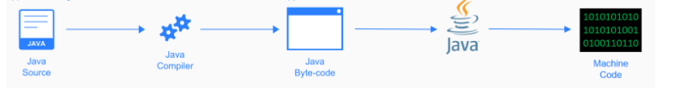
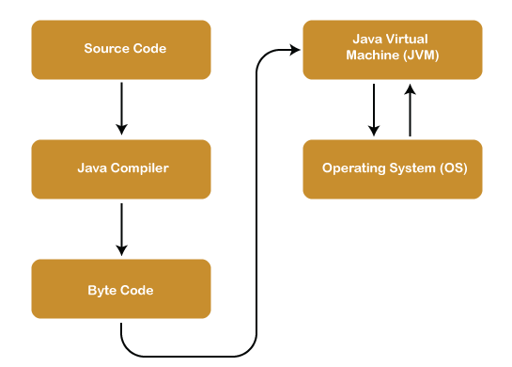
Java Architecture
1. Introduction to object oriented programming
2. Software Evolution
3. Procedural vs Object Oriented Programming
4.Introduction to Java
5. History of Java
6. Java Architecture
7. Features of Java
8.Java keywords
9. Simple Java Program
10. Analysing Java Program
11.Program Structure
12. Calling Java library Methods
13.Java Variables
14. Java Data Types
15. Declaring variables in Java
16.Java operators
17.Naming convention in Java
18. Java Expressions
19. Types of Error
20. Comments in Java

Slide 22
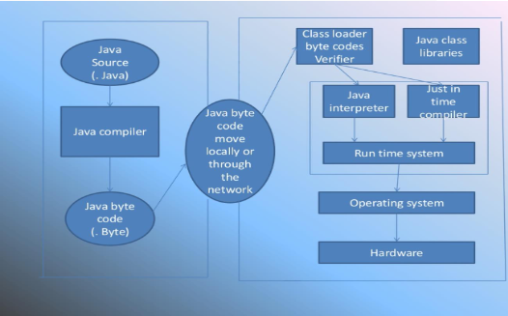
Java Architecture
1. Introduction to object oriented programming
2. Software Evolution
3. Procedural vs Object Oriented Programming
4.Introduction to Java
5. History of Java
6. Java Architecture
7. Features of Java
8.Java keywords
9. Simple Java Program
10. Analysing Java Program
11.Program Structure
12. Calling Java library Methods
13.Java Variables
14. Java Data Types
15. Declaring variables in Java
16.Java operators
17.Naming convention in Java
18. Java Expressions
19. Types of Error
20. Comments in Java

Slide 23
Java Architecture
1. Introduction to object oriented programming
2. Software Evolution
3. Procedural vs Object Oriented Programming
4.Introduction to Java
5. History of Java
6. Java Architecture
7. Features of Java
8.Java keywords
9. Simple Java Program
10. Analysing Java Program
11.Program Structure
12. Calling Java library Methods
13.Java Variables
14. Java Data Types
15. Declaring variables in Java
16.Java operators
17.Naming convention in Java
18. Java Expressions
19. Types of Error
20. Comments in Java
Java Architecture is a collection of components, i.e., JVM, JRE, and JDK.
It integrates the process of interpretation and compilation.
It defines all the processes involved in creating a Java program
Java Architecture can be explained by using the following steps:
• There is a process of compilation and interpretation in Java
• Java compiler converts the Java code into bytecode.
• After that, the JVM converts the byte code into machine code.
• The machine code is then executed by the machine

Slide 24
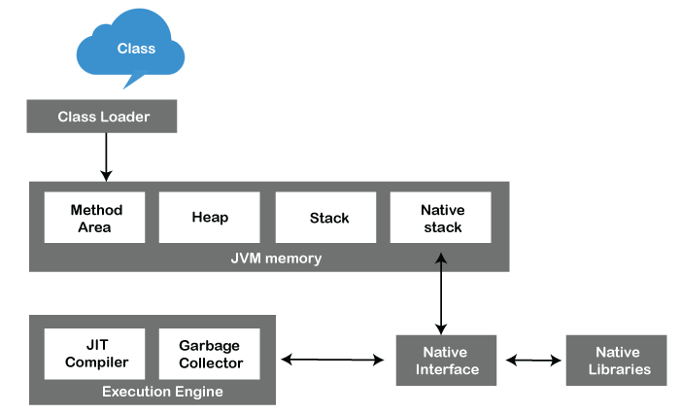
Java Architecture Components
1. Introduction to object oriented programming
2. Software Evolution
3. Procedural vs Object Oriented Programming
4.Introduction to Java
5. History of Java
6. Java Architecture
7. Features of Java
8.Java keywords
9. Simple Java Program
10. Analysing Java Program
11.Program Structure
12. Calling Java library Methods
13.Java Variables
14. Java Data Types
15. Declaring variables in Java
16.Java operators
17.Naming convention in Java
18. Java Expressions
19. Types of Error
20. Comments in Java
1. Java Virtual Machine (JVM)
2. Java Runtime Environment (JRE)
3. Java Development Kit (JDK)

Slide 25
Java Architecture Components
1. Software Evolution
2. Introduction to Java
3.History of Java
4.Features of Java
5.Java SE 8 Platform
6.Platform Independent
7.How does Java program run?
8.Java keywords
9.Program structure
10.Java Variables
11.Java Data Types
12.Declaring Variables
13.Java Operators
14.Naming convention
15.Java Expressions
16.Types of Errors
16.1. Compile Time Error
16.2. Run Time Error
16.3. Logical Error
17. Comments
1. Java Virtual Machine (JVM)
ClassLoader: ClassLoader is a subsystem used to load class files
ClassLoader first loads the Java code whenever we run it
Class Method Area: In the memory, there is an area where the class data is stored during the code's execution
Class method area holds the information of static variables, static methods, static blocks, and instance methods
Heap: The heap area is a part of the JVM memory and is created when the JVM starts up
Its size cannot be static because it increase or decrease during the application runs

Slide 26
Java Architecture Components
1. Software Evolution
2. Introduction to Java
3.History of Java
4.Features of Java
5.Java SE 8 Platform
6.Platform Independent
7.How does Java program run?
8.Java keywords
9.Program structure
10.Java Variables
11.Java Data Types
12.Declaring Variables
13.Java Operators
14.Naming convention
15.Java Expressions
16.Types of Errors
16.1. Compile Time Error
16.2. Run Time Error
16.3. Logical Error
17. Comments
1. Java Virtual Machine (JVM)
Stack: also referred to as thread stack
created for a single execution thread
thread uses this area to store the elements like the partial result, local variable, data used for calling method and returns etc.
Native Stack: contains the information of all the native methods used in our application.

Slide 27
Java Architecture Components
1. Software Evolution
2. Introduction to Java
3.History of Java
4.Features of Java
5.Java SE 8 Platform
6.Platform Independent
7.How does Java program run?
8.Java keywords
9.Program structure
10.Java Variables
11.Java Data Types
12.Declaring Variables
13.Java Operators
14.Naming convention
15.Java Expressions
16.Types of Errors
16.1. Compile Time Error
16.2. Run Time Error
16.3. Logical Error
17. Comments
1. Java Virtual Machine (JVM)
Execution Engine: central part of the JVM
execute the byte code and execute the Java classes
The execution engine has three main components used for executing Java classes
1) Interpreter
2) JIT Compiler
3) Garbage Collector

Slide 28
Java Architecture Components
1. Software Evolution
2. Introduction to Java
3.History of Java
4.Features of Java
5.Java SE 8 Platform
6.Platform Independent
7.How does Java program run?
8.Java keywords
9.Program structure
10.Java Variables
11.Java Data Types
12.Declaring Variables
13.Java Operators
14.Naming convention
15.Java Expressions
16.Types of Errors
16.1. Compile Time Error
16.2. Run Time Error
16.3. Logical Error
17. Comments
1. Java Virtual Machine (JVM)
1) Interpreter :It converts the bytecode into native code and executes
It sequentially executes the code
The interpreter interprets continuously and even the same method multiple times
This reduces the performance of the system, and to solve this, the JIT compiler is introduced
2) JIT Compiler: JIT compiler is introduced to remove the drawback of the interpreter
It increases the speed of execution and improves performance
3) Garbage Collector: used to manage the memory, and it is a program written in Java
works in two phases, i.e., Mark and Sweep
Mark: an area where the garbage collector identifies the used and unused chunks of memory
Sweep: removes the identified object from the Mark

Slide 29
Java Architecture Components
1. Software Evolution
2. Introduction to Java
3.History of Java
4.Features of Java
5.Java SE 8 Platform
6.Platform Independent
7.How does Java program run?
8.Java keywords
9.Program structure
10.Java Variables
11.Java Data Types
12.Declaring Variables
13.Java Operators
14.Naming convention
15.Java Expressions
16.Types of Errors
16.1. Compile Time Error
16.2. Run Time Error
16.3. Logical Error
17. Comments
1. Java Virtual Machine (JVM)
Java Native Interface: Java Native Interface works as a mediator between Java method calls and native libraries
2. Java Runtime Environment(JRE): It provides an environment in which Java programs are executed
• JRE takes our Java code, integrates it with the required libraries, and then starts the JVM to execute it
3. Java Development Kit(JDK): software development environment used in the development of Java applications and applets
• JDK holds JRE, a compiler, an interpreter or loader, and several development tools in it

Slide 30
1. Software Evolution
2. Introduction to Java
3. History of Java
4. Features of Java
5. Java SE 8 Platform
6. Platform Independent
7. How does Java program run?
8. Java keywords
9. Program structure
10. Java Variables
11. Java Data Types
12. Declaring Variables
13. Java Operators
14. Naming convention
15. Java Expressions
16. Types of Errors
16.1. Compile Time Error
16.2. Run Time Error
16.3. Logical Error
17. Comments
Java Architecture Components
JDK | JRE | JVM
It is a cross platform software development kit that provides necessary libraries and tools needed to develop java application. | It is a software layer that runs on top of a computer's operating system and provides the class libraries and other specific Java program needs to run. | It provides an environment where the bytecode can be executed.
Used for code execution and development. | Used for creating environment for code execution. | Used for providing environment to JRE.
Contains tools for development, debugging, and monitoring. | Contains libraries useful for the java class also files required for the JVM to execute program | Does not require any software tools

Slide 31
Features of Java
1. Introduction to object oriented programming
2. Software Evolution
3. Procedural vs Object Oriented Programming
4.Introduction to Java
5. History of Java
6. Java Architecture
7. Features of Java
8.Java keywords
9. Simple Java Program
10. Analysing Java Program
11.Program Structure
12. Calling Java library Methods
13.Java Variables
14. Java Data Types
15. Declaring variables in Java
16.Java operators
17.Naming convention in Java
18. Java Expressions
19. Types of Error
20. Comments in Java
1. Simple
Java is very easy to learn, and its syntax is simple, clean and easy to understand
Java has removed many complicated and rarely-used features, for example, explicit pointers, operator overloading, etc
There is no need to remove unreferenced objects because there is an Automatic Garbage Collection in Java
2. Object-oriented
This allows you to create modular programs and reusable code
Java is an Object-oriented programming language and everything in Java is an object
Basic concepts of OOP are Object, class, Inheritance, Polymorphism, Abstraction, Encapsulation.
3. Dynamic
Java is a dynamic language
Java supports dynamic loading of classes
Java supports dynamic compilation and automatic memory management (garbage collection)

Slide 32
Features of Java
1. Introduction to object oriented programming
2. Software Evolution
3. Procedural vs Object Oriented Programming
4.Introduction to Java
5. History of Java
6. Java Architecture
7. Features of Java
8.Java keywords
9. Simple Java Program
10. Analysing Java Program
11.Program Structure
12. Calling Java library Methods
13.Java Variables
14. Java Data Types
15. Declaring variables in Java
16.Java operators
17.Naming convention in Java
18. Java Expressions
19. Types of Error
20. Comments in Java
4. Secured
Java is best known for its security and with Java, we can develop virus-free systems
Due to no use of explicit pointer and Java always run inside a virtual machine sandbox it is considered more secure.
5. Robust
Java uses strong memory management and lack of pointers that avoids security problems
Automatic garbage collection in java which runs on the Java Virtual Machine to get rid of objects which are not being used by a Java application anymore
exception handling and the type checking mechanism
6. Architecture-neutral
Java is architecture neutral because there are no implementation dependent features, for example, the size of primitive types is fixed

Slide 33
Features of Java
1. Introduction to object oriented programming
2. Software Evolution
3. Procedural vs Object Oriented Programming
4.Introduction to Java
5. History of Java
6. Java Architecture
7. Features of Java
8.Java keywords
9. Simple Java Program
10. Analysing Java Program
11.Program Structure
12. Calling Java library Methods
13.Java Variables
14. Java Data Types
15. Declaring variables in Java
16.Java operators
17.Naming convention in Java
18. Java Expressions
19. Types of Error
20. Comments in Java
7. Portable
Java facilitates you to carry the Java bytecode to any platform
8. Distributed
Java facilitates users to create distributed applications
RMI and EJB are used for creating distributed applications
9. High-performance
Java is faster than other traditional interpreted programming languages because Java bytecode is "close" to native code
10. Multi-threaded
In Java we can write multi-threaded program and use all core
The main advantage of multi-threading is that it doesn't occupy memory for each thread, it shares a common memory area
Threads are important for multimedia, Web applications, games etc.

Slide 34
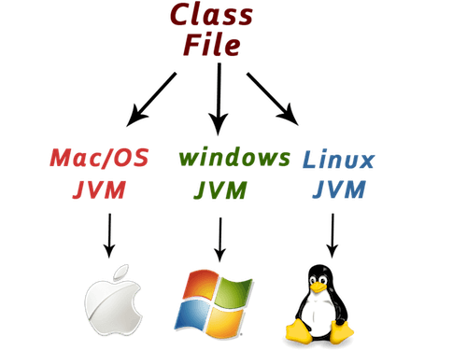
Features of Java
1. Introduction to object oriented programming
2. Software Evolution
3. Procedural vs Object Oriented Programming
4.Introduction to Java
5. History of Java
6. Java Architecture
7. Features of Java
8.Java keywords
9. Simple Java Program
10. Analysing Java Program
11.Program Structure
12. Calling Java library Methods
13.Java Variables
14. Java Data Types
15. Declaring variables in Java
16.Java operators
17.Naming convention in Java
18. Java Expressions
19. Types of Error
20. Comments in Java
11. Platform-independent
One of the most significant advantages of Java is its ability to move easily from one computer system to another
The ability to run the same program on many different systems is crucial to World Wide Web software, and Java succeeds at this by being platform-independent at both the source and binary levels

Slide 35
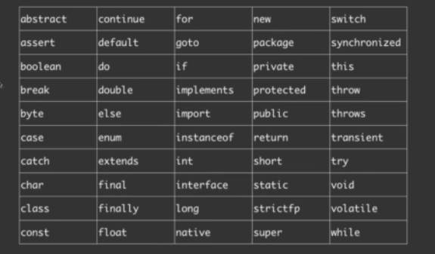
1. Introduction to object oriented programming
2. Software Evolution
3. Procedural vs Object Oriented Programming
4.Introduction to Java
5. History of Java
6. Java Architecture
7. Features of Java
8.Java keywords
9. Simple Java Program
10. Analysing Java Program
11.Program Structure
12. Calling Java library Methods
13.Java Variables
14. Java Data Types
15. Declaring variables in Java
16.Java operators
17.Naming convention in Java
18. Java Expressions
19. Types of Error
20. Comments in Java
JAVA KEYWORDS
51 reserved words

Slide 36
Simple Java Program
1. Introduction to object oriented programming
2. Software Evolution
3. Procedural vs Object Oriented Programming
4.Introduction to Java
5. History of Java
6. Java Architecture
7. Features of Java
8.Java keywords
9. Simple Java Program
10. Analysing Java Program
11.Program Structure
12. Calling Java library Methods
13.Java Variables
14. Java Data Types
15. Declaring variables in Java
16.Java operators
17.Naming convention in Java
18. Java Expressions
19. Types of Error
20. Comments in Java
public class Main{
public static void main(String[] args){
System.out.println("Hello World");
}
}
Output :
Hello World

Slide 37
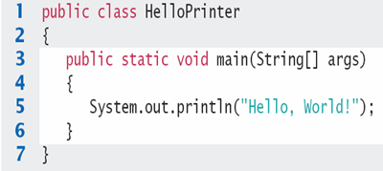
Analysing Java program
1. Introduction to object oriented programming
2. Software Evolution
3. Procedural vs Object Oriented Programming
4.Introduction to Java
5. History of Java
6. Java Architecture
7. Features of Java
8.Java keywords
9. Simple Java Program
10. Analysing Java Program
11.Program Structure
12. Calling Java library Methods
13.Java Variables
14. Java Data Types
15. Declaring variables in Java
16.Java operators
17.Naming convention in Java
18. Java Expressions
19. Types of Error
20. Comments in Java
1: Declares a ‘class’ HelloPrinter -- Every Java program has one or more classes.
2: Declares a method called ‘main’ -- All Java programs have exactly one ‘main’function, this is where the program starts.
3: Method System.out.println outputs ‘Hello, World!’ -- A statement must end with a semicolon (;)

Slide 38
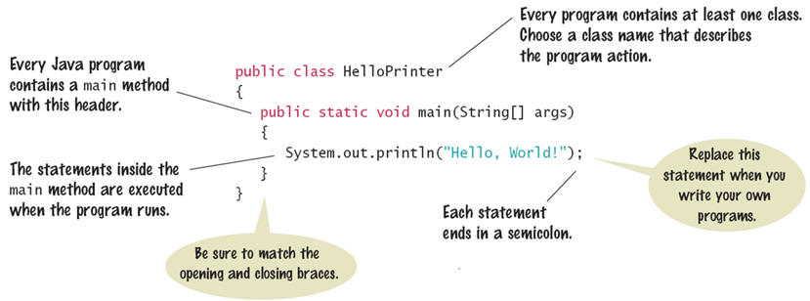
Program Structure
1. Introduction to object oriented programming
2. Software Evolution
3. Procedural vs Object Oriented Programming
4.Introduction to Java
5. History of Java
6. Java Architecture
7. Features of Java
8.Java keywords
9. Simple Java Program
10. Analysing Java Program
11.Program Structure
12. Calling Java library Methods
13.Java Variables
14. Java Data Types
15. Declaring variables in Java
16.Java operators
17.Naming convention in Java
18. Java Expressions
19. Types of Error
20. Comments in Java
Every application has the same basic layout
◦Add your code inside the main method

Slide 39
Calling Java Library Methods
1. Introduction to object oriented programming
2. Software Evolution
3. Procedural vs Object Oriented Programming
4.Introduction to Java
5. History of Java
6. Java Architecture
7. Features of Java
8.Java keywords
9. Simple Java Program
10. Analysing Java Program
11.Program Structure
12. Calling Java library Methods
13.Java Variables
14. Java Data Types
15. Declaring variables in Java
16.Java operators
17.Naming convention in Java
18. Java Expressions
19. Types of Error
20. Comments in Java
Line 5 shows how to ‘call’ a ‘method’ from the Java API: System.out.println
◦Code that somebody else wrote for you!
◦Notice the dots (periods)
◦Parenthesis surround the arguments that you ‘pass’ to a method
◦We are passing a String “Hello World” (Note: the double quotes which denote a String inside)
◦You can also print numerical values - System.out.println(3 + 4);

Slide 40
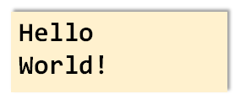
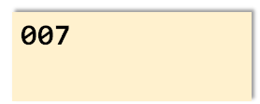
How does print work?
1. Introduction to object oriented programming
2. Software Evolution
3. Procedural vs Object Oriented Programming
4.Introduction to Java
5. History of Java
6. Java Architecture
7. Features of Java
8.Java keywords
9. Simple Java Program
10. Analysing Java Program
11.Program Structure
12. Calling Java library Methods
13.Java Variables
14. Java Data Types
15. Declaring variables in Java
16.Java operators
17.Naming convention in Java
18. Java Expressions
19. Types of Error
20. Comments in Java
The println method prints a string or a number and then starts a new line.
System.out.println("Hello");
System.out.println("World!");
println has a companion method named print that does not print a new line.
System.out.print("00");
System.out.println(3 + 4);

Slide 41
Java Variables
1. Introduction to object oriented programming
2. Software Evolution
3. Procedural vs Object Oriented Programming
4.Introduction to Java
5. History of Java
6. Java Architecture
7. Features of Java
8.Java keywords
9. Simple Java Program
10. Analysing Java Program
11.Program Structure
12. Calling Java library Methods
13.Java Variables
14. Java Data Types
15. Declaring variables in Java
16.Java operators
17.Naming convention in Java
18. Java Expressions
19. Types of Error
20. Comments in Java
Most computer programs hold temporary values in named storage locations
◦Programmers name them for easy access
There are different types (sizes) of storage to hold different things
You declare a variable by telling the compiler:
◦What type (size) of variable you need
◦What name you will use to refer to it
Remember: In Python, we declare our variable a but differently.

Slide 42





1. Introduction to object oriented programming
2. Software Evolution
3. Procedural vs Object Oriented Programming
4.Introduction to Java
5. History of Java
6. Java Architecture
7. Features of Java
8.Java keywords
9. Simple Java Program
10. Analysing Java Program
11.Program Structure
12. Calling Java library Methods
13.Java Variables
14. Java Data Types
15. Declaring variables in Java
16.Java operators
17.Naming convention in Java
18. Java Expressions
19. Types of Error
20. Comments in Java
When declaring a variable, you often specify an initial value. This is also where you tell the compiler the size (type) it will hold
Each variable must have:
•A data type Data Type
•A unique identifier (or name)
•A value
Name/Identifier
Value
Semicolon

Slide 43
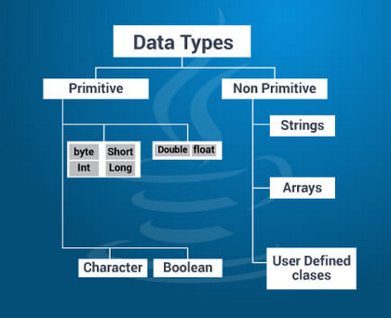
1. Introduction to object oriented programming
2. Software Evolution
3. Procedural vs Object Oriented Programming
4.Introduction to Java
5. History of Java
6. Java Architecture
7. Features of Java
8.Java keywords
9. Simple Java Program
10. Analysing Java Program
11.Program Structure
12. Calling Java library Methods
13.Java Variables
14. Java Data Types
15. Declaring variables in Java
16.Java operators
17.Naming convention in Java
18. Java Expressions
19. Types of Error
20. Comments in Java
1. Software Evolution
2. Introduction to Java
3. History of Java
4. Features of Java
5. Java SE 8 Platform
6. Platform Independent
7. How does Java program run?
8. Java keywords
9. Program structure
10. Java Variables
11. Java Data Types
12. Declaring Variables
13. Java Operators
14. Naming convention
15. Java Expressions
16. Types of Errors
16.1. Compile Time Error
16.2. Run Time Error
16.3. Logical Error
17. Comments
Java Data types

Slide 44
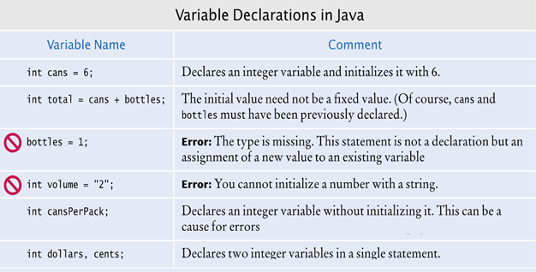
How to declare variables in JAVA?
1. Introduction to object oriented programming
2. Software Evolution
3. Procedural vs Object Oriented Programming
4.Introduction to Java
5. History of Java
6. Java Architecture
7. Features of Java
8.Java keywords
9. Simple Java Program
10. Analysing Java Program
11.Program Structure
12. Calling Java library Methods
13.Java Variables
14. Java Data Types
15. Declaring variables in Java
16.Java operators
17.Naming convention in Java
18. Java Expressions
19. Types of Error
20. Comments in Java
Understanding variable declaration with examples:

Slide 45
Things to remember
1. Introduction to object oriented programming
2. Software Evolution
3. Procedural vs Object Oriented Programming
4.Introduction to Java
5. History of Java
6. Java Architecture
7. Features of Java
8.Java keywords
9. Simple Java Program
10. Analysing Java Program
11.Program Structure
12. Calling Java library Methods
13.Java Variables
14. Java Data Types
15. Declaring variables in Java
16.Java operators
17.Naming convention in Java
18. Java Expressions
19. Types of Error
20. Comments in Java
•Variable names must start with a letter
•You cannot use other symbols (? or %...) and spaces are not permitted
•Separate words with ‘camelCase’ notation
•Use upper case letters to signify word boundaries
•Don’t use reserved ‘Java’ words

Slide 46
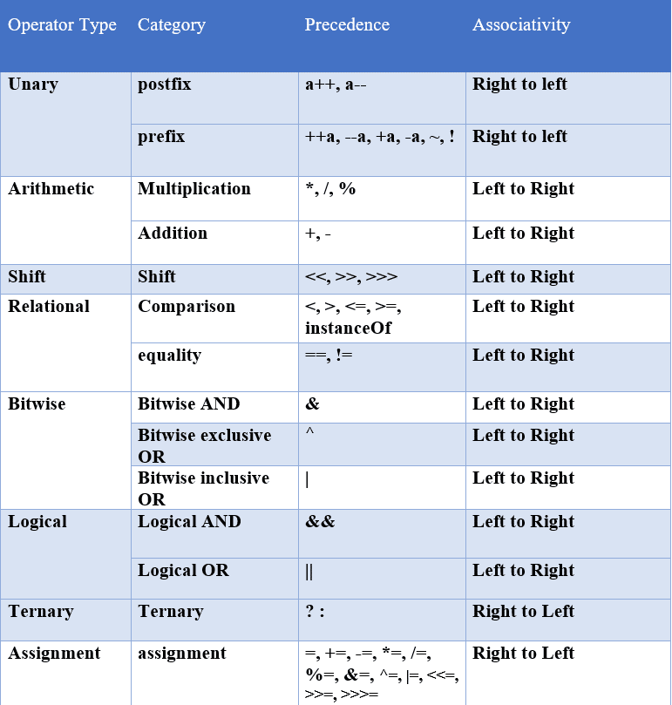
1. Introduction to object oriented programming
2. Software Evolution
3. Procedural vs Object Oriented Programming
4.Introduction to Java
5. History of Java
6. Java Architecture
7. Features of Java
8.Java keywords
9. Simple Java Program
10. Analysing Java Program
11.Program Structure
12. Calling Java library Methods
13.Java Variables
14. Java Data Types
15. Declaring variables in Java
16.Java operators
17.Naming convention in Java
18. Java Expressions
19. Types of Error
20. Comments in Java
Java operators

Slide 47
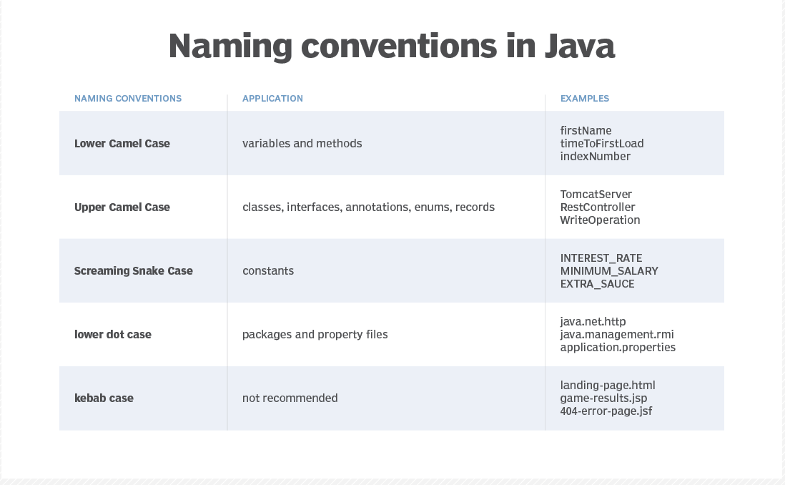
1. Introduction to object oriented programming
2. Software Evolution
3. Procedural vs Object Oriented Programming
4.Introduction to Java
5. History of Java
6. Java Architecture
7. Features of Java
8.Java keywords
9. Simple Java Program
10. Analysing Java Program
11.Program Structure
12. Calling Java library Methods
13.Java Variables
14. Java Data Types
15. Declaring variables in Java
16.Java operators
17.Naming convention in Java
18. Java Expressions
19. Types of Error
20. Comments in Java

Slide 48
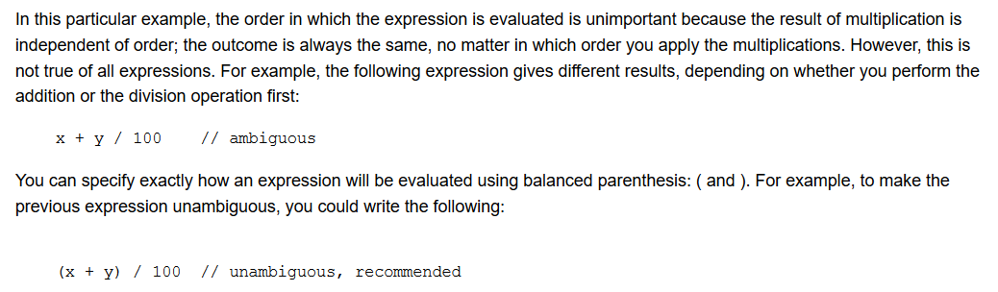
Java Expressions
1. Introduction to object oriented programming
2. Software Evolution
3. Procedural vs Object Oriented Programming
4.Introduction to Java
5. History of Java
6. Java Architecture
7. Features of Java
8.Java keywords
9. Simple Java Program
10. Analysing Java Program
11.Program Structure
12. Calling Java library Methods
13.Java Variables
14. Java Data Types
15. Declaring variables in Java
16.Java operators
17.Naming convention in Java
18. Java Expressions
19. Types of Error
20. Comments in Java
An expression is a construct made up of variables, operators, and method invocations, which are constructed according to the syntax of the language, that evaluates to a single value.

Slide 49
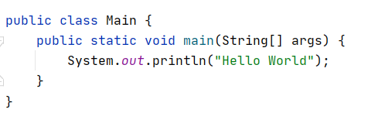
Types of Errors
1. Introduction to object oriented programming
2. Software Evolution
3. Procedural vs Object Oriented Programming
4.Introduction to Java
5. History of Java
6. Java Architecture
7. Features of Java
8.Java keywords
9. Simple Java Program
10. Analysing Java Program
11.Program Structure
12. Calling Java library Methods
13.Java Variables
14. Java Data Types
15. Declaring variables in Java
16.Java operators
17.Naming convention in Java
18. Java Expressions
19. Types of Error
20. Comments in Java
Compile Time Error
•Syntax Errors
• Spelling, Capitalization, punctuation
• Ordering of statements, matching of braces/parenthesis…
• No .class file is generated by the compiler
•Correct first error listed, then compile again

Slide 50
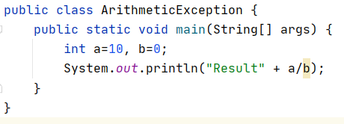
1. Introduction to object oriented programming
2. Software Evolution
3. Procedural vs Object Oriented Programming
4.Introduction to Java
5. History of Java
6. Java Architecture
7. Features of Java
8.Java keywords
9. Simple Java Program
10. Analysing Java Program
11.Program Structure
12. Calling Java library Methods
13.Java Variables
14. Java Data Types
15. Declaring variables in Java
16.Java operators
17.Naming convention in Java
18. Java Expressions
19. Types of Error
20. Comments in Java
Run Time Error
•Logical Errors.
• Program runs, but produces unintended results.
• Program may crash.

Slide 51
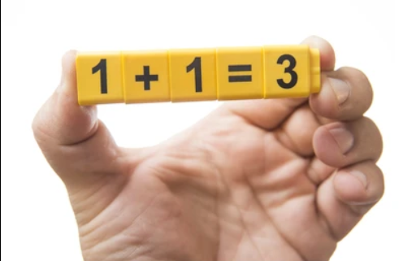
1. Introduction to object oriented programming
2. Software Evolution
3. Procedural vs Object Oriented Programming
4.Introduction to Java
5. History of Java
6. Java Architecture
7. Features of Java
8.Java keywords
9. Simple Java Program
10. Analysing Java Program
11.Program Structure
12. Calling Java library Methods
13.Java Variables
14. Java Data Types
15. Declaring variables in Java
16.Java operators
17.Naming convention in Java
18. Java Expressions
19. Types of Error
20. Comments in Java
Logical Error
Logical error occurs when the programmer makes mistakes on their code.
Neither detected by compiler nor by JVM

Slide 52
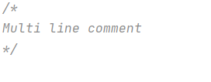

Comments in Java
1. Introduction to object oriented programming
2. Software Evolution
3. Procedural vs Object Oriented Programming
4.Introduction to Java
5. History of Java
6. Java Architecture
7. Features of Java
8.Java keywords
9. Simple Java Program
10. Analysing Java Program
11.Program Structure
12. Calling Java library Methods
13.Java Variables
14. Java Data Types
15. Declaring variables in Java
16.Java operators
17.Naming convention in Java
18. Java Expressions
19. Types of Error
20. Comments in Java
Comments are useful to describe what your code is doing. During runtime the interpreter just ignores them and does not treat them as code.
Single line comment
Multiple line comment

Slide 53


