Slide 1


Object Oriented Programming and Design WEEK 7 – UML Diagrams

Slide 2
Revision Topic
Abstraction
Abstract class and Methods
Interface
Regular Expression
Exception handling
Try, catch block
Finally, throw ,throws

Slide 3
LET’S GET STARTED WITH LECTURE 7

Slide 5
UML

Slide 7
1.UML
1.1. UML - Introduction
1.2. UML - Characteristics
1.3. UML - Types
2. Behavioral Diagram
2.1. Use Case Diagram
2.2. Use Case Diagram - Notation
2.3. Use Case Diagram – Example
2.4. Use Case Diagram - Relationship
3. Sequence Diagram
3.1. Sequence Diagram – Notation
3.2 Sequence Diagram - Example
4. Structural Diagram
4.1. Class Diagram – Purpose
4.2. Elements of class diagram
4.3. Classes
4.4. Class Diagram – Representation
4.5. Class Diagram – Relationship
4.6. Class Diagram - Association
4.7. Class Diagram – Generalization
4.8. Class Diagram – Aggregation
4.9. Class Diagram – Composition
4.10. Class Diagram – Dependency
4.11. Class Diagram – Roles
4.12. Class Diagram – Multiplicity
4.13. Class Diagram – Example 1
4.14. Class Diagram – Example 2
Unified Modeling Language (UML) - Introduction
A regulated modelling language that consists of several diagrams
Specify, construct, visualize, and document different aspects of software systems
Collection of best engineering practices that successfully model large and complex systems
Help project teams communicate, explore potential design, and validate the architecture design of the software

Slide 8
1.UML
1.1. UML - Introduction
1.2. UML - Characteristics
1.3. UML - Types
2. Behavioral Diagram
2.1. Use Case Diagram
2.2. Use Case Diagram - Notation
2.3. Use Case Diagram – Example
2.4. Use Case Diagram - Relationship
3. Sequence Diagram
3.1. Sequence Diagram – Notation
3.2 Sequence Diagram - Example
4. Structural Diagram
4.1. Class Diagram – Purpose
4.2. Elements of class diagram
4.3. Classes
4.4. Class Diagram – Representation
4.5. Class Diagram – Relationship
4.6. Class Diagram - Association
4.7. Class Diagram – Generalization
4.8. Class Diagram – Aggregation
4.9. Class Diagram – Composition
4.10. Class Diagram – Dependency
4.11. Class Diagram – Roles
4.12. Class Diagram – Multiplicity
4.13. Class Diagram – Example 1
4.14. Class Diagram – Example 2
UML - Characteristics
Generalized Modeling Language
Different from programming language
Pictorial Language
Has Unlimited Application

Slide 9
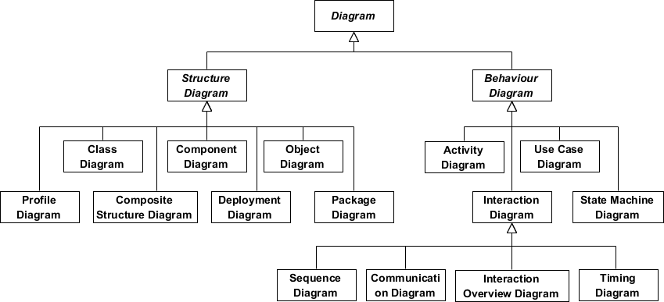
UML - Types
1.UML
1.1. UML - Introduction
1.2. UML - Characteristics
1.3. UML - Types
2. Behavioral Diagram
2.1. Use Case Diagram
2.2. Use Case Diagram - Notation
2.3. Use Case Diagram – Example
2.4. Use Case Diagram - Relationship
3. Sequence Diagram
3.1. Sequence Diagram – Notation
3.2 Sequence Diagram - Example
4. Structural Diagram
4.1. Class Diagram – Purpose
4.2. Elements of class diagram
4.3. Classes
4.4. Class Diagram – Representation
4.5. Class Diagram – Relationship
4.6. Class Diagram - Association
4.7. Class Diagram – Generalization
4.8. Class Diagram – Aggregation
4.9. Class Diagram – Composition
4.10. Class Diagram – Dependency
4.11. Class Diagram – Roles
4.12. Class Diagram – Multiplicity
4.13. Class Diagram – Example 1
4.14. Class Diagram – Example 2
Structural Diagram
Behavioral Diagram

Slide 10
1.UML
1.1. UML - Introduction
1.2. UML - Characteristics
1.3. UML - Types
2. Behavioral Diagram
2.1. Use Case Diagram
2.2. Use Case Diagram - Notation
2.3. Use Case Diagram – Example
2.4. Use Case Diagram - Relationship
3. Sequence Diagram
3.1. Sequence Diagram – Notation
3.2 Sequence Diagram - Example
4. Structural Diagram
4.1. Class Diagram – Purpose
4.2. Elements of class diagram
4.3. Classes
4.4. Class Diagram – Representation
4.5. Class Diagram – Relationship
4.6. Class Diagram - Association
4.7. Class Diagram – Generalization
4.8. Class Diagram – Aggregation
4.9. Class Diagram – Composition
4.10. Class Diagram – Dependency
4.11. Class Diagram – Roles
4.12. Class Diagram – Multiplicity
4.13. Class Diagram – Example 1
4.14. Class Diagram – Example 2
Behavioral Diagram
Depict the elements that are dependent on time and convey dynamic concepts
Resemble the verbs present in the English language and the relationships that connect them, conveying the passage of time

Slide 11
1.UML
1.1. UML - Introduction
1.2. UML - Characteristics
1.3. UML - Types
2. Behavioral Diagram
2.1. Use Case Diagram
2.2. Use Case Diagram - Notation
2.3. Use Case Diagram – Example
2.4. Use Case Diagram - Relationship
3. Sequence Diagram
3.1. Sequence Diagram – Notation
3.2 Sequence Diagram - Example
4. Structural Diagram
4.1. Class Diagram – Purpose
4.2. Elements of class diagram
4.3. Classes
4.4. Class Diagram – Representation
4.5. Class Diagram – Relationship
4.6. Class Diagram - Association
4.7. Class Diagram – Generalization
4.8. Class Diagram – Aggregation
4.9. Class Diagram – Composition
4.10. Class Diagram – Dependency
4.11. Class Diagram – Roles
4.12. Class Diagram – Multiplicity
4.13. Class Diagram – Example 1
4.14. Class Diagram – Example 2
Behavioral Diagram
Activity diagram
Use case diagrams
State machine diagrams
Timing diagrams
Sequence diagrams
Collaboration diagrams
Interaction overview diagrams

Slide 12
Use Case Diagrams
1.UML
1.1. UML - Introduction
1.2. UML - Characteristics
1.3. UML - Types
2. Behavioral Diagram
2.1. Use Case Diagram
2.2. Use Case Diagram - Notation
2.3. Use Case Diagram – Example
2.4. Use Case Diagram - Relationship
3. Sequence Diagram
3.1. Sequence Diagram – Notation
3.2 Sequence Diagram - Example
4. Structural Diagram
4.1. Class Diagram – Purpose
4.2. Elements of class diagram
4.3. Classes
4.4. Class Diagram – Representation
4.5. Class Diagram – Relationship
4.6. Class Diagram - Association
4.7. Class Diagram – Generalization
4.8. Class Diagram – Aggregation
4.9. Class Diagram – Composition
4.10. Class Diagram – Dependency
4.11. Class Diagram – Roles
4.12. Class Diagram – Multiplicity
4.13. Class Diagram – Example 1
4.14. Class Diagram – Example 2
Represent the details of a system and the person that uses it
Specify the expected behavior, not the exact method
Visualize a system from the end user’s perspective

Slide 13
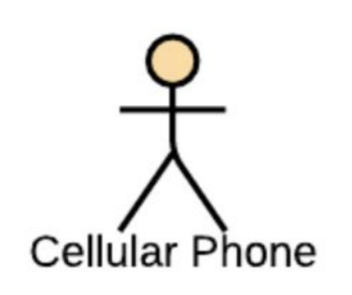
Use Case Diagrams - Notations
1.UML
1.1. UML - Introduction
1.2. UML - Characteristics
1.3. UML - Types
2. Behavioral Diagram
2.1. Use Case Diagram
2.2. Use Case Diagram - Notation
2.3. Use Case Diagram – Example
2.4. Use Case Diagram - Relationship
3. Sequence Diagram
3.1. Sequence Diagram – Notation
3.2 Sequence Diagram - Example
4. Structural Diagram
4.1. Class Diagram – Purpose
4.2. Elements of class diagram
4.3. Classes
4.4. Class Diagram – Representation
4.5. Class Diagram – Relationship
4.6. Class Diagram - Association
4.7. Class Diagram – Generalization
4.8. Class Diagram – Aggregation
4.9. Class Diagram – Composition
4.10. Class Diagram – Dependency
4.11. Class Diagram – Roles
4.12. Class Diagram – Multiplicity
4.13. Class Diagram – Example 1
4.14. Class Diagram – Example 2
Actor
Interact with use case
Named by Noun
Plays a role in the business
Communication Link
Use to connect actors to use cases
Indicating that the actor and the use case communicate with one another using messages

Slide 14

Use Case Diagrams - Notations
1.UML
1.1. UML - Introduction
1.2. UML - Characteristics
1.3. UML - Types
2. Behavioral Diagram
2.1. Use Case Diagram
2.2. Use Case Diagram - Notation
2.3. Use Case Diagram – Example
2.4. Use Case Diagram - Relationship
3. Sequence Diagram
3.1. Sequence Diagram – Notation
3.2 Sequence Diagram - Example
4. Structural Diagram
4.1. Class Diagram – Purpose
4.2. Elements of class diagram
4.3. Classes
4.4. Class Diagram – Representation
4.5. Class Diagram – Relationship
4.6. Class Diagram - Association
4.7. Class Diagram – Generalization
4.8. Class Diagram – Aggregation
4.9. Class Diagram – Composition
4.10. Class Diagram – Dependency
4.11. Class Diagram – Roles
4.12. Class Diagram – Multiplicity
4.13. Class Diagram – Example 1
4.14. Class Diagram – Example 2
Boundary
Entire System as defined in the required document
Use to enclose all the use cases

Slide 15
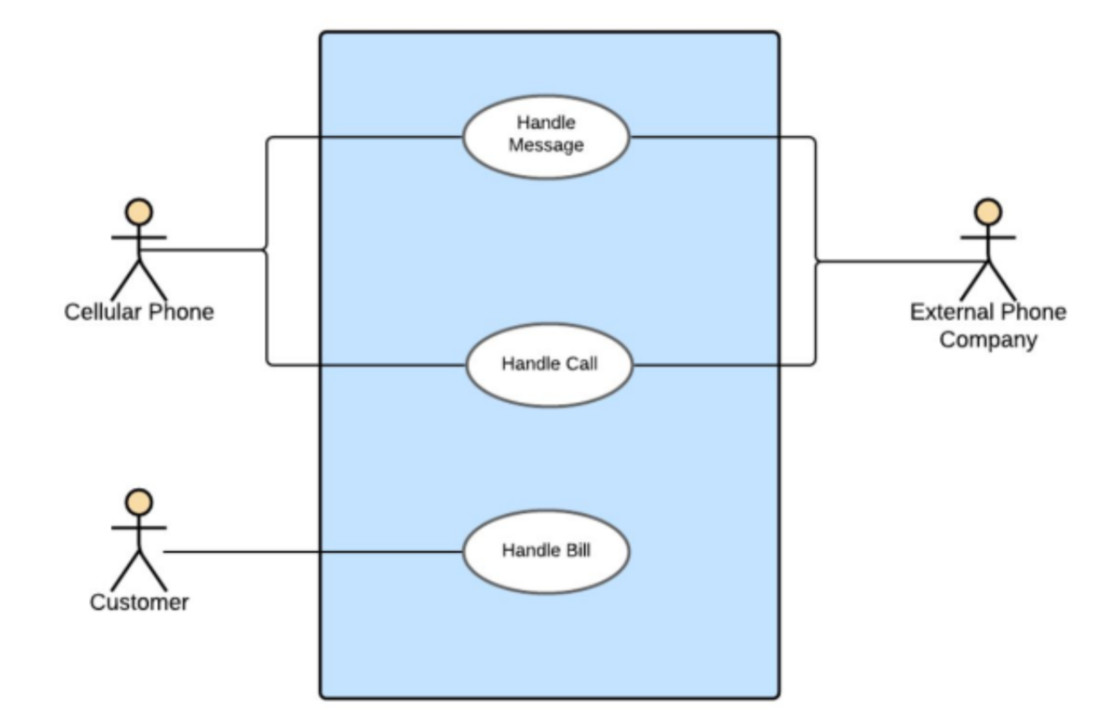
Use Case Diagrams – Example 1
1.UML
1.1. UML - Introduction
1.2. UML - Characteristics
1.3. UML - Types
2. Behavioral Diagram
2.1. Use Case Diagram
2.2. Use Case Diagram - Notation
2.3. Use Case Diagram – Example
2.4. Use Case Diagram - Relationship
3. Sequence Diagram
3.1. Sequence Diagram – Notation
3.2 Sequence Diagram - Example
4. Structural Diagram
4.1. Class Diagram – Purpose
4.2. Elements of class diagram
4.3. Classes
4.4. Class Diagram – Representation
4.5. Class Diagram – Relationship
4.6. Class Diagram - Association
4.7. Class Diagram – Generalization
4.8. Class Diagram – Aggregation
4.9. Class Diagram – Composition
4.10. Class Diagram – Dependency
4.11. Class Diagram – Roles
4.12. Class Diagram – Multiplicity
4.13. Class Diagram – Example 1
4.14. Class Diagram – Example 2

Slide 16
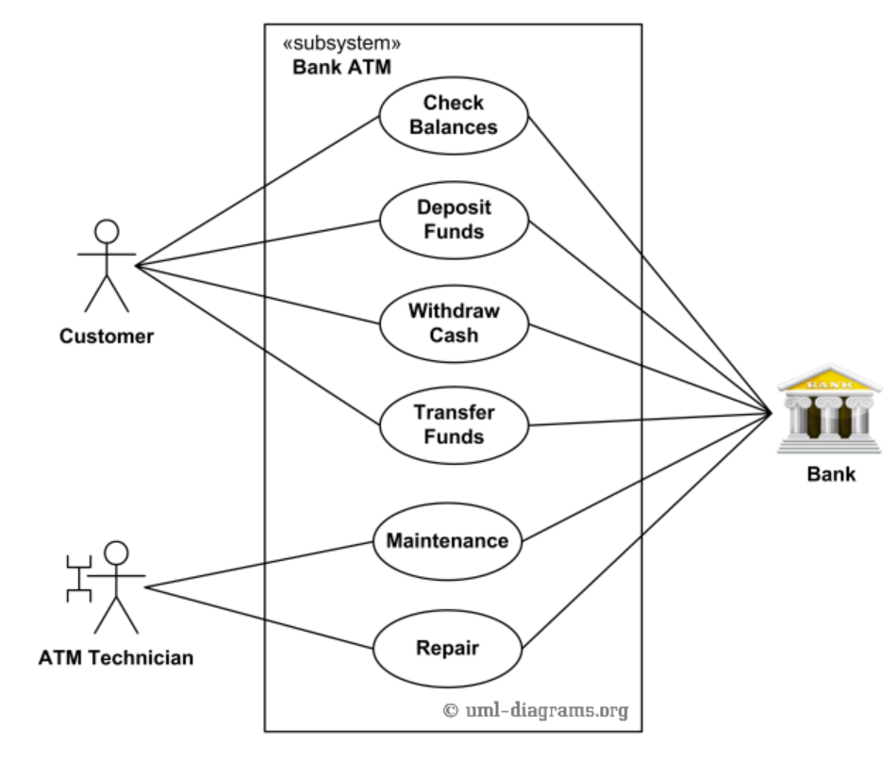
Use Case Diagrams – Example 2
1.UML
1.1. UML - Introduction
1.2. UML - Characteristics
1.3. UML - Types
2. Behavioral Diagram
2.1. Use Case Diagram
2.2. Use Case Diagram - Notation
2.3. Use Case Diagram – Example
2.4. Use Case Diagram - Relationship
3. Sequence Diagram
3.1. Sequence Diagram – Notation
3.2 Sequence Diagram - Example
4. Structural Diagram
4.1. Class Diagram – Purpose
4.2. Elements of class diagram
4.3. Classes
4.4. Class Diagram – Representation
4.5. Class Diagram – Relationship
4.6. Class Diagram - Association
4.7. Class Diagram – Generalization
4.8. Class Diagram – Aggregation
4.9. Class Diagram – Composition
4.10. Class Diagram – Dependency
4.11. Class Diagram – Roles
4.12. Class Diagram – Multiplicity
4.13. Class Diagram – Example 1
4.14. Class Diagram – Example 2

Slide 17
Use Case Diagrams - Relationship
1.UML
1.1. UML - Introduction
1.2. UML - Characteristics
1.3. UML - Types
2. Behavioral Diagram
2.1. Use Case Diagram
2.2. Use Case Diagram - Notation
2.3. Use Case Diagram – Example
2.4. Use Case Diagram - Relationship
3. Sequence Diagram
3.1. Sequence Diagram – Notation
3.2 Sequence Diagram - Example
4. Structural Diagram
4.1. Class Diagram – Purpose
4.2. Elements of class diagram
4.3. Classes
4.4. Class Diagram – Representation
4.5. Class Diagram – Relationship
4.6. Class Diagram - Association
4.7. Class Diagram – Generalization
4.8. Class Diagram – Aggregation
4.9. Class Diagram – Composition
4.10. Class Diagram – Dependency
4.11. Class Diagram – Roles
4.12. Class Diagram – Multiplicity
4.13. Class Diagram – Example 1
4.14. Class Diagram – Example 2
Association
Generalization
Extends
Includes

Slide 18
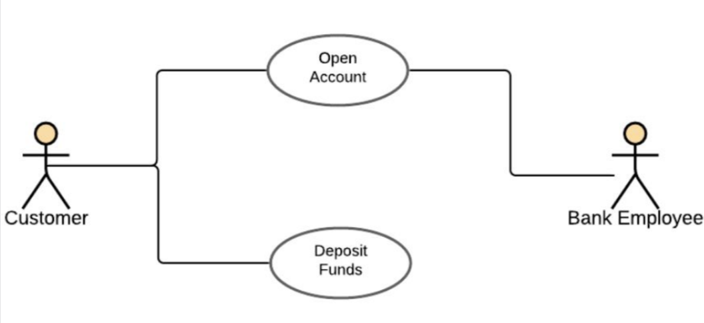
Use Case Diagrams - Relationship
1.UML
1.1. UML - Introduction
1.2. UML - Characteristics
1.3. UML - Types
2. Behavioral Diagram
2.1. Use Case Diagram
2.2. Use Case Diagram - Notation
2.3. Use Case Diagram – Example
2.4. Use Case Diagram - Relationship
3. Sequence Diagram
3.1. Sequence Diagram – Notation
3.2 Sequence Diagram - Example
4. Structural Diagram
4.1. Class Diagram – Purpose
4.2. Elements of class diagram
4.3. Classes
4.4. Class Diagram – Representation
4.5. Class Diagram – Relationship
4.6. Class Diagram - Association
4.7. Class Diagram – Generalization
4.8. Class Diagram – Aggregation
4.9. Class Diagram – Composition
4.10. Class Diagram – Dependency
4.11. Class Diagram – Roles
4.12. Class Diagram – Multiplicity
4.13. Class Diagram – Example 1
4.14. Class Diagram – Example 2
Association
Present in every use case diagram
An actor involved with a use case
Identified through a simple line or a line with arrows at both ends.

Slide 19
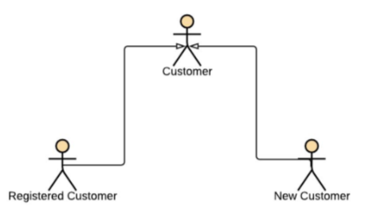
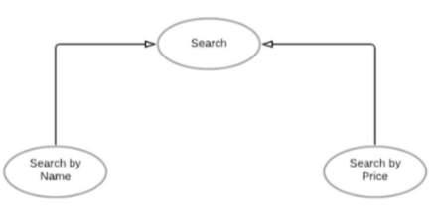
Use Case Diagrams - Relationship
1.UML
1.1. UML - Introduction
1.2. UML - Characteristics
1.3. UML - Types
2. Behavioral Diagram
2.1. Use Case Diagram
2.2. Use Case Diagram - Notation
2.3. Use Case Diagram – Example
2.4. Use Case Diagram - Relationship
3. Sequence Diagram
3.1. Sequence Diagram – Notation
3.2 Sequence Diagram - Example
4. Structural Diagram
4.1. Class Diagram – Purpose
4.2. Elements of class diagram
4.3. Classes
4.4. Class Diagram – Representation
4.5. Class Diagram – Relationship
4.6. Class Diagram - Association
4.7. Class Diagram – Generalization
4.8. Class Diagram – Aggregation
4.9. Class Diagram – Composition
4.10. Class Diagram – Dependency
4.11. Class Diagram – Roles
4.12. Class Diagram – Multiplicity
4.13. Class Diagram – Example 1
4.14. Class Diagram – Example 2
Generalization
Parent-child relationship
Child is an enhancement of parent
Identified as a directed arrow with a triangle arrowhead
Can be further divided into
Generalization of an actor:
Generalization of a use case:

Slide 20
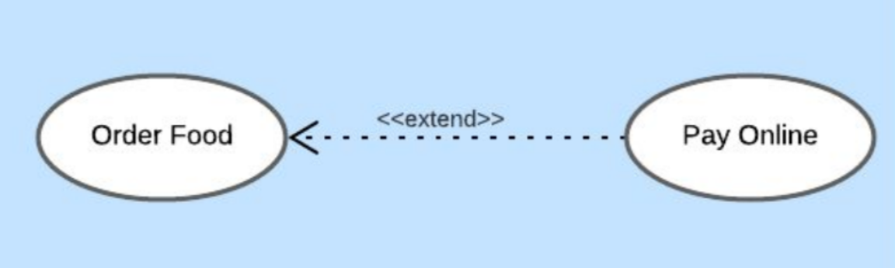
Use Case Diagrams - Relationship
1.UML
1.1. UML - Introduction
1.2. UML - Characteristics
1.3. UML - Types
2. Behavioral Diagram
2.1. Use Case Diagram
2.2. Use Case Diagram - Notation
2.3. Use Case Diagram – Example
2.4. Use Case Diagram - Relationship
3. Sequence Diagram
3.1. Sequence Diagram – Notation
3.2 Sequence Diagram - Example
4. Structural Diagram
4.1. Class Diagram – Purpose
4.2. Elements of class diagram
4.3. Classes
4.4. Class Diagram – Representation
4.5. Class Diagram – Relationship
4.6. Class Diagram - Association
4.7. Class Diagram – Generalization
4.8. Class Diagram – Aggregation
4.9. Class Diagram – Composition
4.10. Class Diagram – Dependency
4.11. Class Diagram – Roles
4.12. Class Diagram – Multiplicity
4.13. Class Diagram – Example 1
4.14. Class Diagram – Example 2
Extends
Shows optional functionality or system behavior
Presented in a use case diagram through a dotted arrow with the label extends

Slide 21
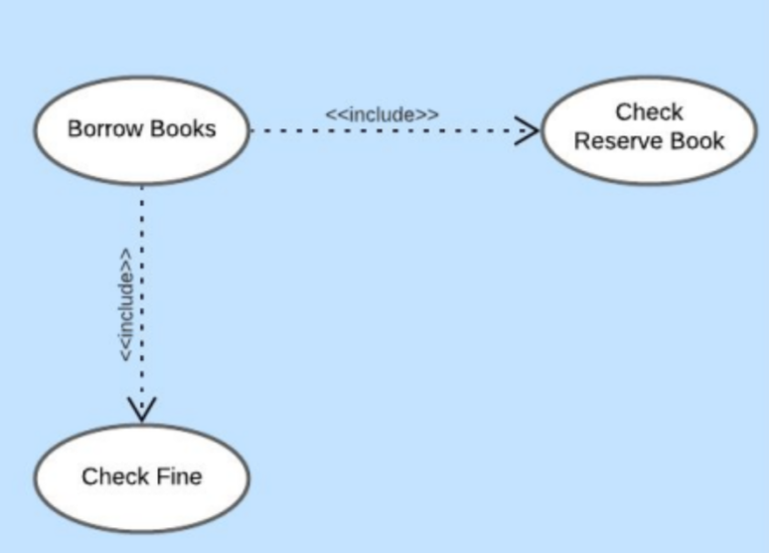
Use Case Diagrams - Relationship
1.UML
1.1. UML - Introduction
1.2. UML - Characteristics
1.3. UML - Types
2. Behavioral Diagram
2.1. Use Case Diagram
2.2. Use Case Diagram - Notation
2.3. Use Case Diagram – Example
2.4. Use Case Diagram - Relationship
3. Sequence Diagram
3.1. Sequence Diagram – Notation
3.2 Sequence Diagram - Example
4. Structural Diagram
4.1. Class Diagram – Purpose
4.2. Elements of class diagram
4.3. Classes
4.4. Class Diagram – Representation
4.5. Class Diagram – Relationship
4.6. Class Diagram - Association
4.7. Class Diagram – Generalization
4.8. Class Diagram – Aggregation
4.9. Class Diagram – Composition
4.10. Class Diagram – Dependency
4.11. Class Diagram – Roles
4.12. Class Diagram – Multiplicity
4.13. Class Diagram – Example 1
4.14. Class Diagram – Example 2
Includes
Adds additional functionality which is not specified in the base use case
Presented in a use case diagram through a dotted arrow with the label include

Slide 22
Sequence Diagram
1.UML
1.1. UML - Introduction
1.2. UML - Characteristics
1.3. UML - Types
2. Behavioral Diagram
2.1. Use Case Diagram
2.2. Use Case Diagram - Notation
2.3. Use Case Diagram – Example
2.4. Use Case Diagram - Relationship
3. Sequence Diagram
3.1. Sequence Diagram – Notation
3.2 Sequence Diagram - Example
4. Structural Diagram
4.1. Class Diagram – Purpose
4.2. Elements of class diagram
4.3. Classes
4.4. Class Diagram – Representation
4.5. Class Diagram – Relationship
4.6. Class Diagram - Association
4.7. Class Diagram – Generalization
4.8. Class Diagram – Aggregation
4.9. Class Diagram – Composition
4.10. Class Diagram – Dependency
4.11. Class Diagram – Roles
4.12. Class Diagram – Multiplicity
4.13. Class Diagram – Example 1
4.14. Class Diagram – Example 2
Describes how and in what order a group of objects work together
Event diagram or event scenario
Visualize and validate various runtime scenarios
Understand requirements for a new system or to document an existing process
Purpose:
Non-technical person to explain the flow
Document future system flow
Forge out the system’s object interaction
Interaction between objects in sequential manner

Slide 23
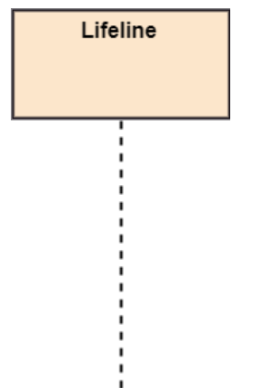
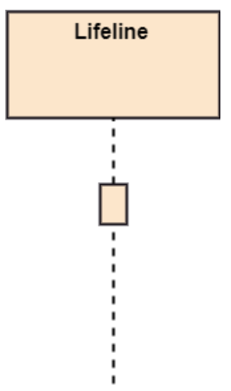
Sequence Diagram - Notation
1.UML
1.1. UML - Introduction
1.2. UML - Characteristics
1.3. UML - Types
2. Behavioral Diagram
2.1. Use Case Diagram
2.2. Use Case Diagram - Notation
2.3. Use Case Diagram – Example
2.4. Use Case Diagram - Relationship
3. Sequence Diagram
3.1. Sequence Diagram – Notation
3.2 Sequence Diagram - Example
4. Structural Diagram
4.1. Class Diagram – Purpose
4.2. Elements of class diagram
4.3. Classes
4.4. Class Diagram – Representation
4.5. Class Diagram – Relationship
4.6. Class Diagram - Association
4.7. Class Diagram – Generalization
4.8. Class Diagram – Aggregation
4.9. Class Diagram – Composition
4.10. Class Diagram – Dependency
4.11. Class Diagram – Roles
4.12. Class Diagram – Multiplicity
4.13. Class Diagram – Example 1
4.14. Class Diagram – Example 2
Lifeline: An individual participant in the sequence diagram is represented by a lifeline. It is positioned at the top of the diagram.
Activation Bar
Rectangle placed on the lifeline
Length represents the duration

Slide 24
Sequence Diagram - Notation
1.UML
1.1. UML - Introduction
1.2. UML - Characteristics
1.3. UML - Types
2. Behavioral Diagram
2.1. Use Case Diagram
2.2. Use Case Diagram - Notation
2.3. Use Case Diagram – Example
2.4. Use Case Diagram - Relationship
3. Sequence Diagram
3.1. Sequence Diagram – Notation
3.2 Sequence Diagram - Example
4. Structural Diagram
4.1. Class Diagram – Purpose
4.2. Elements of class diagram
4.3. Classes
4.4. Class Diagram – Representation
4.5. Class Diagram – Relationship
4.6. Class Diagram - Association
4.7. Class Diagram – Generalization
4.8. Class Diagram – Aggregation
4.9. Class Diagram – Composition
4.10. Class Diagram – Dependency
4.11. Class Diagram – Roles
4.12. Class Diagram – Multiplicity
4.13. Class Diagram – Example 1
4.14. Class Diagram – Example 2
Messages
Arrow from the caller to the receiver
Flows in any direction
Comes with a description called message signature
message_name(argument): return_type
Messages - Types
Synchronous Message
Asynchronous Message
Return Message
Creation Message
Destructive Message
Reflexive Message

Slide 25
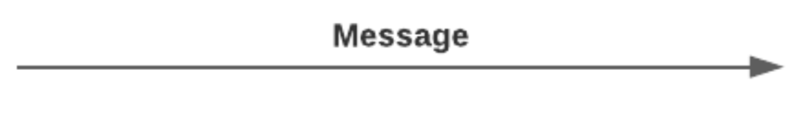
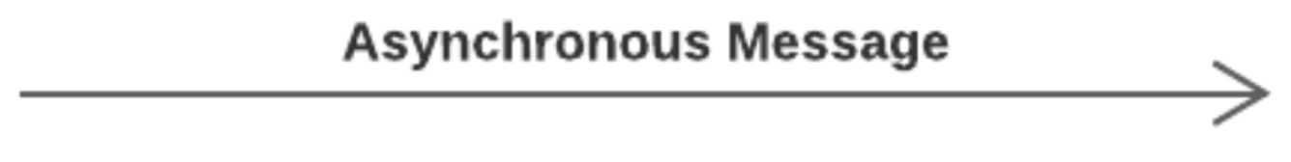
Sequence Diagram - Notation
1.UML
1.1. UML - Introduction
1.2. UML - Characteristics
1.3. UML - Types
2. Behavioral Diagram
2.1. Use Case Diagram
2.2. Use Case Diagram - Notation
2.3. Use Case Diagram – Example
2.4. Use Case Diagram - Relationship
3. Sequence Diagram
3.1. Sequence Diagram – Notation
3.2 Sequence Diagram - Example
4. Structural Diagram
4.1. Class Diagram – Purpose
4.2. Elements of class diagram
4.3. Classes
4.4. Class Diagram – Representation
4.5. Class Diagram – Relationship
4.6. Class Diagram - Association
4.7. Class Diagram – Generalization
4.8. Class Diagram – Aggregation
4.9. Class Diagram – Composition
4.10. Class Diagram – Dependency
4.11. Class Diagram – Roles
4.12. Class Diagram – Multiplicity
4.13. Class Diagram – Example 1
4.14. Class Diagram – Example 2
Synchronous Message
Waits for the receiver to process the message
Represented as a straight line with a solid arrowhead
Regular message call
Asynchronous Message
Caller does not wait for the receiver to process the message
Represented as a straight line with a line arrow
Does not have a reply

Slide 26
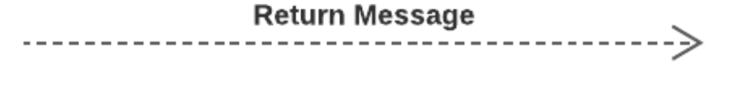
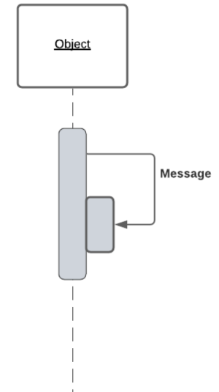
Sequence Diagram - Notation
1.UML
1.1. UML - Introduction
1.2. UML - Characteristics
1.3. UML - Types
2. Behavioral Diagram
2.1. Use Case Diagram
2.2. Use Case Diagram - Notation
2.3. Use Case Diagram – Example
2.4. Use Case Diagram - Relationship
3. Sequence Diagram
3.1. Sequence Diagram – Notation
3.2 Sequence Diagram - Example
4. Structural Diagram
4.1. Class Diagram – Purpose
4.2. Elements of class diagram
4.3. Classes
4.4. Class Diagram – Representation
4.5. Class Diagram – Relationship
4.6. Class Diagram - Association
4.7. Class Diagram – Generalization
4.8. Class Diagram – Aggregation
4.9. Class Diagram – Composition
4.10. Class Diagram – Dependency
4.11. Class Diagram – Roles
4.12. Class Diagram – Multiplicity
4.13. Class Diagram – Example 1
4.14. Class Diagram – Example 2
Return Message
Done processing the message
Represented as a dotted line with a line arrow
Are optional notations
Reflexive Message
Object sends a message to itself

Slide 27
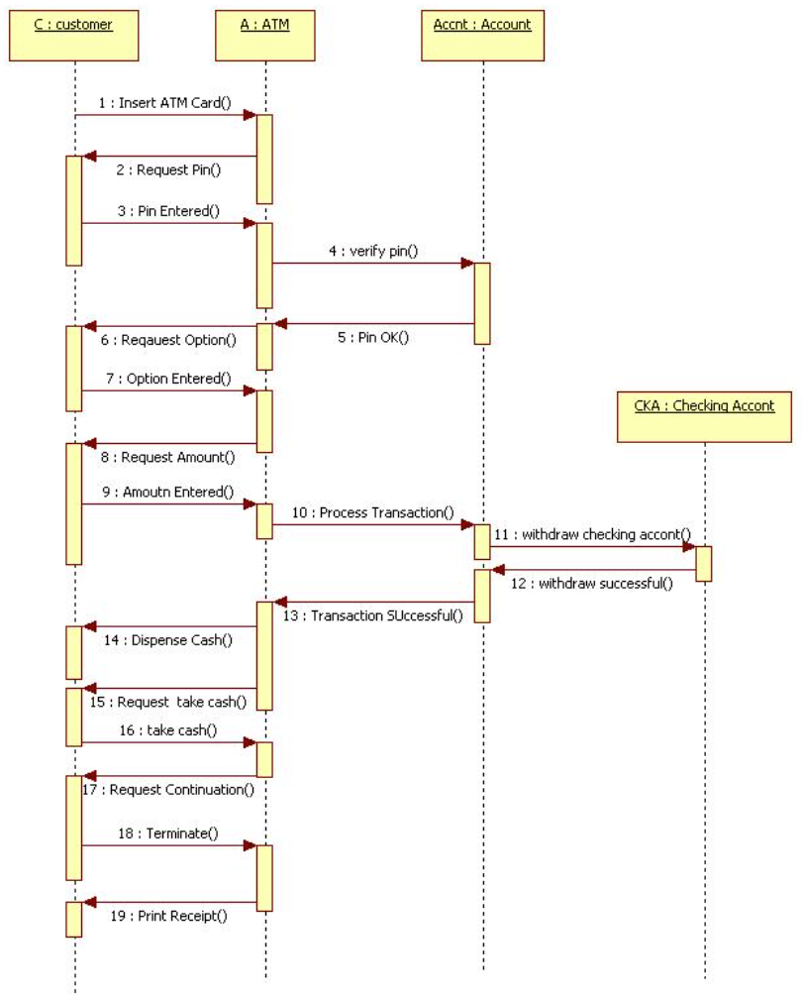
Sequence Diagram - Example
1.UML
1.1. UML - Introduction
1.2. UML - Characteristics
1.3. UML - Types
2. Behavioral Diagram
2.1. Use Case Diagram
2.2. Use Case Diagram - Notation
2.3. Use Case Diagram – Example
2.4. Use Case Diagram - Relationship
3. Sequence Diagram
3.1. Sequence Diagram – Notation
3.2 Sequence Diagram - Example
4. Structural Diagram
4.1. Class Diagram – Purpose
4.2. Elements of class diagram
4.3. Classes
4.4. Class Diagram – Representation
4.5. Class Diagram – Relationship
4.6. Class Diagram - Association
4.7. Class Diagram – Generalization
4.8. Class Diagram – Aggregation
4.9. Class Diagram – Composition
4.10. Class Diagram – Dependency
4.11. Class Diagram – Roles
4.12. Class Diagram – Multiplicity
4.13. Class Diagram – Example 1
4.14. Class Diagram – Example 2

Slide 28
Structural Diagram
1.UML
1.1. UML - Introduction
1.2. UML - Characteristics
1.3. UML - Types
2. Behavioral Diagram
2.1. Use Case Diagram
2.2. Use Case Diagram - Notation
2.3. Use Case Diagram – Example
2.4. Use Case Diagram - Relationship
3. Sequence Diagram
3.1. Sequence Diagram – Notation
3.2 Sequence Diagram - Example
4. Structural Diagram
4.1. Class Diagram – Purpose
4.2. Elements of class diagram
4.3. Classes
4.4. Class Diagram – Representation
4.5. Class Diagram – Relationship
4.6. Class Diagram - Association
4.7. Class Diagram – Generalization
4.8. Class Diagram – Aggregation
4.9. Class Diagram – Composition
4.10. Class Diagram – Dependency
4.11. Class Diagram – Roles
4.12. Class Diagram – Multiplicity
4.13. Class Diagram – Example 1
4.14. Class Diagram – Example 2
Depict the static structure of different elements
Used extensively in documenting the software architecture of a software system

Slide 29
Structural Diagram
1.UML
1.1. UML - Introduction
1.2. UML - Characteristics
1.3. UML - Types
2. Behavioral Diagram
2.1. Use Case Diagram
2.2. Use Case Diagram - Notation
2.3. Use Case Diagram – Example
2.4. Use Case Diagram - Relationship
3. Sequence Diagram
3.1. Sequence Diagram – Notation
3.2 Sequence Diagram - Example
4. Structural Diagram
4.1. Class Diagram – Purpose
4.2. Elements of class diagram
4.3. Classes
4.4. Class Diagram – Representation
4.5. Class Diagram – Relationship
4.6. Class Diagram - Association
4.7. Class Diagram – Generalization
4.8. Class Diagram – Aggregation
4.9. Class Diagram – Composition
4.10. Class Diagram – Dependency
4.11. Class Diagram – Roles
4.12. Class Diagram – Multiplicity
4.13. Class Diagram – Example 1
4.14. Class Diagram – Example 2
Composite Structure Diagram
Deployment diagrams
Package diagram
Profile diagram
Class diagrams
Object diagram
Component diagrams

Slide 30
Class Diagram
1.UML
1.1. UML - Introduction
1.2. UML - Characteristics
1.3. UML - Types
2. Behavioral Diagram
2.1. Use Case Diagram
2.2. Use Case Diagram - Notation
2.3. Use Case Diagram – Example
2.4. Use Case Diagram - Relationship
3. Sequence Diagram
3.1. Sequence Diagram – Notation
3.2 Sequence Diagram - Example
4. Structural Diagram
4.1. Class Diagram – Purpose
4.2. Elements of class diagram
4.3. Classes
4.4. Class Diagram – Representation
4.5. Class Diagram – Relationship
4.6. Class Diagram - Association
4.7. Class Diagram – Generalization
4.8. Class Diagram – Aggregation
4.9. Class Diagram – Composition
4.10. Class Diagram – Dependency
4.11. Class Diagram – Roles
4.12. Class Diagram – Multiplicity
4.13. Class Diagram – Example 1
4.14. Class Diagram – Example 2
Structure diagram for designing and modeling software
Models software in a high level abstraction and without having to look at the source code
Corresponds with classes in the source code
Shows names and attributes of a class, connection between the classes and sometimes also the methods of the class

Slide 31
Class Diagram - Purpose
1.UML
1.1. UML - Introduction
1.2. UML - Characteristics
1.3. UML - Types
2. Behavioral Diagram
2.1. Use Case Diagram
2.2. Use Case Diagram - Notation
2.3. Use Case Diagram – Example
2.4. Use Case Diagram - Relationship
3. Sequence Diagram
3.1. Sequence Diagram – Notation
3.2 Sequence Diagram - Example
4. Structural Diagram
4.1. Class Diagram – Purpose
4.2. Elements of class diagram
4.3. Classes
4.4. Class Diagram – Representation
4.5. Class Diagram – Relationship
4.6. Class Diagram - Association
4.7. Class Diagram – Generalization
4.8. Class Diagram – Aggregation
4.9. Class Diagram – Composition
4.10. Class Diagram – Dependency
4.11. Class Diagram – Roles
4.12. Class Diagram – Multiplicity
4.13. Class Diagram – Example 1
4.14. Class Diagram – Example 2
Provides a detailed insight into the structure of the system
Quick overview of the synergy happening among different system elements as well as their properties and relationships
Static view of the elements
Blueprint for a building or a piece of machinery, see the parts used to make it and how they are assembled
Cannot see how they behave when they are set in motion

Slide 32
Elements of Class Diagram
1.UML
1.1. UML - Introduction
1.2. UML - Characteristics
1.3. UML - Types
2. Behavioral Diagram
2.1. Use Case Diagram
2.2. Use Case Diagram - Notation
2.3. Use Case Diagram – Example
2.4. Use Case Diagram - Relationship
3. Sequence Diagram
3.1. Sequence Diagram – Notation
3.2 Sequence Diagram - Example
4. Structural Diagram
4.1. Class Diagram – Purpose
4.2. Elements of class diagram
4.3. Classes
4.4. Class Diagram – Representation
4.5. Class Diagram – Relationship
4.6. Class Diagram - Association
4.7. Class Diagram – Generalization
4.8. Class Diagram – Aggregation
4.9. Class Diagram – Composition
4.10. Class Diagram – Dependency
4.11. Class Diagram – Roles
4.12. Class Diagram – Multiplicity
4.13. Class Diagram – Example 1
4.14. Class Diagram – Example 2
A set of classes
A set of relationships between classes

Slide 33
Classes
1.UML
1.1. UML - Introduction
1.2. UML - Characteristics
1.3. UML - Types
2. Behavioral Diagram
2.1. Use Case Diagram
2.2. Use Case Diagram - Notation
2.3. Use Case Diagram – Example
2.4. Use Case Diagram - Relationship
3. Sequence Diagram
3.1. Sequence Diagram – Notation
3.2 Sequence Diagram - Example
4. Structural Diagram
4.1. Class Diagram – Purpose
4.2. Elements of class diagram
4.3. Classes
4.4. Class Diagram – Representation
4.5. Class Diagram – Relationship
4.6. Class Diagram - Association
4.7. Class Diagram – Generalization
4.8. Class Diagram – Aggregation
4.9. Class Diagram – Composition
4.10. Class Diagram – Dependency
4.11. Class Diagram – Roles
4.12. Class Diagram – Multiplicity
4.13. Class Diagram – Example 1
4.14. Class Diagram – Example 2
A description of a group of objects all with similar roles in the system, which consists of a structural and Behavioral feature.
Classes - Behavioral Features
Define what objects of the class can do
Methods of a class
Classes - Structural Features
Define what objects of the class knows
Attributes of a class

Slide 34
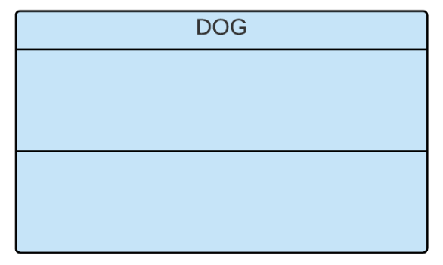
Class - Representation
1.UML
1.1. UML - Introduction
1.2. UML - Characteristics
1.3. UML - Types
2. Behavioral Diagram
2.1. Use Case Diagram
2.2. Use Case Diagram - Notation
2.3. Use Case Diagram – Example
2.4. Use Case Diagram - Relationship
3. Sequence Diagram
3.1. Sequence Diagram – Notation
3.2 Sequence Diagram - Example
4. Structural Diagram
4.1. Class Diagram – Purpose
4.2. Elements of class diagram
4.3. Classes
4.4. Class Diagram – Representation
4.5. Class Diagram – Relationship
4.6. Class Diagram - Association
4.7. Class Diagram – Generalization
4.8. Class Diagram – Aggregation
4.9. Class Diagram – Composition
4.10. Class Diagram – Dependency
4.11. Class Diagram – Roles
4.12. Class Diagram – Multiplicity
4.13. Class Diagram – Example 1
4.14. Class Diagram – Example 2
A box separated into three parts
Class name in first partition

Slide 35
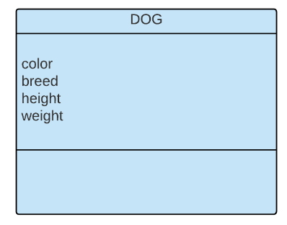
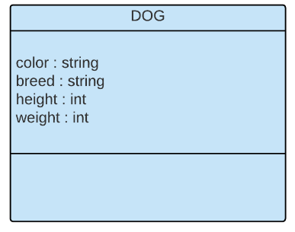
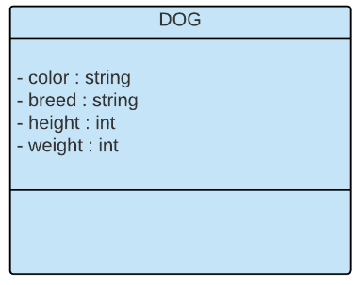
Class - Representation
1.UML
1.1. UML - Introduction
1.2. UML - Characteristics
1.3. UML - Types
2. Behavioral Diagram
2.1. Use Case Diagram
2.2. Use Case Diagram - Notation
2.3. Use Case Diagram – Example
2.4. Use Case Diagram - Relationship
3. Sequence Diagram
3.1. Sequence Diagram – Notation
3.2 Sequence Diagram - Example
4. Structural Diagram
4.1. Class Diagram – Purpose
4.2. Elements of class diagram
4.3. Classes
4.4. Class Diagram – Representation
4.5. Class Diagram – Relationship
4.6. Class Diagram - Association
4.7. Class Diagram – Generalization
4.8. Class Diagram – Aggregation
4.9. Class Diagram – Composition
4.10. Class Diagram – Dependency
4.11. Class Diagram – Roles
4.12. Class Diagram – Multiplicity
4.13. Class Diagram – Example 1
4.14. Class Diagram – Example 2
Attribute name in second partition

Slide 36
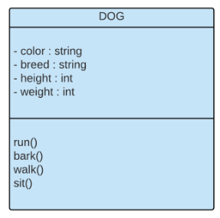
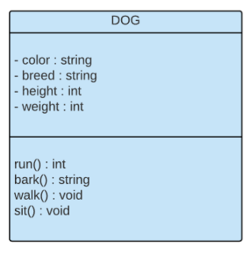
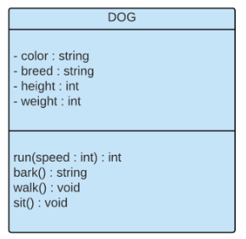
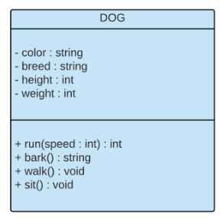
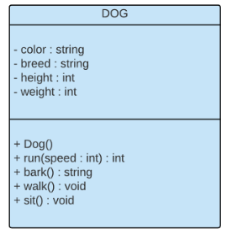
Class - Representation
1.UML
1.1. UML - Introduction
1.2. UML - Characteristics
1.3. UML - Types
2. Behavioral Diagram
2.1. Use Case Diagram
2.2. Use Case Diagram - Notation
2.3. Use Case Diagram – Example
2.4. Use Case Diagram - Relationship
3. Sequence Diagram
3.1. Sequence Diagram – Notation
3.2 Sequence Diagram - Example
4. Structural Diagram
4.1. Class Diagram – Purpose
4.2. Elements of class diagram
4.3. Classes
4.4. Class Diagram – Representation
4.5. Class Diagram – Relationship
4.6. Class Diagram - Association
4.7. Class Diagram – Generalization
4.8. Class Diagram – Aggregation
4.9. Class Diagram – Composition
4.10. Class Diagram – Dependency
4.11. Class Diagram – Roles
4.12. Class Diagram – Multiplicity
4.13. Class Diagram – Example 1
4.14. Class Diagram – Example 2
Method name in third partition

Slide 37
Class - Relationship
1.UML
1.1. UML - Introduction
1.2. UML - Characteristics
1.3. UML - Types
2. Behavioral Diagram
2.1. Use Case Diagram
2.2. Use Case Diagram - Notation
2.3. Use Case Diagram – Example
2.4. Use Case Diagram - Relationship
3. Sequence Diagram
3.1. Sequence Diagram – Notation
3.2 Sequence Diagram - Example
4. Structural Diagram
4.1. Class Diagram – Purpose
4.2. Elements of class diagram
4.3. Classes
4.4. Class Diagram – Representation
4.5. Class Diagram – Relationship
4.6. Class Diagram - Association
4.7. Class Diagram – Generalization
4.8. Class Diagram – Aggregation
4.9. Class Diagram – Composition
4.10. Class Diagram – Dependency
4.11. Class Diagram – Roles
4.12. Class Diagram – Multiplicity
4.13. Class Diagram – Example 1
4.14. Class Diagram – Example 2
Association
Generalization
Aggregation
Composition
Dependency

Slide 38

Association
1.UML
1.1. UML - Introduction
1.2. UML - Characteristics
1.3. UML - Types
2. Behavioral Diagram
2.1. Use Case Diagram
2.2. Use Case Diagram - Notation
2.3. Use Case Diagram – Example
2.4. Use Case Diagram - Relationship
3. Sequence Diagram
3.1. Sequence Diagram – Notation
3.2 Sequence Diagram - Example
4. Structural Diagram
4.1. Class Diagram – Purpose
4.2. Elements of class diagram
4.3. Classes
4.4. Class Diagram – Representation
4.5. Class Diagram – Relationship
4.6. Class Diagram - Association
4.7. Class Diagram – Generalization
4.8. Class Diagram – Aggregation
4.9. Class Diagram – Composition
4.10. Class Diagram – Dependency
4.11. Class Diagram – Roles
4.12. Class Diagram – Multiplicity
4.13. Class Diagram – Example 1
4.14. Class Diagram – Example 2
Any relationship between classes
Represented as a solid line connecting two classes

Slide 39
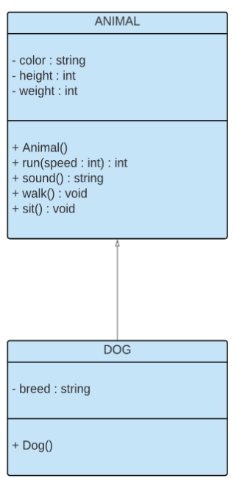
Generalization
1.UML
1.1. UML - Introduction
1.2. UML - Characteristics
1.3. UML - Types
2. Behavioral Diagram
2.1. Use Case Diagram
2.2. Use Case Diagram - Notation
2.3. Use Case Diagram – Example
2.4. Use Case Diagram - Relationship
3. Sequence Diagram
3.1. Sequence Diagram – Notation
3.2 Sequence Diagram - Example
4. Structural Diagram
4.1. Class Diagram – Purpose
4.2. Elements of class diagram
4.3. Classes
4.4. Class Diagram – Representation
4.5. Class Diagram – Relationship
4.6. Class Diagram - Association
4.7. Class Diagram – Generalization
4.8. Class Diagram – Aggregation
4.9. Class Diagram – Composition
4.10. Class Diagram – Dependency
4.11. Class Diagram – Roles
4.12. Class Diagram – Multiplicity
4.13. Class Diagram – Example 1
4.14. Class Diagram – Example 2
Inheritance
Parent-child relationship
Described by a solid line with a hollow arrowhead that points from the child to the parent class
Child class inherits properties from of the parent class

Slide 40

Aggregation
1.UML
1.1. UML - Introduction
1.2. UML - Characteristics
1.3. UML - Types
2. Behavioral Diagram
2.1. Use Case Diagram
2.2. Use Case Diagram - Notation
2.3. Use Case Diagram – Example
2.4. Use Case Diagram - Relationship
3. Sequence Diagram
3.1. Sequence Diagram – Notation
3.2 Sequence Diagram - Example
4. Structural Diagram
4.1. Class Diagram – Purpose
4.2. Elements of class diagram
4.3. Classes
4.4. Class Diagram – Representation
4.5. Class Diagram – Relationship
4.6. Class Diagram - Association
4.7. Class Diagram – Generalization
4.8. Class Diagram – Aggregation
4.9. Class Diagram – Composition
4.10. Class Diagram – Dependency
4.11. Class Diagram – Roles
4.12. Class Diagram – Multiplicity
4.13. Class Diagram – Example 1
4.14. Class Diagram – Example 2
Represents ‘has a’ relationship
More specific than a association relationship as it defines a part-whole or a part-of relationship
Denoted by a solid line with an unfilled diamond.
Child can exist independently of its parent

Slide 41
Composition
1.UML
1.1. UML - Introduction
1.2. UML - Characteristics
1.3. UML - Types
2. Behavioral Diagram
2.1. Use Case Diagram
2.2. Use Case Diagram - Notation
2.3. Use Case Diagram – Example
2.4. Use Case Diagram - Relationship
3. Sequence Diagram
3.1. Sequence Diagram – Notation
3.2 Sequence Diagram - Example
4. Structural Diagram
4.1. Class Diagram – Purpose
4.2. Elements of class diagram
4.3. Classes
4.4. Class Diagram – Representation
4.5. Class Diagram – Relationship
4.6. Class Diagram - Association
4.7. Class Diagram – Generalization
4.8. Class Diagram – Aggregation
4.9. Class Diagram – Composition
4.10. Class Diagram – Dependency
4.11. Class Diagram – Roles
4.12. Class Diagram – Multiplicity
4.13. Class Diagram – Example 1
4.14. Class Diagram – Example 2
Subset of aggregation
Represents a whole-part relationship, portrays the dependency between the parent and the child
If one is deleted, the other one is discarded
Solid line with a filled diamond

Slide 42

Dependency
1.UML
1.1. UML - Introduction
1.2. UML - Characteristics
1.3. UML - Types
2. Behavioral Diagram
2.1. Use Case Diagram
2.2. Use Case Diagram - Notation
2.3. Use Case Diagram – Example
2.4. Use Case Diagram - Relationship
3. Sequence Diagram
3.1. Sequence Diagram – Notation
3.2 Sequence Diagram - Example
4. Structural Diagram
4.1. Class Diagram – Purpose
4.2. Elements of class diagram
4.3. Classes
4.4. Class Diagram – Representation
4.5. Class Diagram – Relationship
4.6. Class Diagram - Association
4.7. Class Diagram – Generalization
4.8. Class Diagram – Aggregation
4.9. Class Diagram – Composition
4.10. Class Diagram – Dependency
4.11. Class Diagram – Roles
4.12. Class Diagram – Multiplicity
4.13. Class Diagram – Example 1
4.14. Class Diagram – Example 2
Semantic relationship between two or more classes
A change in one class causes changes in others
Denoted by a dashed line with an arrow towards the dependent class

Slide 43
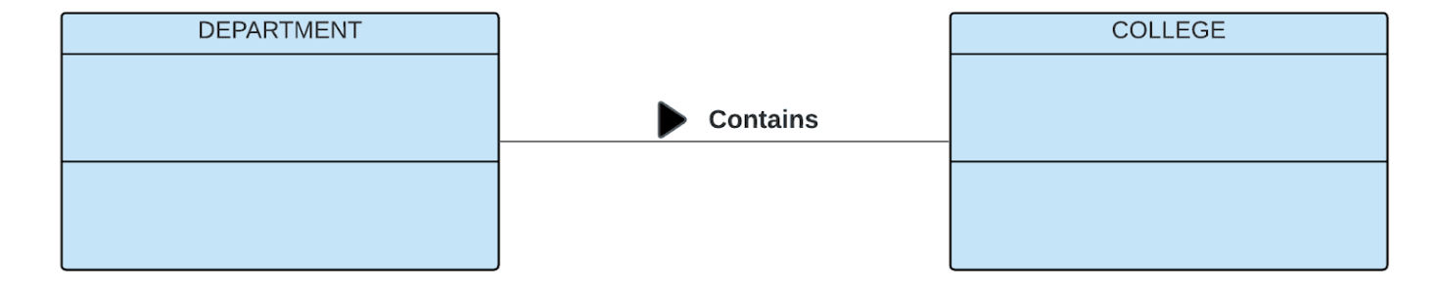
Class Diagram - Roles
1.UML
1.1. UML - Introduction
1.2. UML - Characteristics
1.3. UML - Types
2. Behavioral Diagram
2.1. Use Case Diagram
2.2. Use Case Diagram - Notation
2.3. Use Case Diagram – Example
2.4. Use Case Diagram - Relationship
3. Sequence Diagram
3.1. Sequence Diagram – Notation
3.2 Sequence Diagram - Example
4. Structural Diagram
4.1. Class Diagram – Purpose
4.2. Elements of class diagram
4.3. Classes
4.4. Class Diagram – Representation
4.5. Class Diagram – Relationship
4.6. Class Diagram - Association
4.7. Class Diagram – Generalization
4.8. Class Diagram – Aggregation
4.9. Class Diagram – Composition
4.10. Class Diagram – Dependency
4.11. Class Diagram – Roles
4.12. Class Diagram – Multiplicity
4.13. Class Diagram – Example 1
4.14. Class Diagram – Example 2
Directional purpose of a class
Written at the end of a relationship line, and describe the purpose played by the class in the relationship
Represented by a verb prefixed by a filled triangle

Slide 44
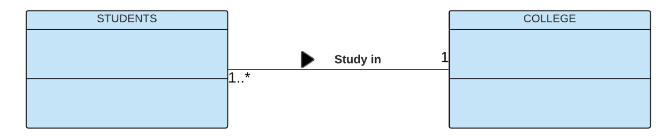
Class Diagram - Multiplicity
1.UML
1.1. UML - Introduction
1.2. UML - Characteristics
1.3. UML - Types
2. Behavioral Diagram
2.1. Use Case Diagram
2.2. Use Case Diagram - Notation
2.3. Use Case Diagram – Example
2.4. Use Case Diagram - Relationship
3. Sequence Diagram
3.1. Sequence Diagram – Notation
3.2 Sequence Diagram - Example
4. Structural Diagram
4.1. Class Diagram – Purpose
4.2. Elements of class diagram
4.3. Classes
4.4. Class Diagram – Representation
4.5. Class Diagram – Relationship
4.6. Class Diagram - Association
4.7. Class Diagram – Generalization
4.8. Class Diagram – Aggregation
4.9. Class Diagram – Composition
4.10. Class Diagram – Dependency
4.11. Class Diagram – Roles
4.12. Class Diagram – Multiplicity
4.13. Class Diagram – Example 1
4.14. Class Diagram – Example 2
Factor associated with an attribute, meaning it specifies how many instances of attributes are created when a class is initialized
They can expressed in the following ways:
Exactly one - 1
Zero or one - 0..1
Many - 0..* or *
One to many - 1..*
exact number of instances - 1, 3, 6
Default multiplicity is exact one

Slide 45
Class Diagram - Multiplicity
1.UML
1.1. UML - Introduction
1.2. UML - Characteristics
1.3. UML - Types
2. Behavioral Diagram
2.1. Use Case Diagram
2.2. Use Case Diagram - Notation
2.3. Use Case Diagram – Example
2.4. Use Case Diagram - Relationship
3. Sequence Diagram
3.1. Sequence Diagram – Notation
3.2 Sequence Diagram - Example
4. Structural Diagram
4.1. Class Diagram – Purpose
4.2. Elements of class diagram
4.3. Classes
4.4. Class Diagram – Representation
4.5. Class Diagram – Relationship
4.6. Class Diagram - Association
4.7. Class Diagram – Generalization
4.8. Class Diagram – Aggregation
4.9. Class Diagram – Composition
4.10. Class Diagram – Dependency
4.11. Class Diagram – Roles
4.12. Class Diagram – Multiplicity
4.13. Class Diagram – Example 1
4.14. Class Diagram – Example 2
Factor associated with an attribute, meaning it specifies how many instances of attributes are created when a class is initialized
They can expressed in the following ways:
Exactly one - 1
Zero or one - 0..1
Many - 0..* or *
One to many - 1..*
exact number of instances - 1, 3, 6
Default multiplicity is exact one

Slide 46
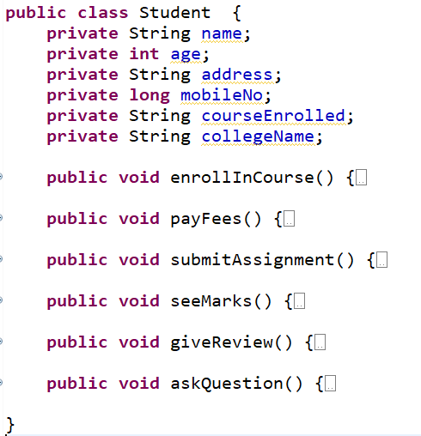
Example 1:
Student
name: String
age: int
address: String
mobileNo: long
courseEnrolled:String collegeName: String
enrollInCourse( ):void payFees( ) :void
submitAssignment( ): void
seeMarks ( ) : void
giveReview( ) : void
askQuestion( ) : void

Slide 47

Visibility – private and public
Student
- name: String
- age: int
- address: String
- mobileNo: long
- courseEnrolled:String - collegeName: String
+ enrollInCourse( ):void
+ payFees( ) :void
+ submitAssignment( ): void
+ seeMarks ( ) : void
+ giveReview( ) : void
+ askQuestion( ) : void

Slide 48

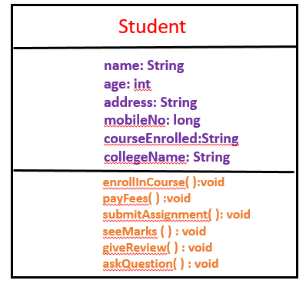
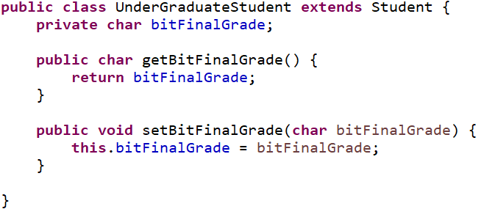

Inheritance relationship in class diagram
UnderGraduateStudent
bitFinalGrade: char
Generalization
getBitFinalGrade( ):char payFees( ) :void
Please note I have ignored access Modifiers(Visibility)

Slide 49
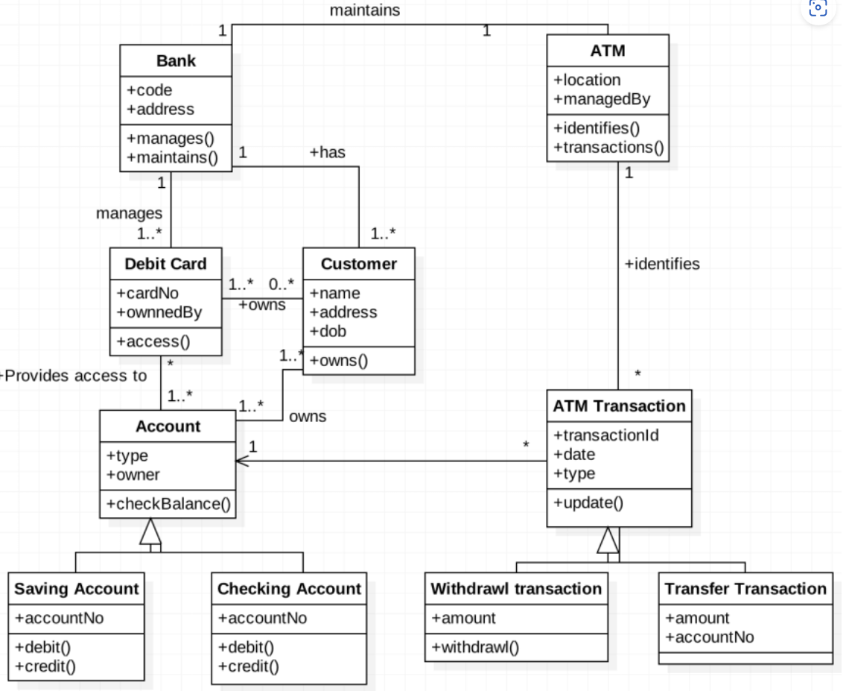
Example 2: ATM SYSTEM

Slide 50
Thank You

