Slide 1


Object Oriented Programming and Design WEEK 3 – Looping and Arrays
Object Oriented Design and Programming
1

Slide 2
LET’S GET STARTED WITH LECTURE 3
Object Oriented Design and Programming
2

Slide 3
Looping and Arrays
Object Oriented Design and Programming
3

Slide 4
Multiple Messages
1. Iterations
1.1 for loop
1.2. while loop
1.3. do while
2. Review of Loops
3. Infinite Loops
4. Iterative Control Statements
4.1. Break
4.2. Continue
5.Nested Loops
6.Array
6.1. Declaring Arrays
6.2. Initializing Arrays
6.3. Accessing Array Elements
7.Types of Arrays
8.Array Operations
9. Enhanced For Loop
10. Linear Search
11. Bubble Sort
public class Main{
public static void main(String[] args){
System.out.println("Hello Class!"); System.out.println("I am a teacher."); System.out.println("How are you doing?"); } }
Output:
Hello Class!
I am a teacher.
How are you doing?
Object Oriented Design and Programming
4

Slide 5

Correct Way?
1. Iterations
1.1 for loop
1.2. while loop
1.3. do while
2. Review of Loops
3. Infinite Loops
4. Iterative Control Statements
4.1. Break
4.2. Continue
5.Nested Loops
6.Array
6.1. Declaring Arrays
6.2. Initializing Arrays
6.3. Accessing Array Elements
7.Types of Arrays
8.Array Operations
9. Enhanced For Loop
10. Linear Search
11. Bubble Sort
What to do if we want to print it from 30 times?
public class Main{
public static void main(String[] args){
System.out.println("Hello World"); System.out.println("Hello World"); System.out.println("Hello World"); System.out.println("Hello World"); System.out.println("Hello World"); System.out.println("Hello World"); System.out.println("Hello World"); System.out.println("Hello World"); System.out.println("Hello World"); } } Correct Way?
Object Oriented Design and Programming
5

Slide 6

Nothing To Worry!!
1. Iterations
1.1 for loop
1.2. while loop
1.3. do while
2. Review of Loops
3. Infinite Loops
4. Iterative Control Statements
4.1. Break
4.2. Continue
5.Nested Loops
6.Array
6.1. Declaring Arrays
6.2. Initializing Arrays
6.3. Accessing Array Elements
7.Types of Arrays
8.Array Operations
9. Enhanced For Loop
10. Linear Search
11. Bubble Sort
Don’t worry to code long codes
Because
Iteration (or looping) is there for you to reduce code line
Object Oriented Design and Programming
6

Slide 7
Iterations
1. Iterations
1.1 for loop
1.2. while loop
1.3. do while
2. Review of Loops
3. Infinite Loops
4. Iterative Control Statements
4.1. Break
4.2. Continue
5.Nested Loops
6.Array
6.1. Declaring Arrays
6.2. Initializing Arrays
6.3. Accessing Array Elements
7.Types of Arrays
8.Array Operations
9. Enhanced For Loop
10. Linear Search
11. Bubble Sort
Iterative Control Statement:
A control statement that enables the repeated execution of a set of instructions.
Iterative Control Structure:
A set of instructions along with the iterative control statement(s) that govern their execution.0
Often referred to as "loops" due to their repetitive nature.
Types of Loops:
There are various types of loops in programming, including for, while, and do-while loops.
Execution Time:
Loops are crucial in programming for executing tasks repeatedly.
Understanding loop execution time is essential for optimizing code performance.
Object Oriented Design and Programming
7

Slide 8
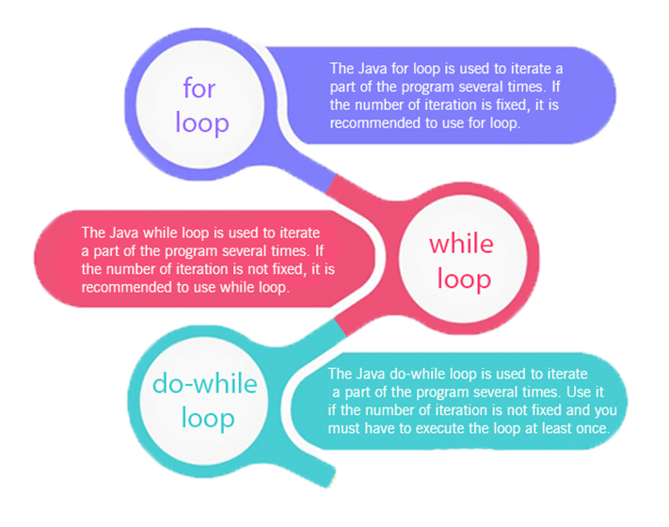
Iterations
1. Iterations
1.1 for loop
1.2. while loop
1.3. do while
2. Review of Loops
3. Infinite Loops
4. Iterative Control Statements
4.1. Break
4.2. Continue
5.Nested Loops
6.Array
6.1. Declaring Arrays
6.2. Initializing Arrays
6.3. Accessing Array Elements
7.Types of Arrays
8.Array Operations
9. Enhanced For Loop
10. Linear Search
11. Bubble Sort
Object Oriented Design and Programming
8

Slide 9
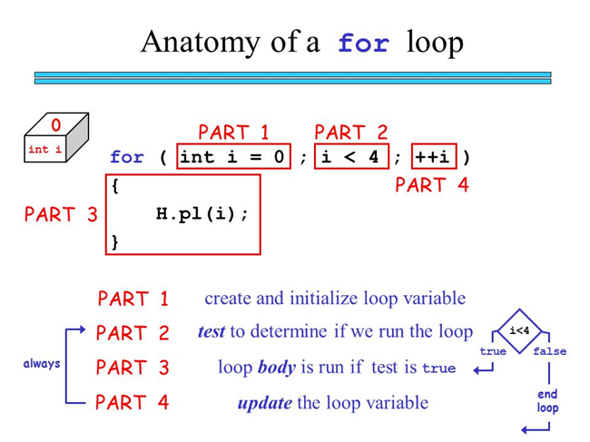
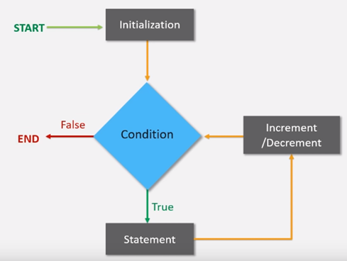
for Loop
1. Iterations
1.1 for loop
1.2. while loop
1.3. do while
2. Review of Loops
3. Infinite Loops
4. Iterative Control Statements
4.1. Break
4.2. Continue
5.Nested Loops
6.Array
6.1. Declaring Arrays
6.2. Initializing Arrays
6.3. Accessing Array Elements
7.Types of Arrays
8.Array Operations
9. Enhanced For Loop
10. Linear Search
11. Bubble Sort
Object Oriented Design and Programming
9

Slide 10
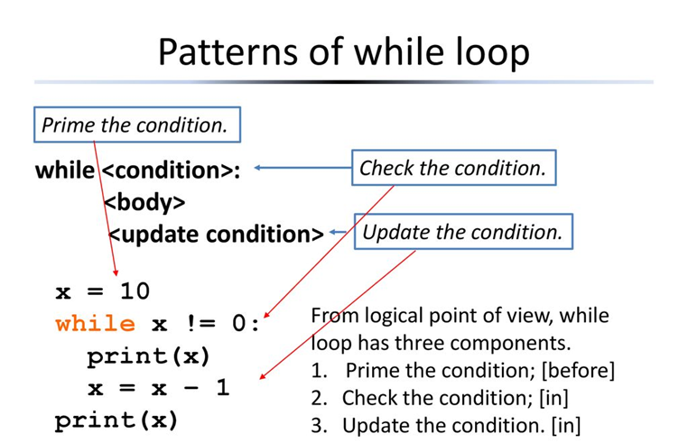
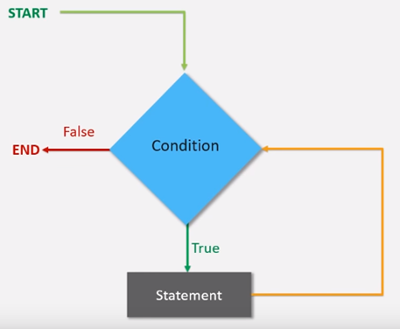
while Loop
1. Iterations
1.1 for loop
1.2. while loop
1.3. do while
2. Review of Loops
3. Infinite Loops
4. Iterative Control Statements
4.1. Break
4.2. Continue
5.Nested Loops
6.Array
6.1. Declaring Arrays
6.2. Initializing Arrays
6.3. Accessing Array Elements
7.Types of Arrays
8.Array Operations
9. Enhanced For Loop
10. Linear Search
11. Bubble Sort
Object Oriented Design and Programming
10

Slide 11
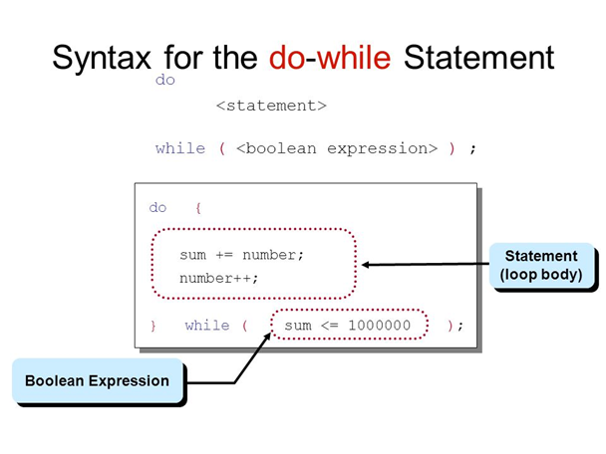
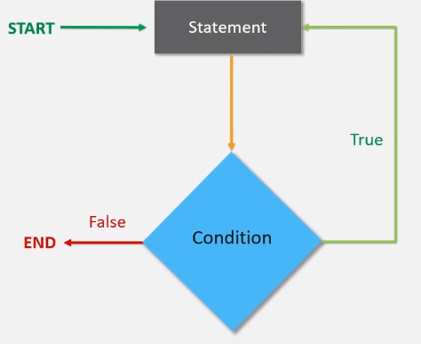
do-while Loop
1. Iterations
1.1 for loop
1.2. while loop
1.3. do while
2. Review of Loops
3. Infinite Loops
4. Iterative Control Statements
4.1. Break
4.2. Continue
5.Nested Loops
6.Array
6.1. Declaring Arrays
6.2. Initializing Arrays
6.3. Accessing Array Elements
7.Types of Arrays
8.Array Operations
9. Enhanced For Loop
10. Linear Search
11. Bubble Sort
Object Oriented Design and Programming
11

Slide 12
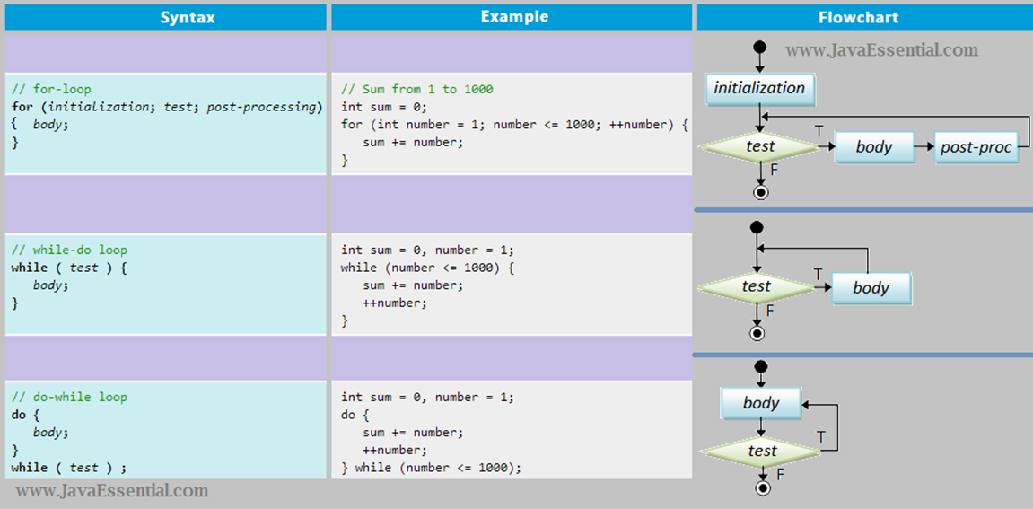
Review of Loops
1. Iterations
1.1 for loop
1.2. while loop
1.3. do while
2. Review of Loops
3. Infinite Loops
4. Iterative Control Statements
4.1. Break
4.2. Continue
5.Nested Loops
6.Array
6.1. Declaring Arrays
6.2. Initializing Arrays
6.3. Accessing Array Elements
7.Types of Arrays
8.Array Operations
9. Enhanced For Loop
10. Linear Search
11. Bubble Sort
Object Oriented Design and Programming
12

Slide 13
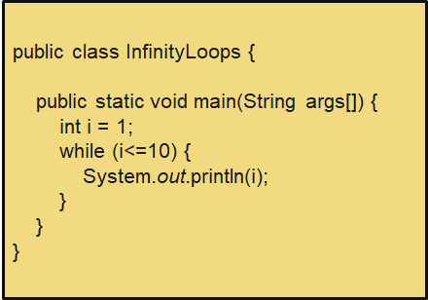

Infinite Loops
1. Iterations
1.1 for loop
1.2. while loop
1.3. do while
2. Review of Loops
3. Infinite Loops
4. Iterative Control Statements
4.1. Break
4.2. Continue
5.Nested Loops
6.Array
6.1. Declaring Arrays
6.2. Initializing Arrays
6.3. Accessing Array Elements
7.Types of Arrays
8.Array Operations
9. Enhanced For Loop
10. Linear Search
11. Bubble Sort
Infinite loops are loops that never end or eventually result in an error.
They are typically the result of programming errors, often caused by loop conditions that never become false.
However, they can be intentionally used in scenarios like real-time systems, servers, embedded systems, games, and event handling.
Caution is necessary when using them, and control mechanisms should be in place to manage and exit these loops when needed.
Object Oriented Design and Programming
13

Slide 14
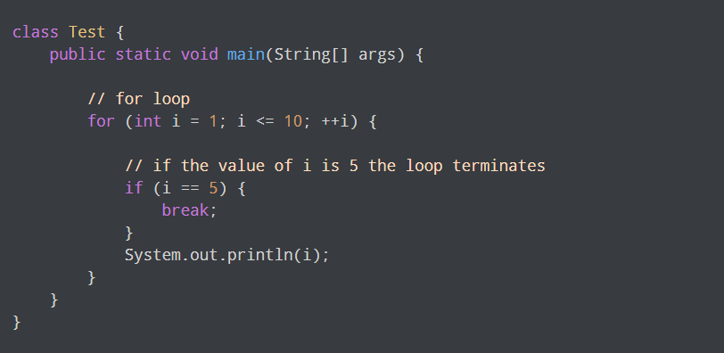
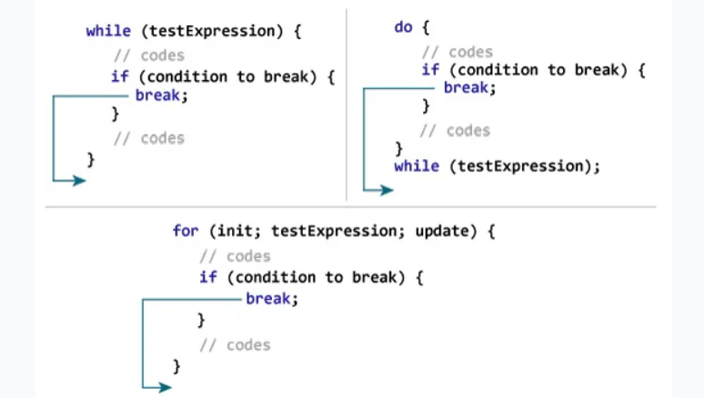
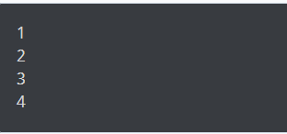
Iteration Control Statements
1. Iterations
1.1 for loop
1.2. while loop
1.3. do while
2. Review of Loops
3. Infinite Loops
4. Iterative Control Statements
4.1. Break
4.2. Continue
5.Nested Loops
6.Array
6.1. Declaring Arrays
6.2. Initializing Arrays
6.3. Accessing Array Elements
7.Types of Arrays
8.Array Operations
9. Enhanced For Loop
10. Linear Search
11. Bubble Sort
Break Statement: The "break" statement is used in Java to control the flow of loops.
Loop Control: When executed within a loop, the "break" statement immediately stops the current loop iteration and exits the loop.
Continuation: After the "break" statement is encountered, the program resumes execution with the statement following the loop.
Use Cases: "Break" is often used when a specific condition is met within a loop, and you want to terminate the loop prematurely.
Example: For instance, in a "while" or "for" loop, you might use "break" when a certain value is found, and you no longer need to continue the loop.
Output:
Object Oriented Design and Programming
14

Slide 15
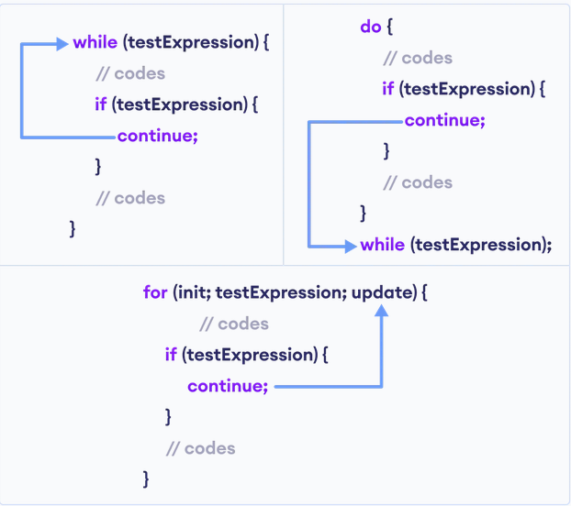
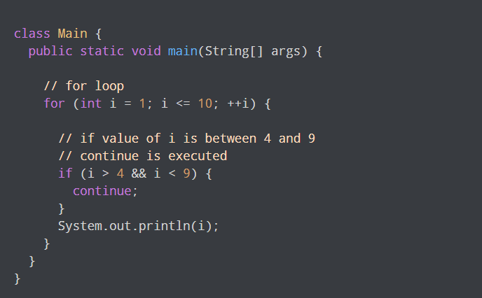
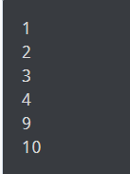
Iteration Control Statements
1. Iterations
1.1 for loop
1.2. while loop
1.3. do while
2. Review of Loops
3. Infinite Loops
4. Iterative Control Statements
4.1. Break
4.2. Continue
5.Nested Loops
6.Array
6.1. Declaring Arrays
6.2. Initializing Arrays
6.3. Accessing Array Elements
7.Types of Arrays
8.Array Operations
9. Enhanced For Loop
10. Linear Search
11. Bubble Sort
Continue Statement: The "continue" statement is another control statement used in Java loops.
Loop Control: Like the "break" statement, "continue" is added within a loop's code block.
Current Iteration: When executed, the "continue" statement stops the current iteration of the loop and skips the remaining code within that iteration.
Next Iteration: After "continue" is encountered, execution proceeds with the next iteration of the loop. It doesn't terminate the loop itself, only the current iteration.
Use Cases: "Continue" is typically used when you want to skip a particular iteration of the loop based on certain conditions.
Output:
Object Oriented Design and Programming
15

Slide 16
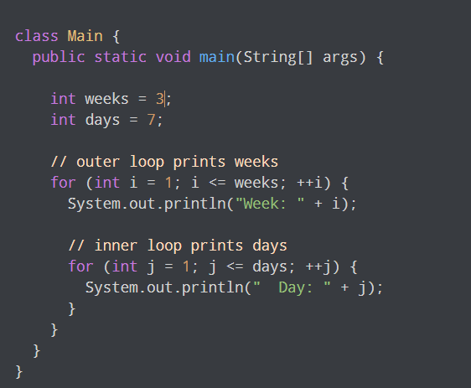
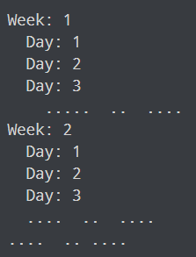
Nested Loop
1. Iterations
1.1 for loop
1.2. while loop
1.3. do while
2. Review of Loops
3. Infinite Loops
4. Iterative Control Statements
4.1. Break
4.2. Continue
5.Nested Loops
6.Array
6.1. Declaring Arrays
6.2. Initializing Arrays
6.3. Accessing Array Elements
7.Types of Arrays
8.Array Operations
9. Enhanced For Loop
10. Linear Search
11. Bubble Sort
Nested Loops: In Java, loops can be placed inside other control structures, including loops. You can nest up to 20 control flow statements.
Structure: Nested loops are typically structured with one loop inside another, where the inner loop is enclosed within the code block of the outer loop.
Practical Use: Nested loops are practical when a single loop is insufficient for a task. For example, they are used to create complex patterns, perform matrix operations, or generate tables.
Example: To print a multiplication table, you can use nested loops, where the outer loop iterates through the rows and the inner loop through the columns.
Output:
Object Oriented Design and Programming
16

Slide 17
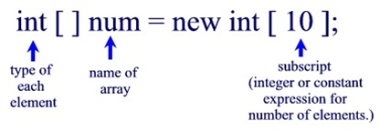
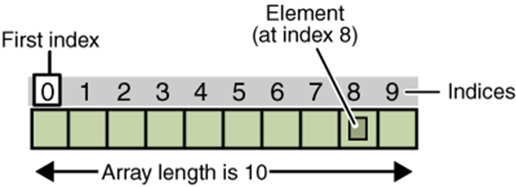
Array
1. Iterations
1.1 for loop
1.2. while loop
1.3. do while
2. Review of Loops
3. Infinite Loops
4. Iterative Control Statements
4.1. Break
4.2. Continue
5.Nested Loops
6.Array
6.1. Declaring Arrays
6.2. Initializing Arrays
6.3. Accessing Array Elements
7.Types of Arrays
8.Array Operations
9. Enhanced For Loop
10. Linear Search
11. Bubble Sort
•Java provides a data structure, the array, which stores a fixed-size sequential collection of elements of the same type.
•An array is used to store a collection of data, but it is often more useful to think of an array as a collection of variables of the same type.
•Instead of declaring individual variables, such as number0, number1, ..., and number99, you declare one array variable such as numbers and use numbers[0], numbers[1], and ..., numbers[99] to represent individual variables.
Object Oriented Design and Programming
17

Slide 18

Array
1. Iterations
1.1 for loop
1.2. while loop
1.3. do while
2. Review of Loops
3. Infinite Loops
4. Iterative Control Statements
4.1. Break
4.2. Continue
5.Nested Loops
6.Array
6.1. Declaring Arrays
6.2. Initializing Arrays
6.3. Accessing Array Elements
7.Types of Arrays
8.Array Operations
9. Enhanced For Loop
10. Linear Search
11. Bubble Sort
Pros
Efficient Data Storage: Arrays allow efficient storage and retrieval of elements as they use contiguous memory locations.
Random Access: You can directly access any element in an array using its index, making data retrieval quick and straightforward.
Simplicity: Arrays are a simple and straightforward way to store collections of elements, especially when the size is known in advance.
Fast Iteration: Iterating through an array using loops is efficient, making it suitable for many algorithms and operations.
Memory Efficiency: Arrays have a low memory overhead since they only store the data elements without additional structure.
Consistency: All elements in an array have the same data type, ensuring data consistency and predictability.
Implementing Data Structures: Arrays serve as a fundamental building block for implementing more complex data structures like lists, stacks, queues, and matrices.
Object Oriented Design and Programming
18

Slide 19

Array
1. Iterations
1.1 for loop
1.2. while loop
1.3. do while
2. Review of Loops
3. Infinite Loops
4. Iterative Control Statements
4.1. Break
4.2. Continue
5.Nested Loops
6.Array
6.1. Declaring Arrays
6.2. Initializing Arrays
6.3. Accessing Array Elements
7.Types of Arrays
8.Array Operations
9. Enhanced For Loop
10. Linear Search
11. Bubble Sort
Cons
Fixed Size: Arrays in Java have a fixed size, meaning you must know in advance how many elements you want to store.
Static Structure: Arrays are static data structures, and once allocated, their size cannot be changed dynamically.
Memory Considerations: Allocating more memory than needed wastes space, and allocating less can lead to issues with data storage.
Consecutive Memory: Array elements are stored in consecutive memory locations, making insertions and deletions challenging and time-consuming.
Object Oriented Design and Programming
19

Slide 20
Declaring Arrays
1. Iterations
1.1 for loop
1.2. while loop
1.3. do while
2. Review of Loops
3. Infinite Loops
4. Iterative Control Statements
4.1. Break
4.2. Continue
5.Nested Loops
6.Array
6.1. Declaring Arrays
6.2. Initializing Arrays
6.3. Accessing Array Elements
7.Types of Arrays
8.Array Operations
9. Enhanced For Loop
10. Linear Search
11. Bubble Sort
•The following statements declare an array marks of type int that can hold 10 elements:
int marks [ ] = new int[10];
int [ ] marks = new int[10] ;
•The above statements declare the array marks which has 10 elements, marks[ 0 ] to marks[ 9 ].
Object Oriented Design and Programming
20

Slide 21
Initializing Arrays
1. Iterations
1.1 for loop
1.2. while loop
1.3. do while
2. Review of Loops
3. Infinite Loops
4. Iterative Control Statements
4.1. Break
4.2. Continue
5.Nested Loops
6.Array
6.1. Declaring Arrays
6.2. Initializing Arrays
6.3. Accessing Array Elements
7.Types of Arrays
8.Array Operations
9. Enhanced For Loop
10. Linear Search
11. Bubble Sort
•When an array object is created with the new operator, its elements are automatically initialized to zero, which is the default initial value for all numeric type.
•If the array is boolean type then all elements are initialized with boolean false value.
•You can initialize arrays to non-zero values using array initializers, which are comma-separated list enclosed in braces as shown in the following example:
int marks[ ] = {90,76,56,60,48};
Object Oriented Design and Programming
21

Slide 22
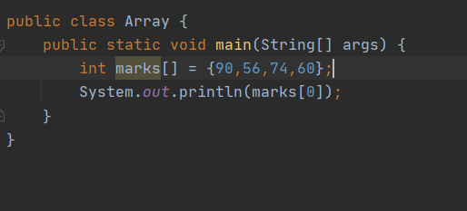

Accessing Array Elements
1. Iterations
1.1 for loop
1.2. while loop
1.3. do while
2. Review of Loops
3. Infinite Loops
4. Iterative Control Statements
4.1. Break
4.2. Continue
5.Nested Loops
6.Array
6.1. Declaring Arrays
6.2. Initializing Arrays
6.3. Accessing Array Elements
7.Types of Arrays
8.Array Operations
9. Enhanced For Loop
10. Linear Search
11. Bubble Sort
Accessing one element
Output:
Object Oriented Design and Programming
22

Slide 23
Types of Arrays
1. Iterations
1.1 for loop
1.2. while loop
1.3. do while
2. Review of Loops
3. Infinite Loops
4. Iterative Control Statements
4.1. Break
4.2. Continue
5.Nested Loops
6.Array
6.1. Declaring Arrays
6.2. Initializing Arrays
6.3. Accessing Array Elements
7.Types of Arrays
8.Array Operations
9. Enhanced For Loop
10. Linear Search
11. Bubble Sort
Single-Dimensional Array: This is the most basic type of array where elements are stored in a linear sequence. Example:
int[] numbers = {1, 2, 3, 4, 5};
Multi-Dimensional Array: These arrays are used to store data in multiple dimensions, like rows and columns. Common examples include 2D and 3D arrays. Example:
int [][] matrix = {{1,2,3},{4,5,6}};
Object Oriented Design and Programming
23

Slide 24
Array Operations
1. Iterations
1.1 for loop
1.2. while loop
1.3. do while
2. Review of Loops
3. Infinite Loops
4. Iterative Control Statements
4.1. Break
4.2. Continue
5.Nested Loops
6.Array
6.1. Declaring Arrays
6.2. Initializing Arrays
6.3. Accessing Array Elements
7.Types of Arrays
8.Array Operations
9. Enhanced For Loop
10. Linear Search
11. Bubble Sort
Length:
The length of an array in Java is determined by the number of elements it contains.
It's accessed using the length property of the array.
The length provides the total count of elements and is fixed once the array is created.
It helps you know the size of the array and is often used to iterate through the elements.
Iteration through Elements:
Iterating through array elements involves accessing and processing each element one by one.
Common methods for iteration include using "for" and "while" loops or enhanced for loops (for-each).
You start from the first element (index 0) and continue until you reach the last element (index length - 1).
During iteration, you can perform various operations on the elements, such as printing, searching, or modification.
Object Oriented Design and Programming
24

Slide 25
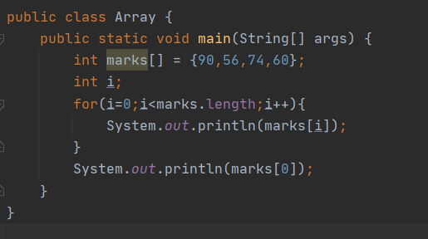

Array Operations
1. Iterations
1.1 for loop
1.2. while loop
1.3. do while
2. Review of Loops
3. Infinite Loops
4. Iterative Control Statements
4.1. Break
4.2. Continue
5.Nested Loops
6.Array
6.1. Declaring Arrays
6.2. Initializing Arrays
6.3. Accessing Array Elements
7.Types of Arrays
8.Array Operations
9. Enhanced For Loop
10. Linear Search
11. Bubble Sort
Length
Output:
Object Oriented Design and Programming
25

Slide 26
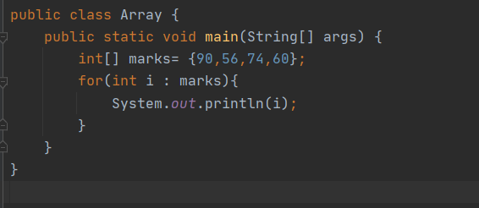
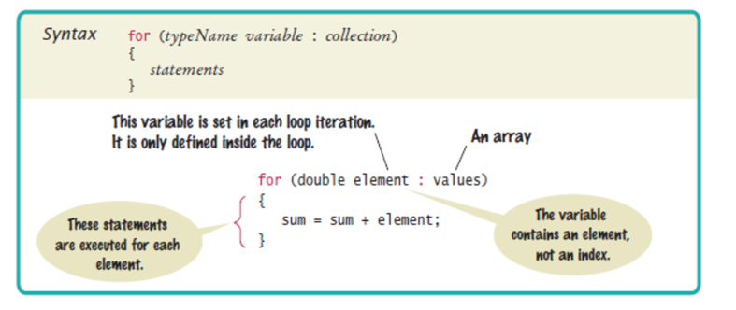
Enhanced For Loop
1. Iterations
1.1 for loop
1.2. while loop
1.3. do while
2. Review of Loops
3. Infinite Loops
4. Iterative Control Statements
4.1. Break
4.2. Continue
5.Nested Loops
6.Array
6.1. Declaring Arrays
6.2. Initializing Arrays
6.3. Accessing Array Elements
7.Types of Arrays
8.Array Operations
9. Enhanced For Loop
10. Linear Search
11. Bubble Sort
Simplified way to iterate through arrays and collections
provides a more concise and readable syntax compared to traditional loops like the “for” or “while” loop
Output:
Object Oriented Design and Programming
26

Slide 27
Enhanced Loop VS Traditional Loop
1. Iterations
1.1 for loop
1.2. while loop
1.3. do while
2. Review of Loops
3. Infinite Loops
4. Iterative Control Statements
4.1. Break
4.2. Continue
5.Nested Loops
6.Array
6.1. Declaring Arrays
6.2. Initializing Arrays
6.3. Accessing Array Elements
7.Types of Arrays
8.Array Operations
9. Enhanced For Loop
10. Linear Search
11. Bubble Sort
Enhanced Loop
Traditional Loop
Pros:
Simplifies code and enhances readability.
Eliminates the need for manual index tracking.
Cons:
Not suitable for scenarios where you need to know the index of the element being processed.
Limited control over the iteration process.
Pros:
Provides more control and flexibility during iteration.
Allows access to the index.
Cons:
Can be more verbose and error-prone.
27
Object Oriented Design and Programming

Slide 28
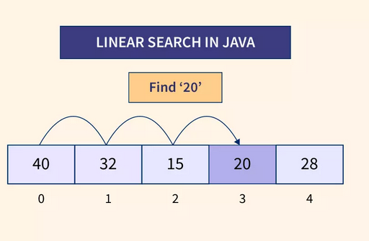
Linear search
1. Iterations
1.1 for loop
1.2. while loop
1.3. do while
2. Review of Loops
3. Infinite Loops
4. Iterative Control Statements
4.1. Break
4.2. Continue
5.Nested Loops
6.Array
6.1. Declaring Arrays
6.2. Initializing Arrays
6.3. Accessing Array Elements
7.Types of Arrays
8.Array Operations
9. Enhanced For Loop
10. Linear Search
11. Bubble Sort
is a sequential search used to find a specific element within a list
it begins by starting at the first element of the list
compares the target element with the current element in the list
checks each element in the list sequentially until a match is found or the end of the list is reached
if the current element matches the target element the search is successful and the index of the matching element is returned

Slide 29
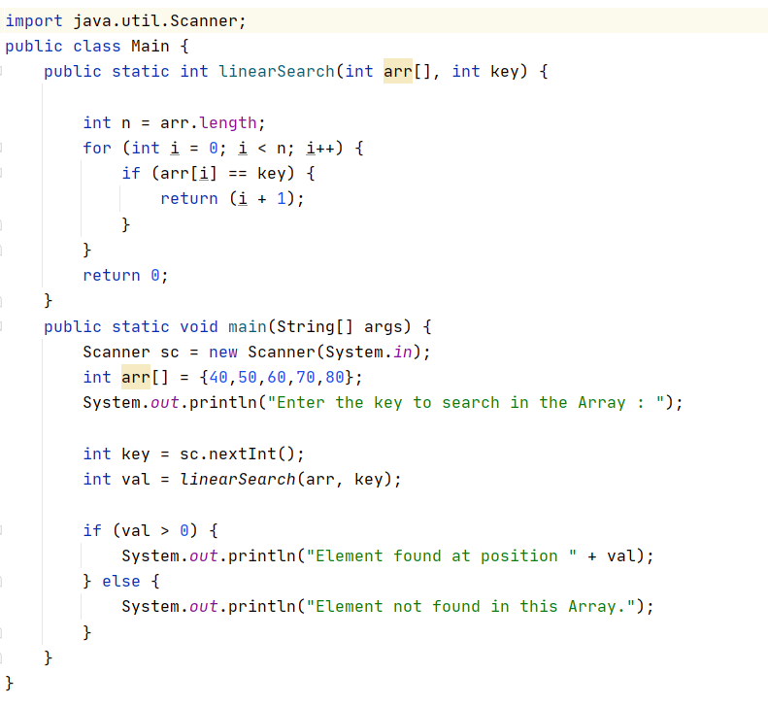

1. Iterations
1.1 for loop
1.2. while loop
1.3. do while
2. Review of Loops
3. Infinite Loops
4. Iterative Control Statements
4.1. Break
4.2. Continue
5.Nested Loops
6.Array
6.1. Declaring Arrays
6.2. Initializing Arrays
6.3. Accessing Array Elements
7.Types of Arrays
8.Array Operations
9. Enhanced For Loop
10. Linear Search
11. Bubble Sort
Steps required to follow for linear search
initialize the iterator variable i=1
check while i<array.length
check if A[i] == key then go to step 6
else increase iterator variable
go to step 2
print the element with the index position
print element not found
Output:

Slide 30
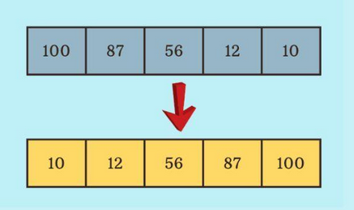
Bubble sort
1. Iterations
1.1 for loop
1.2. while loop
1.3. do while
2. Review of Loops
3. Infinite Loops
4. Iterative Control Statements
4.1. Break
4.2. Continue
5.Nested Loops
6.Array
6.1. Declaring Arrays
6.2. Initializing Arrays
6.3. Accessing Array Elements
7.Types of Arrays
8.Array Operations
9. Enhanced For Loop
10. Linear Search
11. Bubble Sort
iterative sorting algorithm
works by comparing each pair of adjacent items and swapping them if they are in wrong order
name “Bubble sort” comes from the way smaller elements gradually “bubble” to the top of the list
Example:

Slide 31
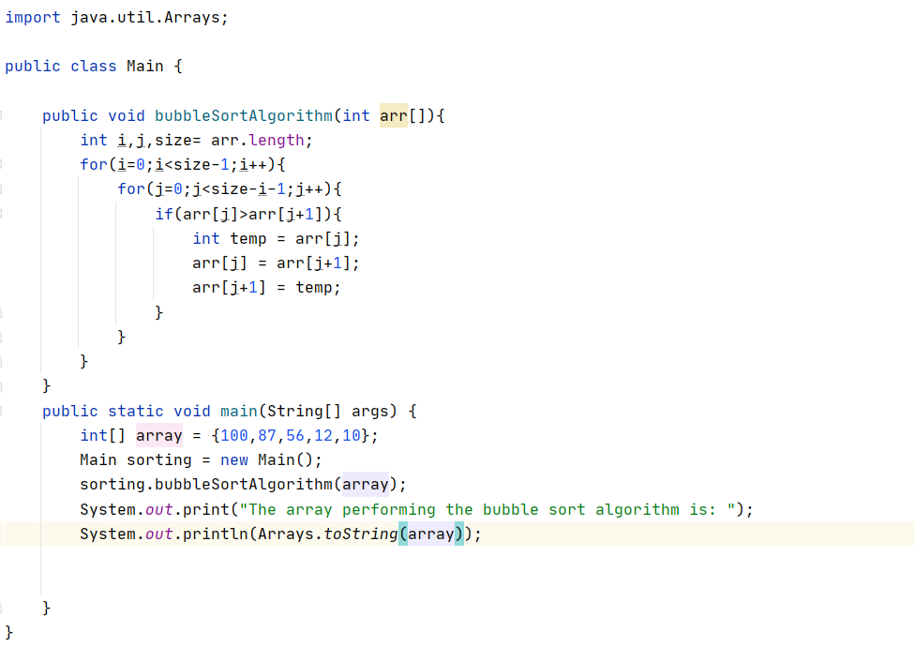
1. Iterations
1.1 for loop
1.2. while loop
1.3. do while
2. Review of Loops
3. Infinite Loops
4. Iterative Control Statements
4.1. Break
4.2. Continue
5.Nested Loops
6.Array
6.1. Declaring Arrays
6.2. Initializing Arrays
6.3. Accessing Array Elements
7.Types of Arrays
8.Array Operations
9. Enhanced For Loop
10. Linear Search
11. Bubble Sort
Steps required to follow for bubble sort
Use two loops to iterate through the input array.
The outer loop runs from i=0 to i=n-2.
The inner loop runs from j=0 to j=n-i-2.
For every j, compare arr[j] and arr[j+1]. if arr[j]>arr[j+1], the swap them or else move forward.
Output:

Slide 32
Tutorial Class
Linear search and bubble sort will be covered
28
Object Oriented Design and Programming

Slide 33

29
Object Oriented Design and Programming

