Slide 1
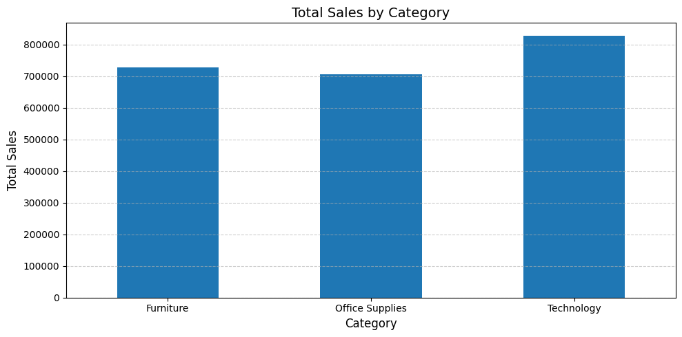
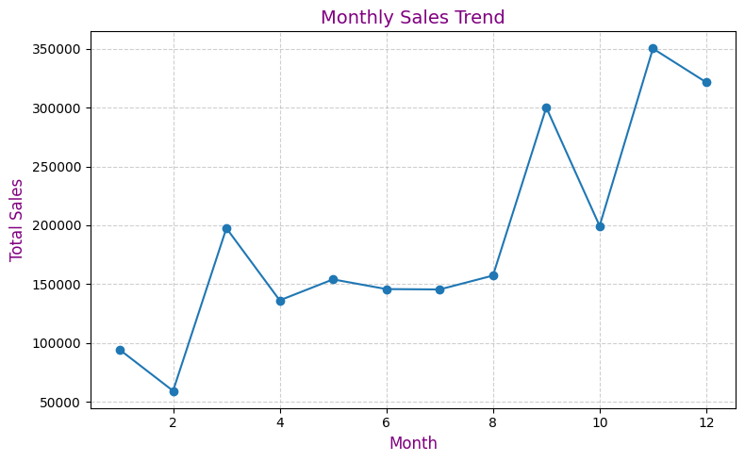
Superstore Sales Dashboard
Total Sales
₹ 2,261,536
Total Orders
9800
Avg Shipping Days
3.95
Technology category generates the highest revenue among all categories.
Sales show an increasing trend in later months, indicating seasonal demand patterns.

