Slide 1
Retail Analytics Project
Descriptive Analysis of Sales, Customers, and Products

Slide 2
Objective
Analyze historical data to understand:
- Product performance
- Customer behavior
- Sales trends

Slide 3
Data Cleaning
- Removed duplicate transactions
- Fixed price inconsistencies
- Handled missing values
- Converted date formats

Slide 4
About 2023 Sales
We have 1000 customers
We have 5000 transactions
We have 200 unique products and 4 categories of the products
Total revenue generated is ₹702003.62

Slide 5
Product Performance
- Identified top-selling products
- Identified low-performing products
- Analyzed category-wise sales
Top 10 products
With highest sales
10 products with least
amount of units sold
performance of product category

Slide 6
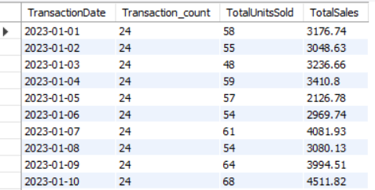
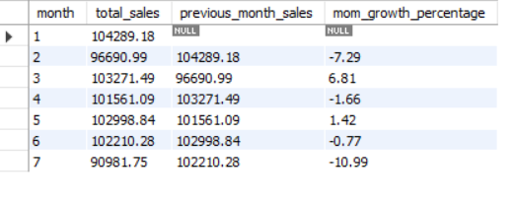
Sales Trends
- Analyzed daily and monthly sales
- Calculated growth using MoM
- Observed overall sales patterns
- Inconsistent monthly growth trend
Daily Sales
Monthly growth rate

Slide 7
Customer Analysis
- Transactions per customer
- High vs low spenders
- Purchase frequency
Insights:
130 customers made only one purchase
Only 18 customers have more than 10 transactions and spend over ₹1000, indicating a small group of high-value customers.

Slide 8
Customer Segmentation
- Low (1–10 units)
- Medium (11–30 units)
- High (>30 units)
- Distribution of customers across segments
Customer Segmentation

Slide 9
Customer Behavior
- Repeat purchase analysis
- Loyalty using purchase duration
- Low frequency customers identified

Slide 10
Key Insights
Revenue is not highly concentrated, as the top 10 products contribute only 10%, indicating a relatively distributed product performance.
A significant portion of customers (43%) fall into the low-value segment, indicating an opportunity to improve engagement and increase purchase volume.
Repeat purchases at the transaction level are limited (70 instances), though this may not fully reflect demand as customers may purchase higher quantities in single transactions.
A large number of customers make only one purchase (130), indicating low purchase frequency.
The monthly growth trend is highly volatile, with frequent shifts between positive and negative growth, suggesting inconsistency in sales performance.

Slide 11
Conclusion
The analysis highlights balanced product performance, a large base of low-value customers, and limited repeat purchasing behavior, indicating opportunities to improve customer engagement and retention.

