Slide 1


Cherry-Pick
Presented By : Sumit Singh
Emp ID : 1561

Slide 2
Cherry-Pick
What is ‘Cherry-Picking’?
Cherry picking in git means a commit from one branch and apply it into another.
This is contrast with other ways such as merge and rebase which normally applies many commits into another branch.
Make sure you are on the branch you want to apply the commit and then use below command:
git cherry-pick <commit-hash>
url: https://github.com/Sumit-Singh01771/Assignment
.

Slide 3
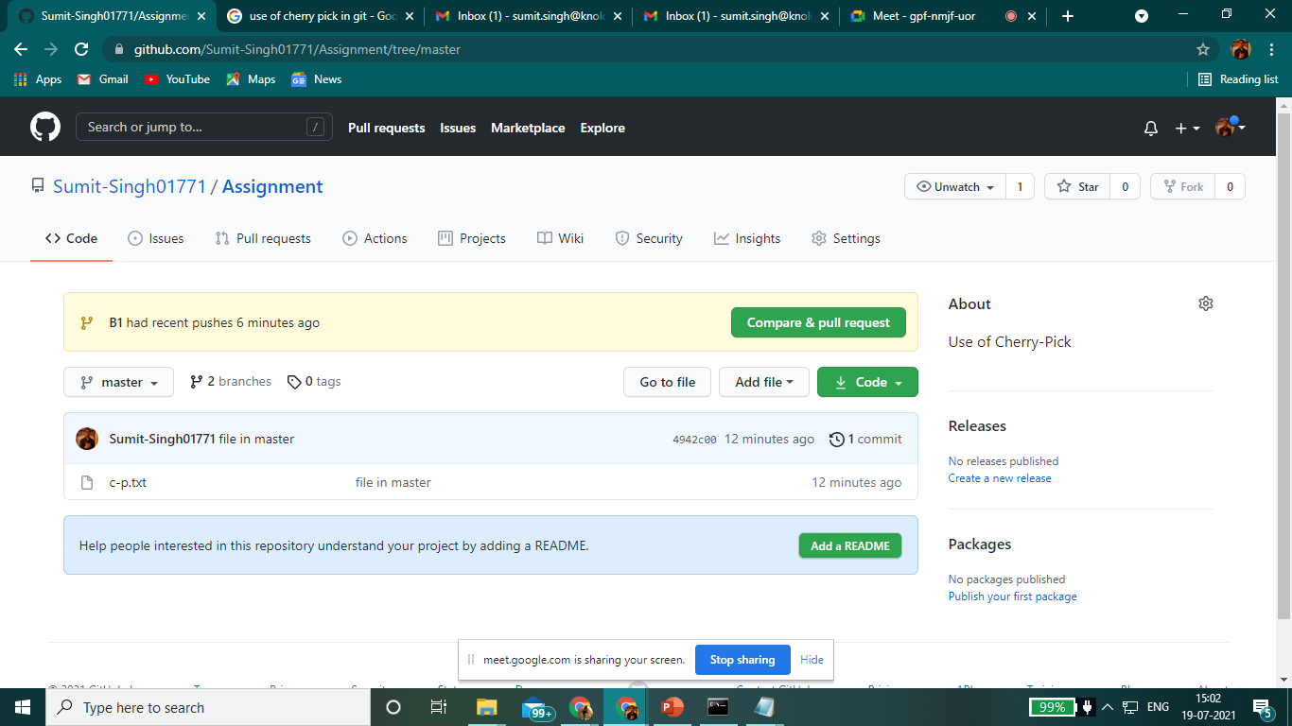
In the Master branch, we created c-p.txt file, and then commit it
Then, we created a branch named, B1 and created a.txt file in it. We also commit this too. .

Slide 4
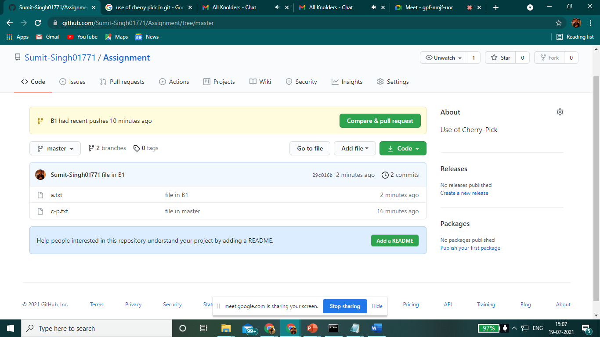
By using cherry-pick command, the commit file i.e a.txt which was in branch B1.
We merge it into the master branch..

Slide 5
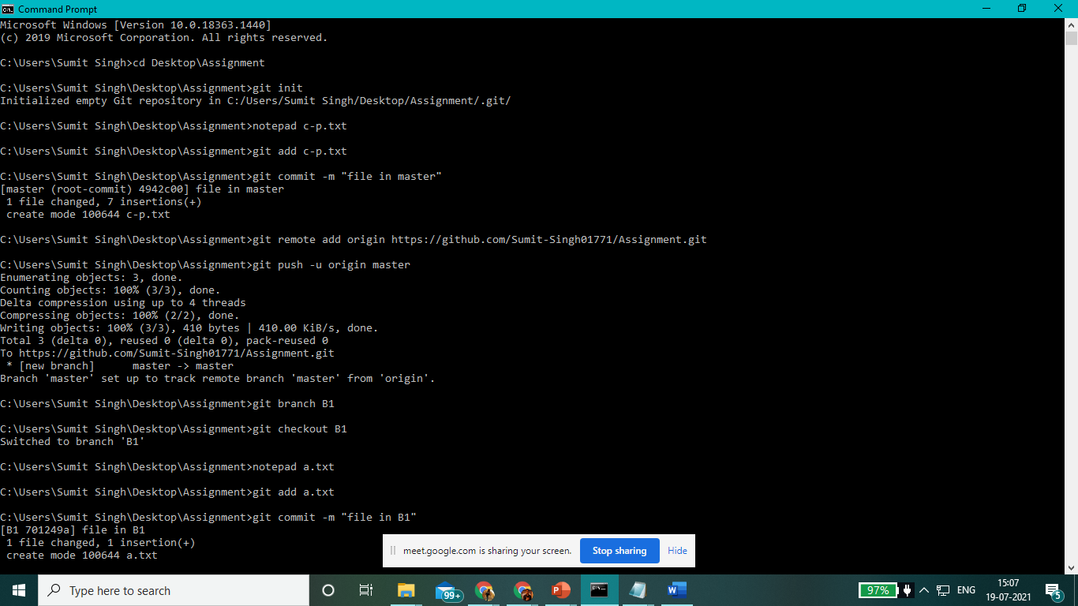

Slide 6
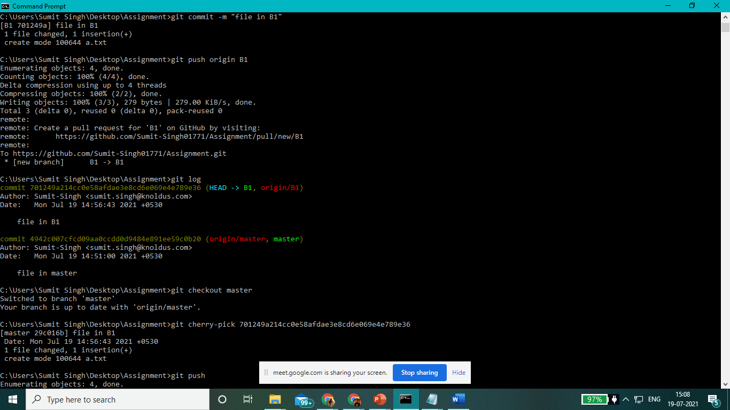

Slide 7
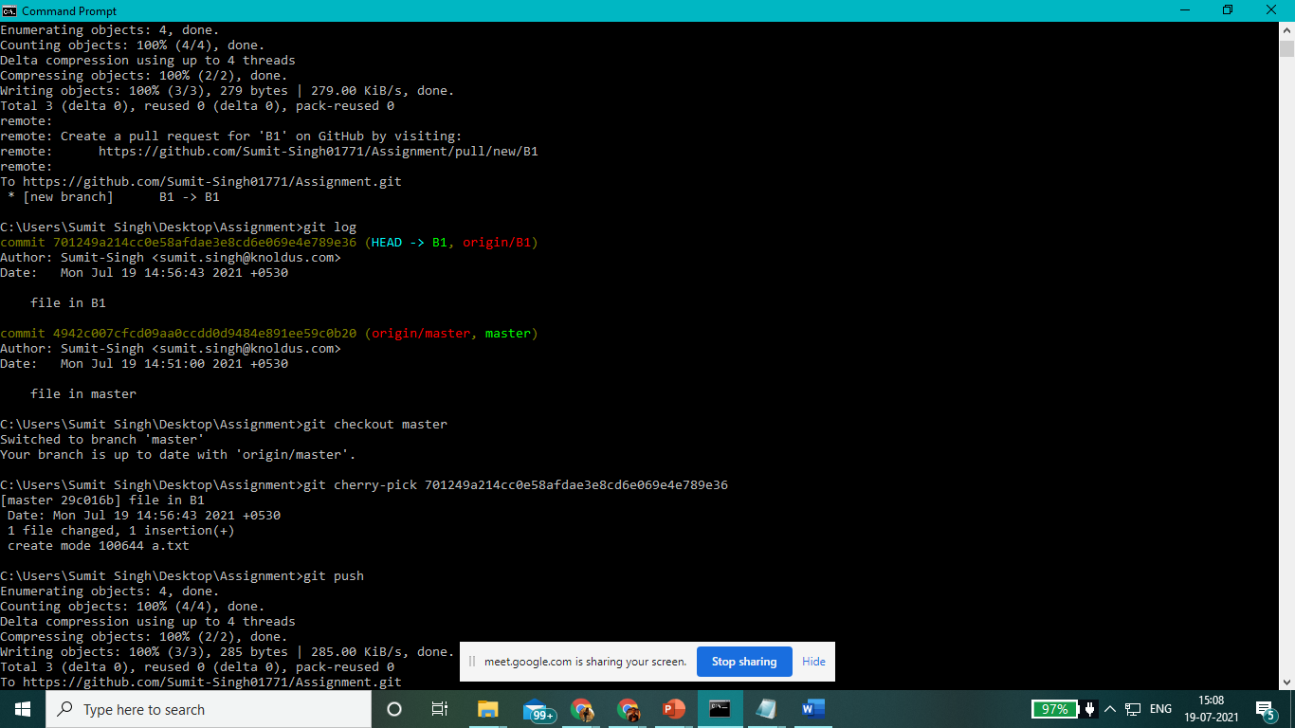

Slide 8
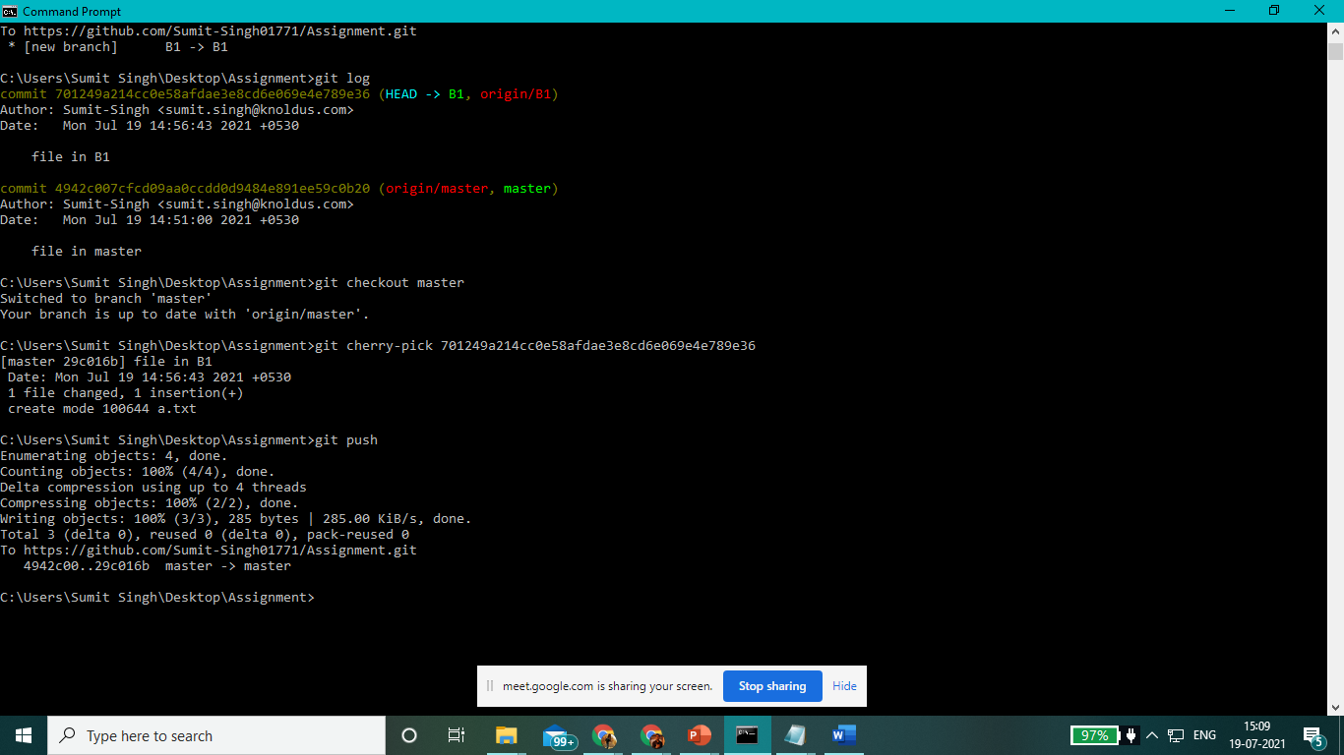

Slide 9

Thank You!

