Slide 1


Cherry-pick
Presented By : Yamika Rajput

Slide 2

Cherry-pick
www.knoldus.com
cherry-pick is a Git feature. If someone wants to Commit specific commits in one branch to a target branch, then cherry-pick is used.
git cherry-pick steps are as below.
checkout (switch to) target branch.
git cherry-pick <commit id>
Here commit id is activity id of another branch.Eg.
git cherry-pick 9772dd546a3609b06f84b680340fb84c5463264f
push to target branch

Slide 3
Cherry-pick (hands on)
www.knoldus.com
To use the cherry-pick command I have done commands for creating repositories local and remote both after that created the file c1.txt then add ,commit.
After it push to specified branch.
Now created another branch named as newbranch , switched to that and created some new files and add , commit, push.
Now I have two branches one of them is master and another is newbranch
Comes to cherry-pick and i wanted to commit the newbranch commits to target master branch and newbranch contained two files n1.txt and n2.txt
So the newbranch commits then cherry-pick added to those files or commits to the target master branch .
url - https://github.com/yamikarajput546/git-cherry-pick/tree/master

Slide 4
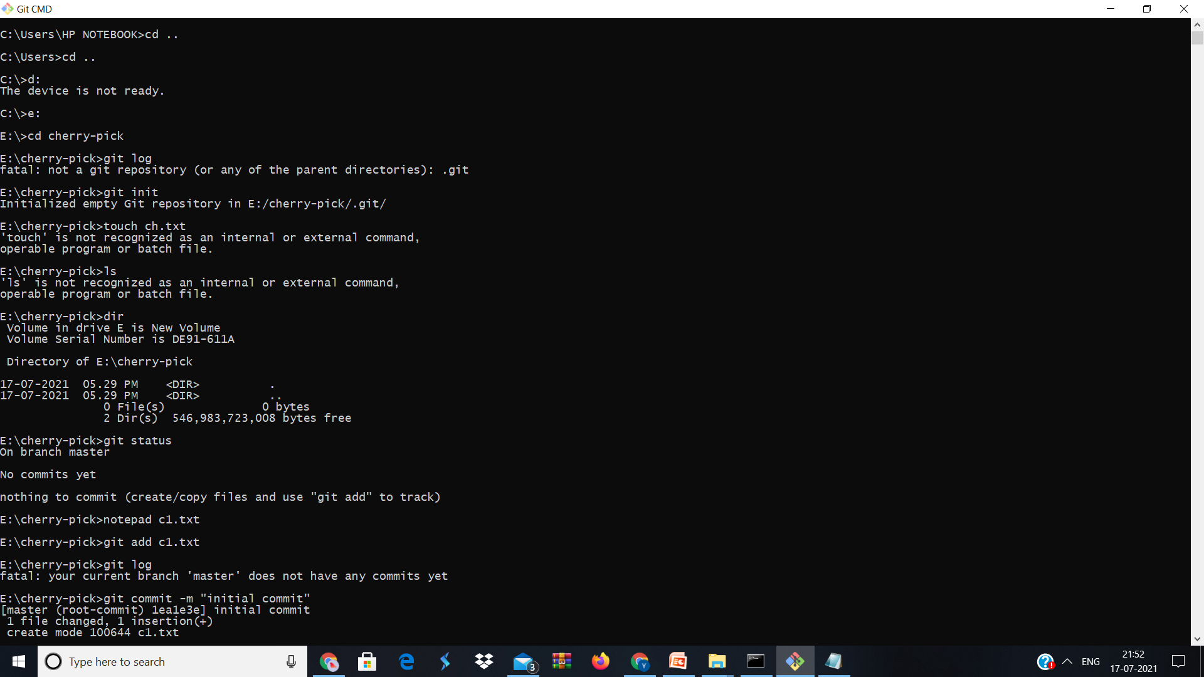
www.knoldus.com

Slide 5
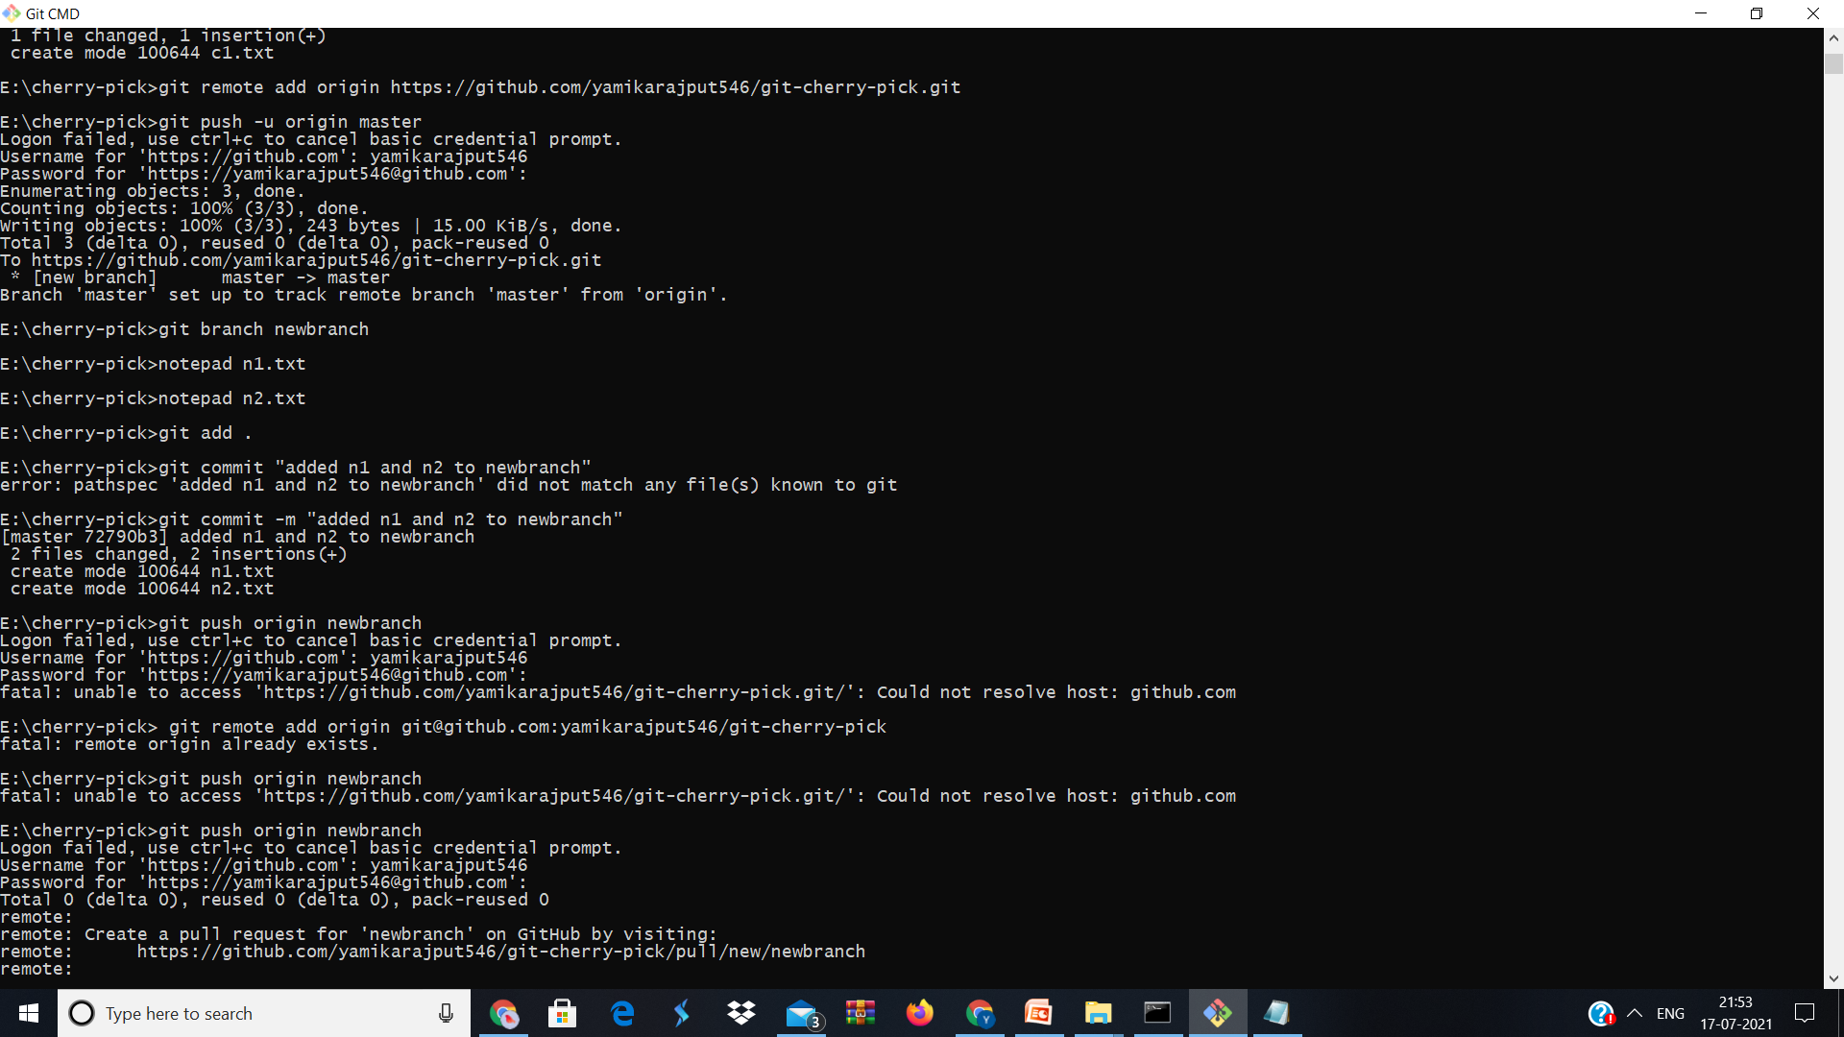
www.knoldus.com

Slide 6
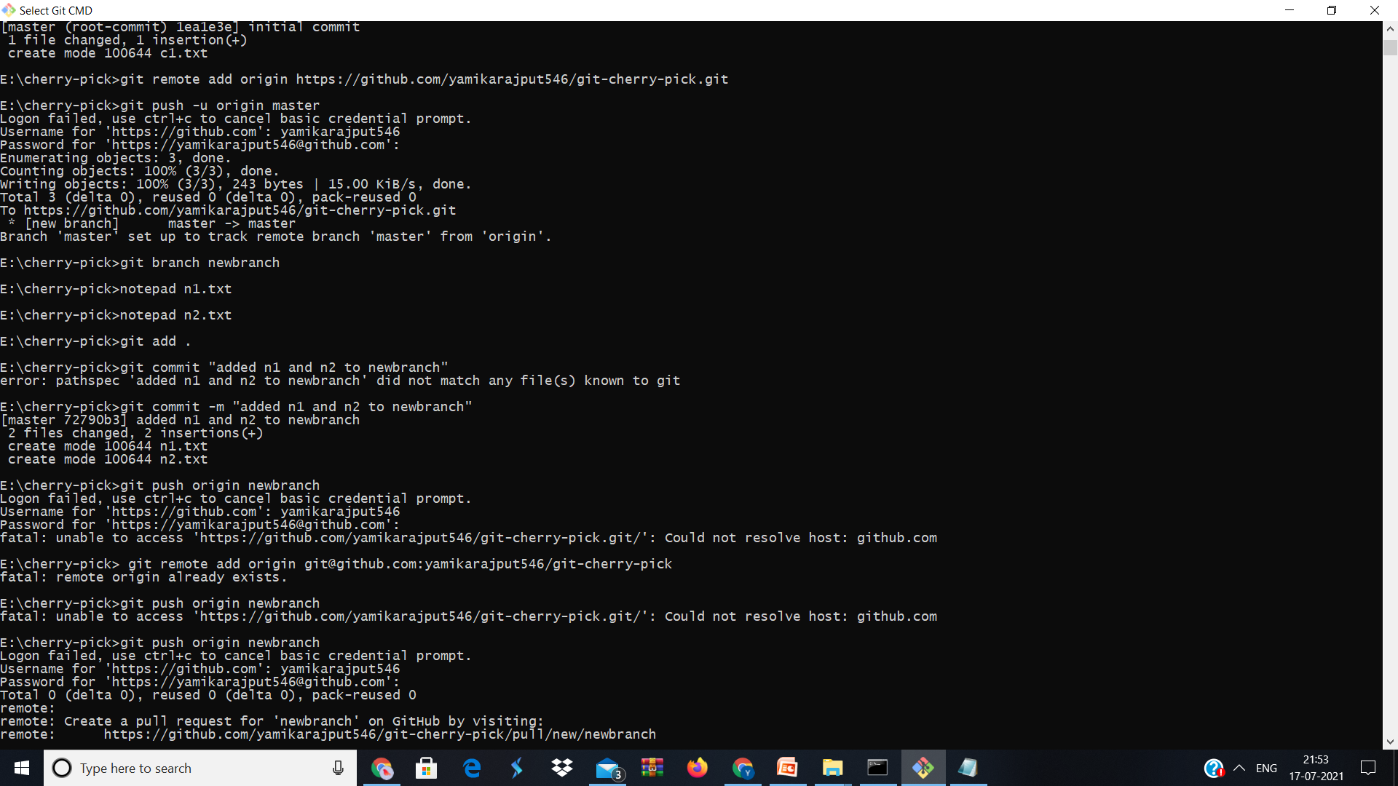
www.knoldus.com

Slide 7
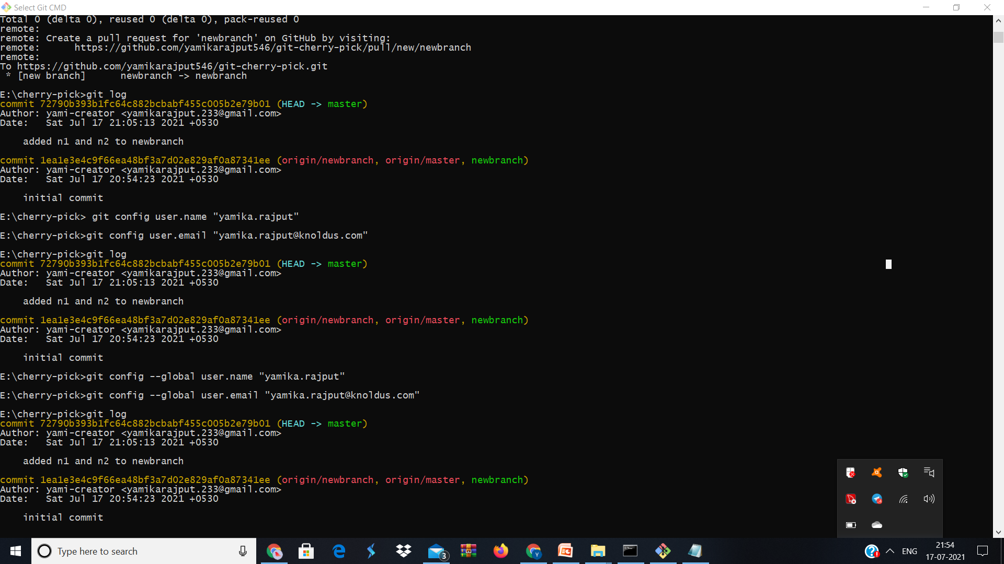

Slide 8
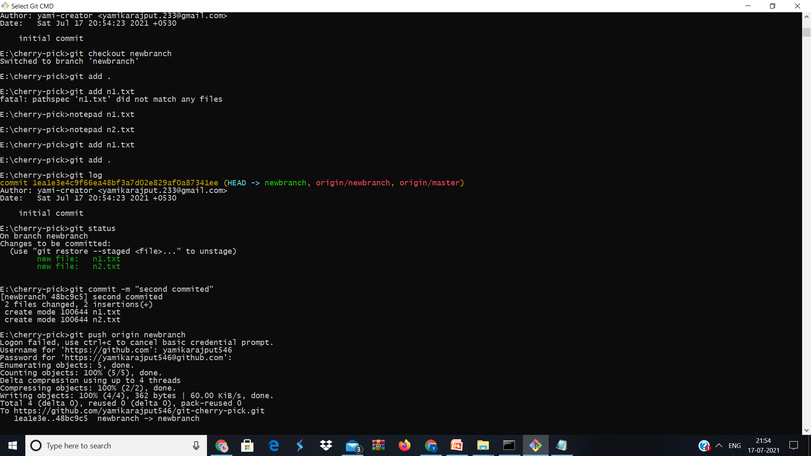

Slide 9
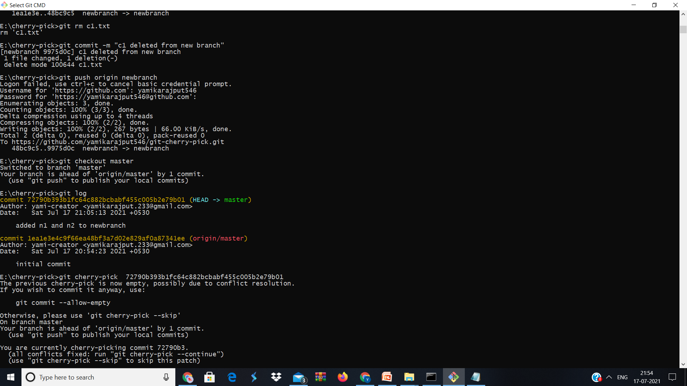

Slide 10
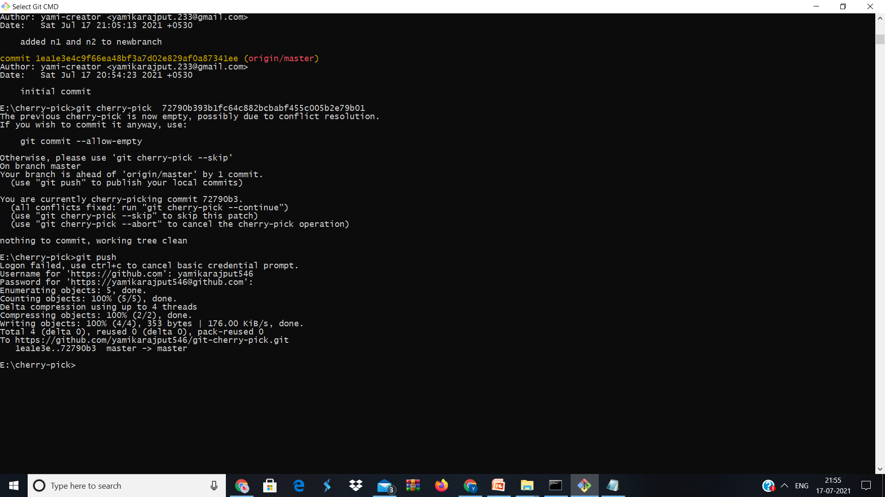

Slide 11
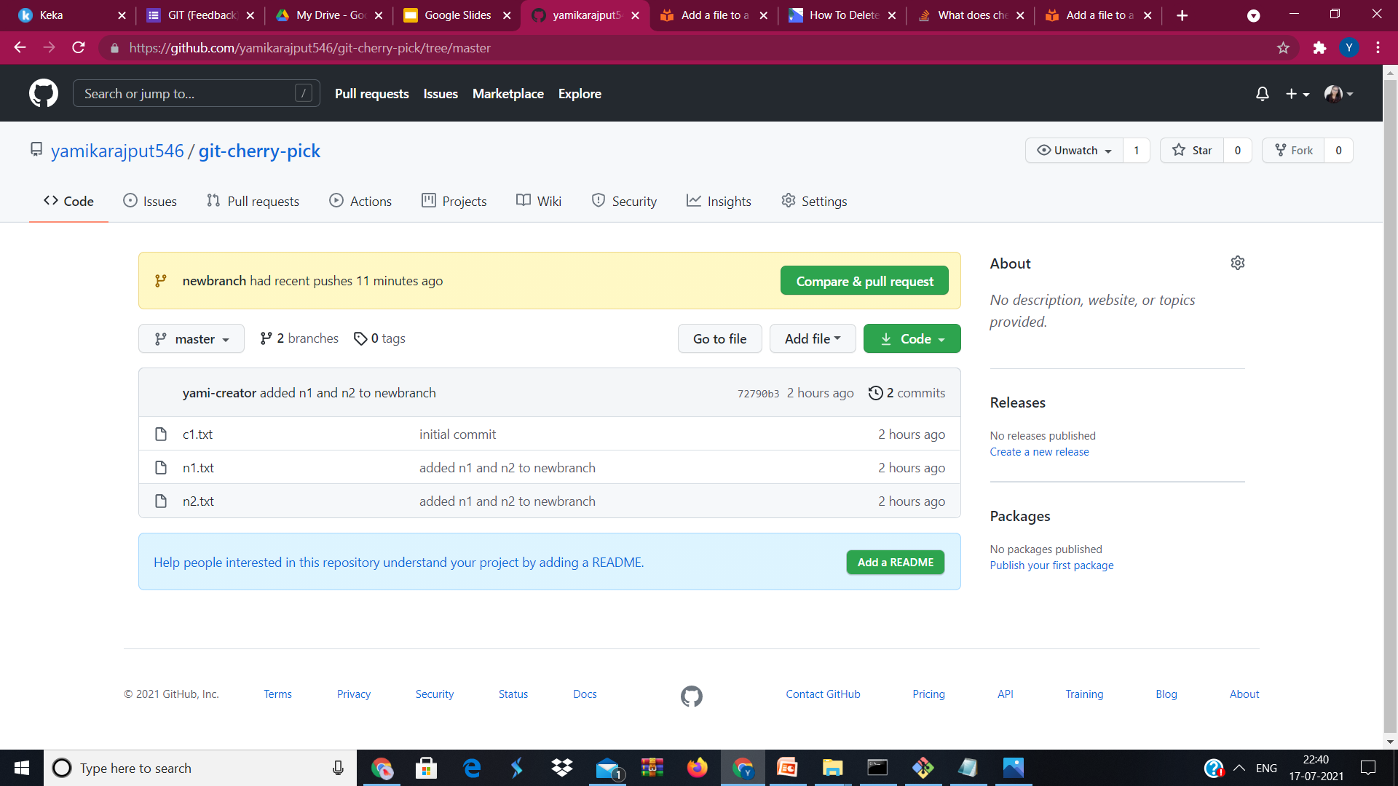

Slide 12
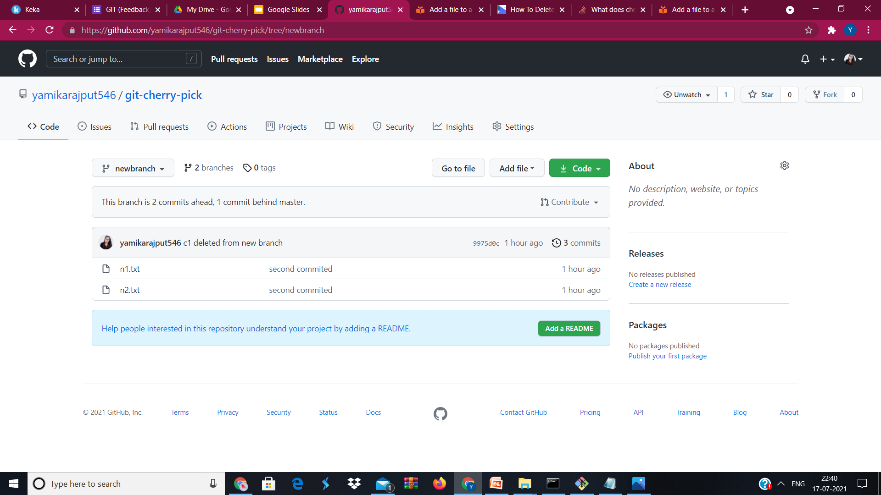

Slide 13


