Slide 1
LEAD SCORE CASE STUDY LOGISTIC REGRESSION
Presented By :
AnisH V S S V R
Riya Kunar
SUMIT SOURAV NANDA

Slide 2
PROBLEM STATEMENT
X Education is an organization which provides online courses for industry professionals. The company marks its courses on several popular websites like google.
X Education wants to select most promising leads that can be converted to paying customers.
Although the company generates a lot of leads, only a few are converted into paying customers, wherein the company wants a higher lead conversion. Leads come through numerous modes like email, advertisements on websites, google searches etc.
The company has 30% conversion rate through the whole process of turning leads into customers by approaching those leads which are to be found having interest in taking the course. The implementation process of lead generating attributes are not efficient in helping conversions.

Slide 3
BUSINESS GOAL
The company requires a model to be built for selecting the most promising leads.
Lead score is to be given to each leads such that it indicates how promising the lead could be.
The higher the lead score the more promising the lead to get converted, the lower it is the lesser the chances of conversion.
The model to be built in lead conversion rate around 80% or more.

Slide 4
STRATEGY
Import Data.
Clean and prepare the acquired data for further analysis.
Exploratory data analysis for figuring out most helpful attributes for conversion.
Scaling features.
Prepare the data for model building.
Build a logistic regression model.
Assign a lead score for each leads.
Test the model on train set.
Evaluate model by different measures and metrics.
Test the model on test set.
Measure the accuracy of the model and other metrics for evaluation.

Slide 5
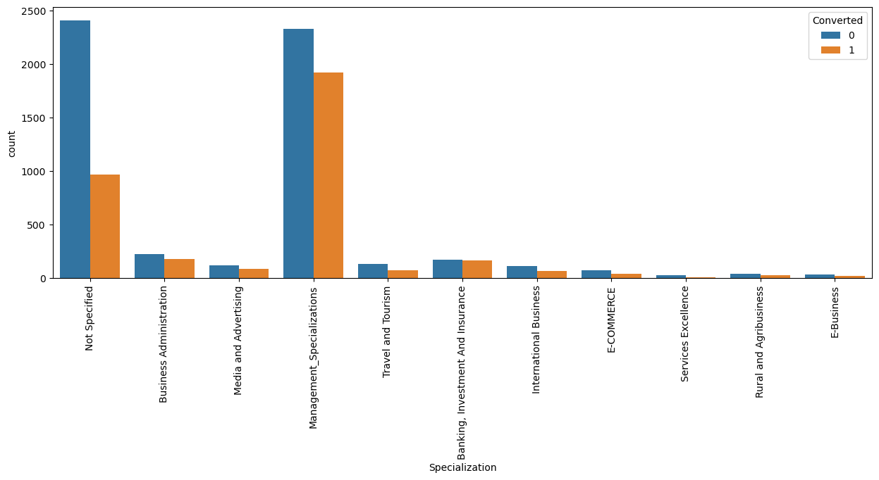
EXPLORATORY DATA ANALYSIS
SPECIALIZATION VS CONVERTED
Specialization with Management in them have higher number of leads as well as leads converted.
Specialization is a significant variable.

Slide 6
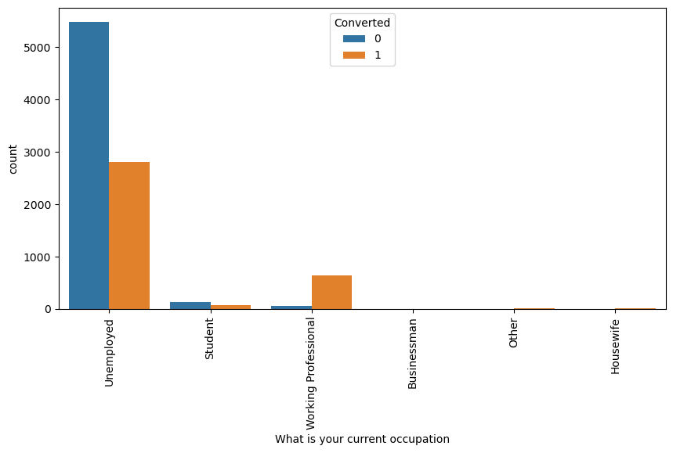
CURRENT OCCUPATION VS CONVERTED
Working Professionals going for the course have high chances of joining it.
Unemployed leads are the most in terms of Absolute numbers.

Slide 7
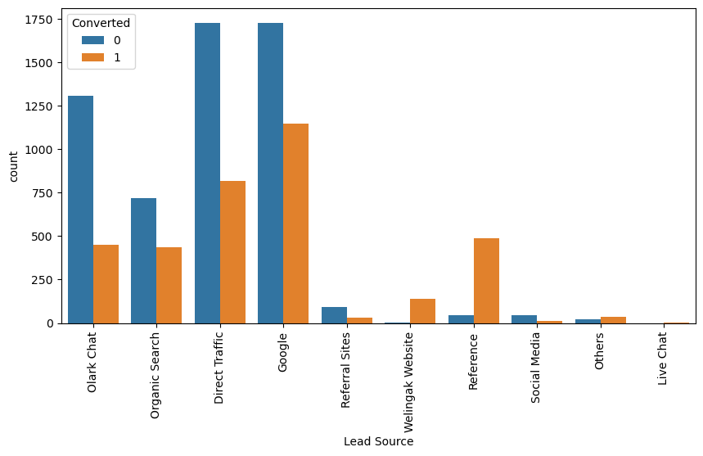
LEAD SOURCE VS CONVERTED
Maximum number of leads are generated by Google and Direct traffic.

Slide 8
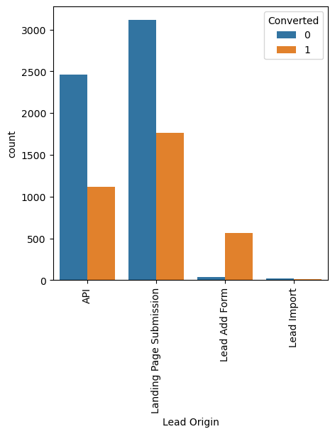
LEAD ORIGIN VS CONVERTED
API and Landing Page Submission bring higher number of leads as well as conversion.
Lead Add Form has a very high conversion rate but count of leads are not very high.
Lead Import and Quick Add Form get very few leads.

Slide 9
MODEL BUILDING
Splitting into train and test set
Scale variables in train set.
Build the first model
User RFE to eliminate less relevant variables.
Build the next model.
Eliminate variables based on high p-values.
Check VIF value for all existing columns.
Predict using train set.
Evaluate accuracy and other metric.
Predict using test set.
Precision and recall analysis on test predictions.

Slide 10
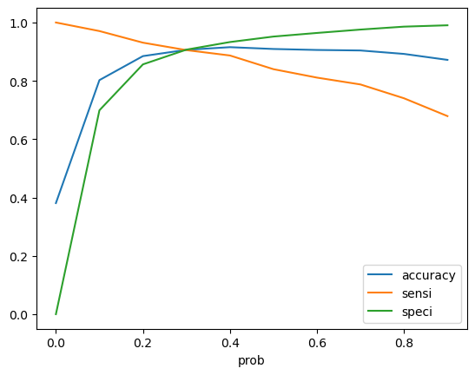
MODEL EVALUATION-TRAIN
Confusion Matrix
Accuracy : 90.63%
Sensitivity : 90.53%
Specificity : 90.69%
3519
361
226
2161
The ROC curve has a value of 0.96, which is very good

Slide 11
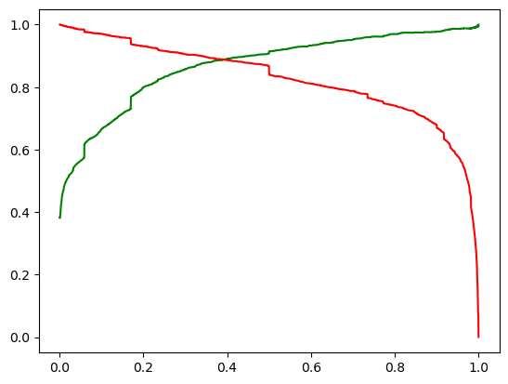
PRECISION AND RECALL
Precision: 85.68%
Recall: 90.53%

Slide 12
MODEL EVALUATION-TEST
Confusion Matrix
1512
157
104
904
Accuracy : 90.28%
Sensitivity : 89.68%
Specificity : 90.64%

Slide 13
CONCLUSION-EDA
Specialization with Management in them have higher number of leads as well as leads converted.
Working Professionals going for the course have high chances of joining it.
Unemployed leads are the most in terms of Absolute numbers.
Maximum number of leads are generated by Google and Direct traffic.
API and Landing Page Submission bring higher number of leads as well as conversion.
Lead Add Form has a very high conversion rate but count of leads are not very high.
Lead Import and Quick Add Form get very few leads.
Leads spending more time on the website are more likely to be converted.

Slide 14
CONCLUSION- LOGISTIC REGRESSION
The Model shows high accuracy close to 90%.
The threshold has been selected from Accuracy, Sensitivity, Specificity measures and precision, recall curves.
The model shows 90% sensitivity and 90% specificity.
The model finds correct promising leads and leads that have less chances of getting converted.
Hence, Overall this model proves to be accurate.

Slide 15
THANK YOU

