Slide 2
Designing of oximeter sensor head.
Hardware Design
(Oximeter sensor head, Arduino mini and ADC circuit)
Arduino circuit
IR and R signals received from Oximeter sensor head
Conversion of analog signals to discrete signals and send them to personal computer.
Discrete - time signal processing algorithm, SpO₂ and Pulse rate computations are performed on received discrete signals.
Software Design (MATLAB)
GUI shows SpO₂ and Pulse rate

Slide 3
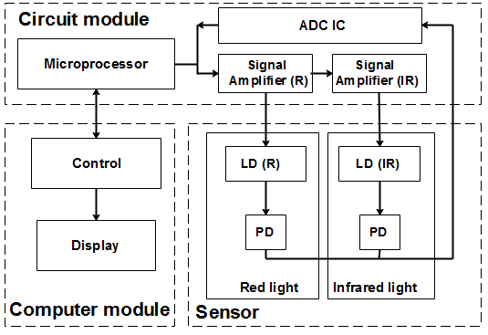

Slide 4
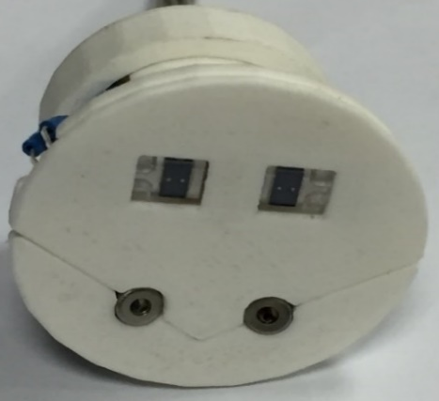
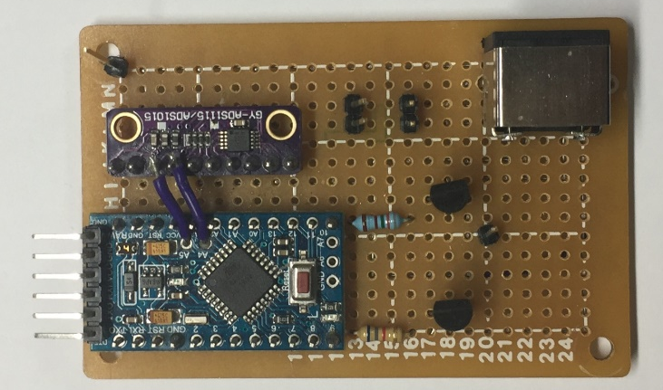
Photodiodes
IR laser
R laser
(a)
(b)

Slide 5
Start
Input data from sensor.
Signal detection and collection.
Save the data in .text file
Low pass filter is applied on IRRAW and RRAW
Discrete-time signal processing.
Patented Signal Processing method
Pulse rate calculation
SpO₂ (Oxygen concentration in blood) calculation
GUI
Stop

Slide 6
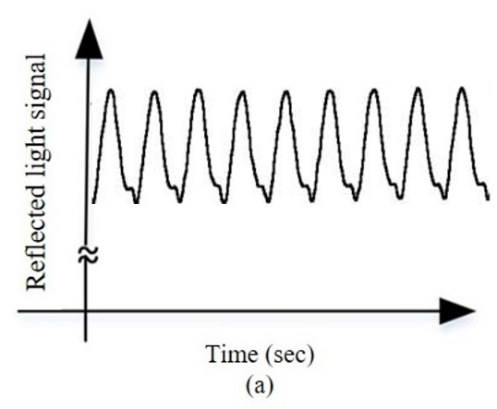
(b)
(c)
(d)

Slide 7
(a)
(b)

Slide 10
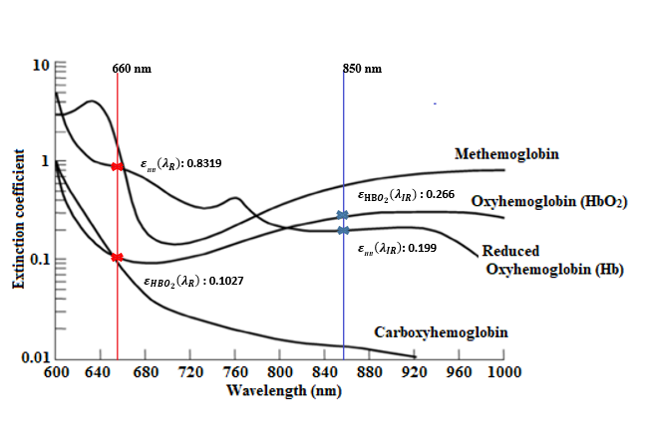

Slide 11
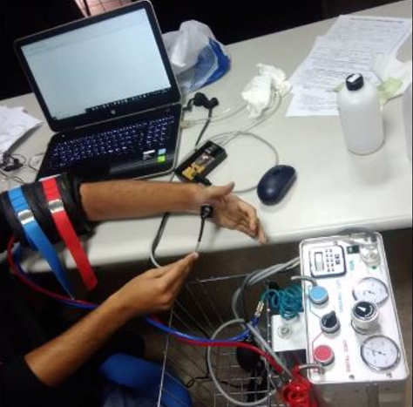

Slide 12
(a)
(b)

Slide 13
(a)
(b)
(c)
(d)
(e)
(f)

