Slide 1
Negative Capacitance
Sumit Pandey
Master of Science CGU

Slide 2
Outline of the presentation
Motivation
History
Negative capacitance
FE-FET
Applications
Remedy for Subthreshold swing 'S'
References

Slide 3
Why low power?
Approx. 1/3 of green house effect is caused by electronics.
1/3 of green house effect is caused by transportation.
Remaining is from other sources.
Because of continuously increasing performance demand of electronics high power dissipation takes place. This leads:
High effort for cooling.
Increasing operating cost.
Reduced reliability & mobility.
Higher weight (Batteries) etc.
Motivation

Slide 4
Salahuddin & Datta proposed that “the switching energy of a device can be reduced by replacing traditional insulating material with Ferroelectric materials”.
This was the first direct observation of a long-hypothesized but elusive phenomenon called “Negative Capacitance.”
Capacitance is the ability of a material to store an electrical charge. Ordinary capacitors—found in virtually all electronic devices—store charge as a voltage is applied to them.
Q=CV
Q α V
History:

Slide 5
Negative Capacitance
Negative Capacitance???
" The applied voltage is increased; the charge goes down. Hence its name, negative capacitance." (vice-Versa).
Some groups proposed that use of negative capacitance gate in FET will reduce Subthreshold Swing (S). Which in turn defines the lower limit of power dissipation.

Slide 6

Subthreshold Swing change in gate voltage (VG) required to change the drain current (IDS) by one order of magnitude.
Lowering S would results in
reduce the power supply voltage
energy dissipation
improve static noise margin
minimum energy point voltage for ultralow power circuits
Subthreshold Swing

Slide 7
NC-FET (Why ???)
Two different approaches to reduce S:
modifying the current transport in the channel (e.g., tunnel-FETs and impact ionization FETs)
gate-to-channel coupling with negative capacitance (NC) gate insulators. (i.e. NC-FET)
Also it is well known that the subthreshold swing (S) associated with FETs cannot be reduced below the Boltzmann limit of 60 mV/decade(SB Z ), which in turn defines the lower limit of power dissipation.
Then question (?) arises that…
Whether there is lower limit of “S”?
If it is so then what is the remedy?
The solution for above problem is NC-FET

Slide 8
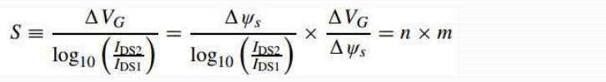
NC-FET
When an FET is operated between gate voltage VG1 < VG <VG2, writing subthreshold swing (S) as
ΔΨ :change in surface potential
S is the product of two factors
Transport factor (n)
body factor (m)
Tunnel-FETs and impact ionization FETs operate by modifying transport factor (n).
NC-FETs address the second factor m

Slide 9
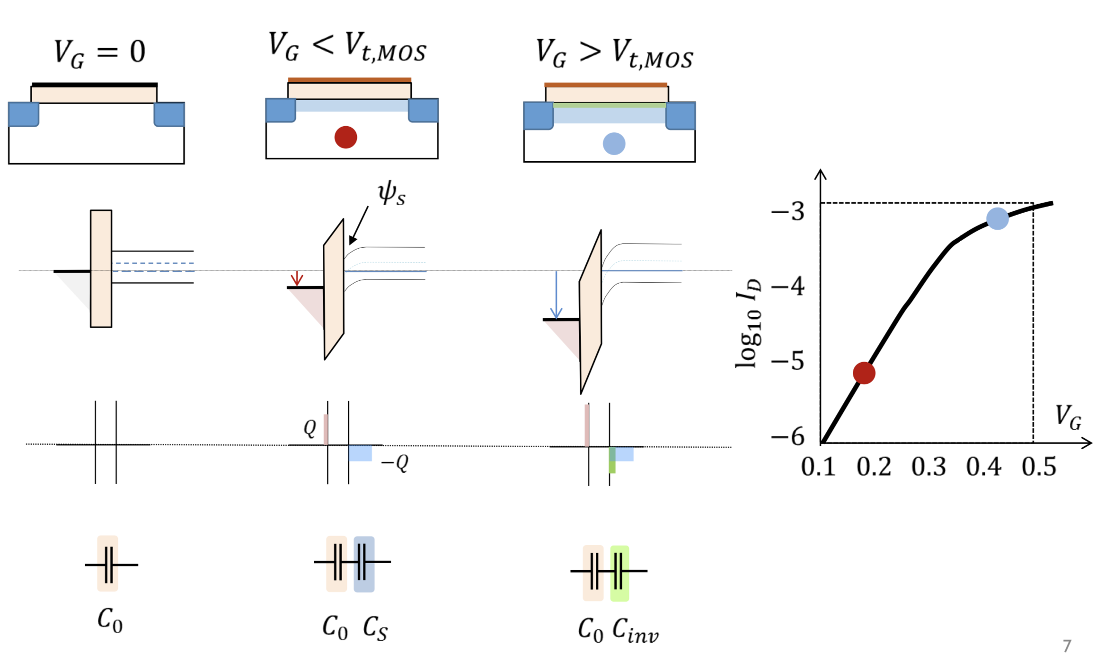
Classical MOSFET: Band diagram

Slide 10
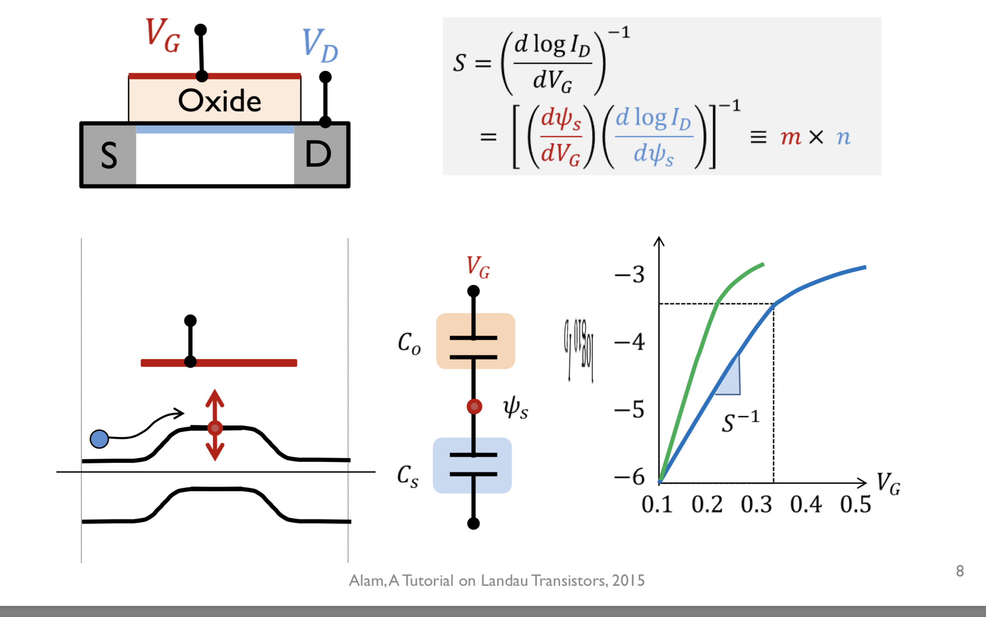
Capacitors control MOSFET Operation

Slide 11
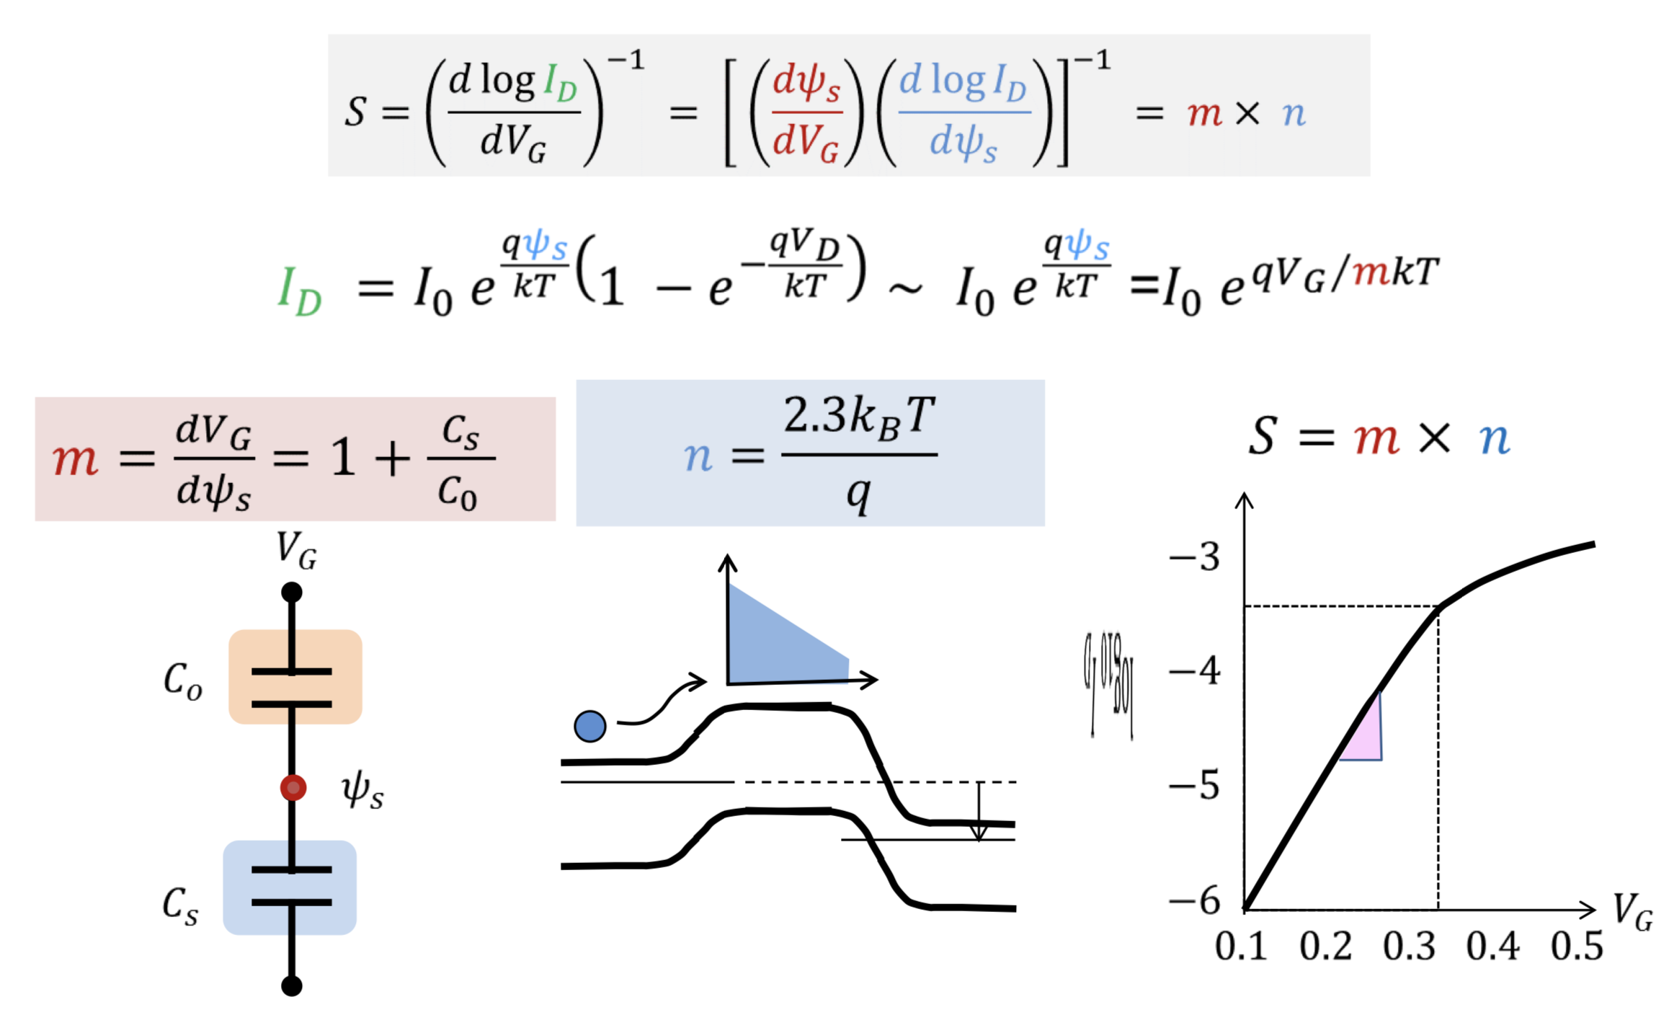
S for classical transistors

Slide 12
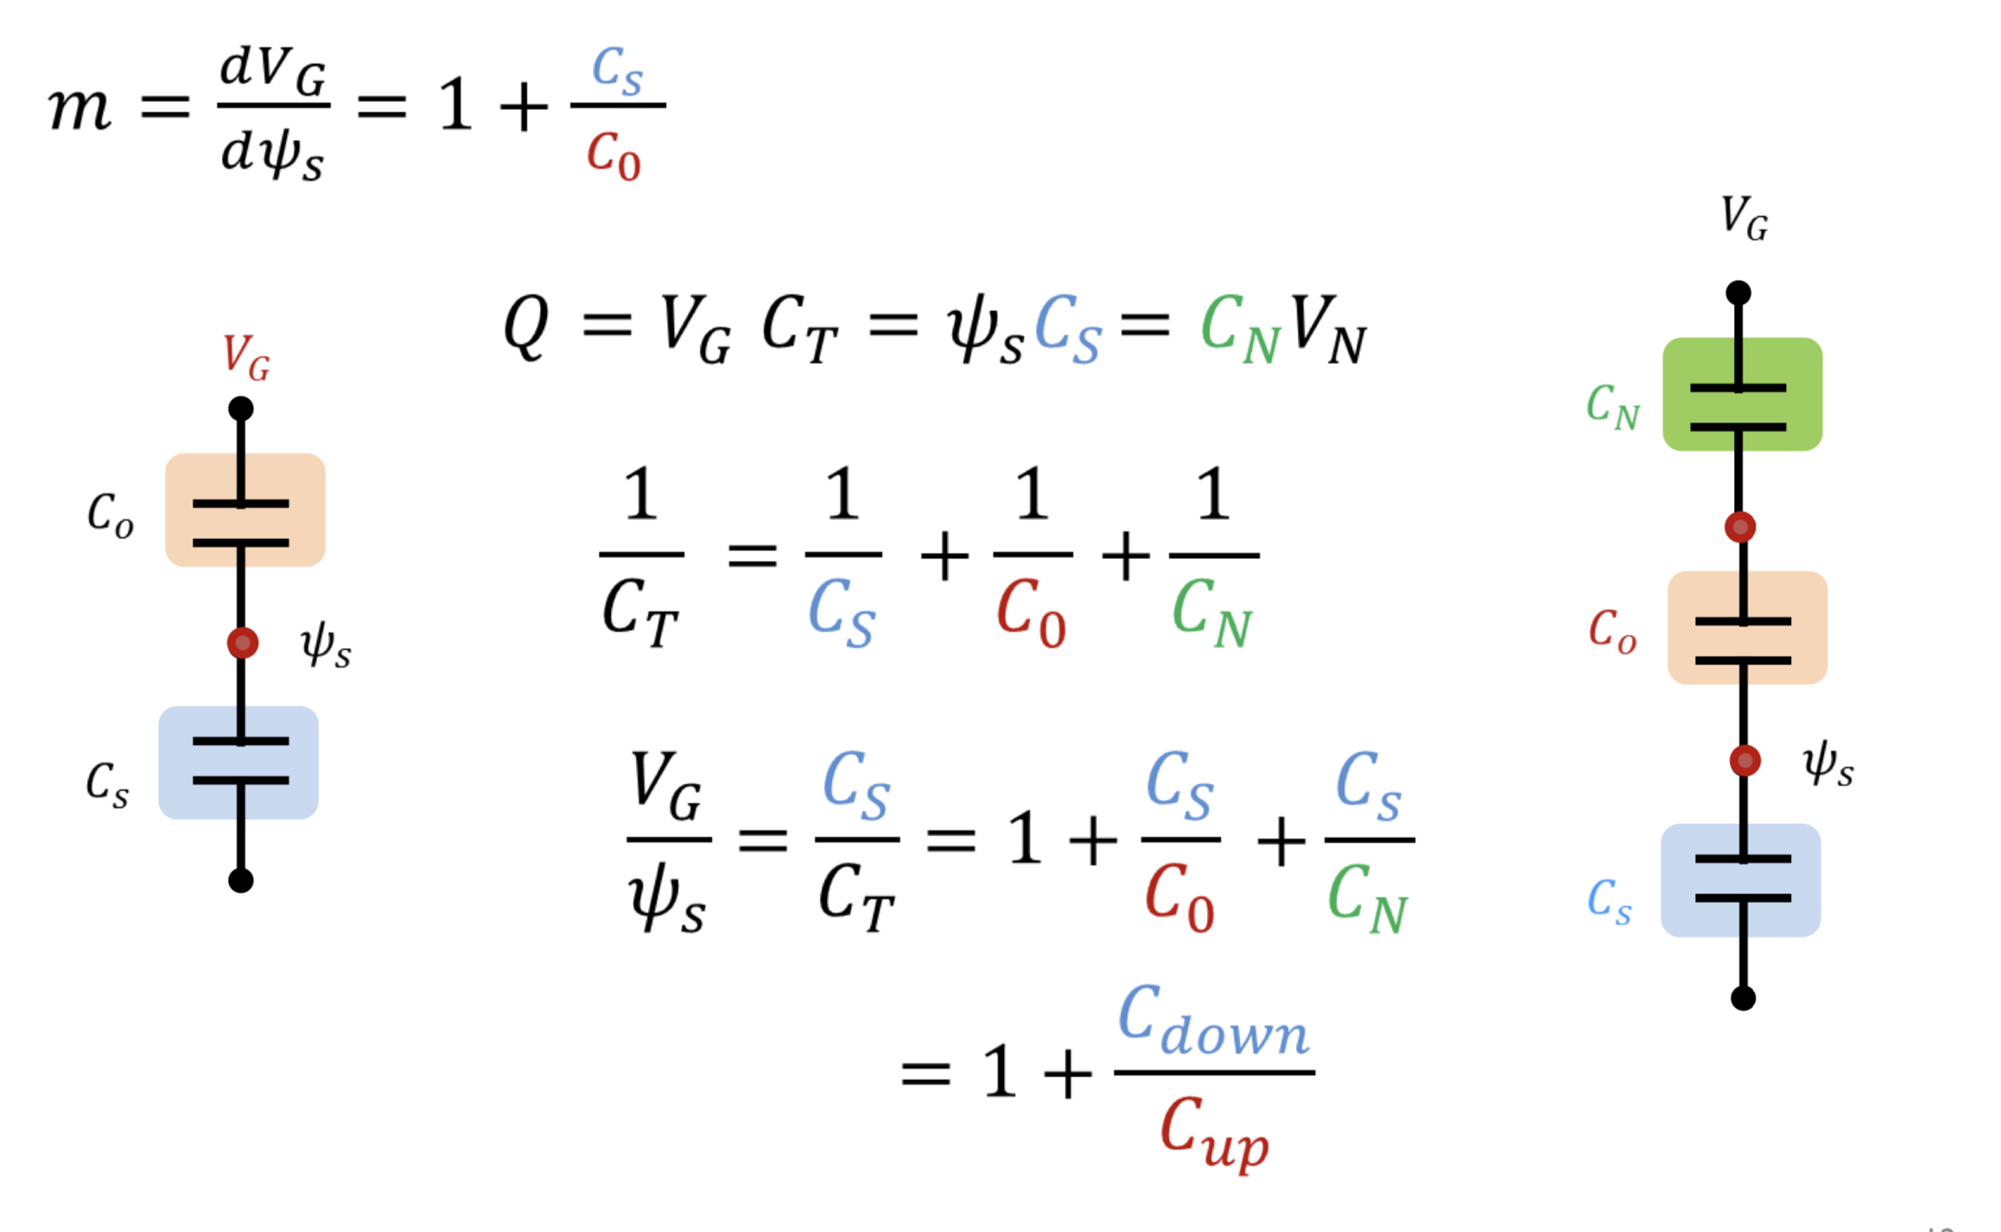
body factor (m)

Slide 13
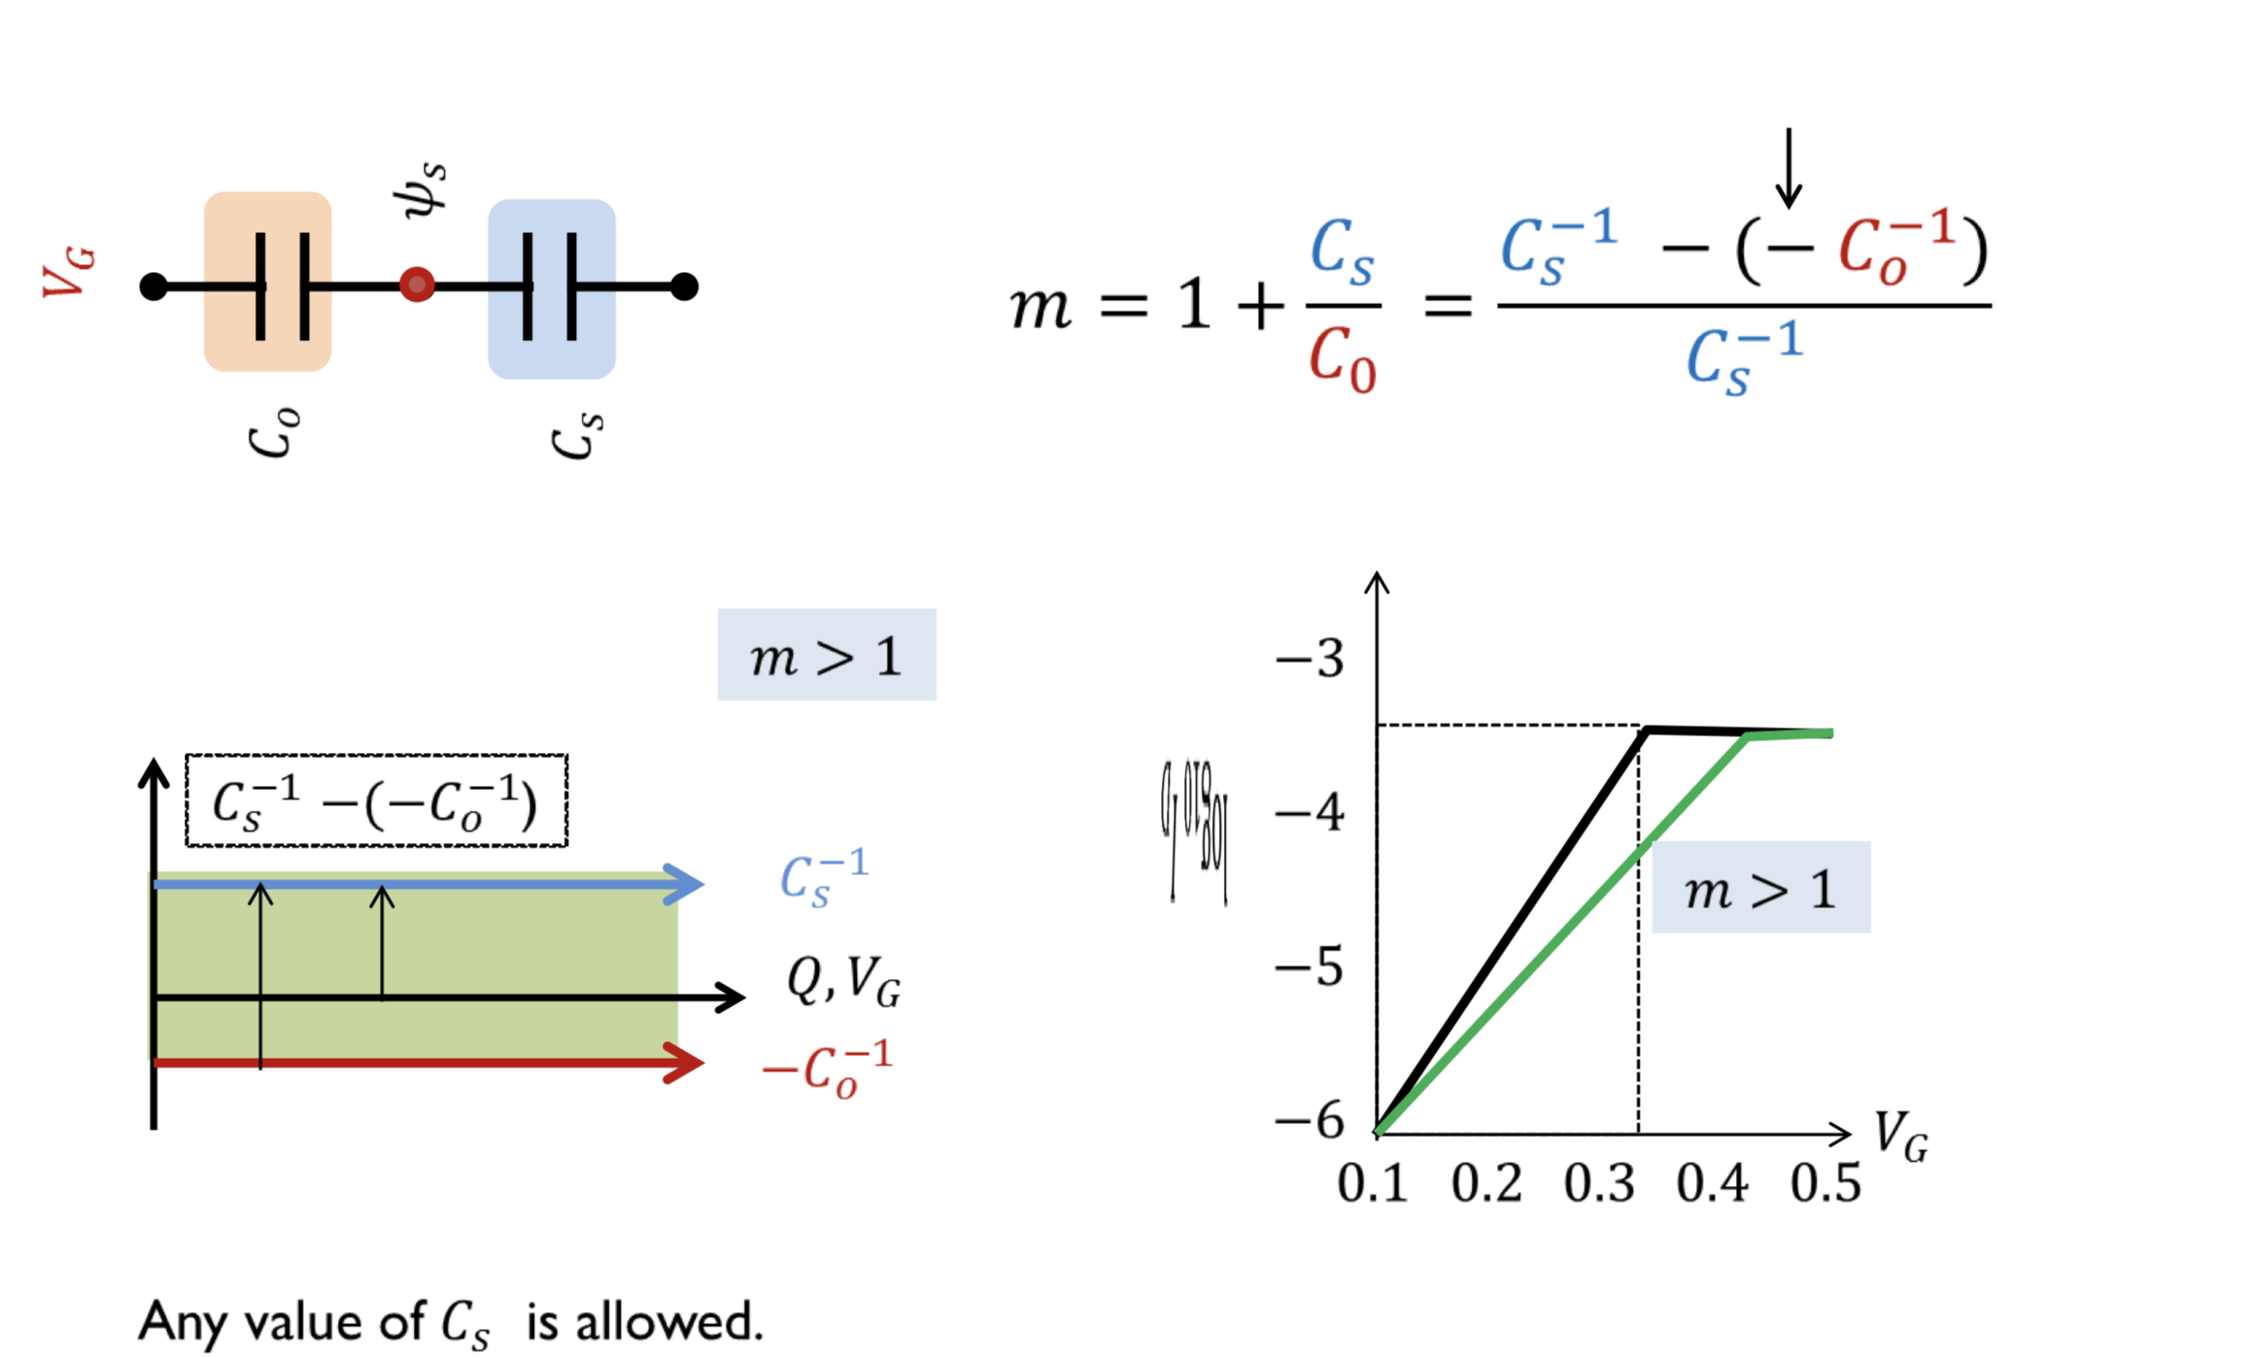
Graphical approach to S: Classical FET

Slide 14
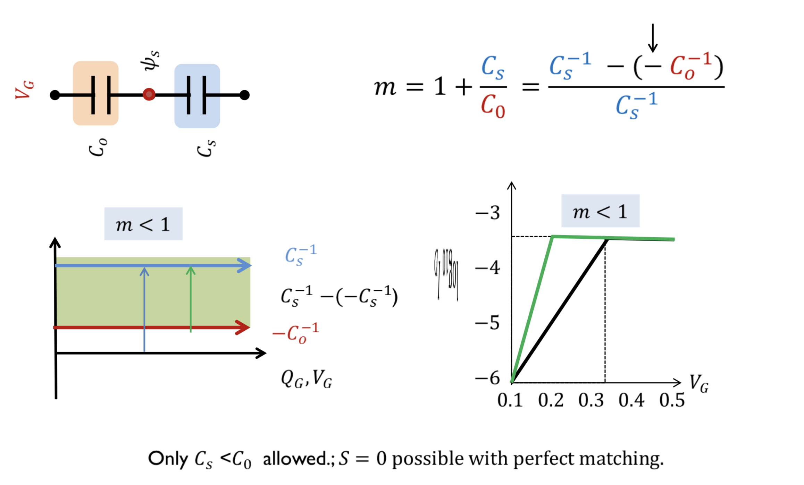
Graphical approach to S: NC-FET

Slide 15
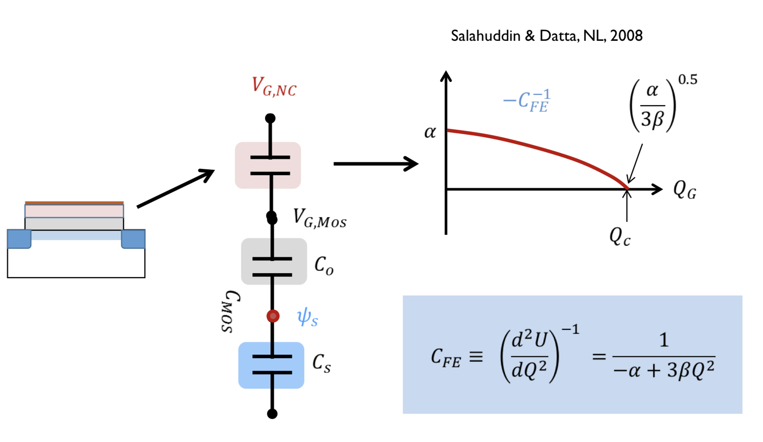
FE: voltage dependent NC

Slide 16
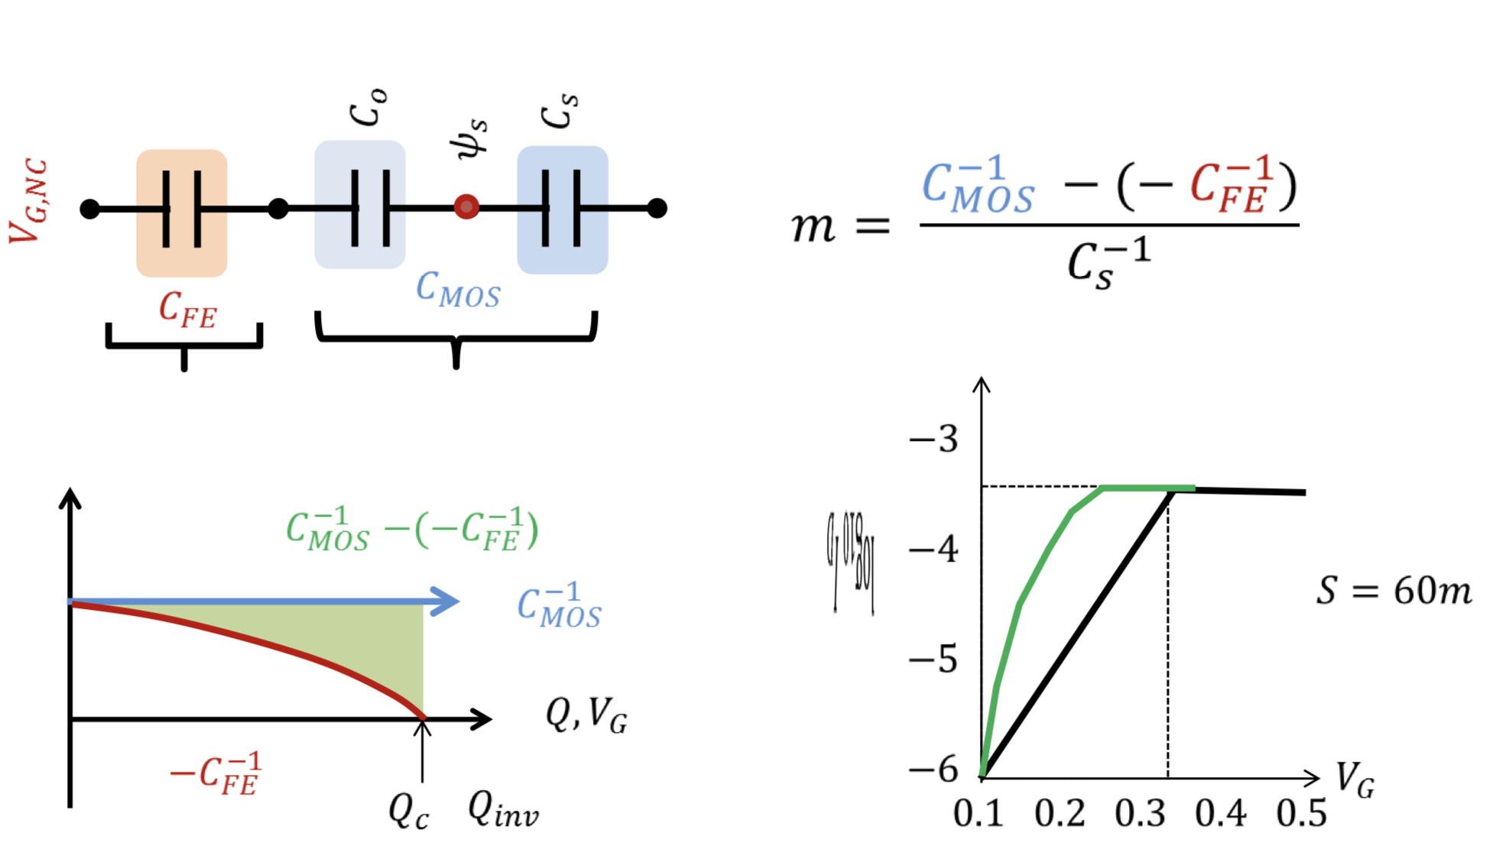
FE-FET improves 0<S<60

Slide 17
High Density Storage Devices
Super capacitors
Harvesting energy from environment
Applications

Slide 18
References
FE-FET: Use of negative capacitance to provide voltage amplification for low power nanoscale devices, S
Salahuddin, S Datta, Nano letters 8 (2), 405-410, 2008
FE-FE T: Ferroelectric negative capacitance MOSFE T: Capacitance tuning & antiferroelectric operation, AI Khan, CW Yeung, C Hu, S Salahuddin, Electron Devices Meeting (IEDM), 2011 IEEE International, 11.3. 1- 11.3. 4, 2011
FE-FE T: Experimental evidence of ferroelectric negative capacitance in nanoscale heterostructures, AI Khan, D Bhowmik, P Yu, SJ Kim, X Pan, R Ramesh, S Salahuddin, Applied Physics Letters 99 (11), 113501, 2011. Negative capacitance in a ferroelectric capacitor, A. I. Khan, K. Chatterjee,B. Wang,S. Drapcho,L. You, Claudy Serrao, S. R. Bakaul, R. Ramesh and S. Salahuddin, Nature Materials 14, 182–186 (2015)
NEFFE T: Three- Terminal Nanoelectromechanical Field Effect Transistor with Abrupt Subthreshold Slope, Ji- Hun Kim†, Zack C. Y. Chen†, Soonshin Kwon‡, and Jie Xiang, Nano Lett., 2014, 14 (3), pp 1687–1691, 2014
FE-FE T, NEMFE T: Prospects of hysteresis-free abrupt switching (0 m V/decade) in Landau switches, A Jain, M Alam, Electron Devices, IEEE Transactions on 60 (12), 4269-4276, 2013.
NEMFET, FEFET: Stability Constraints Define the Minimum Subthreshold Swing of a Negative Capacitance Field-Effect Transistor, A Jain, MA Alam, IEEE Transactions on Electron Devices 61 (7), 2235 – 2242, 2014
Piezo-FE T: A Nanoscale Piezoelectric Transformer for Low- Voltage Transistors, Sapan Agarwal* and Eli Yablonovitch, Nano Lett., 2014, 14 (11), pp 6263–6268 , DOI: 10.1021/nl502578q, 2014
HfO2-FE: T. S. Böscke , J. Müller , D. Bräuhaus , U. Schröder and U. Böttger "Ferroelectricity in Hafnium Oxide: CMOS compatible ferroelectric field effect transistors", IEDM Tech. Dig., pp.547 -550 2011

Slide 19
Thank You

