Slide 1
Credit Card Fraud Detection System
Name: Sumit Kumar

Slide 2
Agenda
Objective & Project Scope
Key Insights (Feature Importance)
Background
Cost-Benefit Analysis (CBA) – The Financial Switch
Strategic Business Impact
Appendix: Data Attributes
Data Methodology

Slide 3
Objective & Project Scope
To evaluate the financial impact of deploying a credit card fraud detection model.
The model aims to reduce losses from fraudulent transactions while minimizing operational costs.

Slide 4
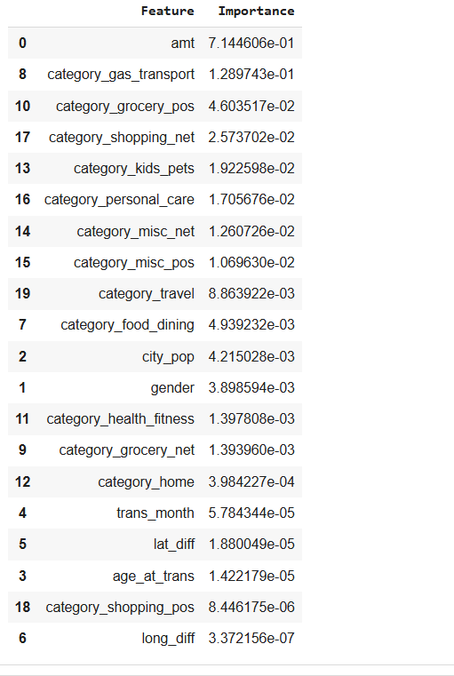
Key Insights (Feature Importance)
Feature | Importance | Insight
amt | 7.14e-01 (≈71% influence) | The Transaction Amount is the single most critical factor in fraud prediction.
category_gas_transport | 1.29e-01 | Gas and transportation is the second most highly correlated category with fraudulent activity.
category_grocery_pos | 4.60e-02 | Fraud is strongly correlated with Point-of-Sale (POS) grocery transactions.

Slide 5
Background
Before deployment, the bank reimbursed customers for every fraudulent transaction, resulting in substantial financial losses.
After model deployment, transactions predicted as fraudulent undergo a second authentication via SMS and customer support, costing $1.5 per flagged transaction.

Slide 6
Cost Benefit Analysis
S. No | Questions | Answer
1 | Cost incurred per month before the model was deployed (b*c) | $213,392
2 | Average number of transactions per month detected as fraudulent by the model (TF) | 402.12
3 | Cost of providing customer executive support per fraudulent transaction detected by the model | $1.5
4 | Total cost of providing customer support per month for fraudulent transactions detected by the model (TF*$1.5) | $603.18
5 | Average number of transactions per month that are fraudulent but not detected by the model (FN) | 99.58
6 | Cost incurred due to fraudulent transactions left undetected by the model (FN*c) | $52,843.12
7 | Cost incurred per month after the model is built and deployed (4+6) | $53,446.30
8 | Final savings = Cost incurred before - Cost incurred after (1-7) | $159,945.70

Slide 7

Business Impact
• Monthly losses reduced by approximately $159,946 (~75% reduction).
• Verification cost remains minimal at $1.5 per flagged transaction.
• Model improves fraud detection accuracy while maintaining efficiency.
• Enhanced customer satisfaction through proactive fraud alerts.
• Strengthened financial security and brand trust for the bank.

Slide 8
Data Attributes
index | Unique Identifier for each row
trans_date_trans_time | Transaction DateTime
cc_num | Credit Card Number of Customer
merchant | Merchant Name
category | Category of Merchant
amt | Amount of Transaction
first | First Name of Credit Card Holder
last | Last Name of Credit Card Holder
gender | Gender of Credit Card Holder
street | Street Address of Credit Card Holder
city | City of Credit Card Holder
state | State of Credit Card Holder
zip | Zip of Credit Card Holder
lat | Latitude Location of Credit Card Holder
long | Longitude Location of Credit Card Holder
city_pop | Credit Card Holder's City Population
job | Job of Credit Card Holder
dob | Date of Birth of Credit Card Holder
trans_num | Transaction Number
unix_time | UNIX Time of transaction
merch_lat | Latitude Location of Merchant
merch_long | Longitude Location of Merchant
is_fraud | Fraud Flag <-- Target Class

Slide 9
Appendix: Data Methodology
The model was built using a Random Forest Classifier on a Kaggle simulated dataset.
Key Techniques Used
Class Imbalance Adjustment: The significant class imbalance (many non-fraudulent vs. few fraudulent cases) was corrected using the Adaptive Synthetic (ADASYN) sampling method. ADASYN is effective because it creates synthetic minority samples near the decision boundary, focusing the model on the "harder-to-learn" examples.
Hyperparameter Tuning: Due to extensive computational times (which ruled out the use of Grid Search Cross-Validation), manual hyperparameter tuning was performed to optimize the model's performance in a time-efficient manner.

Slide 10
Presented By:
Sumit Kumar

