Slide 1
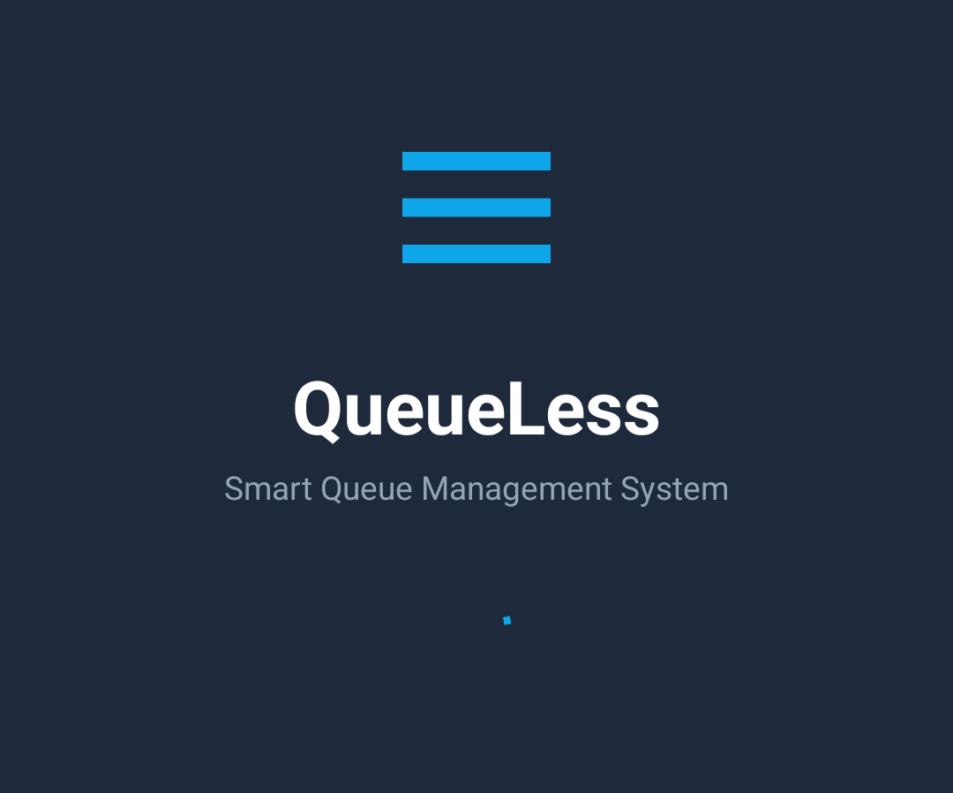
QueueLess
Smart Queue Management System for Android
Emergency TKN-101-001
Senior Citizen TKN-101-002
General TKN-101-003
SUBJECT
Mobile Application Development (MAD)
SUBMITTED BY
Amey (T052) and Sumit (T053)
SUBMITTED TO
Dr. Preetjot Kaur

Slide 2
Introduction and Objectives
The problem
Long physical queues in hospitals, banks, colleges and offices waste time, and urgent cases get no priority.
Our objectives
Replace paper tokens with digital tokens
Serve urgent cases first, fairly
Show live queue position and wait time
Give admins one place to run the queue
30
16
Java classes
Screens
4
4
SQLite tables
Priority levels

Slide 3






Key Features
Secure Login and Roles
Digital Tokens
Smart Priority
USER and ADMIN accounts with salted PBKDF2 password hashing
Pick a service and get a numbered token like TKN-101-001
Emergency, Senior, Appointment and General, with aging
ETA
QR Code Tokens
Admin Control
See your place in the queue and the estimated wait
Show a QR code; staff scan it to open the token
Call next, complete, skip or cancel; manage services

Slide 4
Technologies Used
Component | Used for
Java 11, Android SDK 34 (min 24) | Core language and platform
AppCompat, ConstraintLayout | Activities and responsive screen layouts
Material Components | Cards, text inputs, bottom navigation, switch
RecyclerView, CardView | Scrolling lists of services, tokens, history
SQLite (SQLiteOpenHelper) | Local database queueless.db
SharedPreferences | Login session, role, notification setting
Google Maps, Location | Service-centre map and distance
ZXing (core, embedded) | Generate and scan QR codes

Slide 5
Layered Architecture
Presentation
Activities, Fragments, Adapters, XML layouts
Business Logic
QueueScheduler, AssetReader, PreferenceUtils, QrCodeUtils, NotificationHelper
Data
DatabaseHelper (SQLite), LocalAuthManager, Model classes
MVC mapping: Model = models package | View = XML layouts | Controller = Activities and Fragments

Slide 6
App Navigation Flow
Start
Splash
Login / Register
MainActivity
Home | Queue | Map | Profile
User flow
Service Selection
Generate Token
Token Detail + QR
Admin flow
Manage Services
Admin Dashboard
QR Scanner

Slide 7
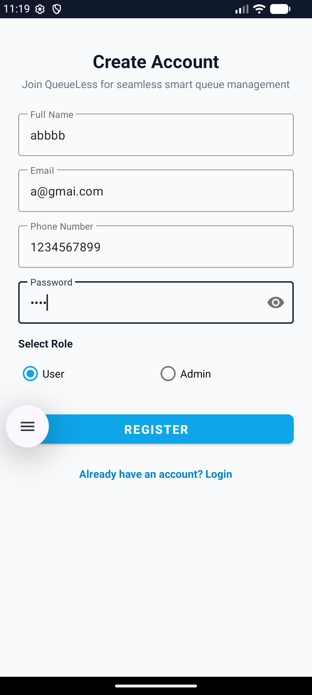
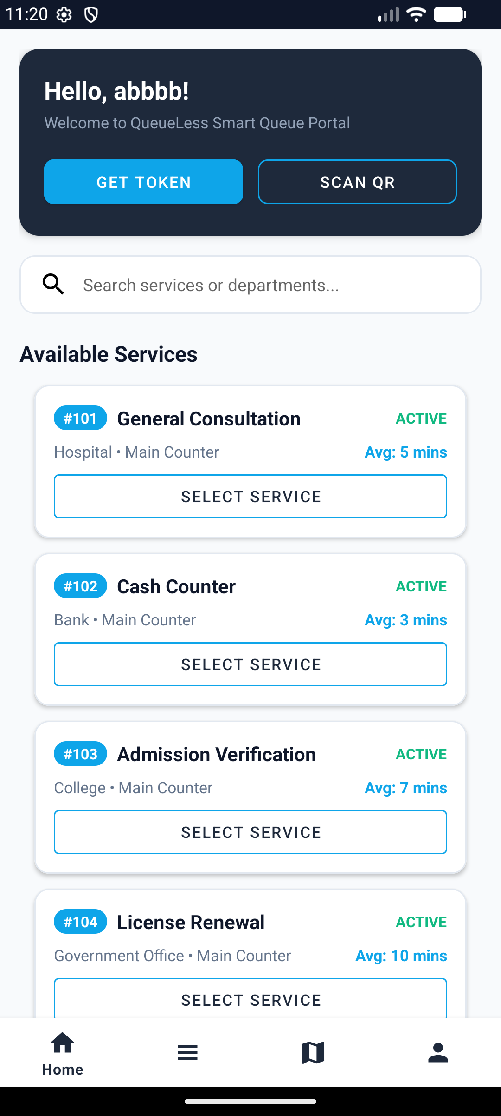
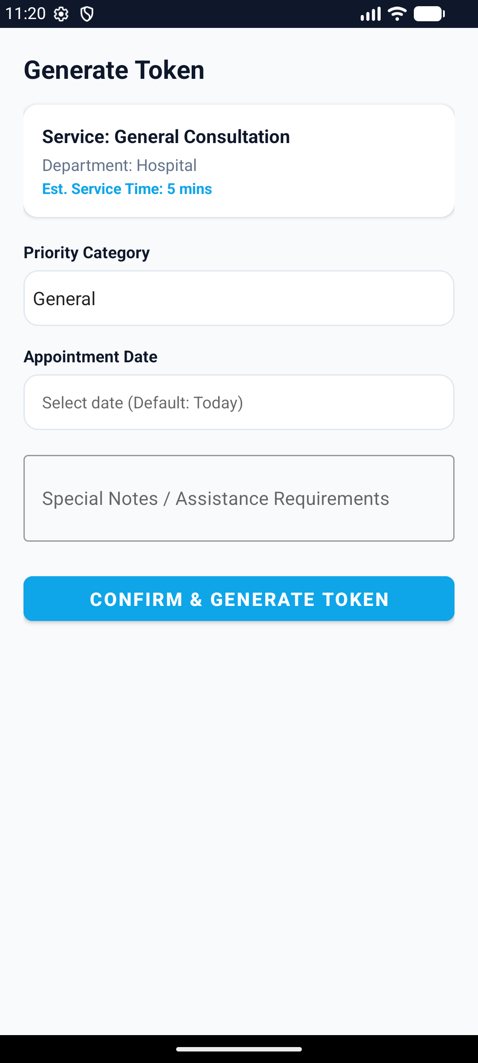
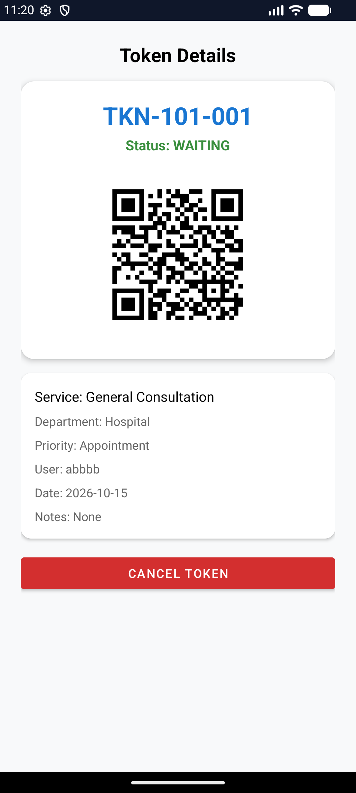
Screenshots: User Side
Paste image here
Login
Paste image here
Home
Paste image here
Queue
Paste image here
Token Detail
Register
Email and password
Home
Services grid, quick QR
Queue
Generate Token and select priority
Token Detail
Token number and QR

Slide 8
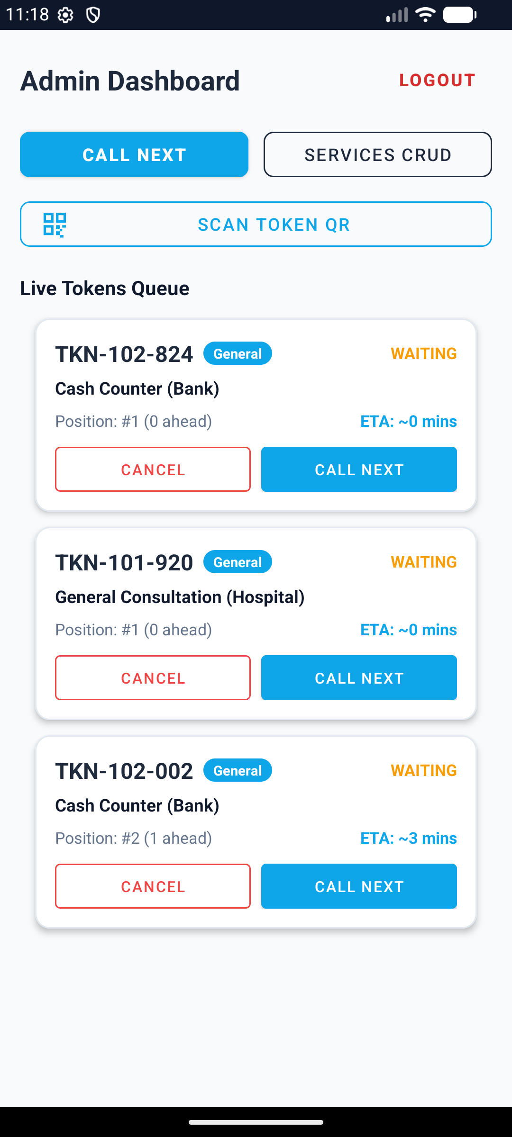
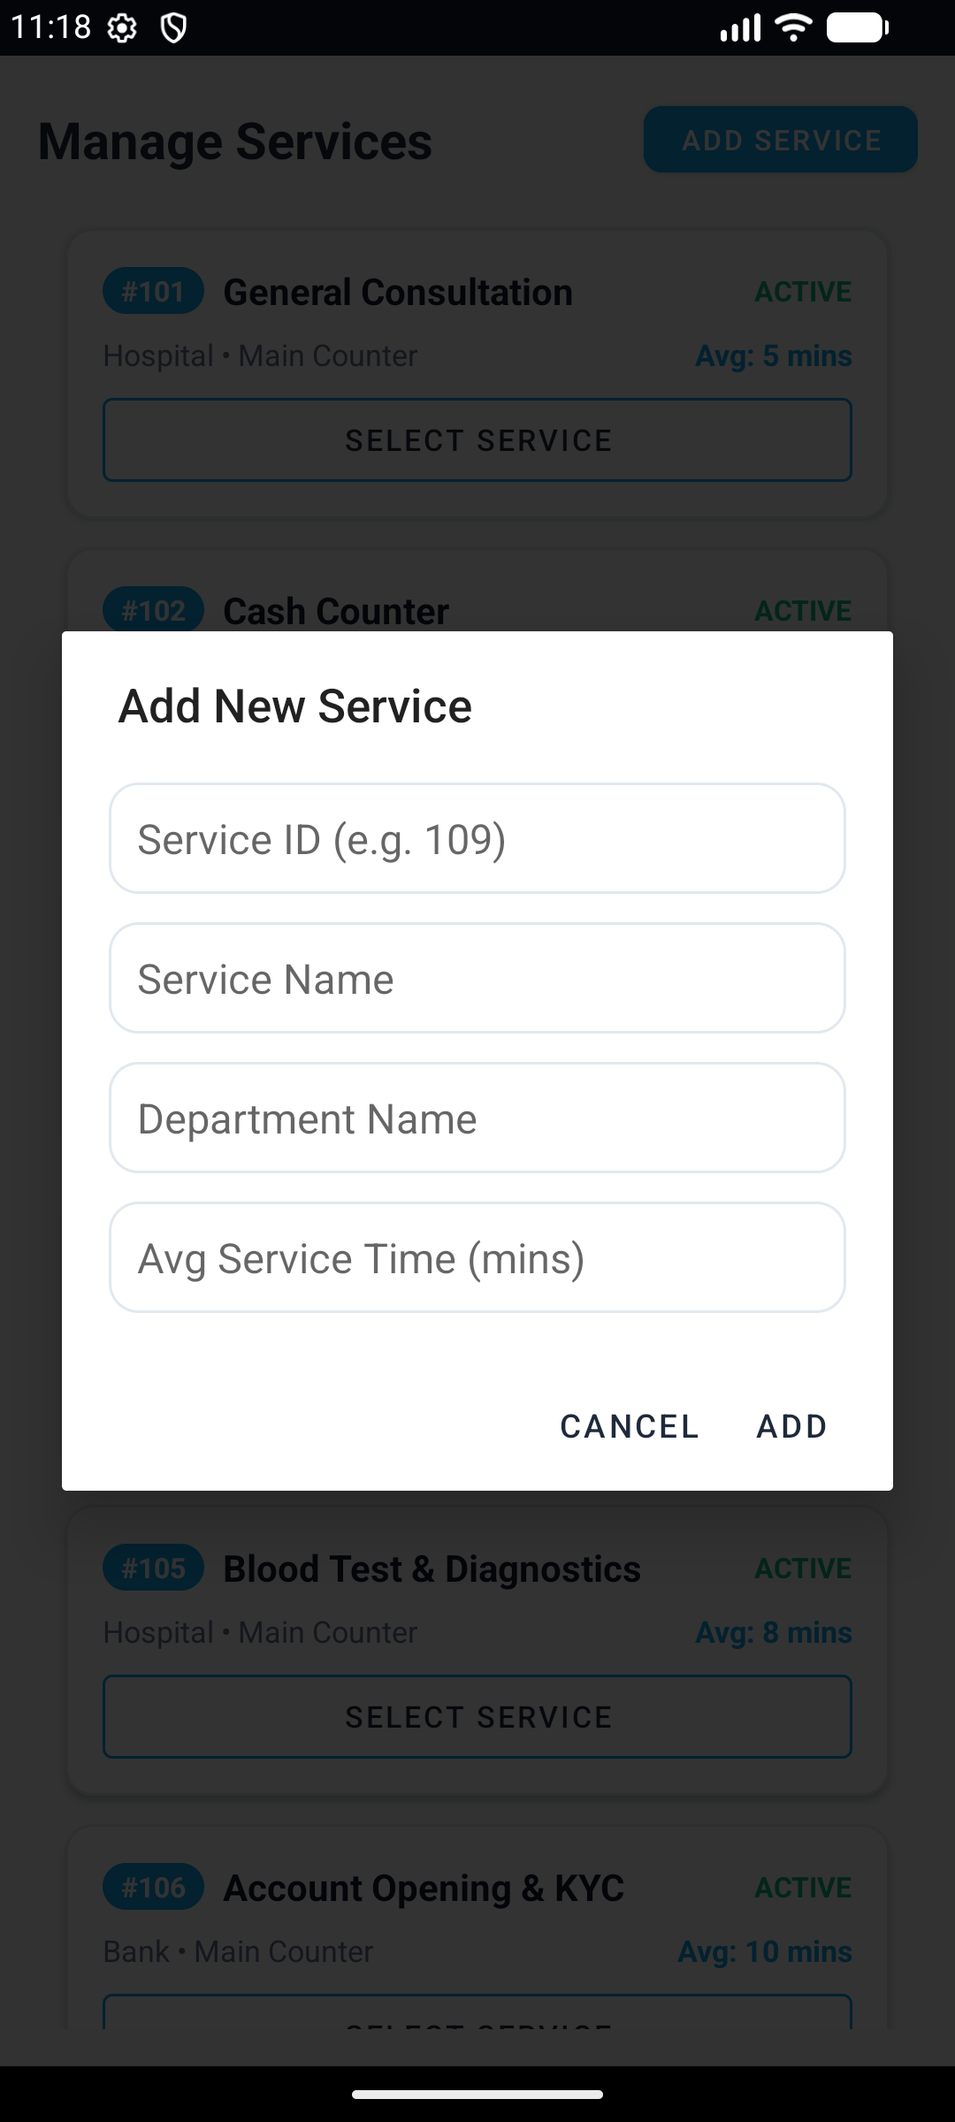
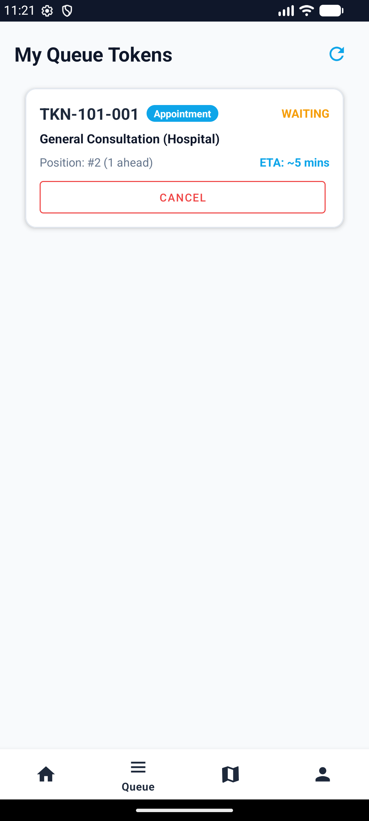
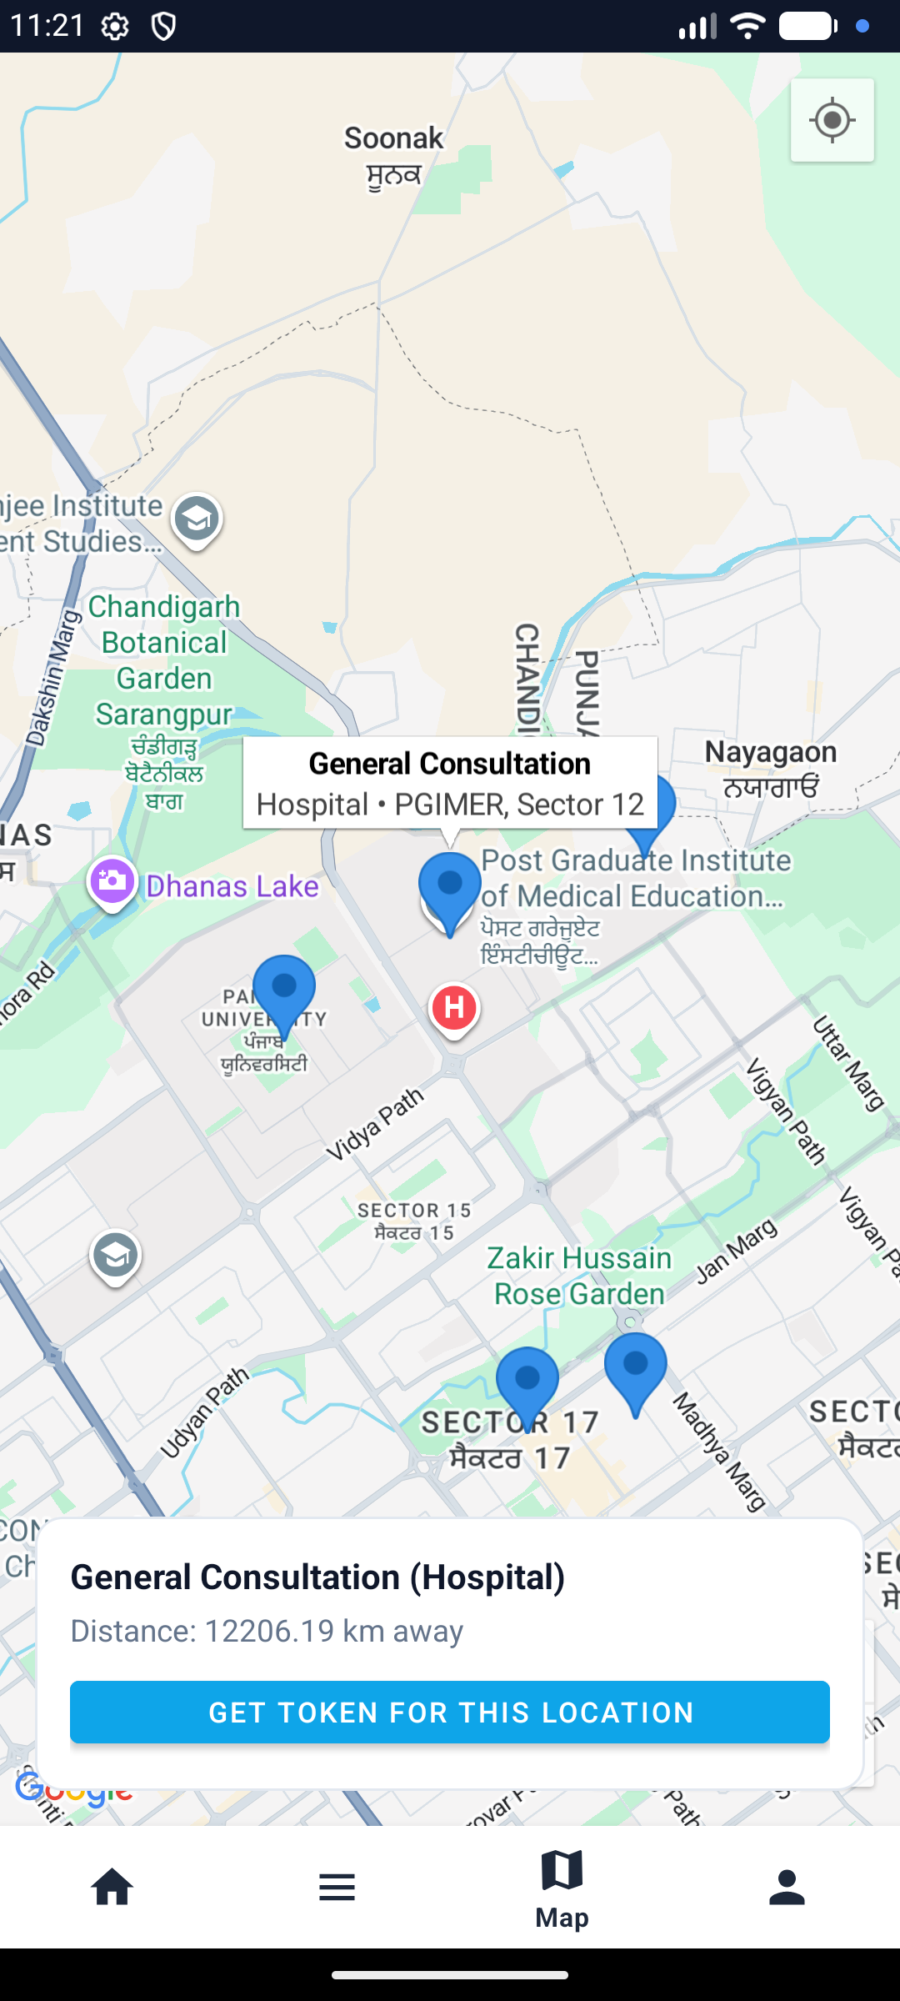
Screenshots: Admin and More
Paste image here
Admin Dashboard
Paste image here
Manage Services
Paste image here
Map
Paste image here
Profile
Admin Dashboard
Call next, update status
Manage Services
Add, edit, delete
Token Queue
In User Profile
Mail
Get Token

Slide 9
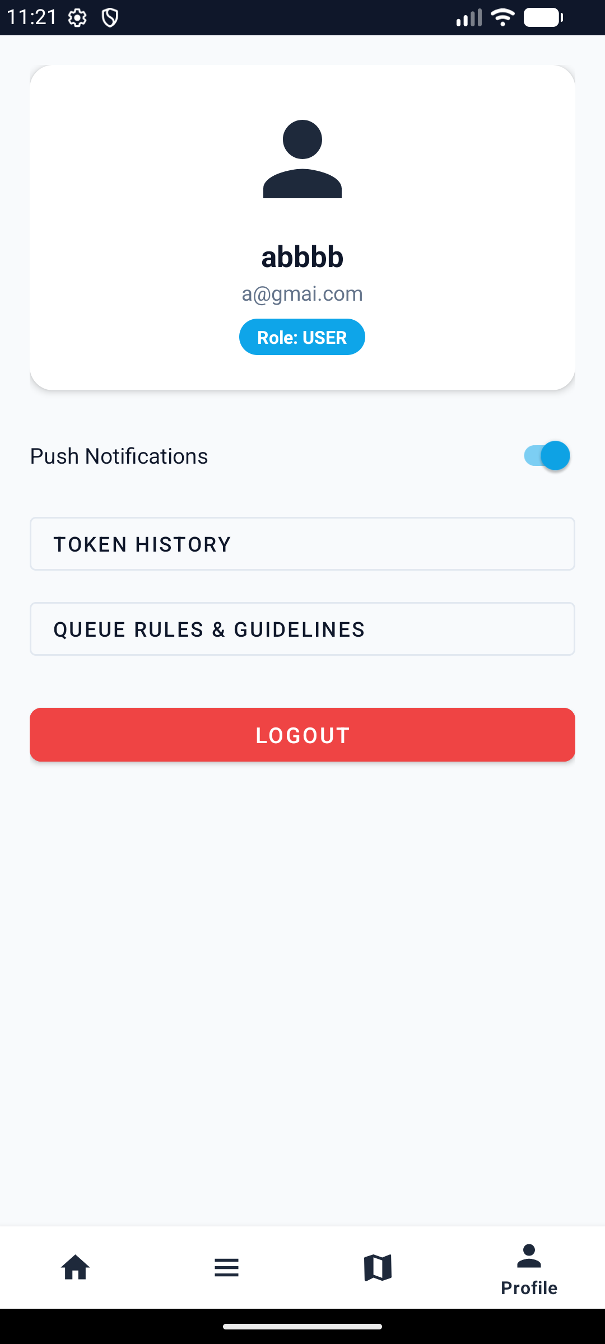
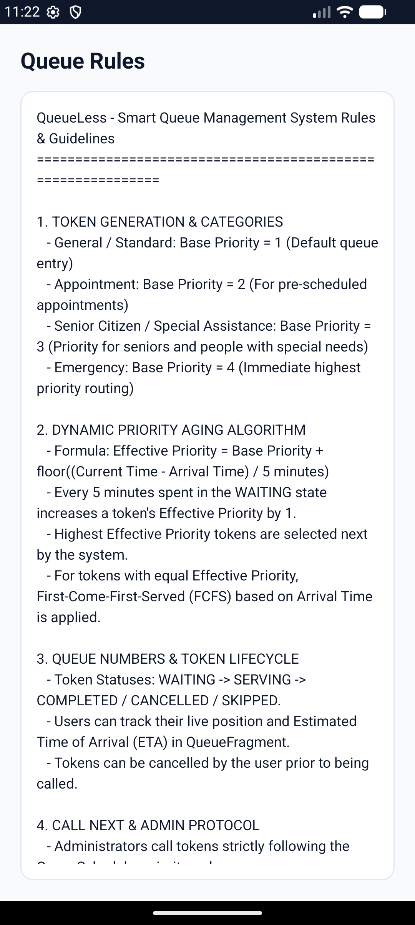
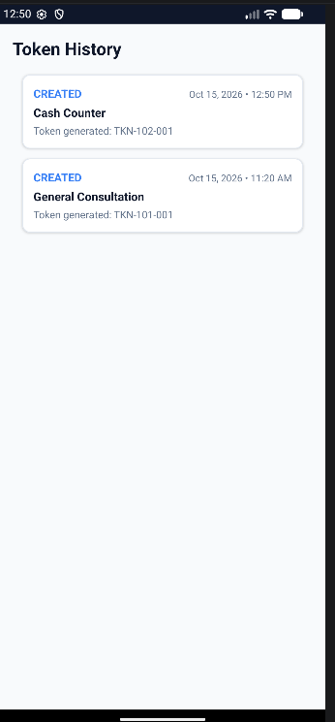
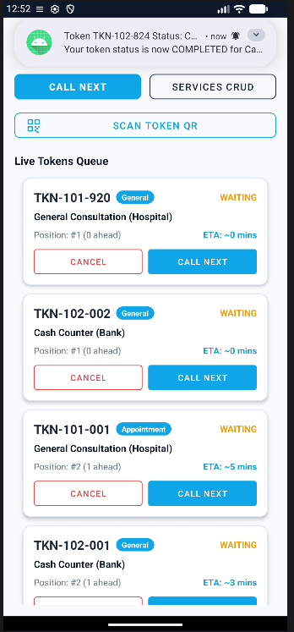
Screenshots: Admin and More
Paste image here
Admin Dashboard
Paste image here
Manage Services
Paste image here
Map
Paste image here
Profile
Profile
Token history, Guidelines
Manage Services
Add, edit, delete
Token History
In User Profile
Mail
Get Token

Slide 10
UI Components Used
MaterialCardView
Service, token, history rows
RecyclerView
Lists on 6 screens
BottomNavigationView
Home, Queue, Map, Profile
TextInputLayout
Login, register, notes
Spinner, RadioGroup
Priority and role choice
MapView
Google Map of centres
DecoratedBarcodeView
Live QR scanner
SwitchMaterial
Notification on / off
ProgressBar
Loading feedback
AlertDialog, DatePicker
Admin actions, date pick
ImageView
Shows the QR bitmap
Toast, Notification
Messages and status alerts

Slide 11
Model Classes: Data Holders
Models are plain Java classes (POJOs): private fields, constructors, getters and setters. They only store data.
User
Stores account details of a person
id, name, email, phone, role (USER or ADMIN), createdAt
ServiceModel
Stores one service a person can queue for
id, serviceName, department, avgTimeMins, location, status
Token
Stores one queue ticket (17 fields)
tokenNumber, userId, serviceId, priorityCategory, basePriority, effectivePriority, status, arrivalTime, notes
QueueHistory
Stores one log entry for a token
id, tokenId, userId, serviceName, action, actionTimestamp, notes

Slide 12
DatabaseHelper and SQLite
Model class | Table
User | users
ServiceModel | services
Token | tokens
QueueHistory | queue_history
Extends SQLiteOpenHelper and creates 4 tables in onCreate()
Singleton: DatabaseHelper.getInstance(context)
Seeds 8 starter services from services.csv
CRUD methods such as insertToken(), getAllServices(), updateTokenStatus()
Every new token and status change also adds a QueueHistory row
queueless.db
SQLite file stored on the device (version 2)

Slide 13
QueueScheduler Algorithm
4 Emergency
3 Senior Citizen
2 Appointment
1 General
Effective = Base + floor(wait / 5 min)
Ties are served first come, first served.
ETA = (position - 1) x avg service time

Slide 14
Helper and Utility Classes
LocalAuthManager
Singleton for register and login on a background thread; passwords hashed with PBKDF2 and a random salt
PreferenceUtils
Keeps the logged-in user, role, avatar and notification setting in SharedPreferences
AssetReader
Reads services.csv (seed data) and queue_rules.txt from the assets folder
QrCodeUtils
Builds the QR payload, creates the QR bitmap with ZXing and parses scanned codes
NotificationHelper
Creates the notification channel and alerts the user when a token status changes

Slide 15
How Classes Are Connected
Activities (12) + Fragments (4)
Controllers: handle taps, move between screens with Intents
Adapters
bind Models to lists
QueueScheduler
priority, order, ETA
Utils
Asset, Pref, QR, Notify
LocalAuthManager
register and login
Models
User, ServiceModel, Token, QueueHistory
DatabaseHelper
insert, query, update, delete, seed
SQLite: queueless.db

Slide 16
Token Lifecycle Flow
1
2
3
4
5
Request token
User chooses a service, priority category and date
Set priority
QueueScheduler maps the category to base priority 1 to 4
Save token
A Token model is stored by DatabaseHelper and history is logged
Show QR and ETA
Token detail shows the QR code, position and wait time
Admin calls next
Highest effective priority is served; user is notified
Token status
WAITING
SERVING
COMPLETED
SKIPPED
CANCELLED

Slide 17
Testing and Conclusion
Conclusion
QueueLess replaces physical queues with fair, priority-based digital tokens
Models store the data, DatabaseHelper saves it, QueueScheduler decides the order
Future scope: cloud sync and push notifications
Thank You

