Slide 1


Online School Management System
Name : Prasad Sumit Dilipkumar
Reg no.2022105317
Branch: CSE
Year : 2 Year ( 4th Semester)
College Name : NIT NAGALAND
Subject : CS253 Web Technology

Slide 2

Introduction
An Online School Management System (OSMS) is a digital platform designed to streamline various administrative
Academic processes within educational institutions.
3.In today's digital age, efficient school management is crucial for enhancing productivity
4. communication, and overall effectiveness.

Slide 3

Objective
Our objective is to enhance administrative efficiency.
We aim to improve communication between stakeholders.
Our goal is to streamline academic processes.

Slide 4

Motivation
Challenges in Traditional School Management: Manual paperwork, data redundancy, communication gaps, and lack of real-time information are common challenges faced by traditional educational institutions.
Opportunities for Improvement: Technology integration provides efficient, centralized solutions for managing schools, addressing various challenges effectively.

Slide 5



Software/Hardware Requirements
Software Requirements: HTML , CSS , JAVASCRIPT , any web browsers , IDE(VS Code)
Hardware Requirements:
Laptops or Any System | Processor: Intel Core i5 | RAM: 8GB minimum | Storage: 512GB, Display: 15.6-inch Full HD

Slide 6
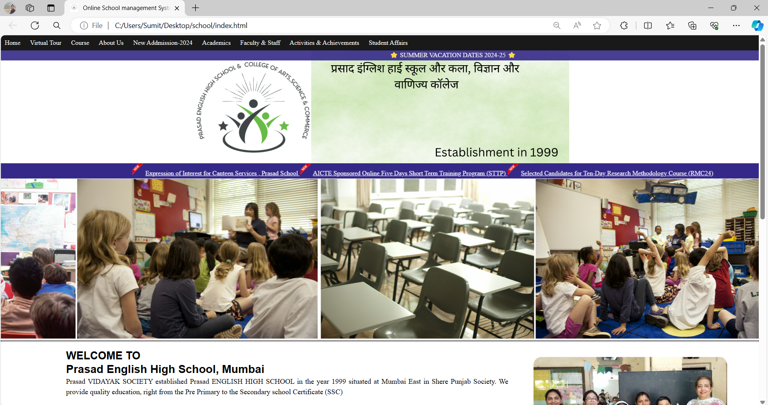
Webpage Screenshots

Slide 7
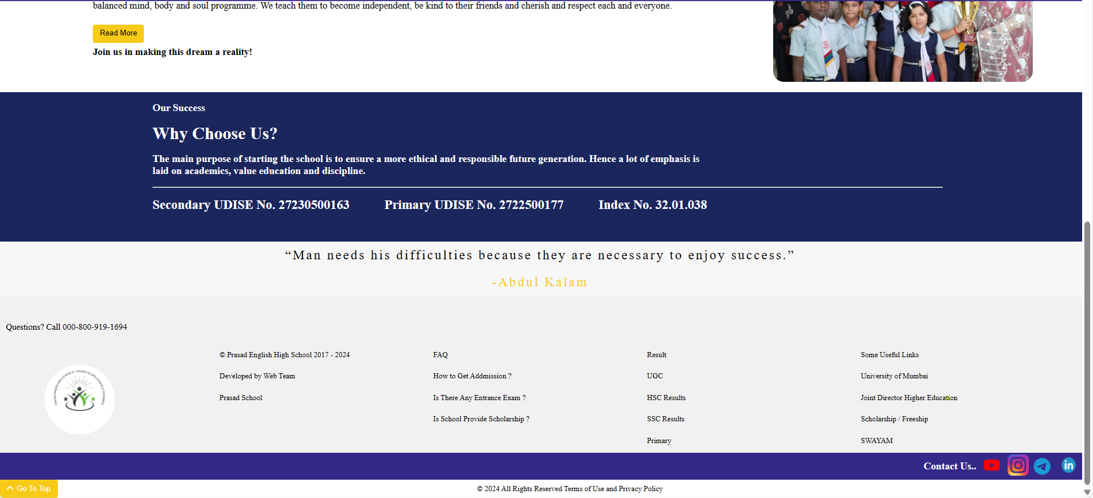

Slide 8
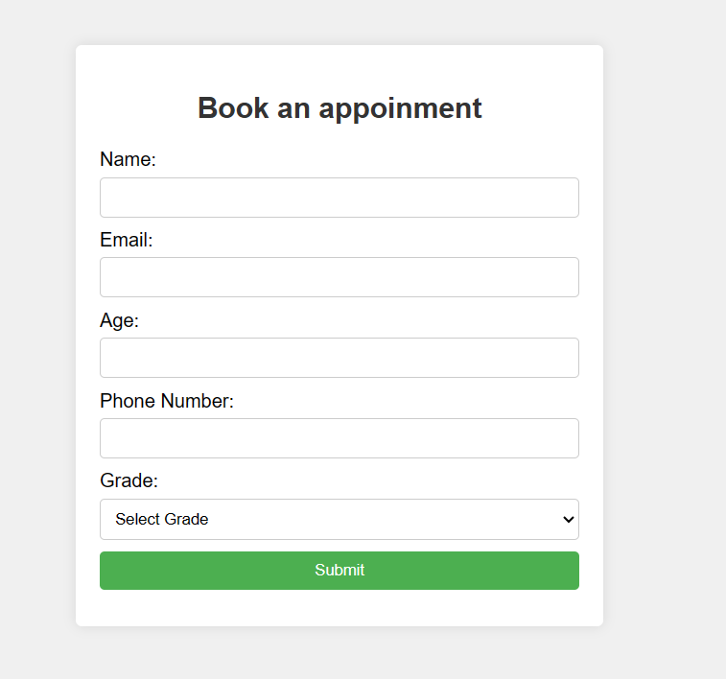
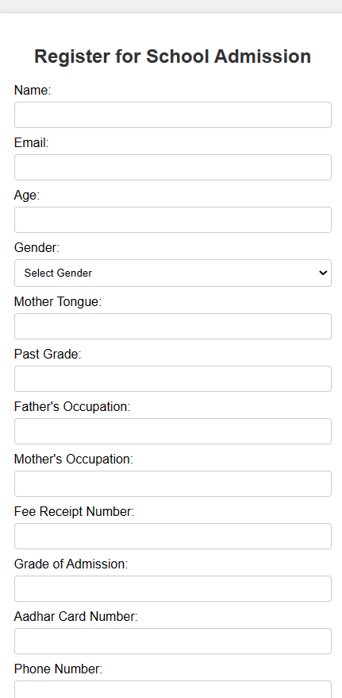
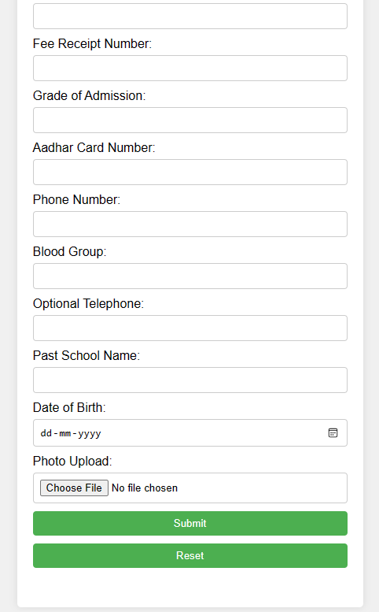
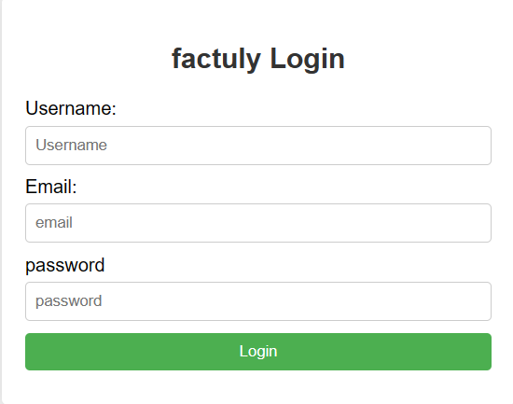

Slide 9
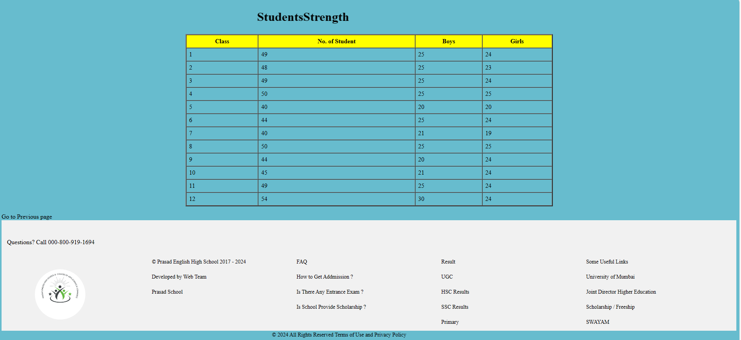

Slide 10
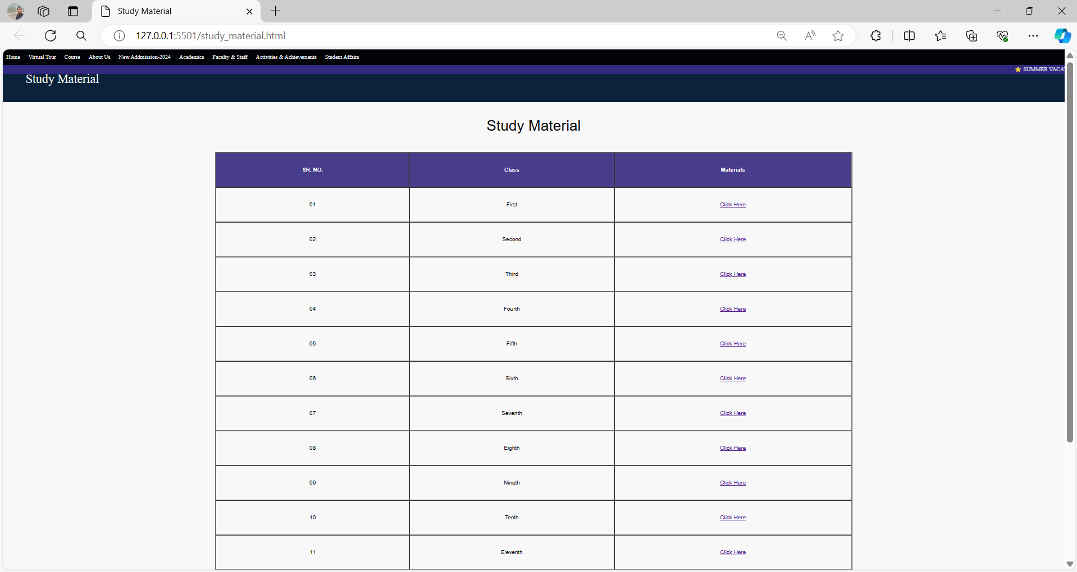

Slide 11

Limitations/Future Work
Current Limitations: Absence of Fee Payment Link, Missing Database Integration , Limited Mobile Functionality
Future Work: Database Integration , Enhanced Device Compatibility, Introduction of Online Chatbot

Slide 12

Conclusion
The Online School Management System offers a comprehensive solution for modernizing and optimizing educational administration processes.
By leveraging technology to streamline administrative tasks, improve communication, and enhance academic operations, the OSMS contributes to the overall efficiency and effectiveness of educational institutions.

Slide 13
Thank You !!

